Slide 1
100
75
57%
Perc
50
25
14%
14%
7%
7%
0
An
An
Murdoch
Other
The
interstate
overseas
University
(please
University
university
university
specify)
of Western
Where did you do your undergraduate studies?
Australia

Slide 2
100
75
Perc
50
43%
36%
25
14%
7%
0
Biological
Conservation
Marine
Marine
Science
Biology
Biology
Science
(terrestrial
and
marine)
Which of the following best matches your undergraduate course?

Slide 3
100
75
71%
Perc
50
25
14%
7%
7%
0
Live in
Live in
Live
Live
Perth
regional
internationally
interstate
WA
When you were selecting a university for your masters studies did you

Slide 4
100
75
Perc
50
41%
29%
25
24%
12%
0
Investigate other
Investigate other
Investigate other
Only UWA
unis in Perth
unis interstate
unis internationally
When you were selecting a university for your masters studies did you?

Slide 5
100
75
71%
Perc
50
29%
25
0
No
Yes
Do you have immediate family members that live in Perth?

Slide 6
100
75
Perc
50
50%
29%
25
21%
0
Attempt to
Find work
Not really
find work
in the
try to
in the
environmental
find work
environmental
sciences
in the
sciences,
environmental
but were
sciences
unsuccessful
After completing your undergraduate studies did you

Slide 7
100
75
Perc
50
43%
25
21%
14%
14%
7%
0
Extremely
Moderately
Not at all
Slightly
Very
interested
interested
interested
interested
interested
At this stage how interested are you in pursuing a PhD in marine biology or marine science?

Slide 8
100
86%
75
Perc
50
25
14%
0
I am
I am
completing
completing
a masters
a masters
of Marine
of Marine
Biology by
Biology by
coursework
coursework
and
research
Which of the following matches your situation

Slide 9
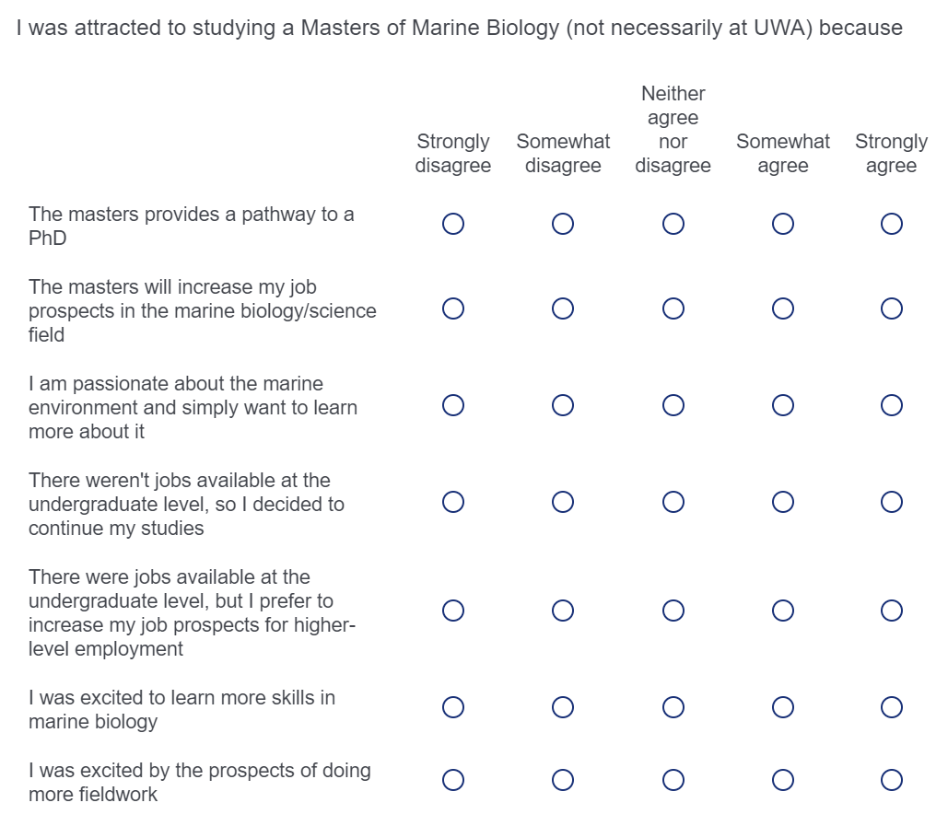

Slide 10
I was attracted to studying a Masters of Marine Biology
(not necessarily at UWA) because
100
75
Percentage (%)
50
29%
25
21%
21%
14%
14%
0
Strongly
Somewhat
Neither
Somewhat
Strongly
disagree
disagree
agree nor
agree
agree
disagree
The masters provides a pathway to a PhD

Slide 11
I was attracted to studying a Masters of Marine Biology
(not necessarily at UWA) because
100
86%
75
Percentage (%)
50
25
7%
7%
0
0%
0%
Strongly
Somewhat
Neither
Somewhat
Strongly
disagree
disagree
agree nor
agree
agree
disagree
The masters will increase my job
prospects in the marine
biology/science field

Slide 12
I was attracted to studying a Masters of Marine Biology
(not necessarily at UWA) because
100
75
57%
Percentage (%)
50
36%
25
7%
0
0%
0%
Strongly
Somewhat
Neither
Somewhat
Strongly
disagree
disagree
agree nor
agree
agree
disagree
I am passionate about the marine
environment and simply want to learn more about it

Slide 13
I was attracted to studying a Masters of Marine Biology
(not necessarily at UWA) because
100
75
Percentage (%)
50%
50
25
21%
21%
7%
0
0%
Strongly
Somewhat
Neither
Somewhat
Strongly
disagree
disagree
agree nor
agree
agree
disagree
There weren't jobs available at
the undergraduate level, so I
decided to continue my studies

Slide 14
I was attracted to studying a Masters of Marine Biology
(not necessarily at UWA) because
100
75
Percentage (%)
50
43%
25
21%
14%
14%
7%
0
Strongly
Somewhat
Neither
Somewhat
Strongly
disagree
disagree
agree nor
agree
agree
disagree
There were jobs available at the
undergraduate level, but I prefer
to increase my job prospects for
higher-level employment

Slide 15
I was attracted to studying a Masters of Marine Biology
(not necessarily at UWA) because
100
79%
75
Percentage (%)
50
25
14%
7%
0
0%
0%
Strongly
Somewhat
Neither
Somewhat
Strongly
disagree
disagree
agree nor
agree
agree
disagree
I was excited to learn more skills
in marine biology

Slide 16
I was attracted to studying a Masters of Marine Biology
(not necessarily at UWA) because
100
79%
75
Percentage (%)
50
25
14%
7%
0
0%
0%
Strongly
Somewhat
Neither
Somewhat
Strongly
disagree
disagree
agree nor
agree
agree
disagree
I was excited by the prospects of
doing more fieldwork

Slide 17
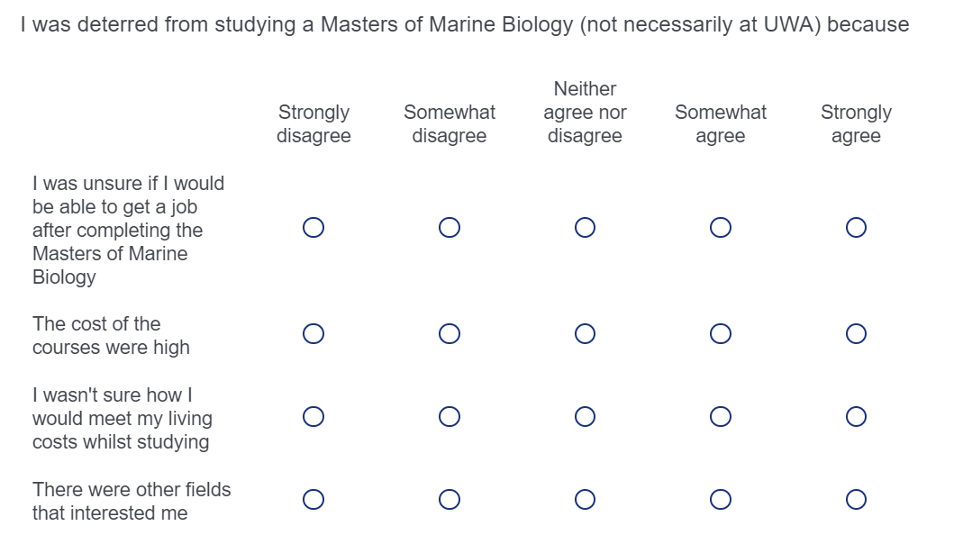

Slide 18
I was deterred from studying a Masters of Marine
Biology (not necessarily at UWA) because
100
75
Percentage (%)
50
36%
36%
25
21%
7%
0
0%
Strongly
Somewhat
Neither
Somewhat
Strongly
disagree
disagree
agree nor
agree
agree
disagree
I was unsure if I would be able to
get a job after completing
the Masters of Marine Biology

Slide 19
I was deterred from studying a Masters of Marine
Biology (not necessarily at UWA) because
100
75
Percentage (%)
50
43%
29%
25
14%
14%
0
0%
Strongly
Somewhat
Neither
Somewhat
Strongly
disagree
disagree
agree nor
agree
agree
disagree
The cost of the courses were high

Slide 20
I was deterred from studying a Masters of Marine
Biology (not necessarily at UWA) because
100
75
Percentage (%)
50
36%
29%
25
14%
14%
7%
0
Strongly
Somewhat
Neither
Somewhat
Strongly
disagree
disagree
agree nor
agree
agree
disagree
I wasn't sure how I would meet
my living costs whilst studying

Slide 21
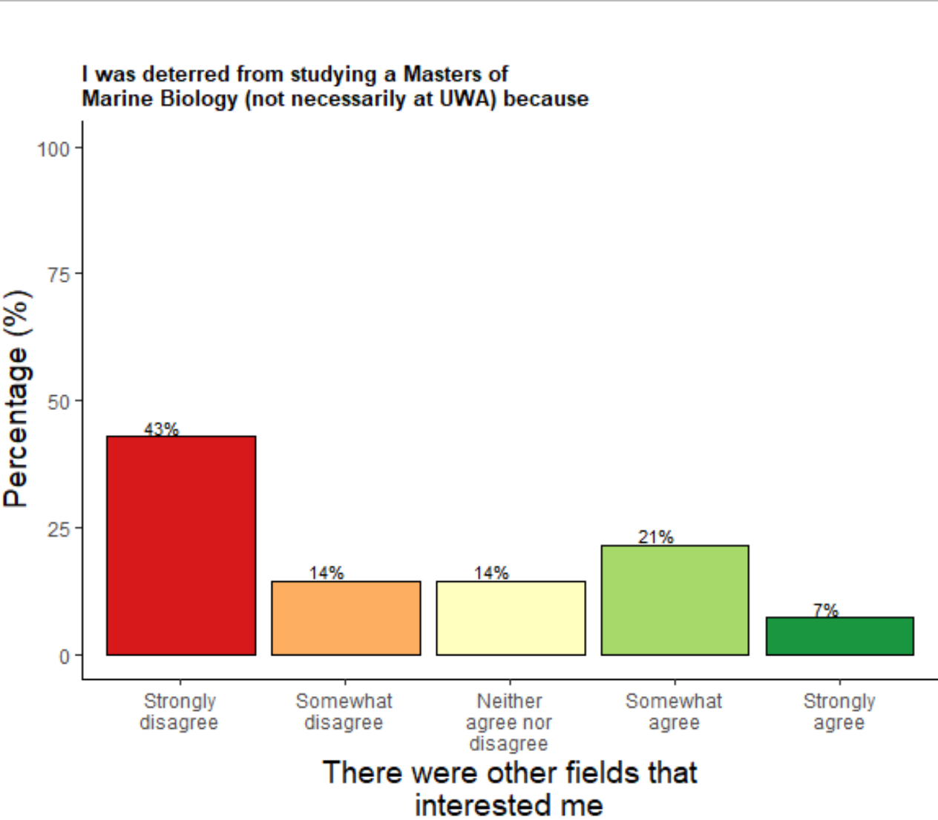

Slide 22
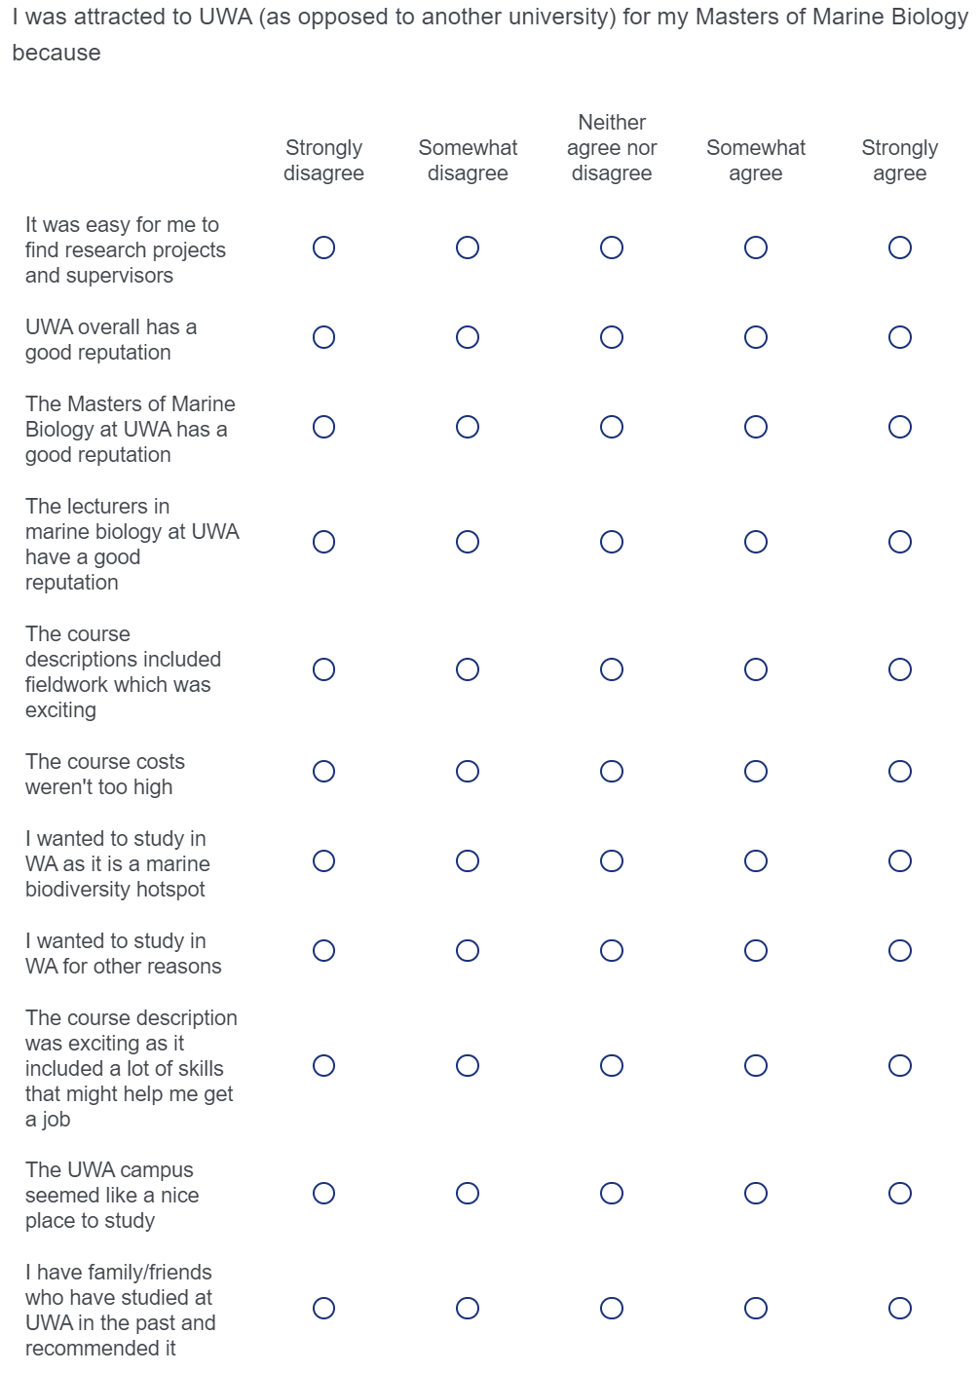

Slide 23
I was attracted to UWA
(as opposed to another university) for
my Masters of Marine Biology because
100
75
62%
Percentage (%)
50
25
25%
12%
0
0%
0%
Strongly
Somewhat
Neither
Somewhat
Strongly
disagree
disagree
agree nor
agree
agree
disagree
I was an undergraduate at UWA and
it was convenient

Slide 24
I was attracted to UWA
(as opposed to another university) for
my Masters of Marine Biology because
100
75
Percentage (%)
50
43%
25
21%
21%
14%
0
0%
Strongly
Somewhat
Neither
Somewhat
Strongly
disagree
disagree
agree nor
agree
agree
disagree
It was easy for me to find research
projects and supervisors

Slide 25
I was attracted to UWA
(as opposed to another university) for
my Masters of Marine Biology because
100
75
57%
Percentage (%)
50
36%
25
7%
0
0%
0%
Strongly
Somewhat
Neither
Somewhat
Strongly
disagree
disagree
agree nor
agree
agree
disagree
UWA overall has a good reputation

Slide 26
I was attracted to UWA
(as opposed to another university) for
my Masters of Marine Biology because
100
75
Percentage (%)
50%
50
36%
25
7%
7%
0
0%
Strongly
Somewhat
Neither
Somewhat
Strongly
disagree
disagree
agree nor
agree
agree
disagree
The Masters of Marine Biology at
UWA has a good reputation

Slide 27
I was attracted to UWA
(as opposed to another university) for
my Masters of Marine Biology because
100
75
64%
Percentage (%)
50
25
21%
14%
0
0%
0%
Strongly
Somewhat
Neither
Somewhat
Strongly
disagree
disagree
agree nor
agree
agree
disagree
The lecturers in marine biology at
UWA have a good reputation

Slide 28
I was attracted to UWA
(as opposed to another university) for
my Masters of Marine Biology because
100
75
Percentage (%)
50%
50
36%
25
14%
0
0%
0%
Strongly
Somewhat
Neither
Somewhat
Strongly
disagree
disagree
agree nor
agree
agree
disagree
The course descriptions included
fieldwork which was exciting

Slide 29
I was attracted to UWA
(as opposed to another university) for
my Masters of Marine Biology because
100
75
Percentage (%)
50
29%
29%
25
21%
14%
7%
0
Strongly
Somewhat
Neither
Somewhat
Strongly
disagree
disagree
agree nor
agree
agree
disagree
The course costs weren't too high

Slide 30
I was attracted to UWA
(as opposed to another university) for
my Masters of Marine Biology because
100
75
57%
Percentage (%)
50
25
21%
7%
7%
7%
0
Strongly
Somewhat
Neither
Somewhat
Strongly
disagree
disagree
agree nor
agree
agree
disagree
I wanted to study in WA as it is
a marine biodiversity hotspot

Slide 31
I was attracted to UWA
(as opposed to another university) for
my Masters of Marine Biology because
100
75
Percentage (%)
50
43%
25
21%
14%
14%
7%
0
Strongly
Somewhat
Neither
Somewhat
Strongly
disagree
disagree
agree nor
agree
agree
disagree
I wanted to study in WA for
other reasons

Slide 32
I was attracted to UWA
(as opposed to another university) for
my Masters of Marine Biology because
100
75
57%
Percentage (%)
50
25
21%
7%
7%
7%
0
Strongly
Somewhat
Neither
Somewhat
Strongly
disagree
disagree
agree nor
agree
agree
disagree
The course description was exciting
as it included a lot of skills that
might help me get a job

Slide 33
I was attracted to UWA
(as opposed to another university) for
my Masters of Marine Biology because
100
75
Percentage (%)
50
30%
30%
25
20%
10%
10%
0
Strongly
Somewhat
Neither
Somewhat
Strongly
disagree
disagree
agree nor
agree
agree
disagree
I lived close to campus when choosing
my university, and UWA was convenient

Slide 34
I was attracted to UWA
(as opposed to another university) for
my Masters of Marine Biology because
100
75
57%
Percentage (%)
50
25
21%
21%
0
0%
0%
Strongly
Somewhat
Neither
Somewhat
Strongly
disagree
disagree
agree nor
agree
agree
disagree
The UWA campus seemed like a
nice place to study

Slide 35
I was attracted to UWA
(as opposed to another university) for
my Masters of Marine Biology because
100
75
Percentage (%)
50
25
27%
27%
27%
9%
9%
0
Strongly
Somewhat
Neither
Somewhat
Strongly
disagree
disagree
agree nor
agree
agree
disagree
I have family/friends who have studied
at UWA in the past and
recommended it

Slide 36
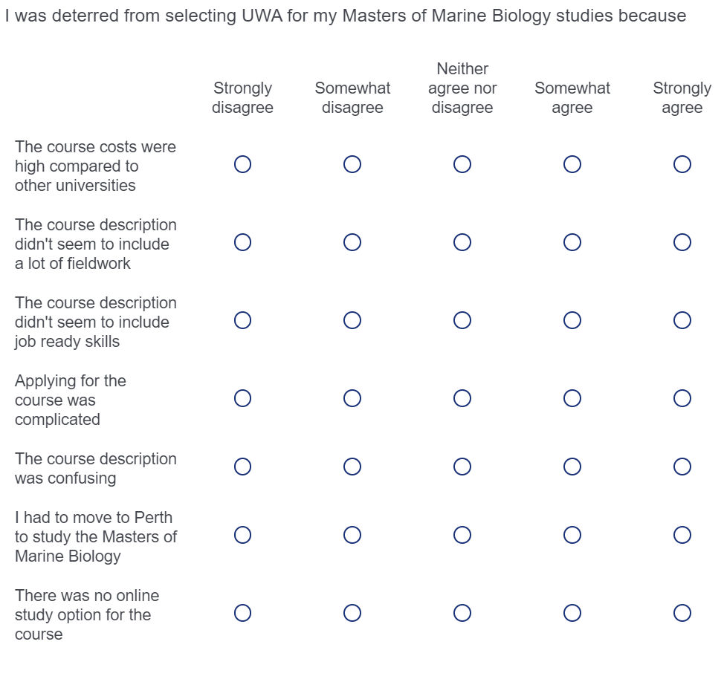

Slide 37
I was deterred from selecting
UWA for my Masters of Marine
Biology studies because
100
75
Percentage (%)
50
46%
25
23%
15%
15%
0
0%
Strongly
Somewhat
Neither
Somewhat
Strongly
disagree
disagree
agree nor
agree
agree
disagree
The course costs were high compared to other universities

Slide 38
I was deterred from selecting
UWA for my Masters of Marine
Biology studies because
100
75
Percentage (%)
50
36%
29%
25
14%
14%
7%
0
Strongly
Somewhat
Neither
Somewhat
Strongly
disagree
disagree
agree nor
agree
agree
disagree
The course description didn't seem to include a lot of fieldwork

Slide 39
I was deterred from selecting
UWA for my Masters of Marine
Biology studies because
100
75
Percentage (%)
50
43%
29%
25
21%
7%
0
0%
Strongly
Somewhat
Neither
Somewhat
Strongly
disagree
disagree
agree nor
agree
agree
disagree
The course description didn't seem to include job ready skills

Slide 40
I was deterred from selecting
UWA for my Masters of Marine
Biology studies because
100
75
Percentage (%)
50
43%
29%
25
21%
7%
0
0%
Strongly
Somewhat
Neither
Somewhat
Strongly
disagree
disagree
agree nor
agree
agree
disagree
Applying for the course was complicated

Slide 41
I was deterred from selecting
UWA for my Masters of Marine
Biology studies because
100
75
Percentage (%)
50
29%
29%
25
21%
14%
7%
0
Strongly
Somewhat
Neither
Somewhat
Strongly
disagree
disagree
agree nor
agree
agree
disagree
The course description was confusing

Slide 42
I was deterred from selecting
UWA for my Masters of Marine
Biology studies because
100
75
Percentage (%)
50%
50
25
25%
25%
0
0%
0%
Strongly
Somewhat
Neither
Somewhat
Strongly
disagree
disagree
agree nor
agree
agree
disagree
I had to move to Perth to study the Masters of Marine Biology

Slide 43
I was deterred from selecting
UWA for my Masters of Marine
Biology studies because
100
75
Percentage (%)
50
43%
29%
29%
25
0
0%
0%
Strongly
Somewhat
Neither
Somewhat
Strongly
disagree
disagree
agree nor
agree
agree
disagree
There was no online study option for the course

