Slide 1
Data Service Scalability
UWB HACKATHON: 2020

Slide 2
Let’s Build a Service
Spec
Scenario: Photo Repository
Upload / Download from repository
Scale: dozen users
Durability: Sure
Security: No

Slide 3




v1
Availability: Poor
Scalability: Poor
Latency: ok
Consistency: Excellent
Web
Server

Slide 4
Definitions
Availability: Is the service available?
Scalability: Can the service grow to support many users (dozen->google) and many photos (dozen->youtube)
Latency: How long for a user to get a response
Consistency: Do I, and other users, see updated photos (and if not, how long does it take to get eventually consistent)

Slide 5
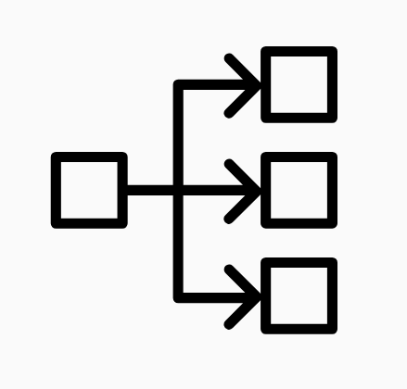
V2: Scale out w/Load balancer
Availability: Good
Scalability: Good
Latency: Good
Consistency: no
Web
Server
Web
Server
Web
Server

Slide 6
V3: Add Backgroud Batch Job
Web
Server
Web
Server
Web
Server

Slide 7
V3: Background Batch Job
Availability: Good
Scalability: Good
Latency: Good
Consistency: less bad
Web
Server
Web
Server
Web
Server
Notes:
Lumpy stuff is bad
Background jobs are bad

Slide 8
Highly Technical Observations
Lumpy stuff is generally bad
Background jobs cause lumpiness

Slide 9
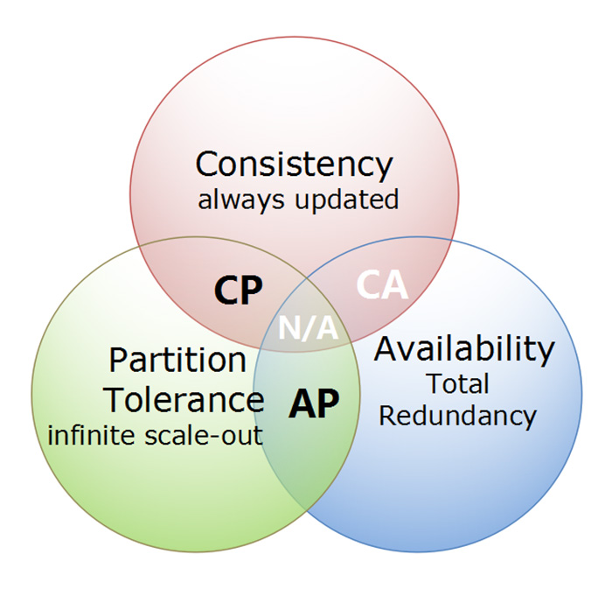

CAP Theorem: You can have two

Slide 10
V4: Sync Writes (all servers)
Read Availability : Good
Write Availability: Less Good
Read Latency: Good
Write Latency: Poor
Scalability: Terrible
Consistency: Good (we think)
Web
Server
Web
Server
Web
Server

Slide 11
V4 Issues
Single machine is down during Write
Fail write?
Could be problems in roll back as another machine goes down
Not likely with 3 machines, how 100s? 1000s?
Ignore machine that is down?
Bad Design
Diverges towards chaos
No self-healing

Slide 12
V5: Sync writes Add Backgroud Batch Job
Read Availability : Good
Write Availability: Less Good
Read Latency: Good
Write Latency: Poor
Scalability: Terrible
Consistency: Actually ok
Web
Server
Web
Server
Web
Server
Notes:
Lumpy stuff is bad
Background jobs are bad

Slide 13
V6: Two Tier Arch
Availability : Poor
Latency: Good (one more hop)
Scalability Mid-Tier: Great!
Scalability Storage Tier: ok
Consistency: Great
Stateless
Mid-Tier
WS
WS
WS
C
HASH Function on Data
Data Tier
A
B
C
Z

Slide 14
V6b: Redundancy at storage tier
Stateless
Mid-Tier
WS
Writes: Synchronize Writes to all three
Data Tier
Front-End
SAME ISSUES WE DISCUSSED IN THE PAST
Data Tier
Back-End
(Storage)

Slide 15
V6c: Redundancy at storage tier
Stateless
Mid-Tier
WS
Writes:
Synchronize writes to all three, but two is fine
Voting Mechanism
Fix machine later
Data Tier
Front-End
Data Tier
Back-End
(Storage)

Slide 16
V6c: Redundancy at storage tier
Stateless
Mid-Tier
WS
Writes: Synchronize Writes to all three
Two compete is fine
Fix machine later
“C”
Data Tier
Front-End
Data Tier
Back-End
(Storage)

Slide 17
V6d: Redundancy at storage tier + Region
Stateless
Mid-Tier
WS
Log ship data to new region
RTO: Recovery Time Objective
RPO: Recovery Point Objective
“C”
Data Tier
Front-End
Log ship to different region
Data Tier
Back-End
(Storage)

