Slide 1
Introduction to HTML, CSS, and JS
UWB Hacks the Internet 2019
Notes:
Should say that this is NOT a workshop. Download the slides to review later
Need to cut this down to 30 min max

Slide 2
Before we begin
This is a high-level introduction to HTML, CSS, and JS.
This covers very basic topics.
No previous experience needed!
If you have questions, raise your hand to let us know.
All of the files and these slides are available at: https://github.com/UWB-ACM/Intro-HTML-CSS-JS
Notes:
Add slides to repository

Slide 3
Quick Glossary
HTML - Hyper Text Markup Language. Provides a structure for the content that makes up all web pages.
CSS - Cascading Style Sheets. Provides a way to format HTML using sets of rules.
JS - JavaScript. A scripting language that can run in your browser (and sometimes in the server too). Java != JavaScript

Slide 4
HTML 101

Slide 5
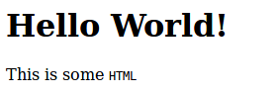
HTML 101
HTML makes up the structure of nearly everything you see on the web. It assigns tags to blocks of text, which helps your web browser understand it.
<html>
<body>
<h1>Hello World!</h1>
<p>This is some
<code>HTML</code>
</p>
</body>
</html>
That HTML, rendered in Firefox.
All example code can be found under:
github.com/UWB-ACM/Intro-HTML-CSS-JS

Slide 6
HTML 101 - Syntax
HTML - Hyper Text Markup Language
Markup Language - Is a syntax used for formatting text, most commonly used by HTML and XML.
Markup Language is made up of tags:
<h1>Hello World!</h1>
Opening Tag
Data
Closing Tag

Slide 7
HTML 101 - Syntax
<b>Good!</b>
<br />
<b>Bad :(</i>
<p><b>Hi!</b></p>
<!-- 3 < 4 -->
<p>3 &lt; 4</p>
Rules about Tags:
Tags need to be closed with a matching pair.
Some tags like br can’t contain text, so they use a different syntax.
Tags can contain other tags.
Comments start with <!-- and end with -->.
Some characters, like < are reserved, but you can escape them.
Just search for “HTML Escape Characters”
HTML doesn’t care about whitespace.
Typically, anything more than a single space is ignored.

Slide 8
HTML 101 - Tags
HTML has nearly 100 tags, each with their own practices of when and how they are used. Luckily for us, you only really need to know about a dozen.
https://www.w3schools.com/tags/
<p>
This is a paragraph of
<i>text</i>.
It contains <b>words</b>.
<br />
This is on a new line!
</p>
p | Paragraph
i | Italic
b | Bold
br | Line break
code | Code block
h1 h2 h3 | Headers
Notes:
P - paragraph
I, em - italic/emphasis
Strong, b - bolded/strong text
Br - line break
Article, code, footer, header

Slide 9

HTML 101 - Tags
<p>
This is a paragraph of
<i>text</i>.
It contains <b>words</b>.
<br />
This is on a new line!
</p>
Notes:
P - paragraph
I, em - italic/emphasis
Strong, b - bolded/strong text
Br - line break
Article, code, footer, header

Slide 10

HTML 101 - Tags
The a tag lets you make links.
Download the examples
<a href="https://github.com/UWB-ACM/Intro-HTML-CSS-JS">here!</a>
Opening tags can define attributes.
In this case, we are setting the href
attribute to the URL for the link.
This tells the browser where the tag
links to.
The href attribute can provide a relative path to content or an absolute path. The example above has an absolute path.
Notes:
How do I link an image? <img>
How do I bold text? <b>
How do I have a link? <a href=...
Input form? <form>, <input>, <button>, etc.
Table? <table>
List? <ul> or <ol> (unordered or ordered)

Slide 11
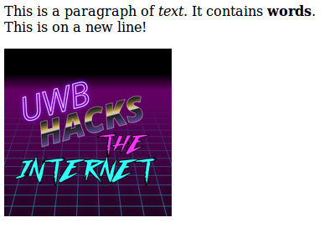
HTML 101 - Tags
The img tag lets you embed images.
<img src="images/logo.png" alt="UWB Hacks Logo" />
We use the src attribute to link to the image. Because these tags don’t contain text, we don’t need a matching tag to close it.
The src attribute can provide a relative path to content or an absolute path. The example above has a relative path.
Notes:
How do I link an image? <img>
How do I bold text? <b>
How do I have a link? <a href=...
Input form? <form>, <input>, <button>, etc.
Table? <table>
List? <ul> or <ol> (unordered or ordered)

Slide 12
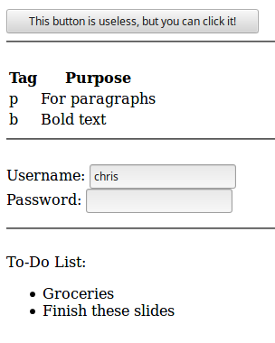
HTML 101 - Tags
How do I make:
Buttons? button
Tables? table tr td
Login forms? form label input
Lists? ul ol li
Notes:
How do I link an image? <img>
How do I bold text? <b>
How do I have a link? <a href=...
Input form? <form>, <input>, <button>, etc.
Table? <table>
List? <ul> or <ol> (unordered or ordered)

Slide 13
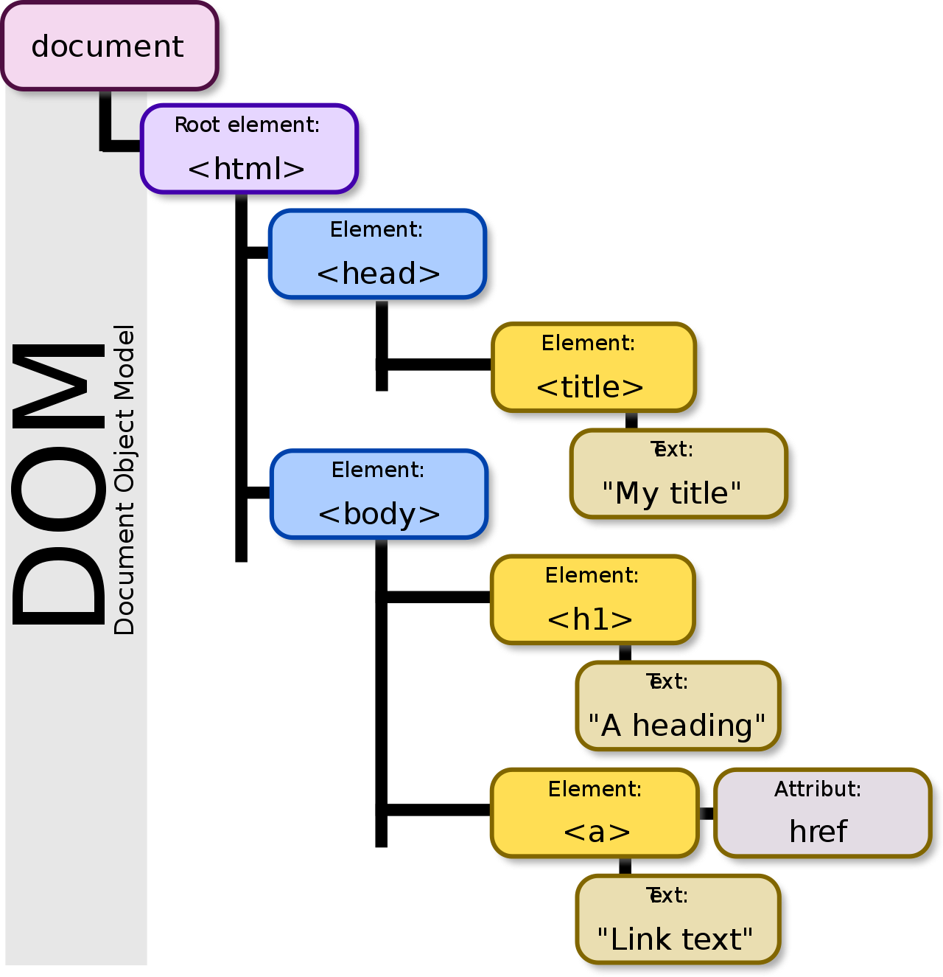
HTML 101 - DOM
Remember how nodes can contain other nodes?
HTML documents are a large tree, where each node is a tag that contains information or other nodes.
Nodes can be nested or sequential.
Two <p> elements are sequential
A <b> tag can be nested inside a <p> element to bold text.
https://en.wikipedia.org/wiki/Document_Object_Model
Notes:
DOM - Document Object Model. Representation of all nodes in a document as a big tree. Nodes can have ids associated with them.

Slide 14
HTML 101 - DOM
We can assign the class and id attribute to DOM nodes so that we can uniquely identify one or many of the same type later on.
The class attribute is used for defining multiple elements that are in the same group.
The id attribute is used for uniquely identifying a single element.
https://en.wikipedia.org/wiki/Document_Object_Model
Notes:
DOM - Document Object Model. Representation of all nodes in a document as a big tree. Nodes can have ids associated with them.

Slide 15
CSS 101

Slide 16
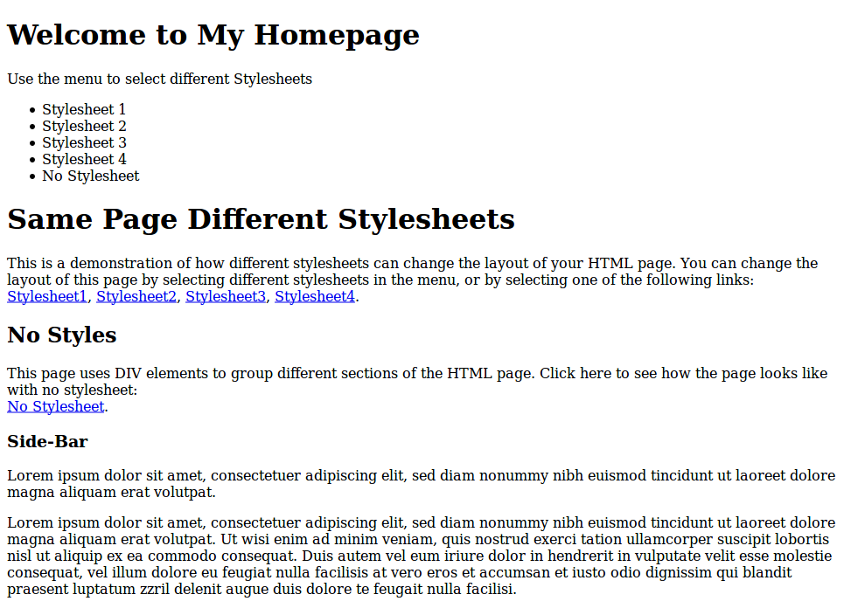
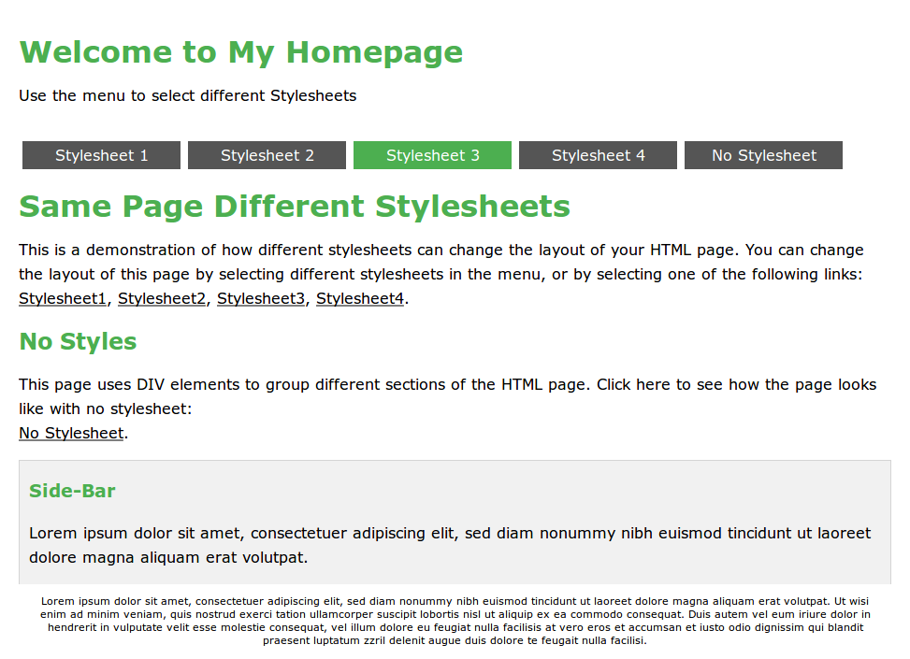
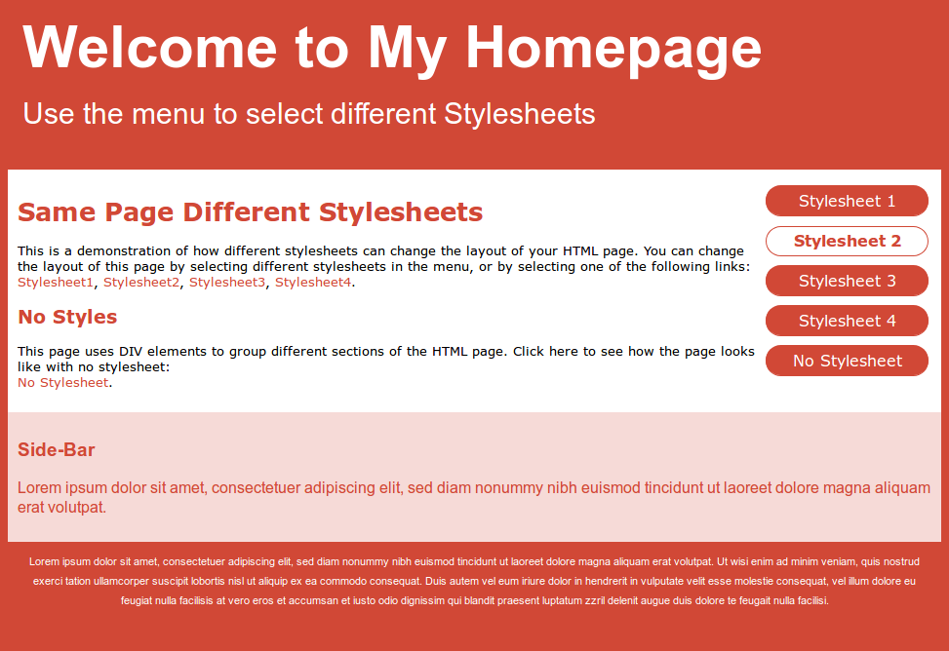
CSS 101 - Cascading Style Sheets
Since HTML is how we structure content in a page, CSS is how we make it look nice.
Each of these are made with the same HTML, but different CSS!
https://www.w3schools.com/css/css_intro.asp
Notes:
Reminder of what CSS is: a way to add formatting to HTML
Demonstrate how you can completely transform the layout / appearance of a page

Slide 17
CSS 101 - How does it work?
CSS uses rules that are applied to elements in the HTML. These rules are made up of the selector, the pattern used to find elements to style, and the declaration block, the set of values to apply to properties.
selector (apply this style to all h1 and h2 elements)
h1, h2
{
color: red;
font-family: "Comic Sans MS";
text-decoration: underline;
}
Set the color property to red
Set the font-family property to “Comic Sans MS”

Slide 18
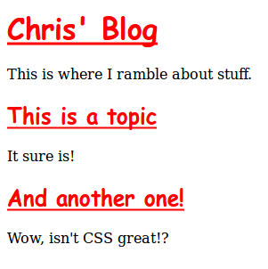
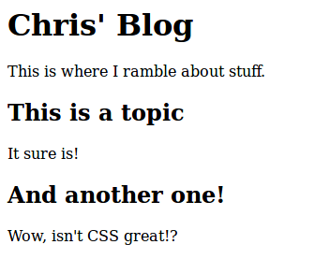
CSS 101 - How does it work?
Apply the CSS
Actually, I think I’ve made it worse. At least it’s unique.

Slide 19
CSS 101 - Adding CSS - Best Practices
There are 3 common ways to add CSS rules to your pages.
However, there is only one (1) best practice.
We will discuss each of these:
Inline stylings for individual HTML elements
<style> delcaration in the <head> section of an HTML page
Linked stylesheets

Slide 20
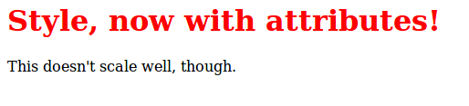
CSS 101 - Adding CSS - inline styling
You can also assign style inside HTML tags using the style attribute.
Very straightforward
Re-using style requires copying and pasting :/
<p>
<h1 style="color: red;">
Style, now with attributes!
</h1>
This doesn't scale well, though.
</p>
Notes:
Todo talk about pros and cons of each approach

Slide 21
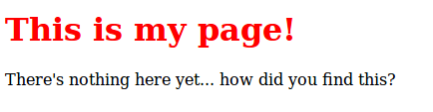
CSS 101 - Adding CSS - <style>
<head>
<style>
h1 { color: red; }
</style>
</head>
<body>
<p>
<h1> This is my page! </h1>
There's nothing here yet... how did you find this?
</p>
</body>
You can add CSS rules for all matching HTML tags in a file by using the <style> tag inside the <head> tag..
Easy and quick to use.
Not great if your site has multiple HTML pages.
Notes:
Todo talk about pros and cons of each approach

Slide 22

CSS 101 - Adding CSS - Linked .css file
<head>
<link rel="stylesheet" type="text/css"
href="example.css" />
</head>
<body>
<p>
<h1> Linked Style </h1>
The style is defined in example.css
</p>
</body>
This method is most commonly used, since it’s the easiest way to reuse a style across multiple HTML documents for consistency.
/* example.css */
h1 { color: red;}
Notes:
Todo talk about pros and cons of each approach\
NOTE: talk about multiple style sheets

Slide 23

CSS 101 - Common Style Attributes
CSS has tons of properties that you can set. Here are a few that you may find useful:
color | Sets the text color. | text-style | Sets if text is underlined.
background-color | Sets the color behind an element. | text-align | Centers text
font-weight | Sets the font weight (how bold it is) | text-transform | ALL CAPS all lowercase All Camel Case
font-family | Sets the font. | background-image | Sets element background as an image
https://www.w3schools.com/cssref/
Notes:
Link to css tags
Or just google it

Slide 24
CSS 101 - Selectors
Selectors are the patterns used to find elements to apply your style to. There are many types of selectors, but here are just a few.
.myclass Selects all elements with the class attribute set to “myclass”
#id Selects the element with the id attribute set to “id”
* Selects all elements
h1 Selects all h1 elements
h1, h2 selects all h1 and h2 elements.
p b selects all b elements inside of p elements.
https://www.w3schools.com/cssref/css_selectors.asp
Notes:
Depending on what types of elements you want to selectively choose, you use a selector in css.
You select items by class name and assign a class name to specific elements (this is one of the most common methods)
You can also select by HTML tag (such as <img> or <a> or <h1>) or element ID
NOte: do not abuse ID tags - they are meant to identify unique items. Usually, if you “have” to duplicate an ID, you should probably define a class instead or use another method.

Slide 25
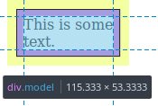
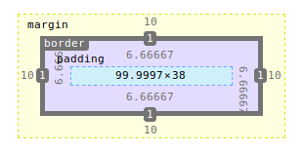
CSS 101 - Box Model
display: block This determines how the element is positioned in the page, by treating everything in that element as a rectangle.
By combining the size of the element’s margins, border, padding, and contents, the overall size of the element can be determined.
Margins != Padding Margins are the outer space of the element, padding is the inner space.

Slide 26


CSS 101 - Display Modes and Positioning
The display property changes the way that elements are positioned relative to each other.
display: block shows the element on a new line
display: inline shows the element on the same line
The position property changes the way elements are positioned in the page.
position: static shows elements as they appear in the order of the DOM Tree
position: fixed shows elements relative to the browser window

Slide 27
Useful Tip: In-Browser Debugging F12
All modern browsers include debugging tools with a similar set of functionality.
In Firefox and Chrome, these can be accessed with F12, or by right-clicking and selecting “Inspect”.
The inspector allows you to interactively see your HTML source, and adjust styles in real time.
The console lets you run JavaScript (more on that later).
The network tab lets you debug every network request.
Try this on your favorite websites!
Notes:
Chrome ff and safari
WE NEED MAC PEOPLE FOR SAFARI - command+option+i (?)
Or Command-Shift-I for Chrome (?)

Slide 28
JavaScript 101

Slide 29
JS 101
JavaScript is a scripting language that runs in your browser.
Don’t let the name fool you: JavaScript is not Java, and has a very different API
JavaScript runs in a sandbox in your browser.
JavaScript is an interpreted or just-in-time (JIT) compiled language.
HTML and CSS can’t make things interactive, so that’s where JavaScript comes in.
https://www.w3schools.com/js/
Notes:
- JavaScript (originally known as Mocha and then later LiveScript) is a multi-paradigm, high-level, weakly typed language.
- Browser engines (such as Chrome’s V8 engine) uses a JIT compiler, as it has performance improvements over an interpreter.

Slide 30

JavaScript != Java
Notes:
Java is similar to JavaScript as a car is to a carpet

Slide 31
JS 101 - Syntax
Some notable quirks of JavaScript syntax:
JavaScript is weakly typed
== operator compares value ( “1” == 1 is true )
=== operator compares value and type ( “1” === 1 is false)
typeof() operator to checks the type of the variable
Strings can use “double quotes”, or ‘single quotes’
Comments use // or /* */
Types are dynamic, one variable can store different types.
Not many types: Strings, Numbers (always floating), Booleans, Arrays, Objects, Null, Undefined
Use the var, const, or let keywords to define variables.
Functions are objects
https://www.w3schools.com/js/
Notes:
- JS is weakly typed, meaning it doesn’t have strict type-checking and opts-in for more implicit conversions when necessary.
- Strings can also be denoted with backticks, indicating what is known as a string template
- Comments are very familiar, coming from Java or C#
- Types are dynamic, meaning a single variable reference can be any type you want it to be, and can be redefined to any other type.
- There are currently three different ways to define a variable, which I encourage everyone to do some research on the differences between them.
- Functions are treated as normal JS objects, but have a special property that allows them to be called like a function. You can assign a function to a variable like a normal object, and do whatever you’d like with them.

Slide 32
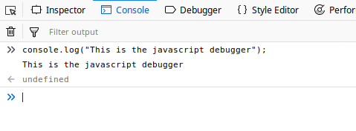
JS 101 - Browser Debugger
All modern browsers provide a JS console that you can use for debugging. It’s interactive and easy to use. Great for learning things for the first time.
Just open the developer tools with F12, and navigate to the Console.
Notes:
- Browsers allow you to run, inject, and extract JS code with any website that you visit. It also has an attached console that you can run any JS-related code into, which can be very useful when debugging your web app.

Slide 33
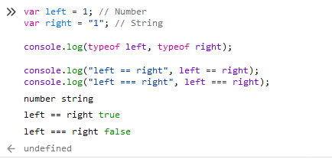
JS 101 - Browser Debugger Example
Code that we want to run
Console output
Return value
This is example also highlights the difference between the == and === operators.

Slide 34
JS 101 - Common Stuff
You can do a lot with JS, but we can’t cover everything today. https://www.w3schools.com/js is an excellent resource for going further with this topic.
console.log(“message”) | Logs “message” to the console. You can also pass objects, not just strings into this method. | Element.innerHTML | Gets or sets the string containing the content of the element.
document.GetElementById(“my-element”) | Gets an element from the DOM tree with the matching ID. | document.createElement | Creates a new HTML element that can be appended to the DOM
Notes:
You can do a lot with JS, but we can’t cover everything today
Some basic stuff you’ll want to know how to do is:
Console.log
document.GetElementById(“id”)
document.Write(“whatever”)
innerHTML = “whatever”
We should cover each of these very briefly and provide screenshots that show what they do

Slide 35
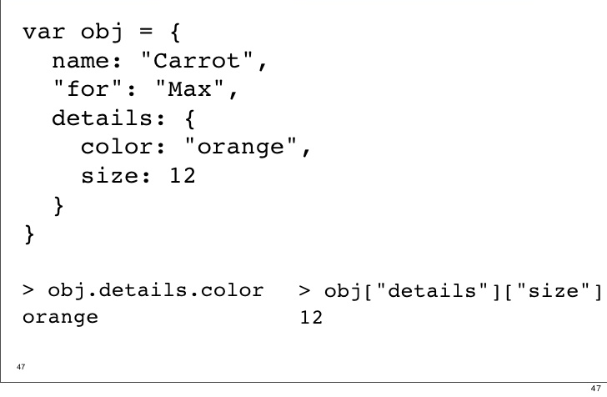
JS 101 - Objects
Objects can be thought of as wrappers around variables within your JS code.
Represented as key/value pairs
Variables assigned within objects can be anything (even functions!)
Object properties can be re-assigned, deleted, or created.
Notes:
- Objects in JS can take on many forms, as they are quite flexible.
- They come with many helpful functions to manipulate the object to whatever you’d like to do.
- Unlike more traditional OOP languages (like Java and C#), you do not have to define a class to define a new type of object
(classes in JS are known as ES6 classes, and are supported in most browsers other than IE)

Slide 36
JS 101 - JSON = JavaScript Object Notation
A lightweight data-interchange format.
Language independent way of transmitting text. JSON libraries exist for nearly everything.
Consists of key-value pairs (a Dictionary), or lists.
Very commonly used with REST APIs.
XML is the next alternative.
var myObj = { name: "John", age: 31, city: "New York" };
var myJSON = JSON.stringify(myObj);
console.log(myJSON);
// "{\"name\":\"John\",\"age\":31,\"city\":\"New York\"}"
// Quotation mark escaping works the same as other languages
var obj = JSON.parse(myJSON);
console.log(obj.name);
// "John"
JS syntax is used to define an object.
This is stored as a String, using the same syntax.
The Object’s attributes be read from this string, then accessed like any other Object.
https://www.w3schools.com/js/js_json_intro.asp
Notes:
- JSON is a standardization of objects being shared across any framework, library, or language.
- JSON differs from traditional JS objects as they don’t have any function attached to them, and can only be assigned three different data types (numbers, string, and objects) for its properties.
- JS has some methods to handle JSON-related use cases, in the form of the JSON object. I encourage everyone to do some research on these helpful methods.
- Any JSON object is a valid js object, but not the other way around.

Slide 37
JS - Security Considerations
At 2:45 PM today, we’ll be hosting a presentation about security considerations that are relevant to web apps.

Slide 38
Where to get help if/when you get stuck
https://www.w3schools.com - w3schools is a fantastic resource for learning html/css/js (among others)
https://developer.mozilla.org/en-US/ Mozilla Developer Network Documentation
https://developer.mozilla.org/en-US/docs/Web/HTML
Notes:
Todo add freecodecamp

Slide 39
Additional Topics & Technologies

Slide 40
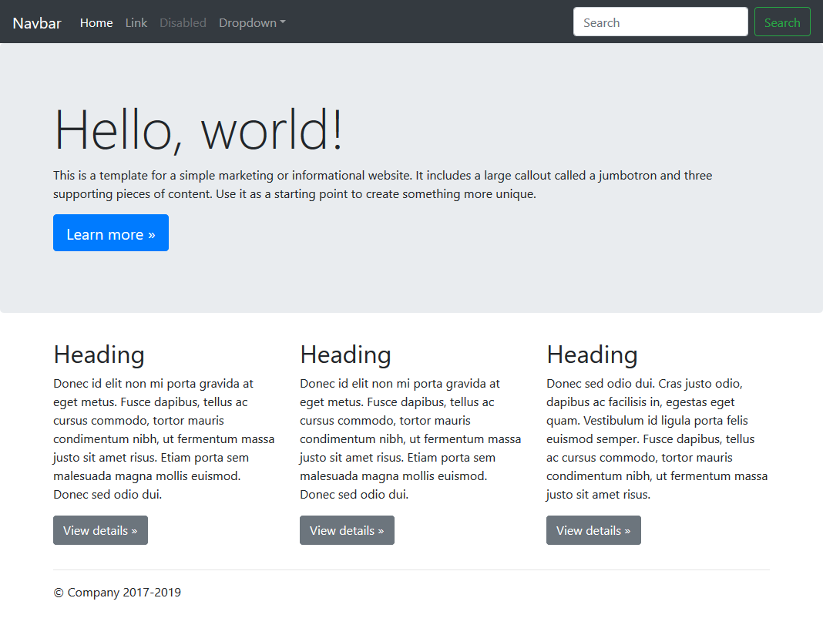
Further Topics - Bootstrap
https://getbootstrap.com/
Bootstrap is a fantastic CSS framework that does the hard stuff for you, including responsiveness and mobile support.
It’s very commonly used for a reason, even the UW website uses it!
Their documentation is also really good.

Slide 41
Further Topics - jQuery
https://jquery.com/
jQuery is a JavaScript library which makes things quicker and easier.
Turn document.getElementById(“button”).innerHTML = “Next” into $(“button”).html(“Next”)
It’s also used by Bootstrap.

Slide 42
Further Topics - TypeScript
https://www.typescriptlang.org/
TypeScript is an extension of JavaScript which adds better support for types, among other language features. It compiles into JavaScript.
This is a slightly more advanced topic, as you’ll also want to look into Node.JS, NPM, and Gulp.

Slide 43

…And So Much More!
Intro to Web Servers with Python Flask Workshop begins at 12:45 PM

Slide 44
Questions?

