Slide 1
Hello, World!
python-pptx was here!

Slide 2
Adding a Bullet Slide
Find the bullet slide layout
Use _TextFrame.text for first bullet
Use _TextFrame.add_paragraph() for subsequent bullets

Slide 3
This is text inside a textbox
This is a second paragraph that's bold
This is a third paragraph that's big

Slide 4
This is text inside a textbox
This is a second paragraph that's bold
This is a third paragraph that's big

Slide 5
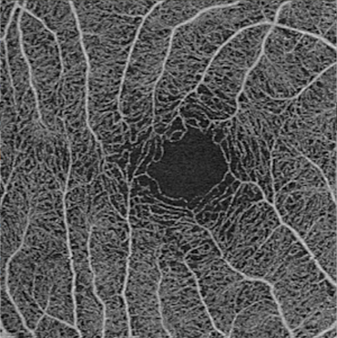

Slide 6
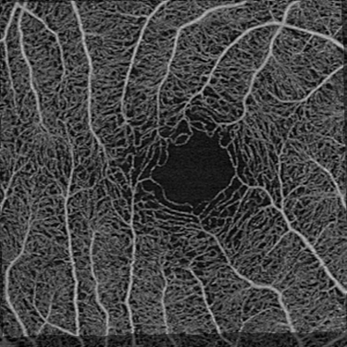
Picture2.png

Slide 7
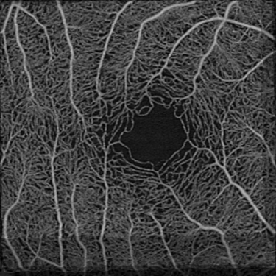
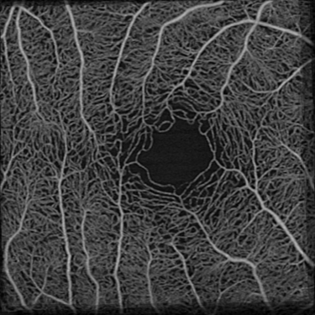
Picture1.png
Picture2.png
Picture3.png
Picture3.png
Picture3.png
Picture4.png

