Slide 1
Bilinguals Already Know: Reducing Internal Control Leads to Faster Task-Switching
Charlotte de Blecourt s2188813

Slide 2
Today
Background
Bilingualism and task-switching
Rapid Instructed Task Learning
Model
Introduction to ACT-R
RITL in ACT-R
A“bilingual” and “monolingual” model
Results
Further directions

Slide 3
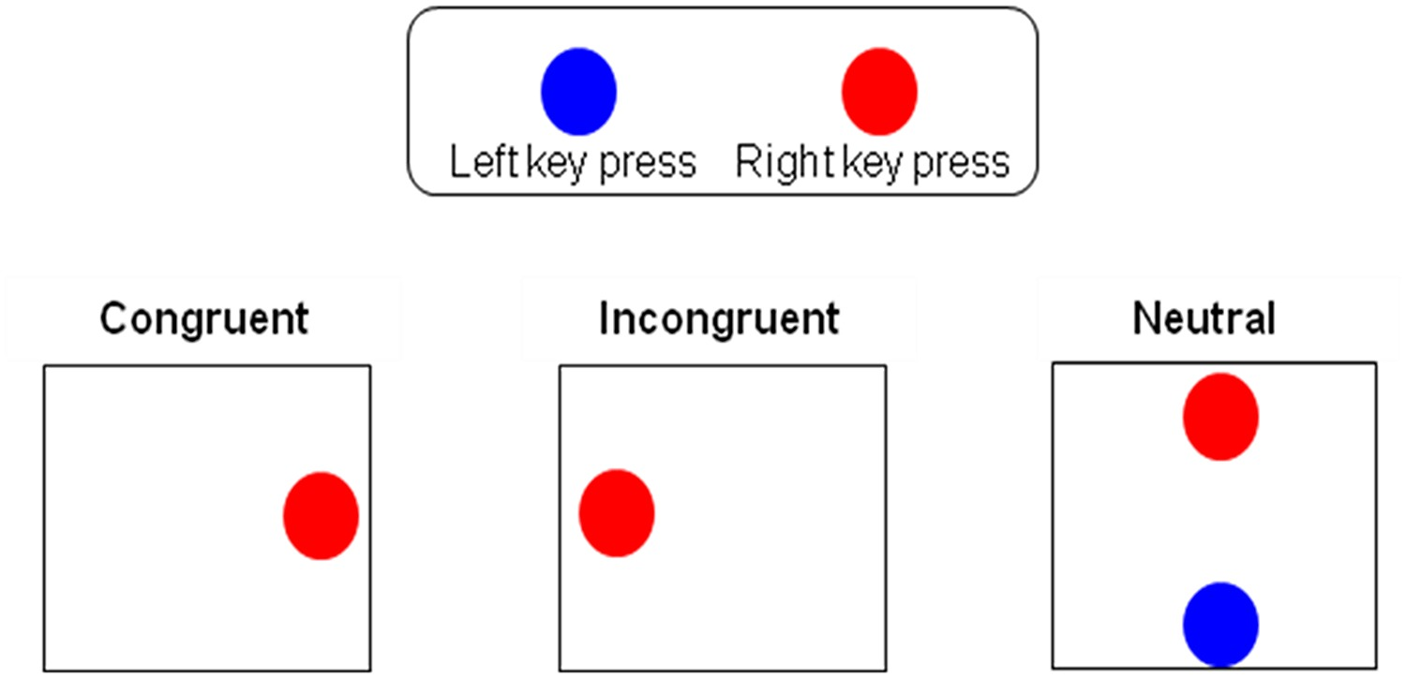
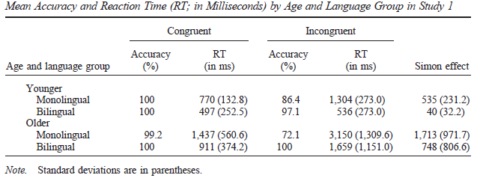
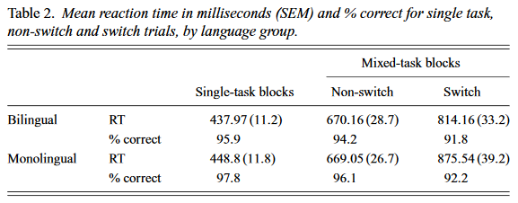
Bilingualism and Task-switching
Bilingual advantages in task-switching are fairly established
Probably due to a better ability to switch between mental sets
card/cards kaart/kaarten
How do bilinguals gain this advantage?
(Bialystok et al., 2004; Prior & MacWhinney, 2010)

Slide 4
Bilingualism and Task-switching
Conditional routing model
Basal ganglia actively shape information routes in the brain when the regular route doesn’t suffice. These paths are established with practice and become more efficient. Bilinguals learn to select appropriate linguistic rules and information, and this experience may train them to select and apply non-linguistic rules as well.
Adaptive control hypothesis
Second language use depends on context. Bilinguals operating in a complex multilingual environment need to adapt more often, and use language-specific control mechanisms. Perhaps these control mechanisms also work in non-linguistic adaptive contexts, such as task-switching.
Stocco, Lebiere, & Anderson,2010; Stocco et al., 2014; Green & Abutalebi, 2013

Slide 5
Bilingualism and Task-switching
Bilinguals seems to be better at set shifting
Thus, we need a paradigm that:
Tests set-shifting
Contains a learning component

Slide 6

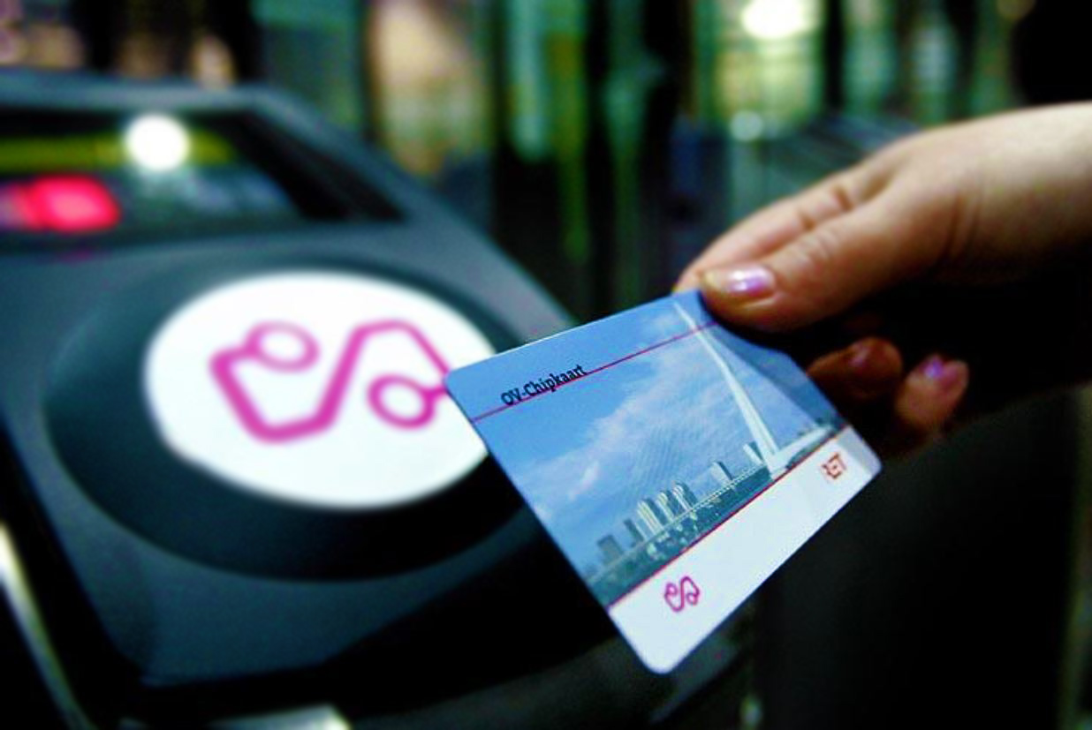
Rapid Instructed task learning
How do you learn to use an OV-chipkaart?

Slide 7
Rapid Instructed task learning
Trial
Separates encoding (remembering) from execution (applying)
Tasks and variables change with every trial
card/cards | kaart/kaarten half/add/multiply | decrease/half/add
As bilinguals may be more used to switching between sets, we’d expect bilinguals to be faster in the RITL’s execution phase.

Slide 8
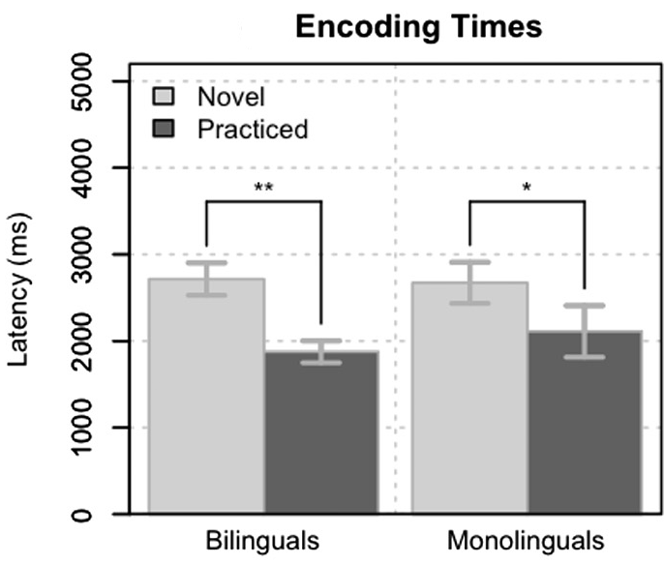
RITL and Bilingualism: Results Encoding
Differences between encoding of novel and practiced trials
No difference between the groups here, just a learning effect
(Stocco & Prat, 2014)

Slide 9
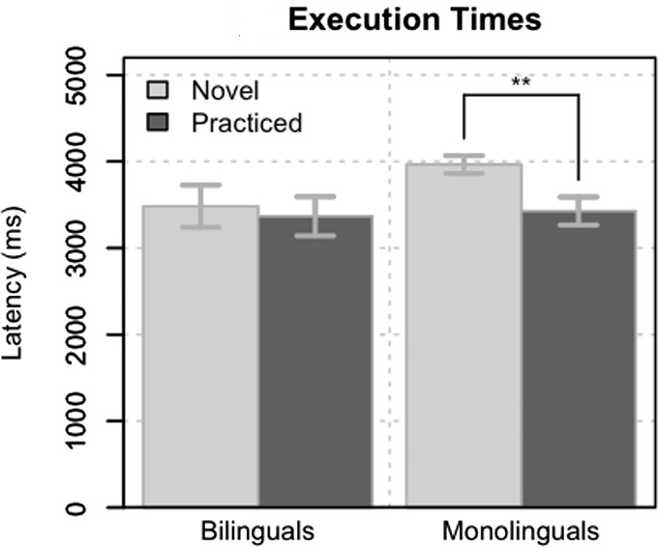
RITL and Bilingualism: Results Execution
No difference between novel and practiced instructions in bilinguals, but monolinguals needed practice.
Only monolinguals learned something here
Still, no explanation where this difference comes from
(Stocco & Prat, 2014)

Slide 10
So what do we know?
Bilingualism offers more practice in set shifting, which might “spill over” into other task-switching paradigms
This may be why they are executing new RITL trials faster than monolinguals.
Investigate the computational mechanism using a model
Notes:
Task-switching

Slide 11
Model

Slide 12
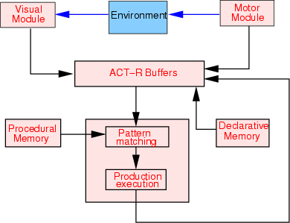
Introduction to ACT-R
ACT-R is an computational architecture that has different parts (modules) that resemble human functions. Each action (production) is an IF-THEN rule.
(p next-slide
Bottom of my slide
Last line spoken
==>
Use finger to continue
Remember text with next slide)
Notes:
Modules get accessed through buffers

Slide 13
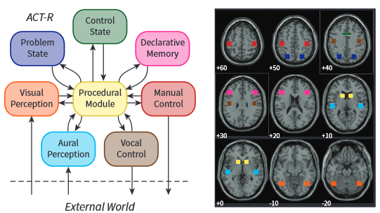
Introduction to ACT-R
ACT-R is useful for modelling this RITL task
Easy to divide tasks into stages
Learning is easy to simulate
Biologically realistic
Flexible
Production compilation through parameter :epl
See rules
Remember rules
Press Space bar
See rules
Press Space bar
(Borst & Anderson, 2015)

Slide 14
Model goal
Replicate Stocco & Prat 2014
A “monolingual” model and a “bilingual” model
In an ideal world…
Response times are similar to the times reported in the paper
The monolingual model improves in the execution phase

Slide 15

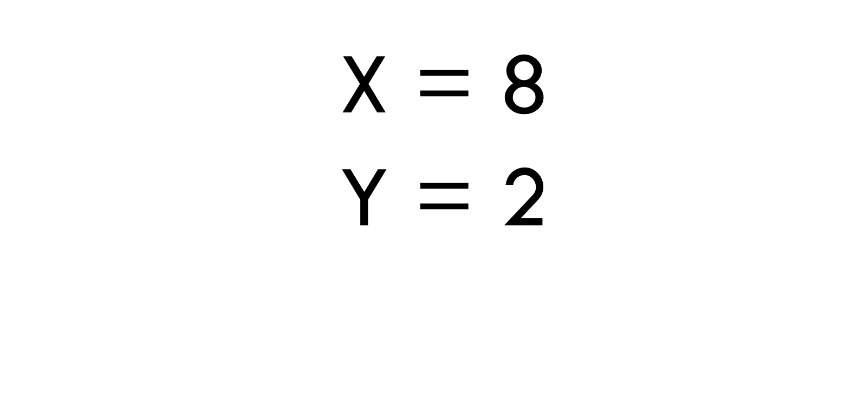

Overview
Encoding
View screen
Check if retrievable
Execution
Retrieve instruction
Retrieve operation
Response
View probe
Retrieve arithmetic fact with values on screen
Press button
Press button
Answer YES or Answer NO
Remember rules
Prepare first operation
Remember result

Slide 16
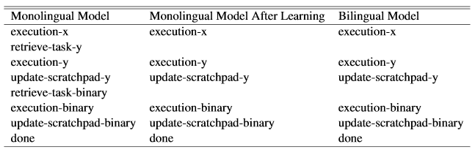
Model differences
Monolingual model
Production compilation: no buffer checks, merge task-retrieval with other productions
Bilingual model
Similar to monolingual model after learning
No production compilation possible

Slide 17
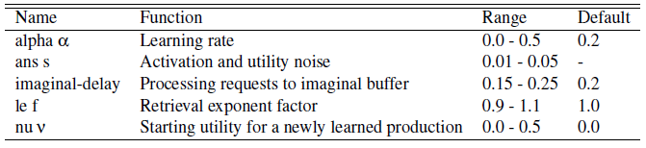
Simulations
60 trials per “subject”: 20 training + 40 test (20 novel / 20 practiced)
6 * 5 * 10 * 3 * 6 * 60 * 100 = 32.400.000
Fit parameters using correlation and Root Mean Squared Error

Slide 18
Results

Slide 19
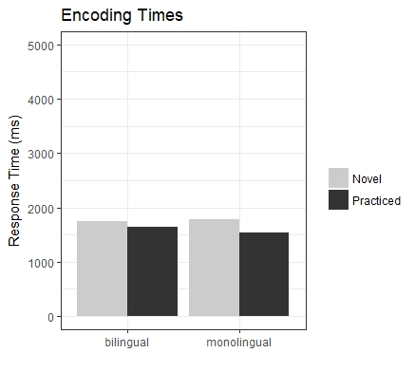
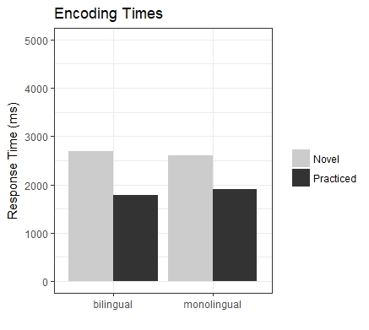
response times
Correlation
Behavioral experiment
Fitting parameters turned out to be challenging
RMSE

Slide 20
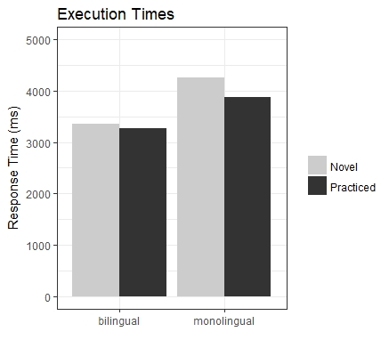
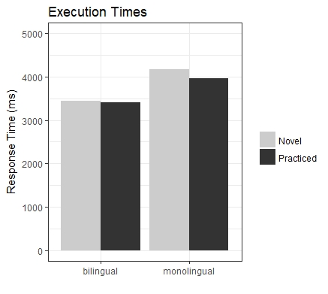
response times
Correlation
Behavioral experiment
Fitting parameters turned out to be challenging
Middle way…
RMSE

Slide 21
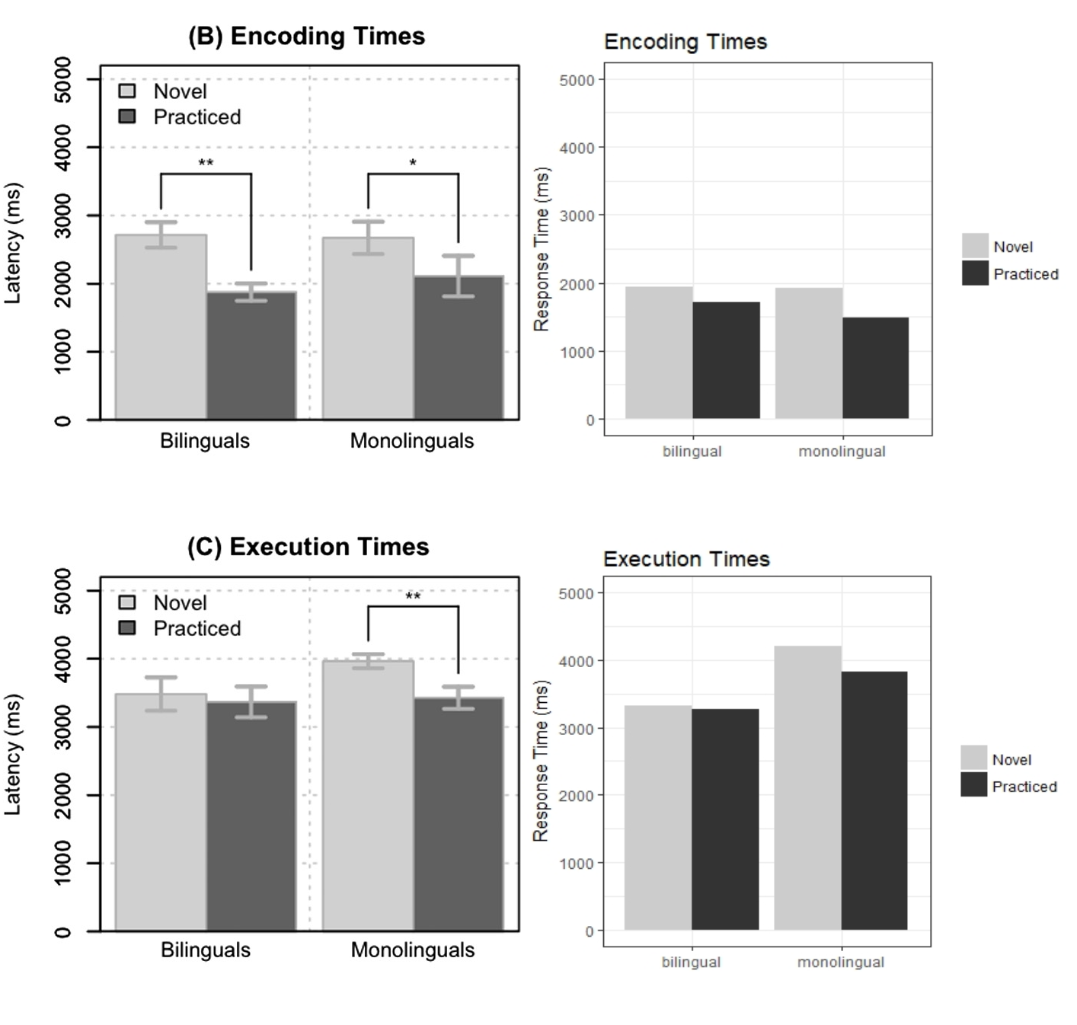
Middle way
Emphasis on patterns instead of RTs
In fact, 99% of all monolingual model simulations show a difference between novel and practiced trials

Slide 22
Summary
Removing internal checks results in faster task-switching, and
In other words: bilinguals already know
Supports that bilingual advantage in task-switching is shaped by conditional and contextual demands

Slide 23
Future directions

Slide 24
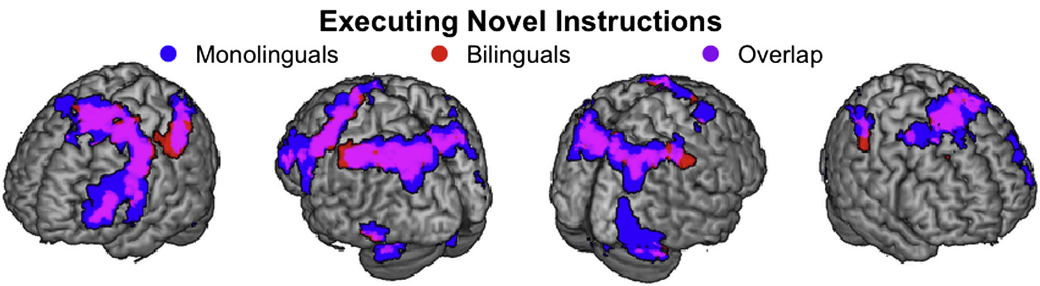
fMRI Results
Differences in adaptability (response to novel/practived trials)
Found in the basal ganglia
ACT-R’s procedural buffer is associated to basal ganglia areas.
(Stocco & Prat, 2014; Borst & Anderson, 2015)

Slide 25
Accuracy
Bilinguals are often faster, but more inaccuracte (usually non-significant though)
The models from this study offers an explanation: they might have a different speed-accuracy trade-off

Slide 26
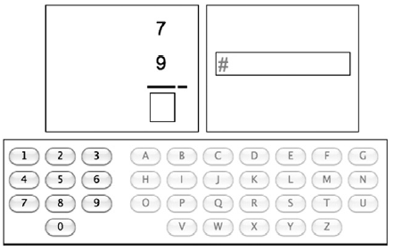
Applying to other paradigms
Simon task
Task-switching paradigms
(Borst, Taatgen, Stocco, Van Rijn, 2010)

Slide 27
The END
Question?

Slide 28
+

Slide 29
ENCODiNG
HALF
DUBBLE
MULTIPLY
NEXT

Slide 30
*

Slide 31
EXECUTION
X = 8
Y = 3
NEXT

Slide 32
Probe
24 ?
YES
NO

