Slide 1
Bilinguals Already Know: Reducing Internal Control Leads to Faster Task-Switching
Charlotte de Blecourt

Slide 2
Today
Background
Bilingualism and task-switching
Rapid Instructed Task Learning
Model
Introduction to ACT-R
RITL in ACT-R
Comparison between “bilingual” and “monolingual” model
Results
Further directions
Model remarks

Slide 3
Bilingualism and executive function
The more proficient someone becomes in L2, the more overlap between languages in the brain. This implies competition between L1 and L2, and thus control. Probably not inhibition, but task-switching abilities.
Bilingualism trains the shifting and switching aspects of executive function, which results in better performance on tasks such as the Simon task.
Regular task-switching paradigms show different results.
(Stocco, Yamasaki, Natalenko, & Prat, 2012; Bialystok, 2018)
Notes:
Switch costs are lower in bilinguals; more efficient switching process

Slide 4
Bilingualism
Conditional routing model
Basal ganglia actively shape information routes in the brain when the regular route doesn’t suffice. These paths are established with practice and become more efficient. Bilinguals learn to select appropriate linguistic rules and information, and this experience may train them to select and apply non-linguistic rules as well.
Adaptive control hypothesis
Second language use depends on context. Bilinguals operating in a complex multilingual environment need to adapt more often, and use language-specific control mechanisms. Perhaps these control mechanisms also work in non-linguistic adaptive contexts, such as task-switching.

Slide 5

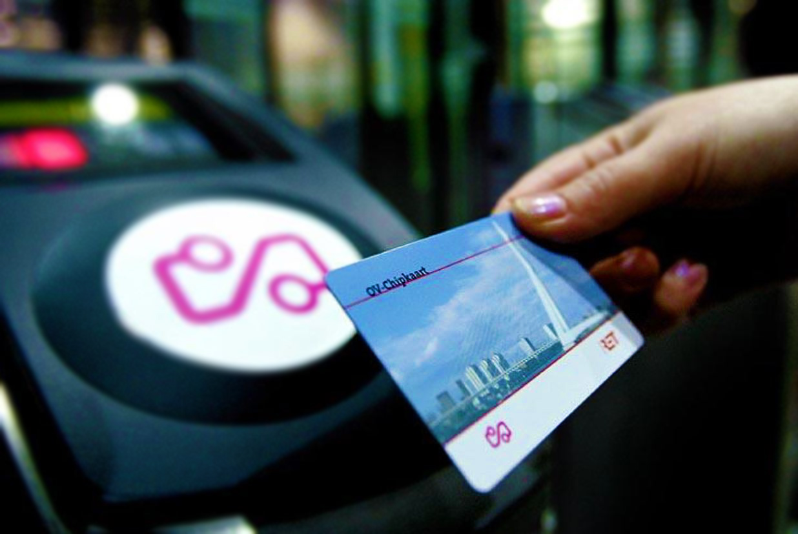
Rapid Instructed task learning
How do you learn to use an OV-chipkaart?

Slide 6
Rapid Instructed task learning
Trial
Separates encoding (remembering) from execution (applying)
Tasks and variables change with every trial

Slide 7
RITL and Bilingualism
Bilinguals have different sets of linguistic rules that serve the same communication goal
card/cards kaart/kaarten
RITL procedure is similar
dubble/half/add decrease/third/multiply
As bilinguals may be more used to set shifting, we’d expect bilinguals to be faster in the execution phase. This is the part where people actually apply rules to given information.

Slide 8
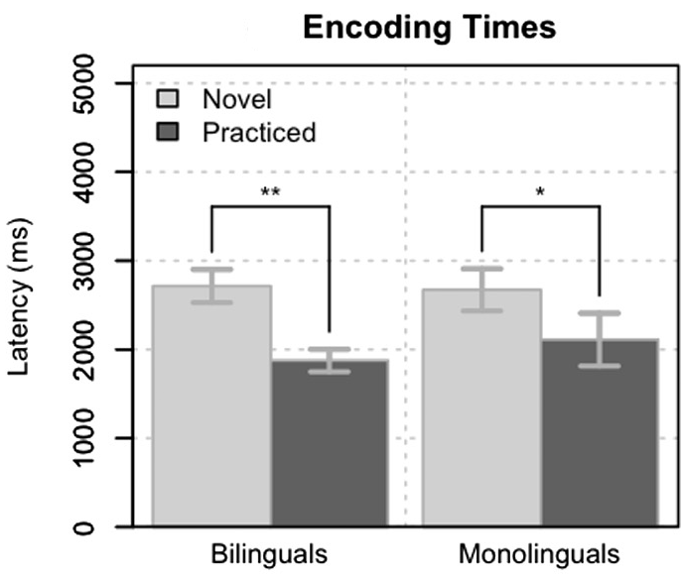
Results Encoding
Differences between encoding of novel and practiced trials
No difference between the groups here, just a learning effect
(Stocco & Prat, 2014)

Slide 9
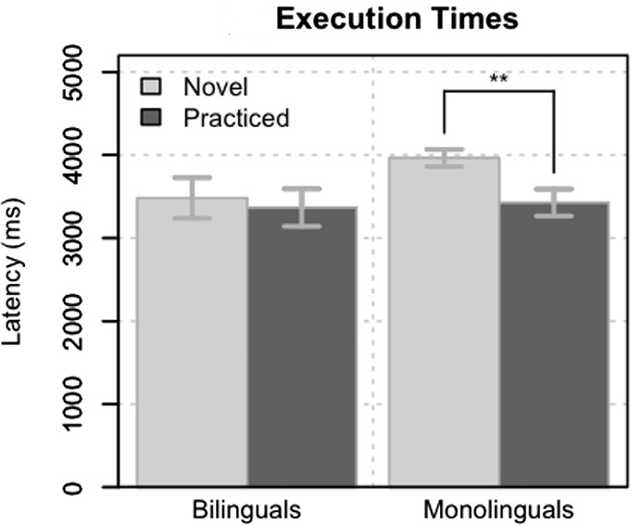
Results Execution
No difference between novel and practiced instructions in bilinguals, but monolinguals needed practice.
Only monolinguals learned something here
(Stocco & Prat, 2014)

Slide 10
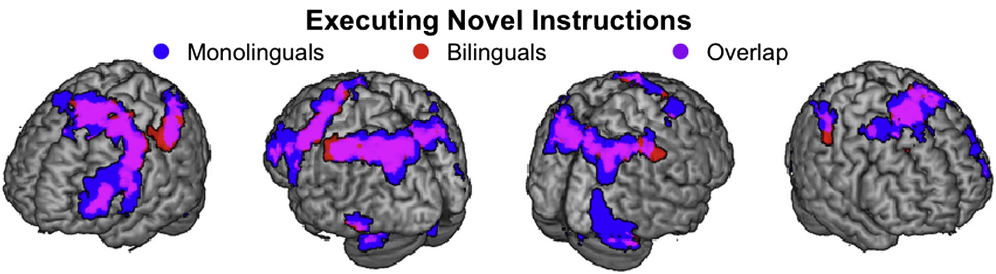
fMRI Results
Differences in adaptability:
Adaptability is assessed in fMRI through subtraction of (beta values??)
Found in the basal ganglia

Slide 11
So what do we know?
Rapid Instructional Task Learning procedures and bilingualism have behavioral similarities: they both involve re-assembling and applying information.
Therefore, bilinguals may have already learned how to switch and re-combine sets of information; this may be why they are executing new trials faster than monolinguals.
The basal ganglia show better adaption to task difficulty in bilinguals.
As ACT-R’s procedural buffer is associated to basal ganglia areas. So, there’s probably a difference between productions during execution phase
Notes:
Task-switching

Slide 12
Model

Slide 13
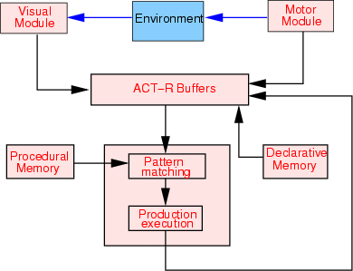
Introduction to ACT-R
ACT-R is an computational architecture that has different parts (modules) that resemble human functions. Each action (production) is an IF-THEN rule.
(p next-slide
Bottom of my slide
Last line spoken
==>
Use finger to continue
Remember text with next slide)
Notes:
Modules get accessed through buffers

Slide 14
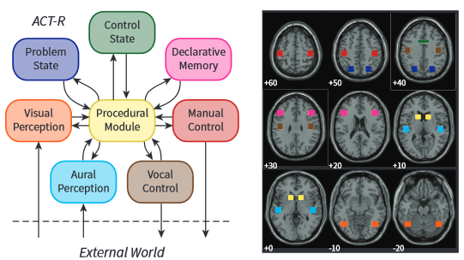
Introduction to ACT-R
ACT-R is useful for modelling this RITL task
Easy to divide tasks into stages
Learning is easy to simulate
Biologically realistic: modules are tied to brain areas, computation times are similar to humans
Flexible
Production compilation through parameter :epl
See rules
Remember rules
Press Space bar
See rules
Press Space bar
(Borst & Anderson, 2015)

Slide 15
Model goal
Replicate Stocco & Prat 2014
A “monolingual” model and a “bilingual” model
In an ideal world…
Response times are similar to the times reported in the paper
Both models would learn to encode faster over time
The monolingual model improves in the execution phase
How to achieve this?

Slide 16
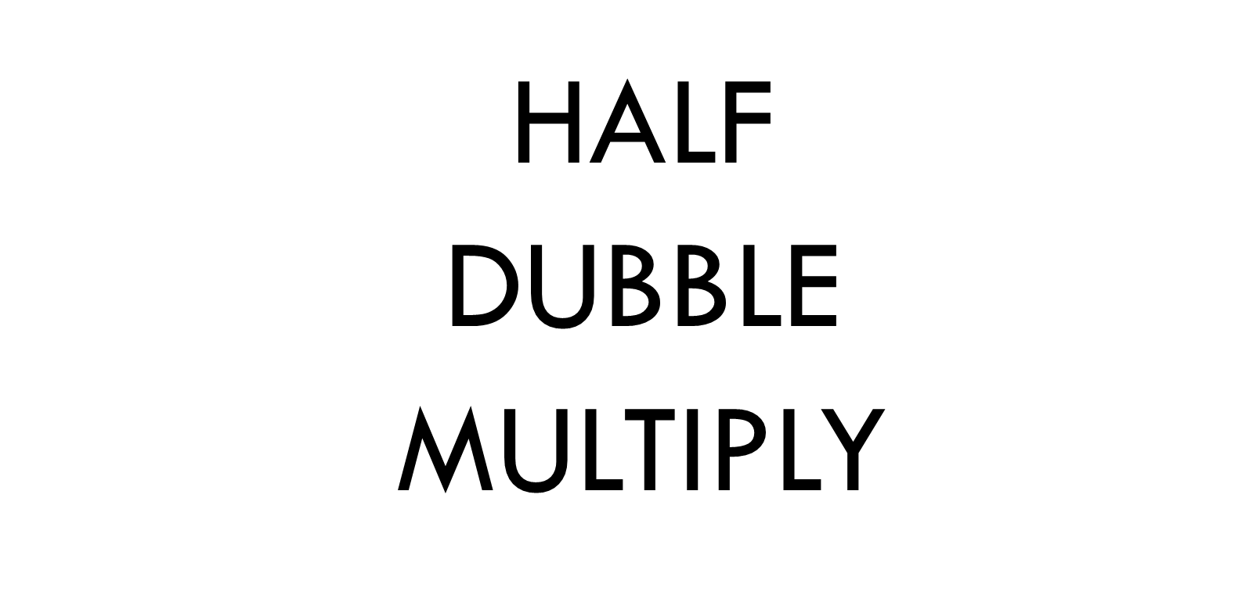
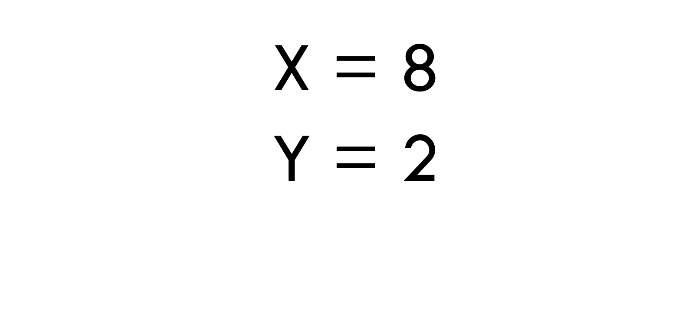

Overview
Encoding
View screen
Check if retrievable
Execution
Retrieve instruction
Retrieve operation
Response
View probe
Retrieve arithmetic fact with values on screen
Press button
Press button
Answer YES or Answer NO
Remember rules
Prepare first operation
Remember result

Slide 17
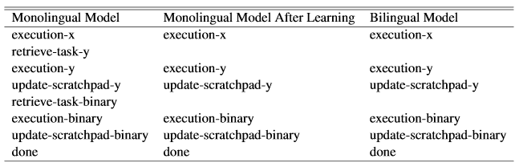
Model differences
Retrieve instruction
Get value from screen
Retrieve arithmetic fact
Remember results until calculations are done
Monolingual model
Production compilation
Bilingual model
No production compilation possible
Similar to monolingual model after learning

Slide 18
Results

Slide 19
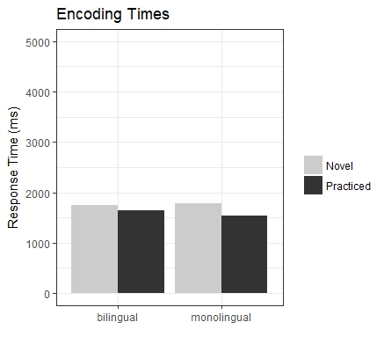
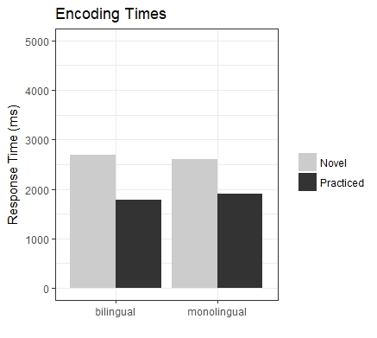
response times
Correlation
Based on RMSE and correlation to Stocco & Prat (2014)
Middle way…
RMSE

Slide 20
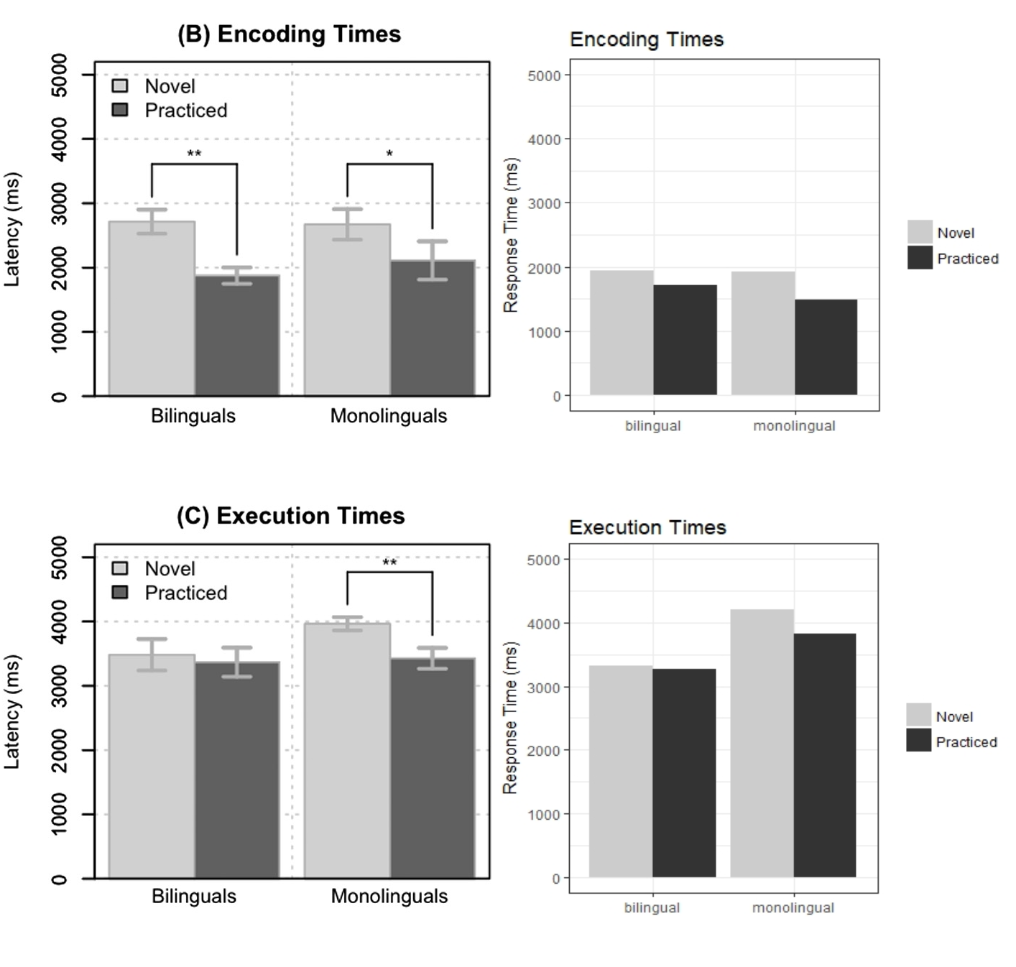

Slide 21
Future directions

Slide 22
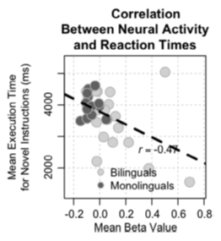
Model remarks
No difference in encoding: it’s just an assumption.
Strategies:
Encode and wait
Encode and prepare first operation (remember Roy’s talk?)
Easy and difficult operations: difference between calculating and retrieving?
Notes:
Easy/difficult differences have also been found in behavioural literature

Slide 23
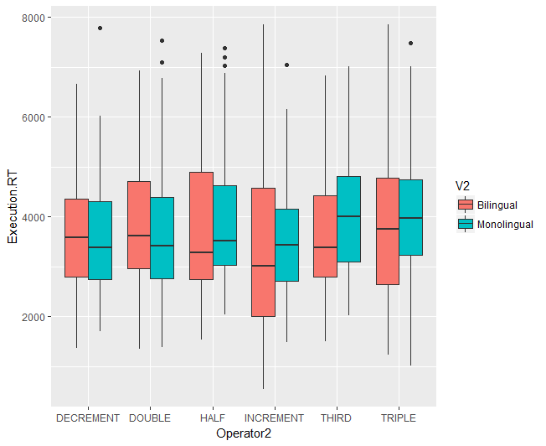
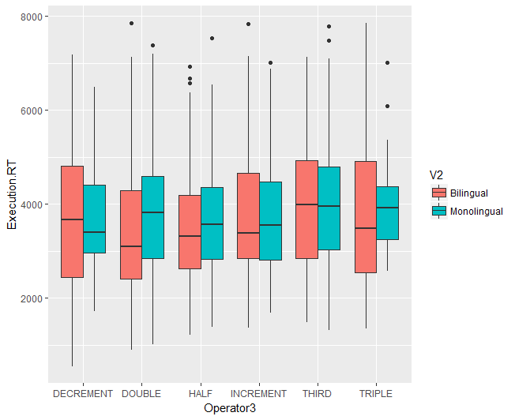
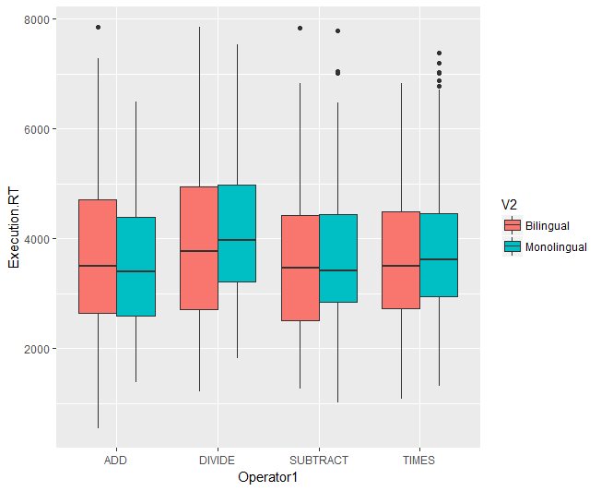
Difficulty of operations
Some combinations are definitely faster than others
Individual operations do not really differ
Not enough for difference in computation
 | TRIPLE DECREMENT SUBSTRACT | DUBBLE INCREMENT ADD | DECREMENT INCREMENT ADD
Monolingual | 4558 (1280) | 2386 (992) | 4278 (1035)
Bilingual | 4610 (1104) | 3618 (1330) | 2901 (1331)

Slide 24
Storage buffers
Instructions and variables are stored together as one chunk in the imaginal buffer
Switching instructions or information?

Slide 25
Test model implications
How to test the implications of my model in an experiment?
Make remembering instructions more difficult → Add more instructions & variables

Slide 26
END
Questions and model suggestions

Slide 27
+

Slide 28
ENCODiNG
HALF
DUBBLE
MULTIPLY
NEXT

Slide 29
*

Slide 30
EXECUTION
X = 8
Y = 3
NEXT

Slide 31
Probe
24 ?
YES
NO

