Slide 1
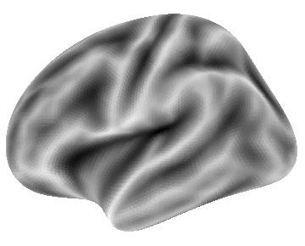
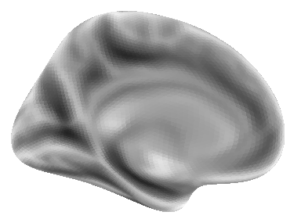
(A)
Long-Term
Memory
(B)
M1
Dorsal
PFC
S1
A1
Basal Ganglia
Procedural
Memory
Working
Memory
Temporal
Cortex
Visual Cortex
Perception
Action
Lateral
Medial

Slide 2
Working
Memory
Action
A
WM
Procedural
Memory
PM
LM
P
Long-Term
Memory
Perception

