Slide 1
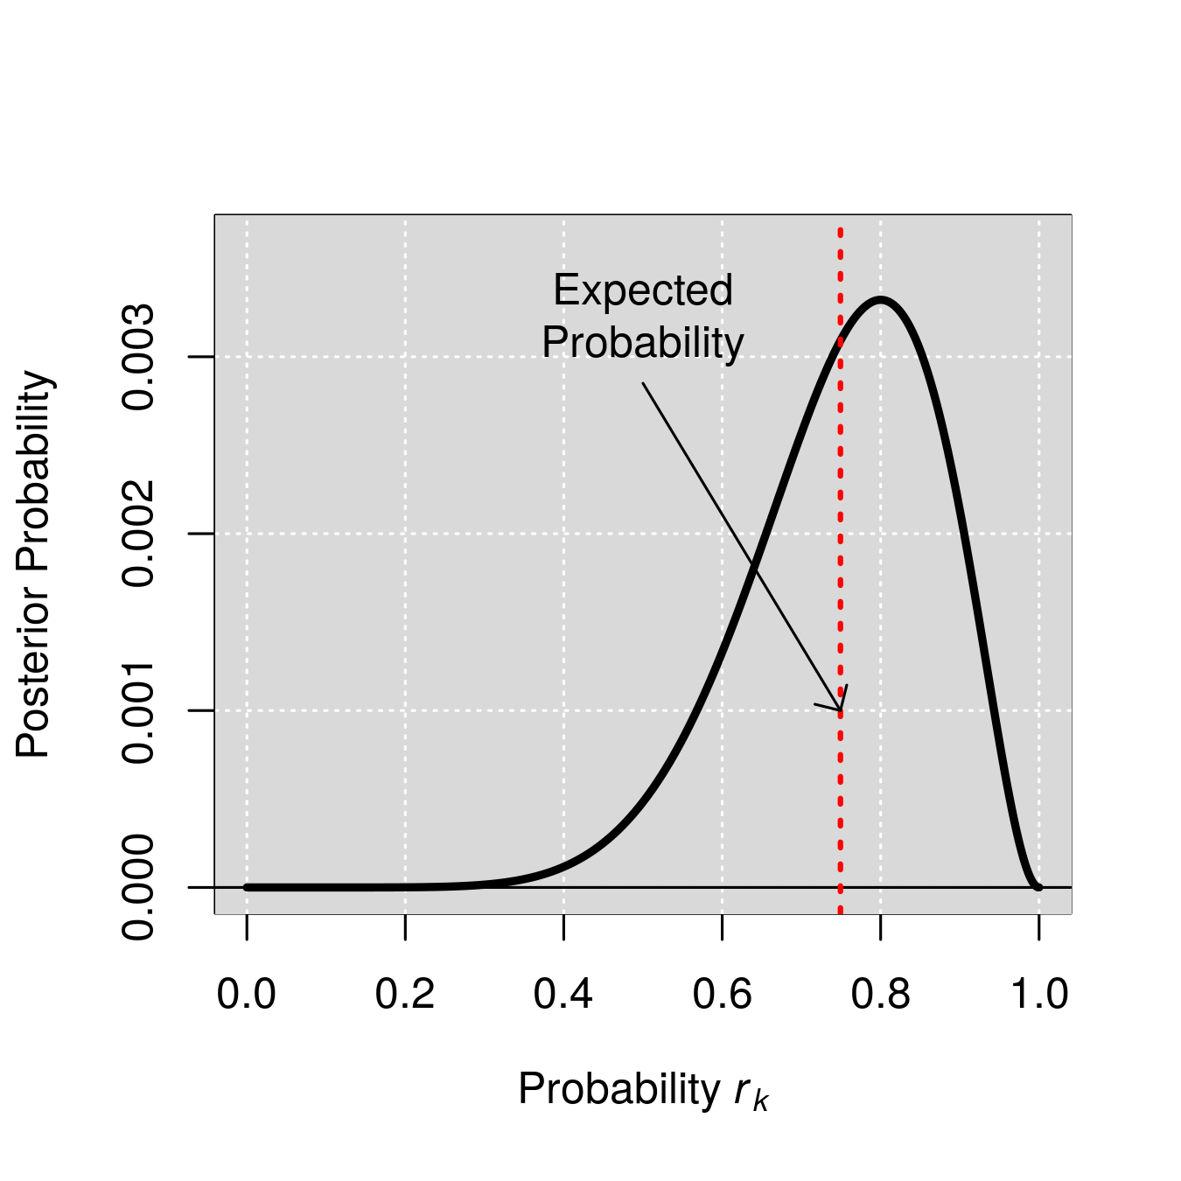
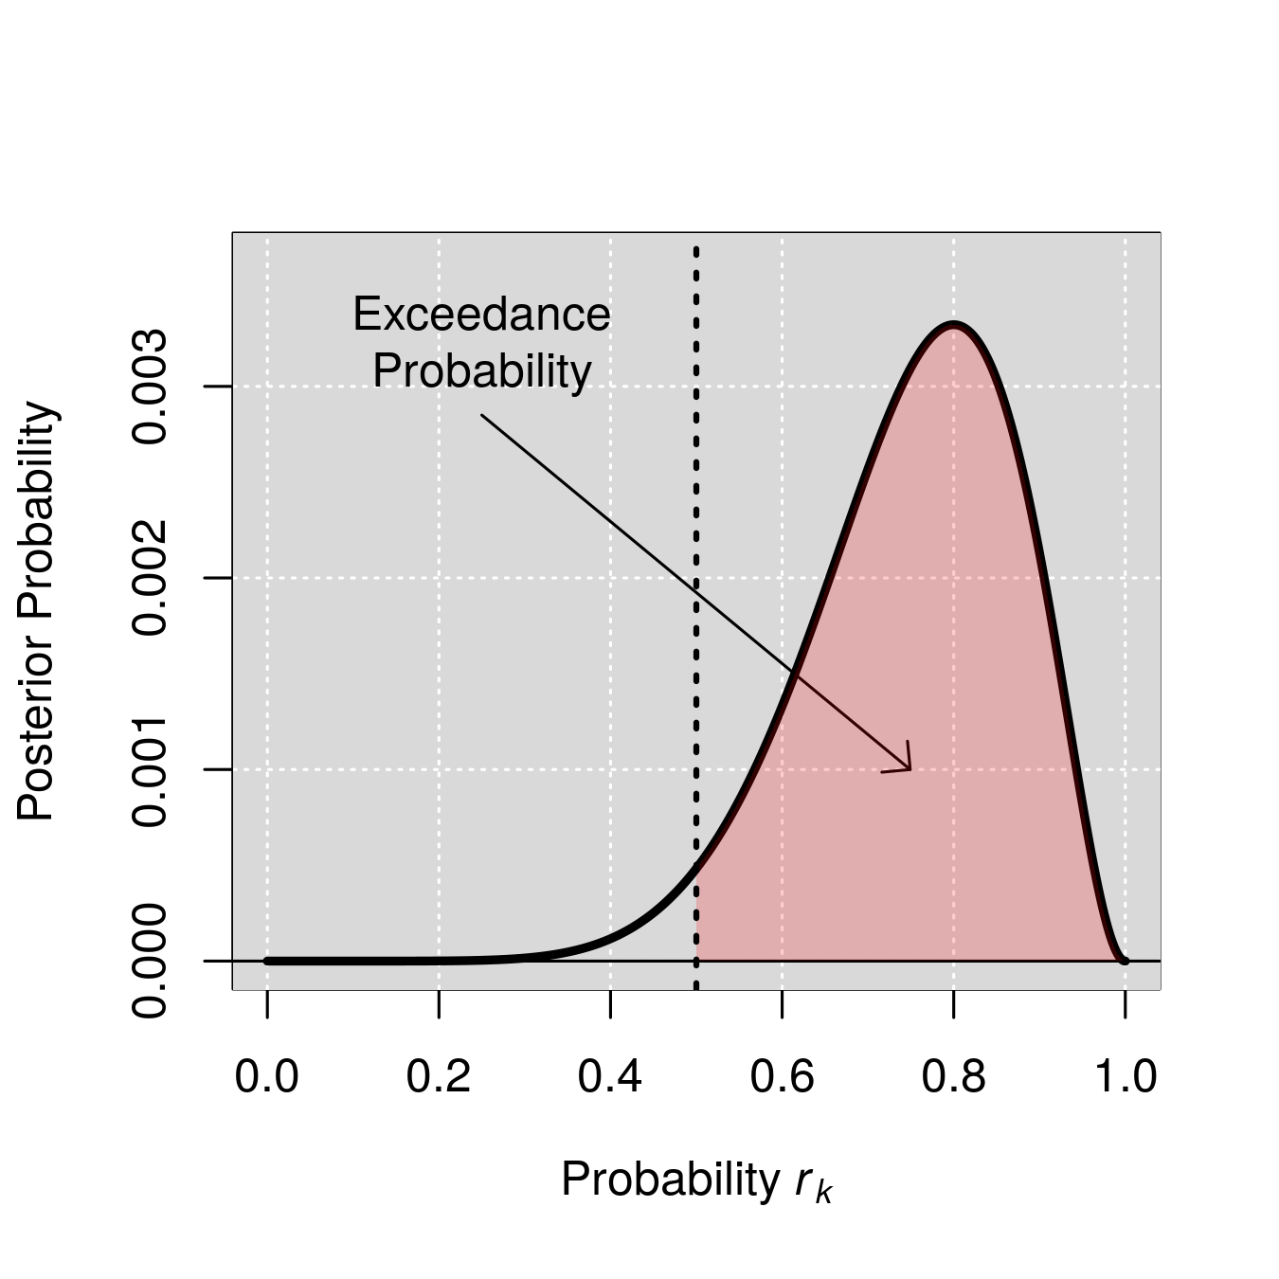
(A)
(B)
(C)
α
r_{k}
m_{k,n}
y_{n}

