Slide 1


Detector Efficiency and Peak Fitting
1
What you need to know:
How semiconductor detectors work
How to determine the detection efficiency
How to find nuclear information
How to compile a code
How to fit peaks with GRSISort
How to run a script in ROOT and GRSISort
What you need to do: The detection efficiency calibration of real germanium detector arrays!
Install GRSISort
Fit gamma-ray photopeaks with GRSISort
Edit and run the RootEffi script
Submit your fitted peaks, your edited RootEffi script and your efficiency curve ☺

Slide 2
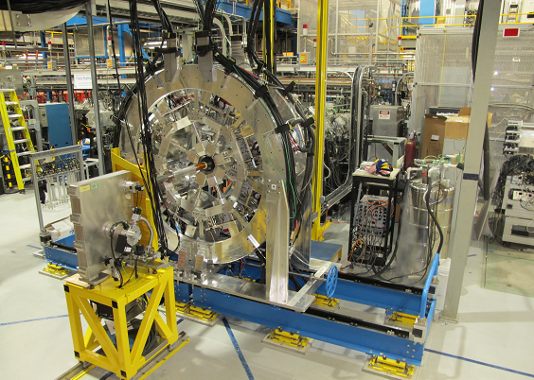
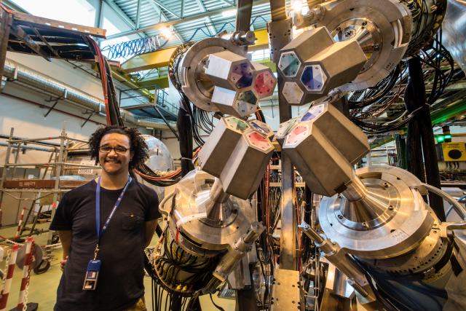
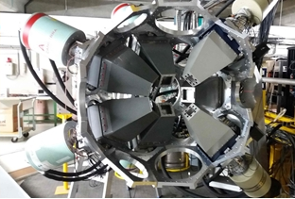
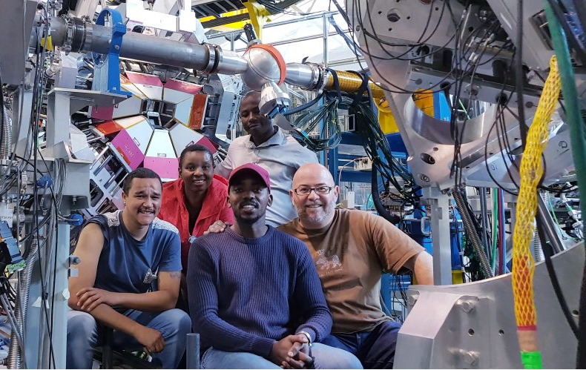
Germanium Detector Arrays
2
GRIFFIN,
TRIUMF,
Vancouver,
Canada
64 crystals
MINIBALL,
CERN,
Geneva,
Switzerland
24 crystals
Soccer Ball,
iThemba LABS,
Cape Town,
South Africa
52 crystals
TIGRESS,
TRIUMF, Vancouver,
Canada
56 crystals

Slide 3
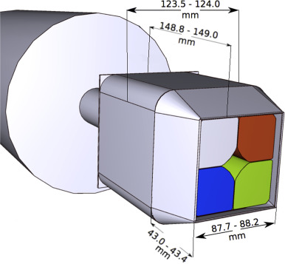
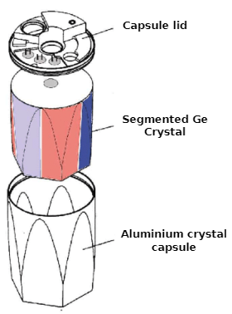
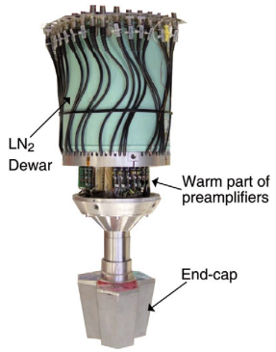
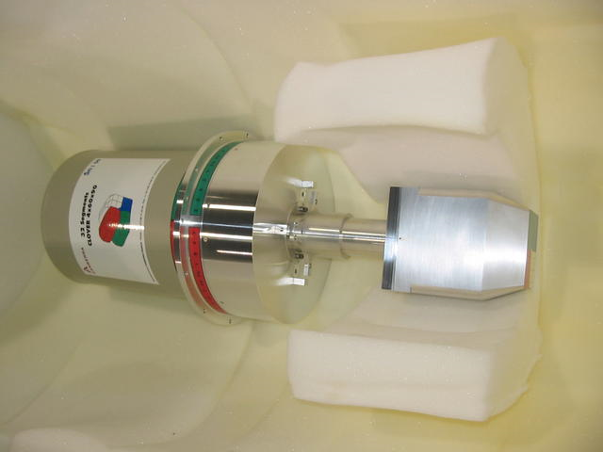
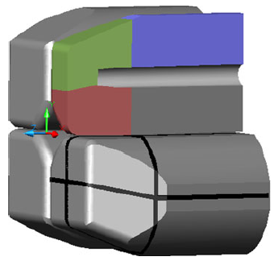
Configurations of Germanium Detectors
3
GRIFFIN,
TRIUMF,
Vancouver,
Canada
64 crystals
MINIBALL,
CERN,
Geneva,
Switzerland
24 crystals
(16 clovers, not segmented)
(8 triple clusters, 6-fold segmented)
Closed-end coaxial right cylinders ☺
Cold finger
LN₂ reservoir
4 tapered Coaxial crystals
Soccer Ball,
iThemba LABS,
Cape Town,
South Africa
52 crystals
TIGRESS,
TRIUMF, Vancouver,
Canada
56 crystals
(13 clovers, 4 segmented and 9 not segmented)
(14 clovers, 8-fold segmented)
Preamp, HV filter

Slide 4
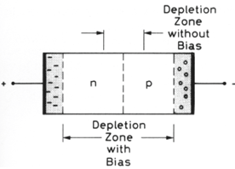
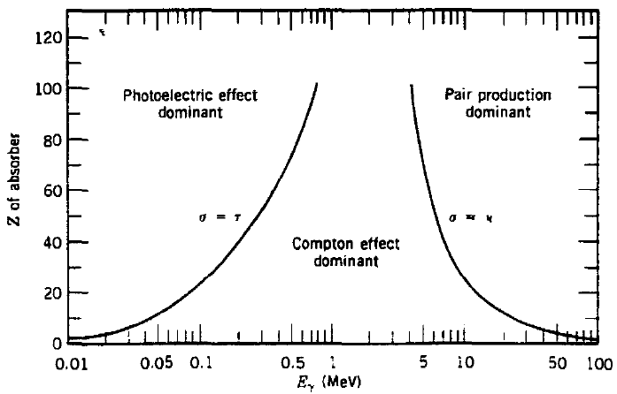
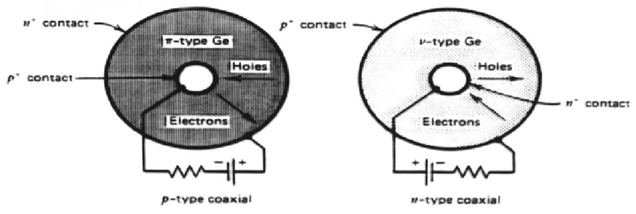
How Semiconductor Detectors Work
4
An external field creates an area depleted of free charge carriers.
Radiation interacts with the crystal and produces of electron-hole pairs.
The electrons and holes drift towards electrodes and the electric pulse is amplified and processed.
K.S. Krane, Introductory Nuclear Physics (1988).
G.F. Knoll, Radiation Detection and Measurement (1989).
W.R. Leo, Techniques for Nuclear and Particle Physics Experiments (1994).

Slide 5
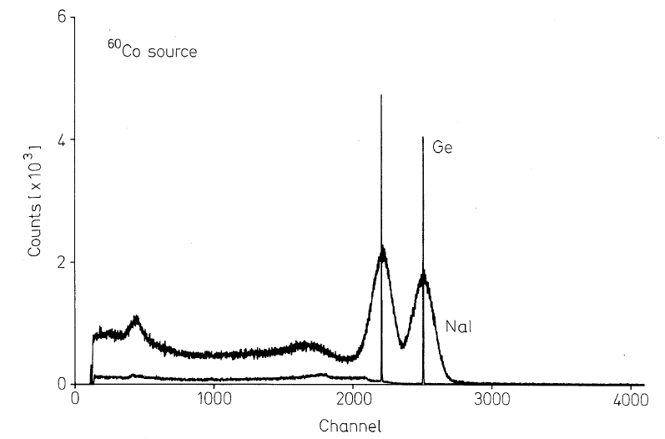
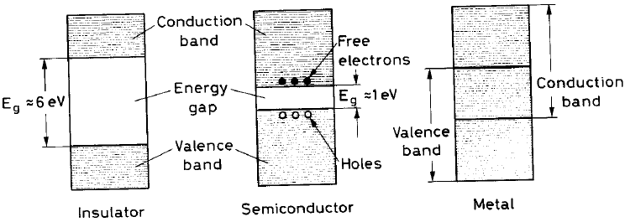
Semiconductors vs. Scintillators
5
Material Property | NaI(Tl) | Germanium | Silicon
Type | Scintillator | Semiconductor | Semiconductor
Cooling | No | ~ 95 K | No
Density (g/cm²) | 3.7 | 5.3 | 2.3
Band gap energy (eV) | 20 | 2.9 | 3.8
Energy resolution at 1332 keV (keV) | 13 | 1.9

Slide 6




How to Determine the Detection Efficiency
6
Area of the photopeak
Data collection time
Activity of the source
Absolute intensity of the gamma ray

Slide 7
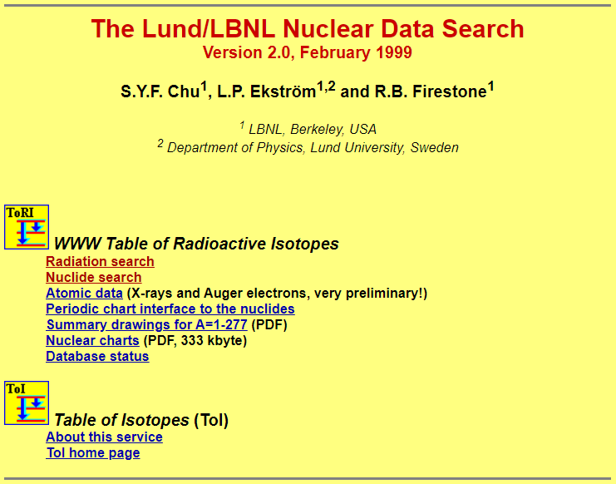
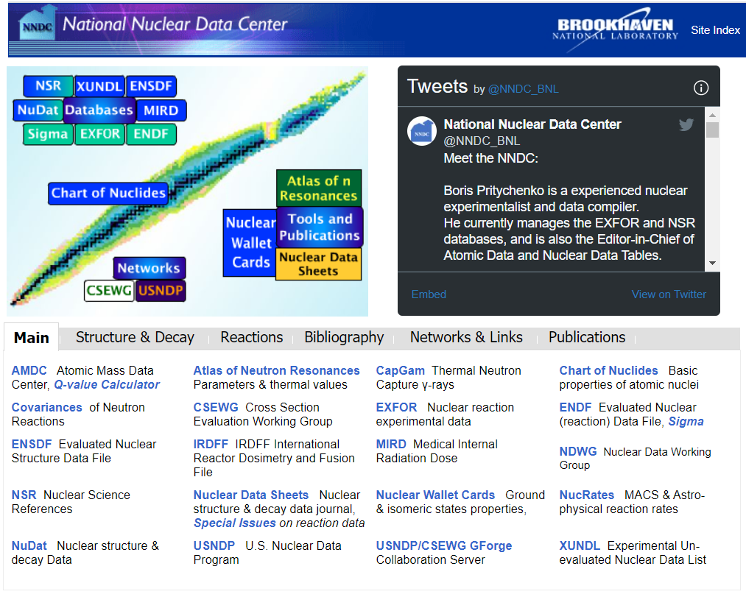
How to Find Nuclear Information
7
Lund/LBNL Nuclear Data Search: http://nucleardata.nuclear.lu.se/toi/
National Nuclear Data Center: https://www.nndc.bnl.gov/

Slide 8
How to Fit Peaks with GRSISort
8
Installation instructions at https://github.com/UWCNuclear/UbuntuSetUp
Open the file with “ grsisort -l Eu152_ARRAYNAME.root ”
See the list of histograms in the file with “.ls”
Draw histogram with “ gammaSingles->Draw() ”
Display rough peak energies by pressing “s”
Click and drag on x-axis to zoom in, zoom out by pressing “o”
Click and drag on y-axis to zoom in, right click and click “UnZoom” to zoom out
Click and click on spectrum to set the fitting boundaries around your peak
Fit by pressing “f”
Remove all markers by pressing “n”
“.q” to quit
Save screenshots of your fitted peaks and the number of counts (Sum) in your peaks.
More tools at https://github.com/GRIFFINCollaboration/GRSISort/wiki/Interactive-Analysis

Slide 9
9
git clone https://github.com/UWCNuclear/PeakFitting.git
How to Fit the Detector Efficiency with RootEffi
Download with “ git clone https://github.com/UWCNuclear/RootEffi.git ”
Download the data files with “ git clone https://github.com/UWCNuclear/PeakFitting.git ”
In gedit, edit RootEffi.C with the peak areas and uncertainties obtained from your data file.
Whenever you edit a script, you should save it and close ROOT/GRSISort to run it again.
To run RootEffi, type in the command line “ grsisort -l RootEffi.C ” or “ grsisort -l ” and then “ .x RootEffi.C ”
Save your edited script and your new efficiency curve
In one file, submit your fitted peaks, your edited RootEffi script, and your efficiency curve ☺

