Slide 1



Establishing the Deformation Characteristics and Decay Spectroscopy of ⁶⁶Ge
K.J. Abrahams and J.N. Orce, UWC
N. Bernier, UWC and UniZulu
Advanced Nuclear Science and Technology Techniques (ANSTT3)
March 19th, 2020.

Slide 2
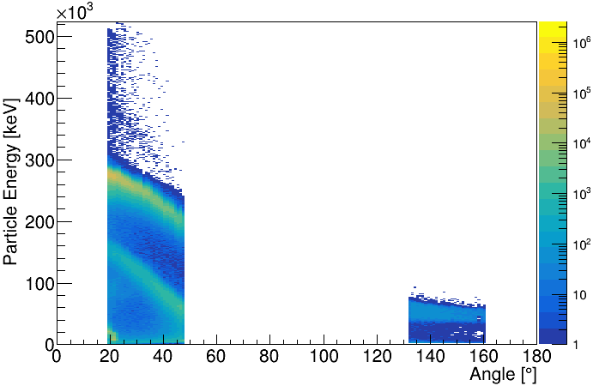
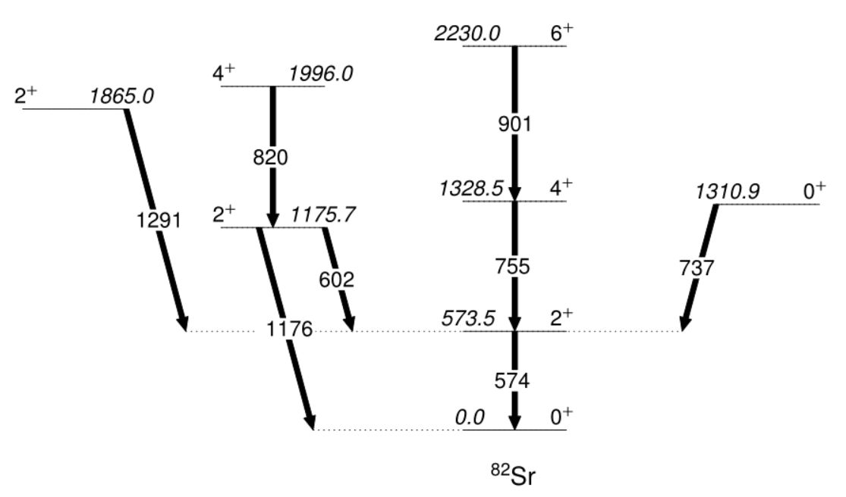
Update on Coulomb Excitation of ⁸²Sr (S1684)
2
Excitations up to the yrast 6⁺ state and third 2⁺ state are seen with ²⁰⁸Pb target at backwards angles (upstream data).
Only the first 2⁺ in ⁸²Sr is seen in the forward angles (downstream data)
The level scheme of the observed transitions in ⁸²Sr is shown
Downstream
Upstream

Slide 3
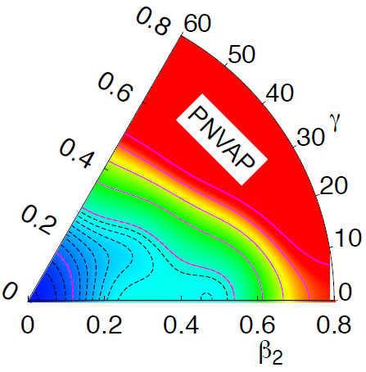
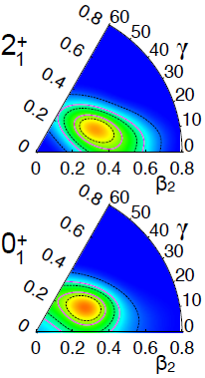
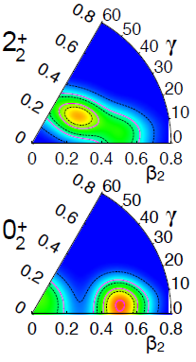
Beyond Mean-field Calculations
3
The complimentary study of ^{80,82}Sr with the β⁺/EC decay of ^{80,82}Y with the measurement of internal conversion electrons at the ISOLDE Decay Station will happen this year :-)
The extreme prolate deformation and large E2 strengths seen in the neutron-deficient A ~ 72-82 isotopes might be explained by softness of the potential energy surface or by shape mixing (Korten, 2001; Bouchez et al., 2003).
T. Rodriguez (2020).

Slide 4
Thanks to collaborators!
https://nuclear.uwc.ac.za/index.php/uwc-triumf/
N. Bernier¹, K. Abrahams¹, J.N. Orce¹, T.R. Rodriguez³, J. Henderson⁴, S. A. Gillespie⁵, F.A. Ali^{6,7}, L. Atar⁶, G. Ball⁵, S. Bhattcharjee⁵, R. Caballero-Folch⁵, A. Chester⁵, R. Coleman⁶, T. Drake⁸, E. Dunling⁹, A.B. Garnsworthy⁵, B. Greaves⁶, G.F. Grinyer¹⁰, G. Hackman⁵, E. Kasanda⁶, R. Lafleur^{5,6}, S. Masango¹, D. Muecher⁶, C. Ngwetsheni¹, S.S. Ntshangase², B. Olaizola⁵, T. Rockman⁶, Y. Saito^{5,11}, L. Sexton^{5,12}, P. Siuryte^{5,12}, J. Smallcombe⁵, J. K. Smith¹³, C. Svensson⁶, E. Timakova^{5,14}, J. Williams¹⁵, T. Zidar⁶
¹ U. of Western Cape
² U. of Zululand
³ Uni. Autonoma de Madrid
⁴ Lawrence Livermore Nat. Lab.
⁵ TRIUMF
⁶ U. of Guelph
⁷ U. of Sulaimani
⁸ U. of Toronto
⁹ U. of York
¹⁰ U. of Regina
¹¹ U. of British Columbia
¹² U. of Surrey
¹² Reed College
¹³ McMaster U.
¹⁴ Simon Fraser U.

