Slide 1
Software Design for Data Science
Advanced Testing
Melissa Winstanley
University of Washington
February 22, 2024

Slide 2
Types of testing
Unit testing
……

Slide 3
Types of testing
Unit testing
Integration testing
Validation testing
System/E2E testing
UI testing
Regression testing
Black box/white box testing
Fuzzy testing
Performance testing
Usability testing
Security testing
Accessibility testing
Load testing
Continuous testing

Slide 4
Today
Mocking
UI testing in Streamlit

Slide 5
Mocking

Slide 6
Mocking: motivation
Your code makes an HTTP request to a website, which may return data that varies over time.
How to write a test that validates…
…that your code works if there are HTTP errors?
…that your code works if the data changes?
…that your code works in normal cases?
…given that you don’t control the network or the other website?

Slide 7
Mocking: motivation
Another example: Homework 3
In HW3, you wrote check_email_validity and process_newsgroup_file.
The instructors want to validate your code - but we want to grade each function separately!
If your check_email_validity is wrong, you should not ALSO lose points for process_newsgroup_file, assuming nothing else is wrong.
One solution: run OUR implementation of check_email_validity with YOUR implementation of process_newsgroup_file
How can we do that?

Slide 8

Mocking: the problem
How do we unit test our code when it depends on other functions, modules, or input that we may not have control over?

Slide 9
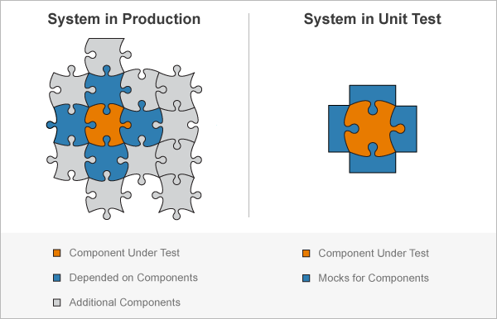
Mocking
Fake implementations (“mocks”)
Image source: https://www.mathworks.com/help/matlab/mocking-framework.html

Slide 10
Mocking in Python
The unittest library has a module for mocking
from unittest import mock
https://docs.python.org/3/library/unittest.mock.html
Allows you to provide false implementations, return values, exceptions, and more for a particular function, module, or class.

Slide 11
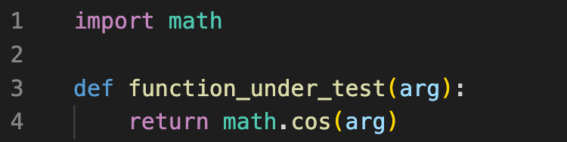
Example: the code under test

Slide 12
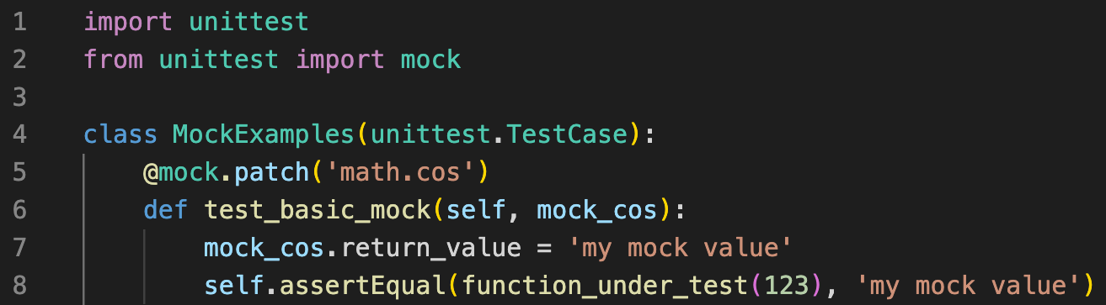
Using the @mock.patch decorator

Slide 13
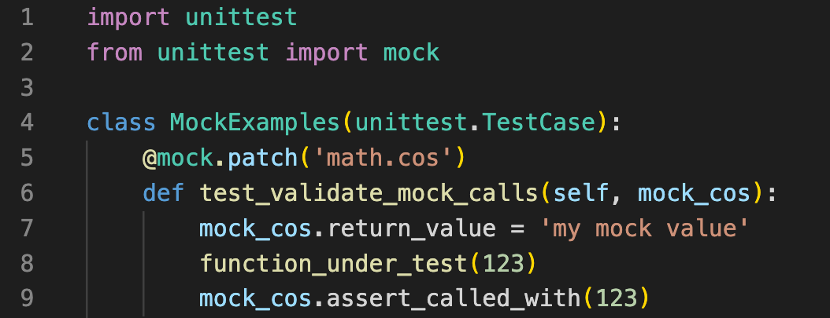
Using assert_called_with

Slide 14
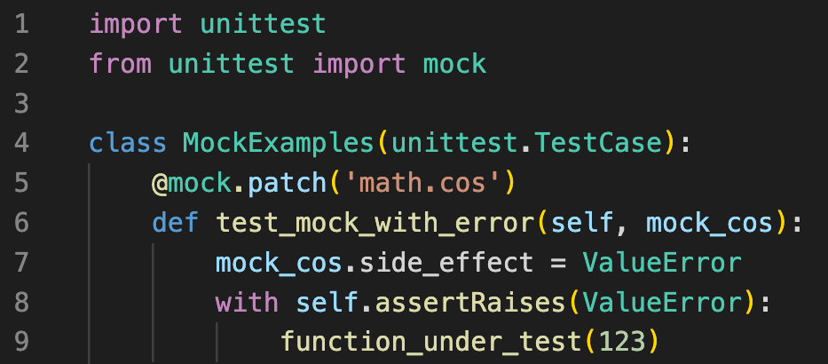
Using side_effect to trigger an exception

Slide 15
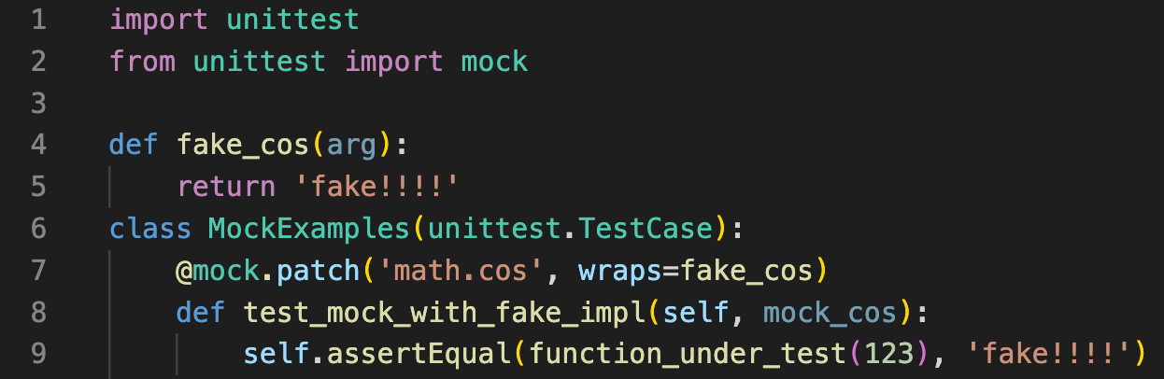
Wrapping a fake implementation

Slide 16
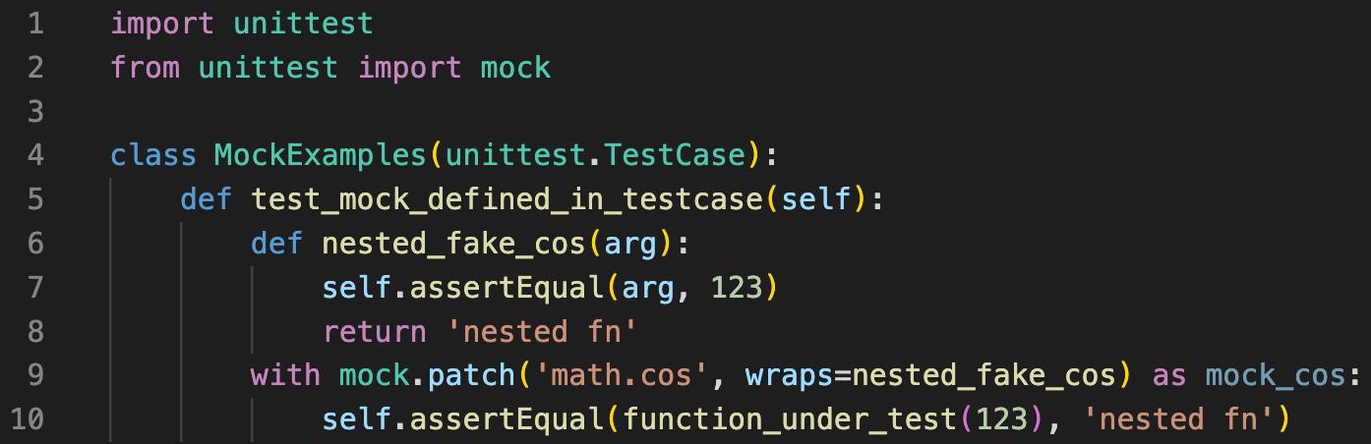
Nesting a mock to use self or other variables

Slide 17
Exercise: Mocking
From the Syllabus, clone the linked repository
git clone https://github.com/UWDATA515/testing_example.git
Cd into the mocking_example directory
Look at the README and follow the directions to try mocking

Slide 18
UI Testing

Slide 19
What is UI testing?
Test the user interface
GUI
CLI
Specifically, the visual elements, layout, and interactions
Lots of tools, but they get pretty complicated
Selenium
Cypress

Slide 20
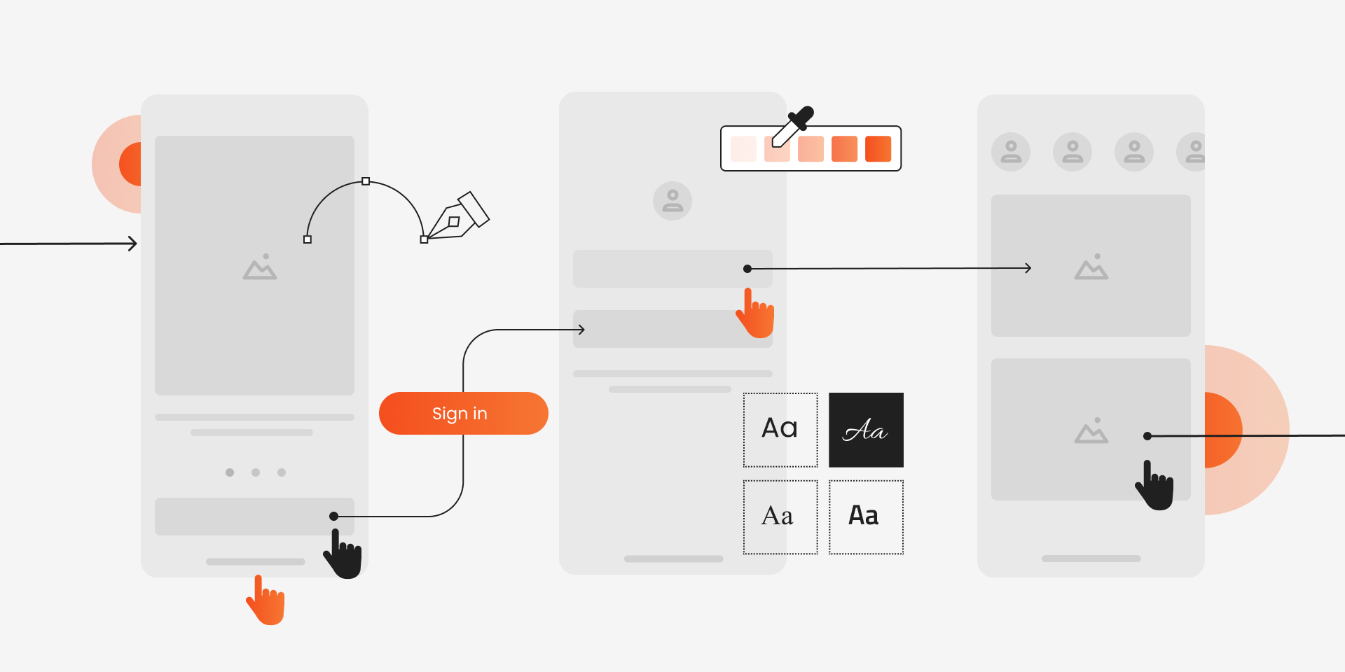

Slide 21

UI testing

Slide 22
How to use Streamlit’s AppTest
Instead of importing the file normally, use from_file
In your test function, create an “AppTest”:
at = AppTest.from_file("app.py").run()
Assert that different content is what you expect it to be:
self.assertEqual(at.text[0].value,"Whatever the content should be")
Interact with components:
at.button[0].click().run()
Access UI elements by their type through the app test object. Here, [0] signifies that there might be many text elements, and we want the first one
Different interactive UI elements have different behaviors that you can trigger

Slide 23
Exercise: Streamlit testing
In the same testing repository as before
Cd into the ui_testing_example directory
Look at the README and follow the directions to try adding tests
If you aren’t using Streamlit, feel free to use this opportunity to research what testing options exist for your user interface framework.

