Slide 1
Software Design for Data Science
Team Collaboration
Naomi Alterman
University of Washington
February 10, 2026

Slide 2
Standups
What is a standup?
  1-2 minutes per person
Why standups?
  Communicate status and actions within and between teams
What do I say in a standup?
  Progress you’ve made since the last standup
    How it compares with the plan
    If behind plan, how to compensate to make plan end date
  Deliverables for next period
  Challenges to making next deliverables
    Technology uncertainties and blockers
    Team issues

Slide 3
Standups
In class!

Slide 4
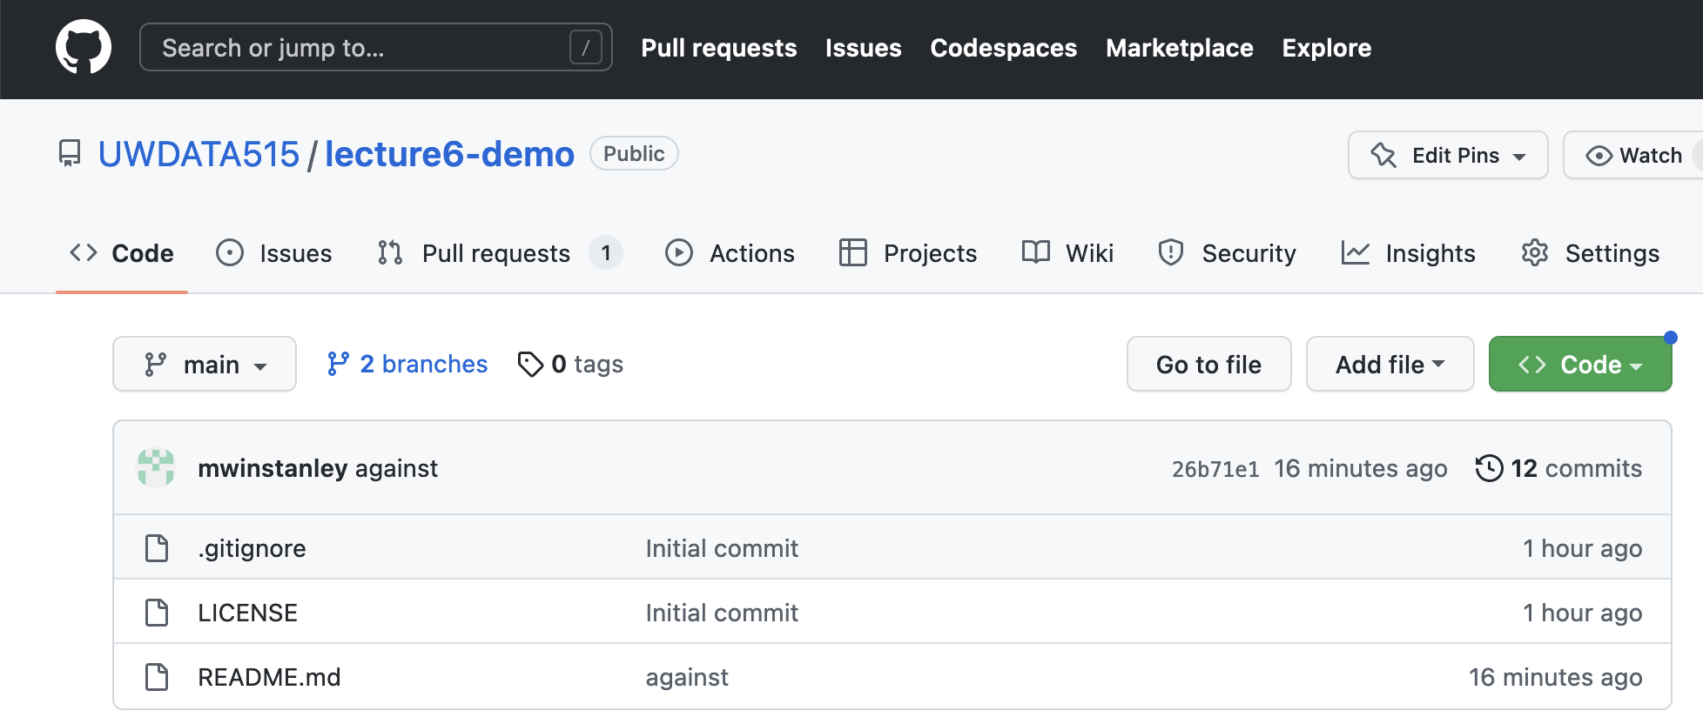
GitHub Issues

Slide 5
GitHub Issues
Good way to keep track of
  Milestones
  Tasks
  Bugs
If you link to an issue in a PR, it will auto-link the two
Use it if you like!

Slide 6
GitHub Pull Requests
Pull Request = “PR”
  Yeah, it’s a confusing name: “hey repo owners, please PULL my change into main”
What’s in the description of a PR?
  Background
    Describe what change you are making
    Describe how that change affects the application
  Test plan
    How did you test the code?
    Include specific commands that you ran, and the output
ALWAYS!
Only push directly to main in a true emergency (not in this class!)

Slide 7
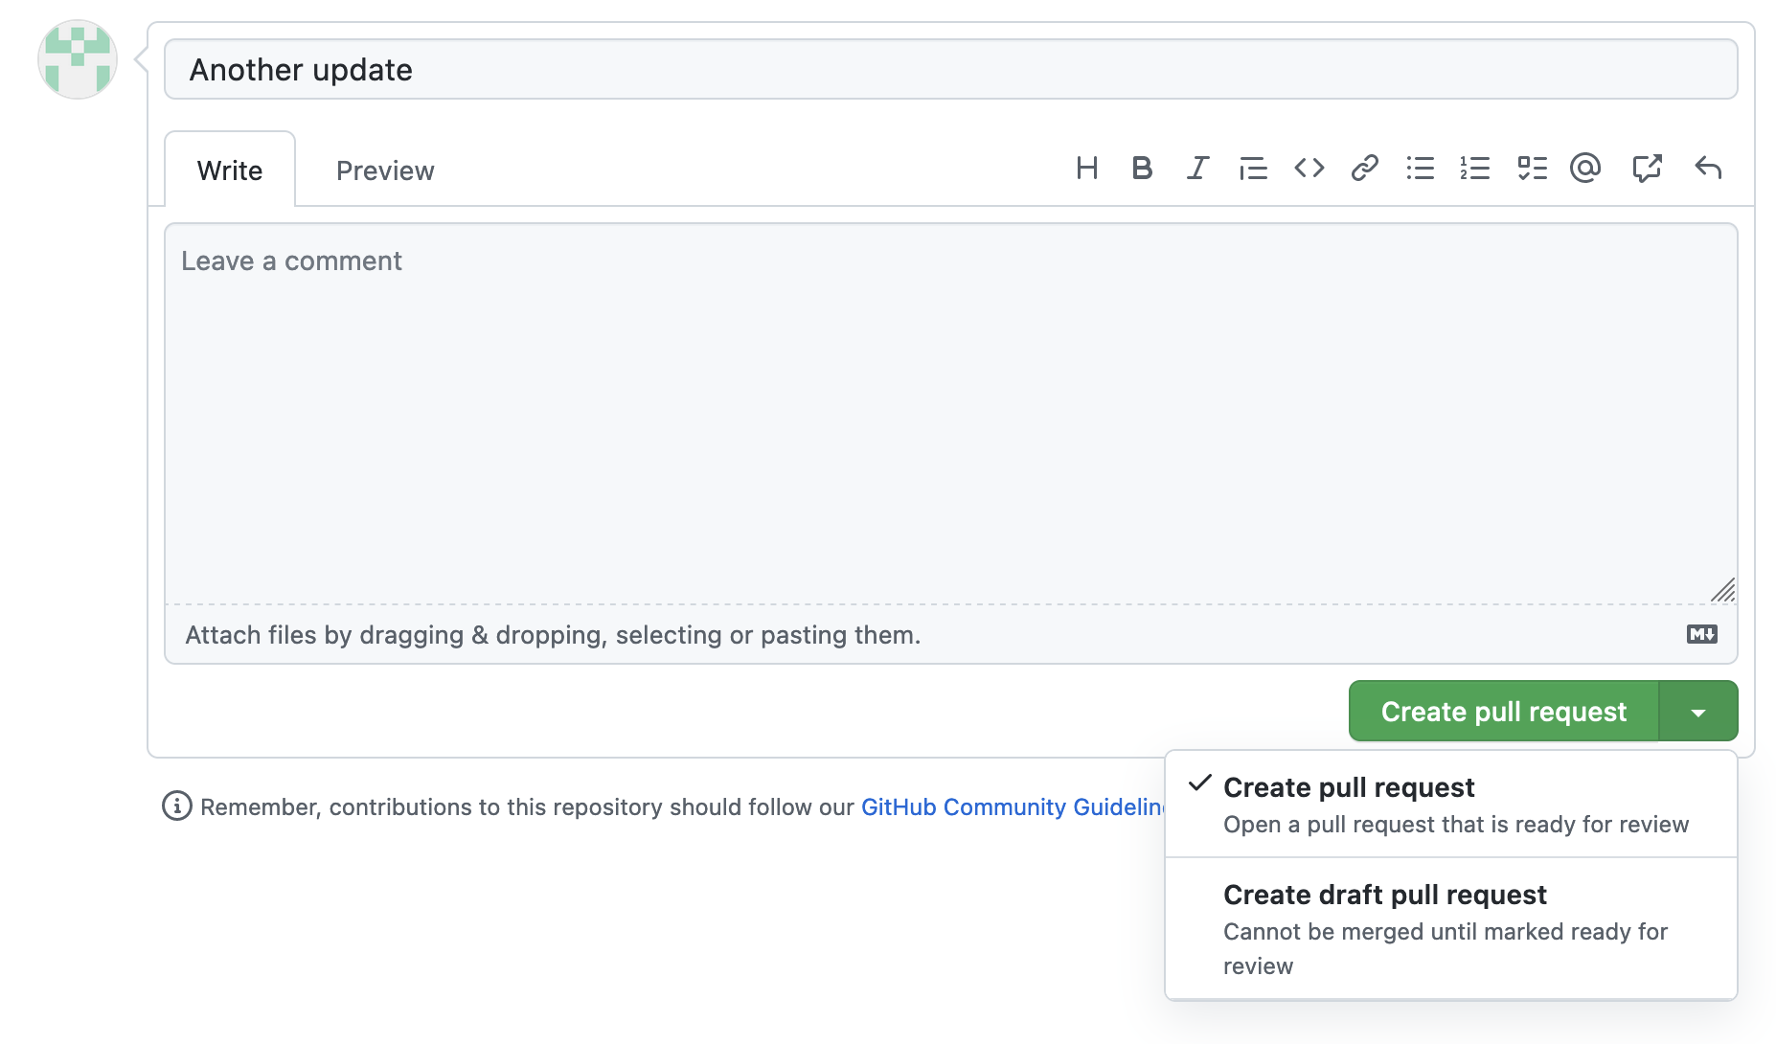
Good option: draft pull requests
If you’re not fully ready to submit it for code review

Slide 8
Code Reviews
What is code review?
  Someone looks at, comments on, and approves a PR - NOT one person
Why code review?
  To find bugs
  To improve code quality
What do you comment on in a code review?
  Bugs or missing pieces
  Style
    Choice of variable and function names
    Code readability
  If the PR doesn’t have a test plan
  How to improve reuse and efficiency
  How to use existing Python packages

Slide 9
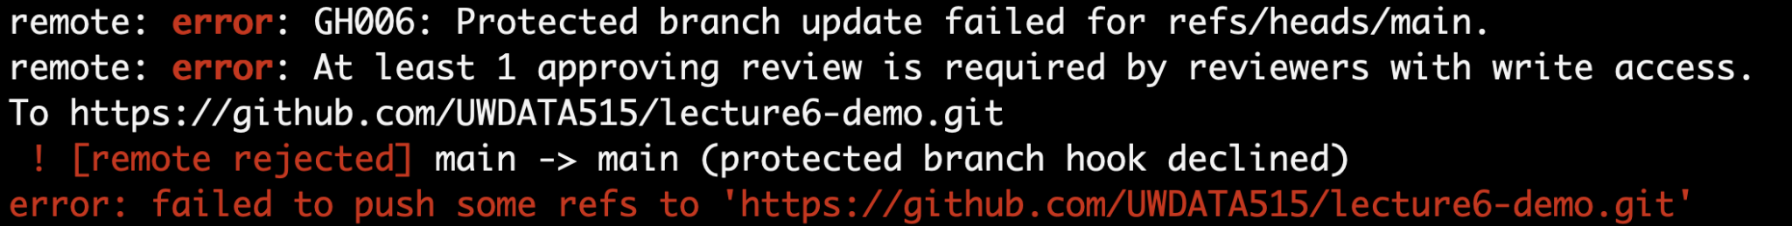
Branch Protection
Protect main against accidents!
Require pull requests and code reviews
Common in the real world

Slide 10
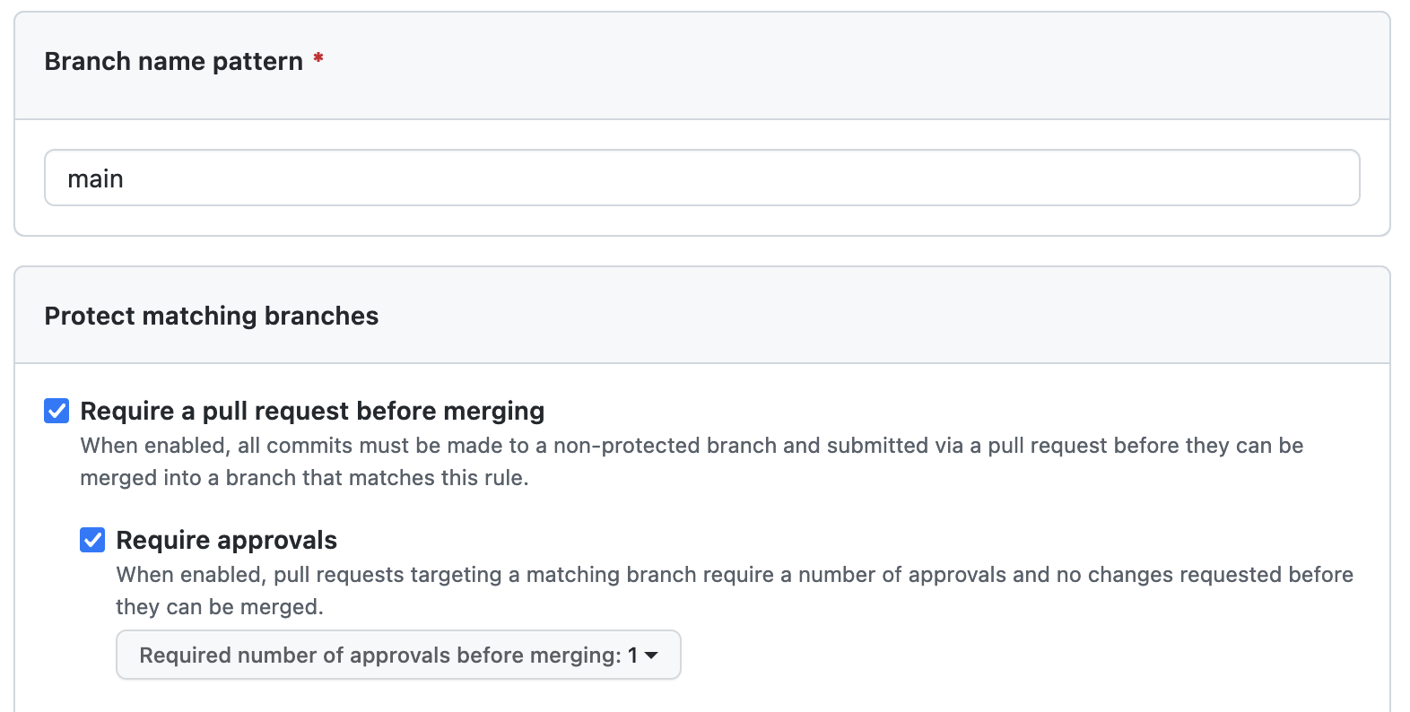
Branch Protection
GitHub Repository Page > Settings > Branches > Add branch protection rule
Do this now for your exercise repository!
Do this on your project repository!

Slide 11
Communication strategies
Use a chat mechanism for informal, quick communication
  Email doesn’t really work
  Slack
  Microsoft Teams
  Discord
  Google Chat
Don’t hesitate to hop on a Zoom to follow-up
Documentation as communication
  Code documentation
  Pull request description

Slide 12
Pair programming
Two people, one keyboard
Fewer mistakes with more eyes
Learning for both people
Consider trying it for difficult tasks!
Swap who has hands on keyboard at least every 30 minutes
Keep talking

Slide 13
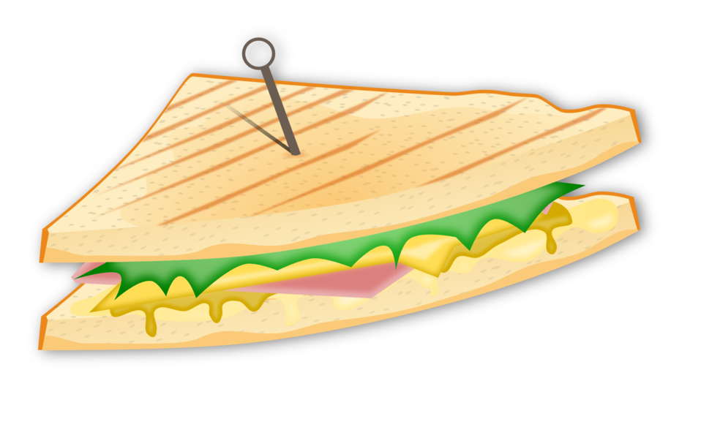
Fast feedback
Quick responses to communication
  Code reviews
  Emails
  Chat
Constructive criticism
  Consider (gently) giving teammates feedback
  Make observations, not generalization
  Sandwich approach
  Listen to the response!
  Don’t wait until the survey at the end of the quarter!

Slide 14
Collaboration Summary
Standups
GitHub issues
Pull requests
Code reviews
Chat
Pair programming
Fast feedback

