Slide 1
Software Design for Data Science
Giving Presentations
Melissa Winstanley
University of Washington
March 13, 2025

Slide 2

Bad presentations bore your listeners!
Caveat: this lecture contains my personal opinions

Slide 3
Advice 1: Slides are not for reading
Too much text on a slide is distracting and redundant.
People struggle with reading and listening at the same time.
You audience may be trying to read the slide instead of listening to you.
If you read it word-for-word, it’s redundant. What’s the point of you even being there?
It can be overwhelming and cause your listeners to glaze over and not remember anything.
It’s not immediately clear what the most important takeaways are.
Full sentences contain lots of words that aren’t actually important to your point.
How much did you hate this slide?

Slide 4


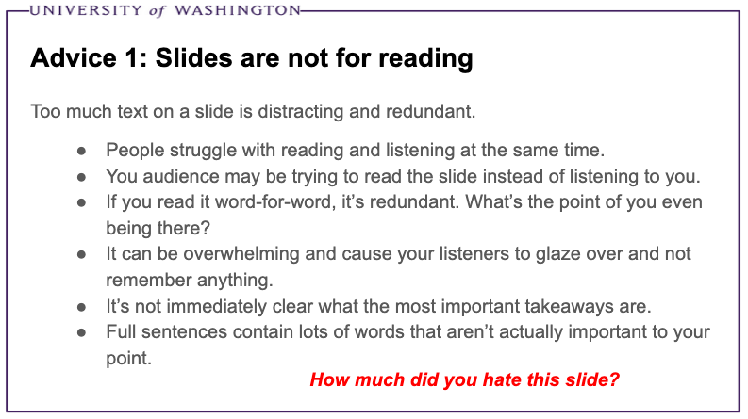

Advice 1: Slides are not for reading
Reading
Listening
= confusion + boredom

Slide 5

Advice 1: Slides are not for reading
Limit text on each slide
No full sentences
Illustrative images
Short bulleted lists if needed
Don’t read your slides!

Slide 6
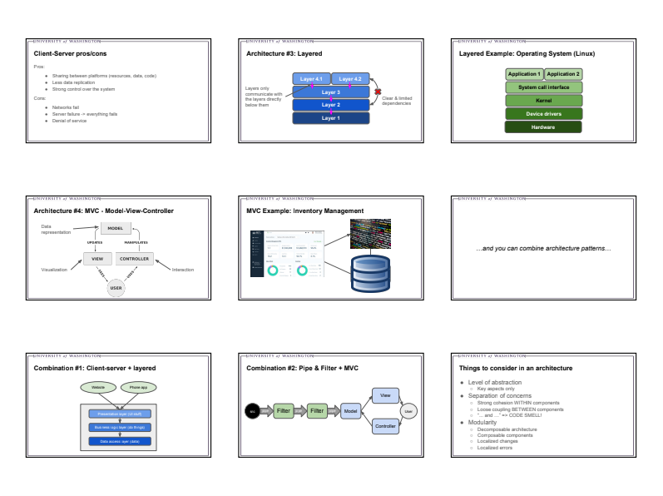
Advice 2 (1b): Slides are not for handouts

Slide 7


Advice 3: Styling your slides
Big fonts!
Illustrative images
A
N
I
M
A
T
I
O
N
S
Don’t be afraid of white space

Slide 8
Advice 4: Tell a story
Hook
Content
Context
Conclusion

Slide 9

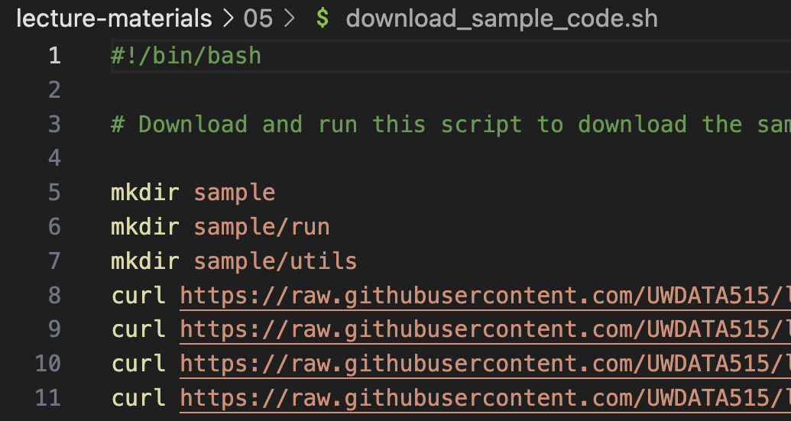
Advice 5: Prepare a script

Slide 10

Advice 6: Live demos
Show, don’t tell

Slide 11


Advice 7: Interactivity
Ask questions / involve the audience with interactive elements

Slide 12
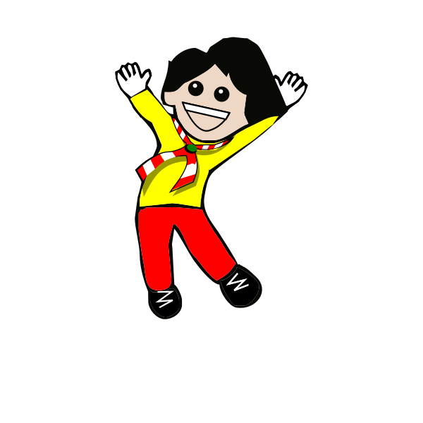



Advice 8: Practice
Enthusiasm
Your script
Timing
Eye contact
Record yourself

Slide 13
Your DATA 515 final presentations
10 minutes
Some of the “story” is already specified
Strive for
Timing
No walls of text
Scripted
Enthusiasm

