Slide 1
Software Design for Data Science
Advanced Packages
Melissa Winstanley
University of Washington
February 29, 2024

Slide 2
Distributing a Python package

Slide 3


Slide 4
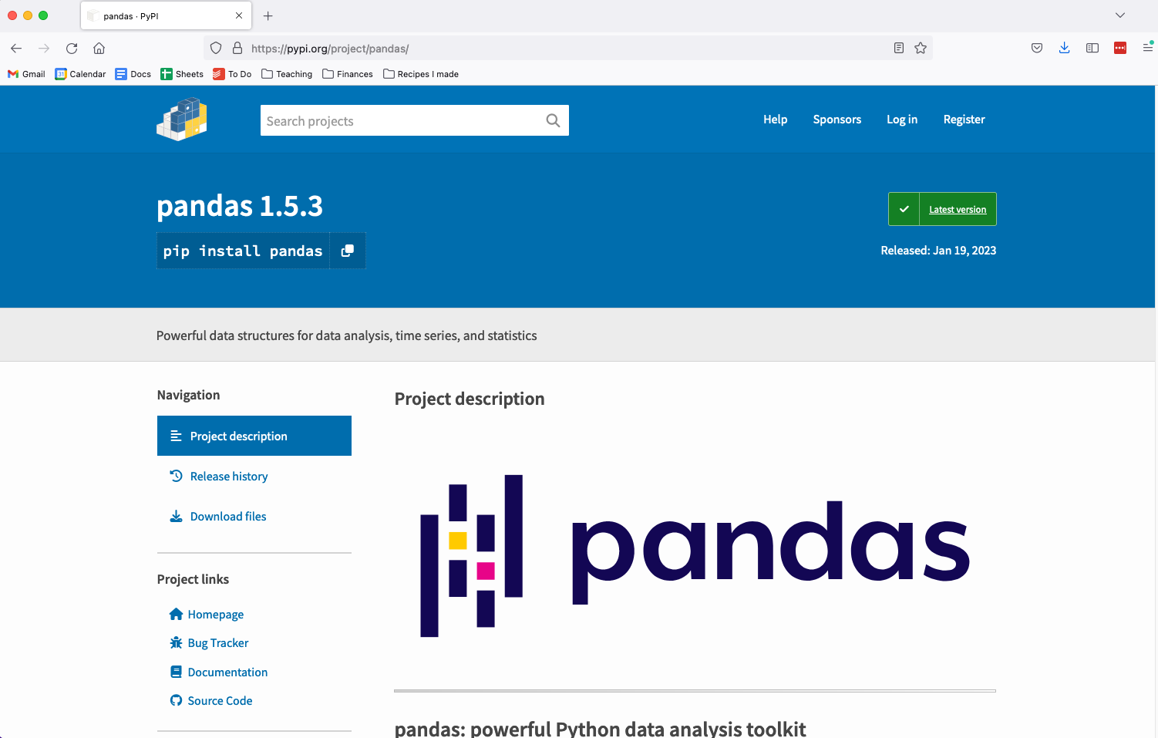
PyPI

Slide 5
Extending project structure for PyPI
myproject/
README.md
LICENSE
myproject/
__init__.py
pyproject.toml
core.py
subpackage/
submodule/
tests/
Contains metadata for the package for PyPI. This metadata is then piped to a package builder - often setuptools but there are others like hatchling
https://packaging.python.org/en/latest/tutorials/packaging-projects/

Slide 6
Extending project structure for PyPI
myproject/
README.md
LICENSE
myproject/
__init__.py
setup.py
requirements.txt
core.py
subpackage/
submodule/
tests/
Contains absolute dependencies, especially useful if you’re publishing an application.
Can be generated using:
conda list --export > requirements.txt
OR
pip freeze > requirements.txt

Slide 7
Extending project structure for PyPI
myproject/
README.md
LICENSE
myproject/
__init__.py
setup.py
requirements.txt
MANIFEST.in
core.py
subpackage/
submodule/
tests/
Specify data and files that should also be packaged in addition to the Python modules

Slide 8
Example pyproject.toml
https://github.com/UWDATA515/ci_example/blob/main/pyproject.toml

Slide 9
More examples
Check out existing Python packages. These may be more complicated:
https://github.com/numpy/numpy
https://github.com/pandas-dev/pandas

Slide 10
Submitting your package to PyPI
Update your code and version number. Run your test suites and ensure your code works as intended. Create a PyPI account if you don’t have one already
Create your source, and if desired, binary distribution:
$ python setup.py bdist_egg upload [options]
$ python setup.py bdist_wininst [options]
$ python setup.py sdist [options]
Install twine package to submit builds to PyPI.
(Can install using conda install twine, pip install twine, etc.)
$ twine upload dist/*
NOT REQUIRED!

Slide 11
Exercise: Set up your project’s pyproject.toml file
https://setuptools.pypa.io/en/latest/userguide/index.html

