Slide 1
Software Design for Data Science
Virtual Environments
Melissa Winstanley
University of Washington
February 29, 2024

Slide 2
Class Updates
Next week: Practice Presentations
Similar to your first demo - low stress
You should ALSO have a first draft of your presentation
Definitely does not need to be complete, but we want to see the beginning
This is also your time to have any last minute discussions with instructors

Slide 3
Project Requirements: stuff we’ve learned
Just to reiterate: you must include the following in your projects.
Tests
High test coverage (>85% minimum)
High coverage is not sufficient - make sure you write good tests
README
Updated!
Inline documentation (docstrings)
For functions/modules
examples folder
How do various users interact with your system?
How do we (the instructors) run the code and tests?
Style: pylint 100%
Today
Virtual environment
pyproject.toml or setup.py
Continuous integration & badges

Slide 4
Melissa’s Office Hours
Monday, Zoom, 4:30-5:30
Once again, if you can’t attend but want some assistance, please let us know and we’ll find a time

Slide 5
To today’s material…

Slide 6
The problem
Melissa is working on a project.
Melissa installs scikit-learn to use in the project.
Melissa writes great tests, which pass!
Melissa publishes her project to PyPI.
Yash wants to contribute to the GitHub repository
Yash clones the repository
Nothing works for Yash because he hasn’t installed scikit-learn (or any other packages required by the project)!

Slide 7
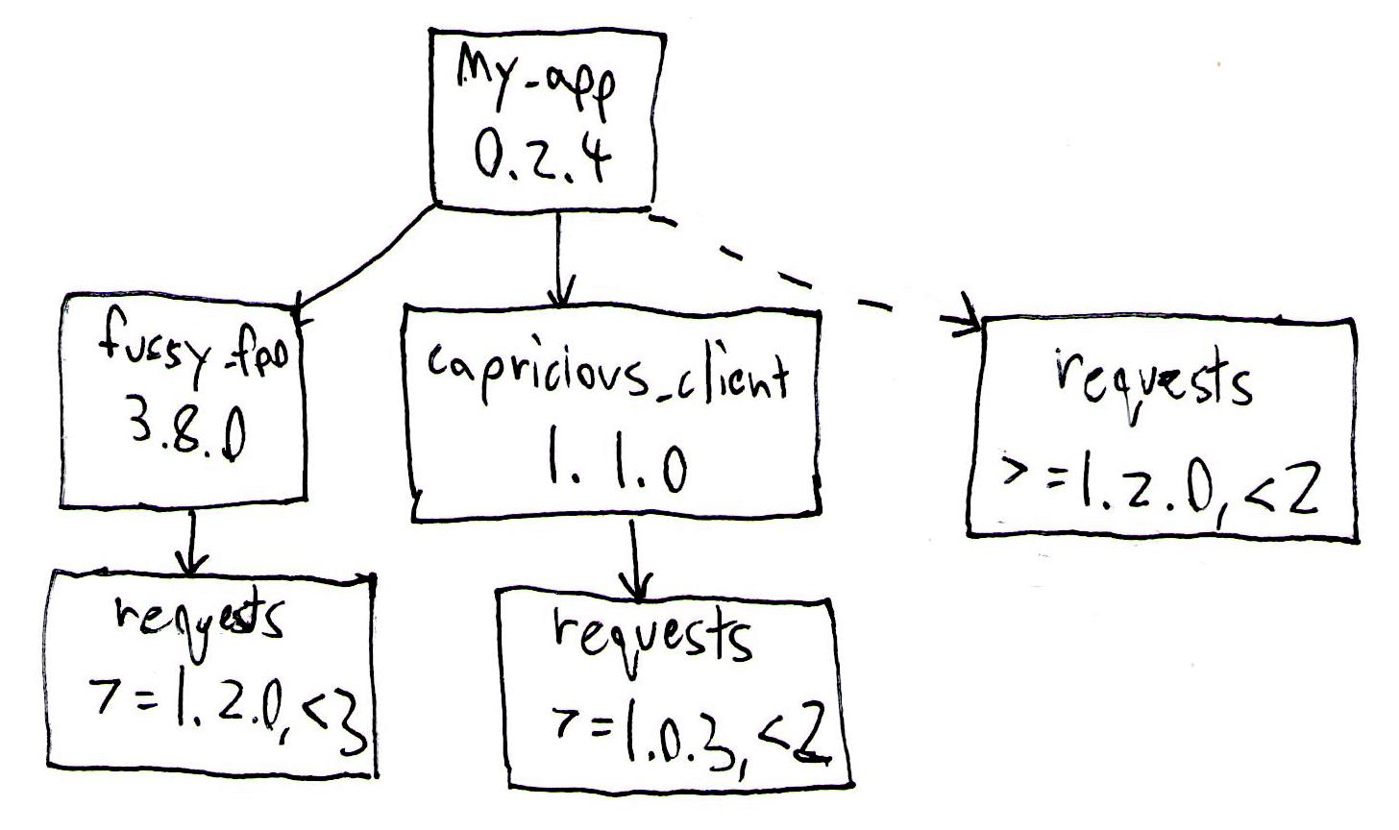
The problem: dependency hell
Dependency chains (A depends on B depends on C …)
Conflicting dependencies
Circular dependencies (A depends on B depends on A)

Slide 8
The problem, continued
Yash and Melissa may be using different systems
Mac
Windows
Yash and Melissa may have different versions of Python
Yash and Melissa may have different Python packages installed
We need a way so that the code will always work for both Yash and Melissa
And for anyone else who wants to use the package!

Slide 9

Abstraction
Hiding the details of the implementation (ie the infrastructure)

Slide 10
Abstraction for Melissa & Yash
We want to hide away the details of the underlying system and make it so that when Melissa & Yash work on the project, they see the same things:
The same Python version
The same packages
The same package versions
etc

Slide 11
Virtualization
The act of creating a virtual (rather than actual) version of something at the same abstraction level, such as an environment, process, operating system, or hardware.

Slide 12

Virtualization example
Hardware, eg VirtualBox

Slide 13
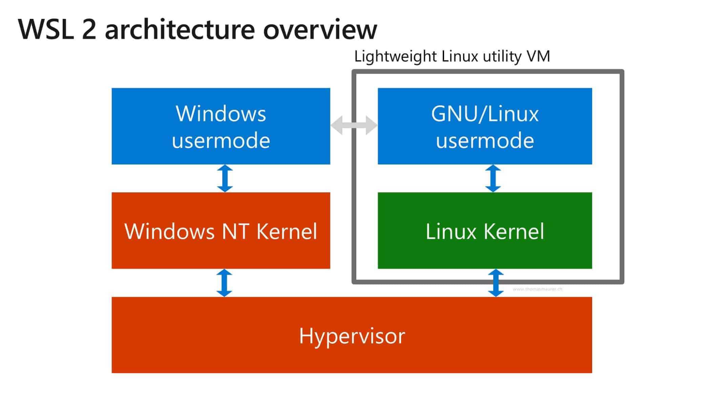
Virtual Machines - WSL

Slide 14
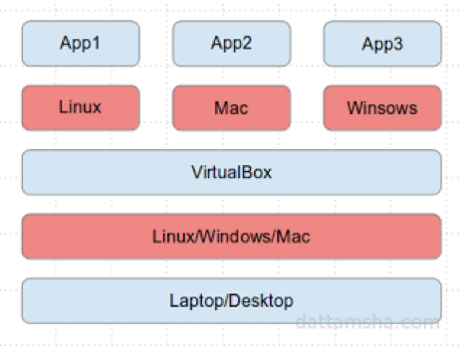
Virtual Machines - VirtualBox
https://www.virtualbox.org
Open source, free, and just works
Uses processor level virtualization instructions to operate guest operating system
Choose the right guest type
Allocate enough resources
Always install guest additions

Slide 15
Virtual Machines - EC2
Start with a base operating system image
Install software you want
Create any data volumes, etc. you want
Halt the instance
Make an Amazon Machine Image
Publish
Pay for S3 storage, use a paid AMI model...

Slide 16
Virtualization of Python environments
For Melissa and Yash, we need to virtualize the environment
Python version
Package dependency versions
Separate your computer’s Python/packages from the project’s Python/packages
Multiple options
venv
virtualenv
conda

Slide 17
Conda Virtual Environments
conda create -n <name> <options>
Creates a new environment with the given name
conda activate <name>
“Activates” the environment (“switches into it”, like a git branch)
Anything you do now will affect only the current environment
Installing packages
Updating package versions
conda deactivate
“Deactivates” the environment (“switches off of it”, like switching back to git’s main branch)
conda remove --name <name> --all
Deletes the environment
conda info --envs
Lists all the environments that exist

Slide 18
Exercise: Create a Python Virtual Environment
Create a conda environment for SPECIFICALLY Python 3.8.15
Hint: use conda create
Hint: don’t forget to activate the environment!
Hint: check the options on the conda create command to see how to set Python version
Start up a Jupyter notebook and prove that it’s Python 3.8.15
Hint: remember that the new environment doesn’t have access to your global packages!
Hint: check out the platform module for how you might access the Python version

Slide 19
Python Virtual Environments
What just happened?
Your computer
Conda virtual environment
Python
Conda-
installed packages
Python
Conda-
installed packages
X

Slide 20
Sharing your virtual environment
conda env export > environment.yml
Encodes all of the Python and package information in your environment to environment.yml
Format is YAML, a human-readable data serialization language
conda env create -f environment.yml
Creates a new environment from a file, with all of its specified packages
conda env update -f environment.yml
Updates your environment to match the environment.yml file
Useful if your teammates are adding packages - do it after you pull
Useful to upgrade packages
Always commit the environment.yml file to the repository!

Slide 21
Exercise: Create an environment.yml file
For your Python 3.8.15 environment:
Create an environment.yml file:
conda env export > environment.yml
Delete the existing environment so that we can practice creating from yml:
conda deactivate
conda remove --name <name> --all
Recreate the environment from the yml file:
conda env create -f environment.yml
Prove that it works - start up your Jupyter notebook again.

Slide 22
Generated environment.yml
Name for the environment
name: py3815
channels:
- defaults
dependencies:
- anyio=3.5.0=py38hca03da5_0
- appnope=0.1.2=py38hca03da5_1001
- argon2-cffi=21.3.0=pyhd3eb1b0_0
- argon2-cffi-bindings=21.2.0=py38h1a28f6b_0
- asttokens=2.0.5=pyhd3eb1b0_0
- attrs=22.1.0=py38hca03da5_0
- babel=2.11.0=py38hca03da5_0
- backcall=0.2.0=pyhd3eb1b0_0
- beautifulsoup4=4.11.1=py38hca03da5_0
- bleach=4.1.0=pyhd3eb1b0_0
- brotlipy=0.7.0=py38h1a28f6b_1002
…
prefix: /Users/melissawinstanley/opt/miniconda3/envs/py3815
Where Conda can find packages (default location)
All the packages that conda has installed in this environment
This includes transitive dependencies (ie the packages that Jupyter depends on)
A LOT!!!!
Where Conda stores the environment on your system.
Not necessary for other people

Slide 23
Simpler environment.yml
name: py3815
channels:
- defaults
dependencies:
- jupyter=1.0.0
- notebook=6.5.2
- python=3.8.15
No prefix
Only explicitly needed dependencies
What does this number mean?

Slide 24
Semantic Package Versioning
Extra stuff
Extra info about release or build (eg for specifying “pre-release” or beta release)
Also known as “semver”
6.5.2
NOT ALL PACKAGES ADHERE TO THIS THOUGH! Do your research.
Major version number
This changes when the package has
BREAKING CHANGES
Minor version number
This changes when the package has new backwards-compatible features
Patch version number
This changes when the package has bug fixes

Slide 25
What I would probably do
name: py3815
channels:
- defaults
dependencies:
- jupyter=1
- notebook=6
- python=3.8
These two packages adhere to semantic versioning.
This way I automatically get any new versions just by doing
conda env update
Python doesn’t adhere to semantic versioning
You don’t HAVE to do it this way - use more specific package versions if you like!
You can also omit package versions (everything after the “=”), although it’s less safe.

Slide 26
What about pip?
If you use pip to manage packages:
environment.yml => requirements.txt
Looks similar!
Can create from the environment in a similar way
pip freeze > requirements.txt
Can reinstall all the requirements into the current environment
pip install -r requirements.txt
This does NOT create a new environment
You can combine environment.yml (for the environment) with requirements.txt (for managing packages with pip) if you like

Slide 27
Adding pip to environment.yml
name: py3815
channels:
- defaults
dependencies:
- jupyter=1
- notebook=6
- python=3.8
- pip
- pip:
- matplotlib
- pandas
Add pip dependencies by adding a colon after another “pip”, then indenting an extra level, then adding the pip dependencies
Add pip as a dependency

Slide 28
Or with requirements.txt
name: py3815
channels:
- defaults
dependencies:
- jupyter=1
- notebook=6
- python=3.8
- pip
- pip:
- -r requirements.txt
Tell conda to load pip dependencies from requirements.txt

Slide 29
Exercise: Simplify your environment.yml
For your Python 3.8.15 environment:
Simplify your environment.yml file.
Remove any unnecessary packages.
Simplify the version numbers if you like.
Update your environment.
conda env update -f environment.yml
Prove that it works - start up your Jupyter notebook again.

Slide 30
What about other dependencies?
Conda environments are for Python & Python packages
If you need to download other tools or infrastructure, you’ll have to do that in a separate script or with a different version manager.

Slide 31
Exercise: create a virtual environment for your project
Create an environment for your team’s project.
Create an environment.yml file for the environment. Include any packages that you need to make your code work.
Commit, create a PR, and merge the change.
Make sure everyone on the team can create the environment from the file.
Include instructions for how to use the environment file in your documentation (README or somewhere in the docs folder).

