Slide 1
Software Design for Data Science
Function Interface Specification
Melissa Winstanley
University of Washington
January 23, 2025

Slide 2
Function Interfaces
What someone needs to know to use a function:
What does it do?
How do I call it?
What do I get it response?
What can go wrong?

Slide 3
Function Interfaces
What someone needs to know to use a function:
Name
Arguments
Return values
Side effects
Edge cases
Exceptions (next week!)
Examples (optional)

Slide 4
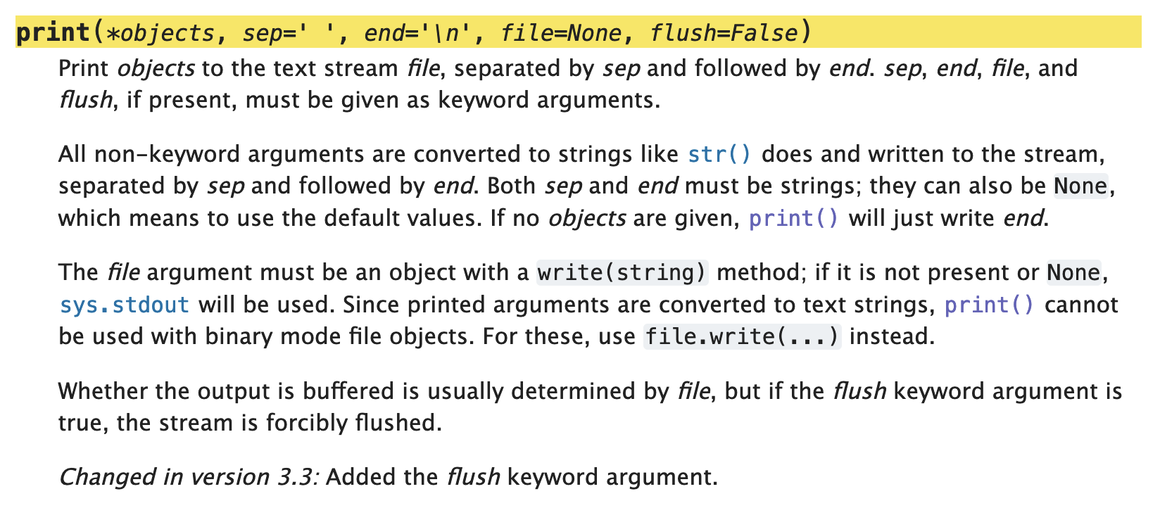
Function name
Duh
So someone can use the function

Slide 5
Arguments
Positional
Keyword
Default values
What it does with the arguments (what do they mean?)
Preconditions (assumptions)

Slide 6
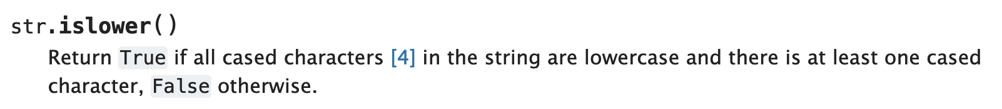
Return values
What it means
The type (boolean here)

Slide 7
Side effects
Printing something
Changing a mutable argument (lists, dictionaries, sets, etc)
Changing a global variable
File operations (creating/deleting/moving/etc)
Be specific!

Slide 8
Side effect example: print()

Slide 9
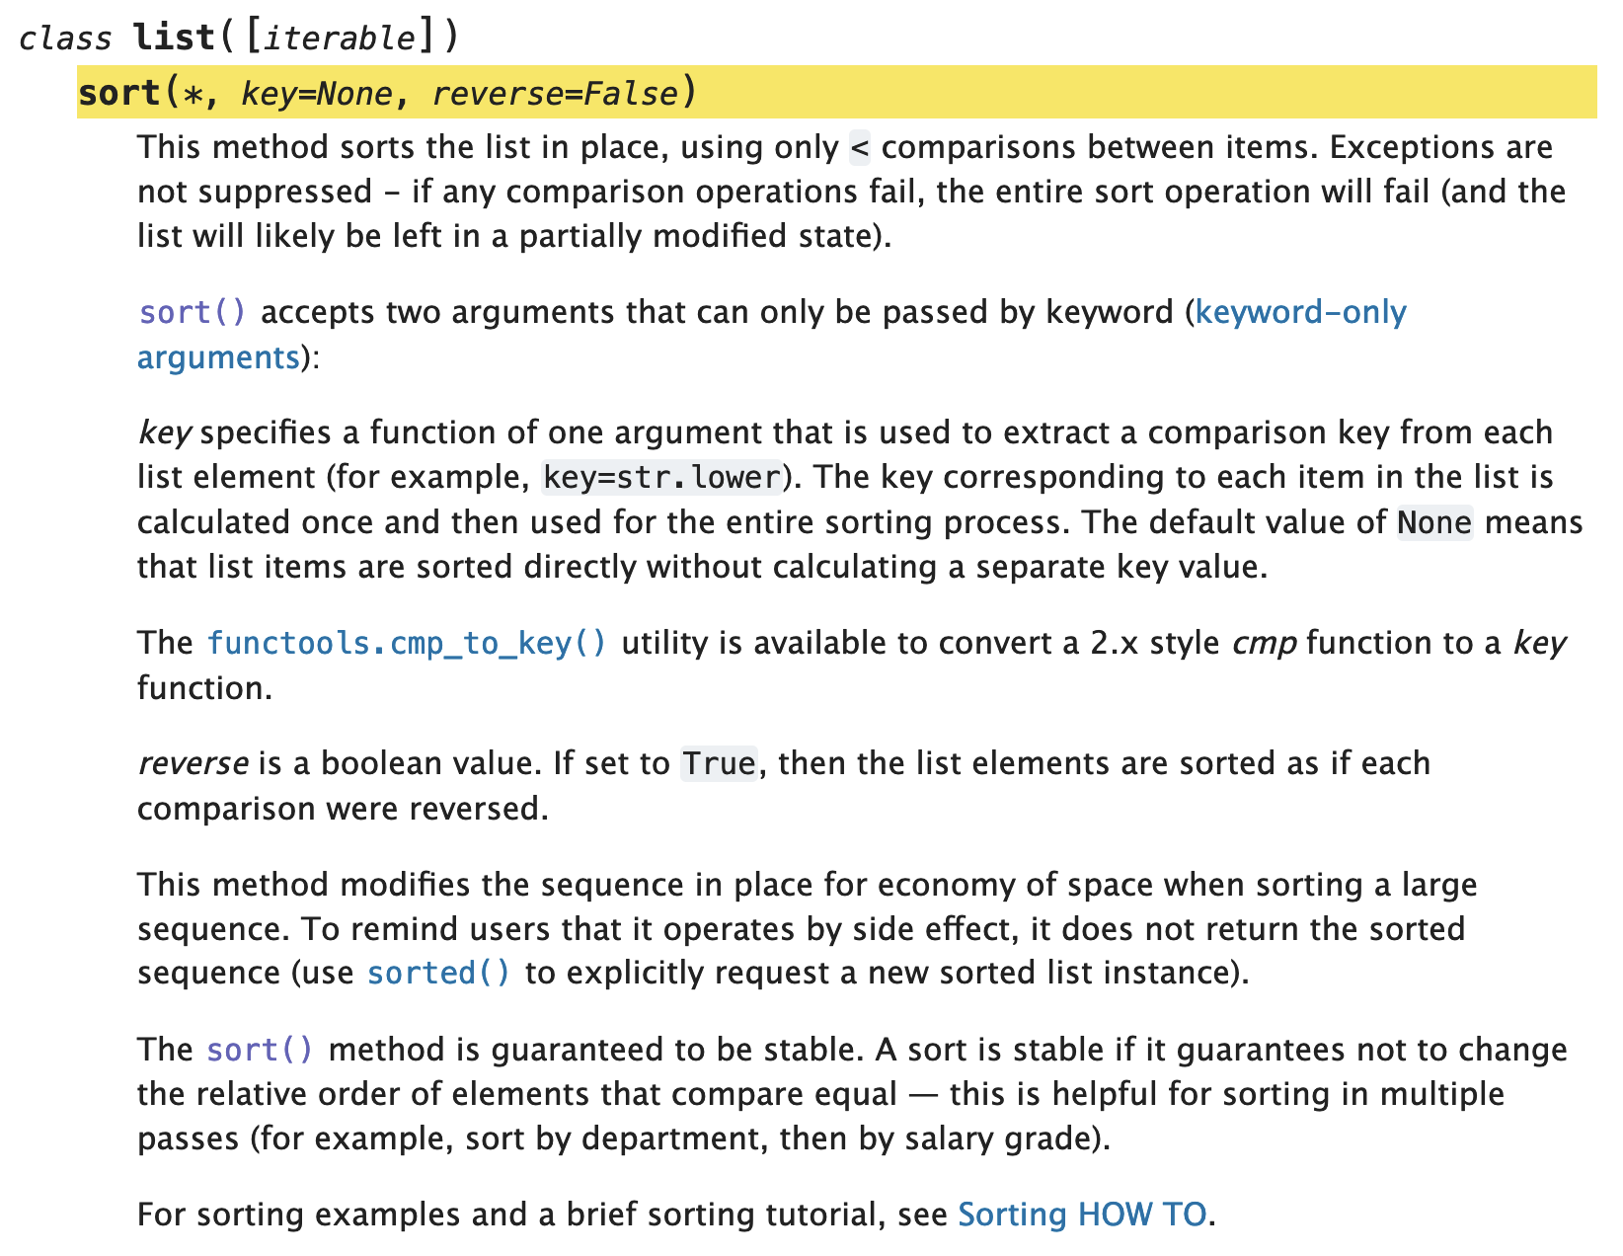
Side effect
example:
list.sort()

Slide 10
Edge cases
Things to watch out for

Slide 11
Edge case example: print()

Slide 12
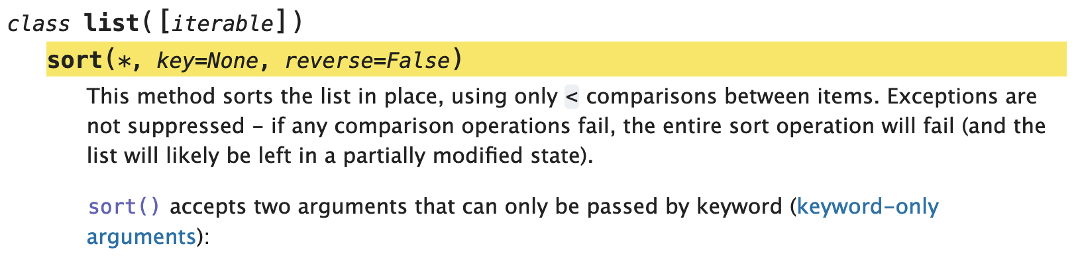
Exceptions
When preconditions aren’t satisfied (arguments are bad)
When something goes wrong, what happens?
… in a few weeks

Slide 13
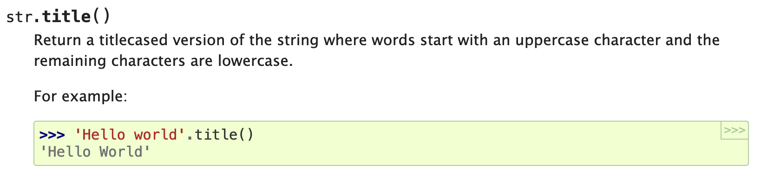
Examples
Help people understand how to use the function

Slide 14
Function Interfaces
What someone needs to know to use a function:
Name
Arguments
Return values
Side effects
Edge cases
Exceptions (next week!)
Examples (optional)

Slide 15
Why do we care?
Reading standard types of documentation
Reading homework instructions
Writing your own for projects
Collaboration - if you agree on function interfaces, you can start writing code that uses the interface even if it isn’t written yet!
Recommendation: start with the interfaces

