Slide 1
Software Design for Data Science
Project
Melissa Winstanley
University of Washington
January 23, 2025

Slide 2


Course Project
Collaborative software engineering experience
Teams of 3 to 4 with 4 being optimal
Develop project using version control

Slide 3
Course Project
Collaborative software engineering experience
Design (use cases, component specification)
Documentation (how to, docstrings)
Style (PEP8, pylint)
Coding, testing & milestones
Standup & code reviews

Slide 4
Project Type 1: Answer “Research” Questions
Problem statement: Answer two to three questions of business or scientific relevance
Use a Jupyter notebook and supporting python files
Example
Climate Police: Analyze effects of pollution on the planet.

Slide 5
Project Type 2: Create a Tool
Problem statement: Solve a problem common to many users
Don’t reinvent the wheel
Example
BioReactor Data Logging – Monitor and publish data from BioReactor experiments

Slide 6
Project Type 3: Teach Analysis
Problem statement: Create a system that teaches others the skills needed to do analysis
Example:
A system that teaches about logistics for businesses in the sharing economy

Slide 7
Project Type 4: Present Data
Problem statement: Create data repository with tools (e.g., search, visualization, analytics) and a user-friendly interface
Example
Car2Know: Provide car rental data to users of Car2Go (e.g., for planning trips)

Slide 8
More on the Data
At least two non-trivial data sets
Data need to be combined, joined, merged, etc. to answer the scientific questions
Have access to the data NOW!

Slide 9
Project Timeline
Week 5
Week 5-6
Week 6
Week 7-8
Week 7-10
Finals
Project Proposals & Team Selection
Idea validation
Software &
Use Case Design
(in class)
Technology Review
Ongoing project work & consultations
Presentations

Slide 10
Week 5: Project Proposals
Share what you’re passionate about and convince others to work with you:
1 slide (PowerPoint, Keynote, or Google Slides)
Title
Project type (research, reusable data, tool)
Short pitch - what will you do, why it is cool
Your 2+ data sources (could be tentative)
Your name
Due by 12pm Thursday 2/6 via Canvas (I need time to compile the deck!)
In-class presentation of your proposal (2 minutes)
Participation points! If you are unable to attend, please let me know.

Slide 11
Week 5: Team Selection
During project proposals:
Take notes on what projects sound interesting to you
After project proposals:
You’ll have time in class to talk to each other and form teams around a project proposal
3-4 people per team - 1 person submits names via Canvas
If you’d prefer, I’m happy to help find a group for you, particularly if your team has just 1-2 people
If you have to miss class
Let me know
I will help you find a project team

Slide 12
Week 5-6: Idea Validation
Agree as a team on what the project is
Clarity about the project type
Consensus on the problem being solved
Validate that the project is feasible and large enough
Is there an unmet need (i.e. no code already exists)?
Do you have data that can solve the problem?
Will this project take about 5-6 weeks of effort for 3-4 people to complete?
Create a git repository for your team
README.md with result of the idea validation
One person submits the repository link via Canvas

Slide 13
Week 6-7: Software & Use Case Design (in class)
In-class exercise to design your project:
Who are the users? What do they know?
What information do users want from the system?
Use cases - how users interact with the system
After class: complete and submit the design in your GitHub repository by 2/15

Slide 14
Week 7-8: Technology Reviews
Writeup addressing a choice of library; in-class presentation to instructors as part of the first project demo in week 8.
Stay tuned!

Slide 15
Week 7-10: Project Work
Weekly standups in class
Collaboration outside of class - code reviews & pull requests
Deliver on the milestones you’ve defined
Functionality
Documentation
Style
Testing

Slide 16
Finals: Presentations
10 minute oral presentations
All group members should present a part
Background
Data
Use cases
Component design
Demo
Lessons learned
Slides + demo

Slide 17
Grading
On the course webpage*: https://uwdata515.github.io/projects.html
Organization: 10%
Can you follow directions?
Code quality: 32%
Test coverage, style, CI, package setup, PRs/code reviews
Documentation: 24%
README, design documents, examples & instructions
Design: 20%
What you built, test design, module design
Presentations: 14%
Technology review, final presentation
*exact percentages may change slightly but will remain approximately as described

Slide 18
Some Public Data
http://drugbank.ca
http://toxnet.nlm.nih.gov
https://data.seattle.gov/Transportation/Traffic-Flow-Counts/7svg-ds5z
https://www.divvybikes.com/data
http://www.nyc.gov/html/tlc/html/about/trip_record_data.shtml
https://www.kaggle.com
Pronto bike data
American Fact Finder Data
European union data (World bank)
Russian federation data (World bank)
China data (World bank)

Slide 19
Project Proposal Examples
Just to get your mind working

Slide 20


Weather Wizard for Farmers
Project output: reusable data (a simple web app)
Give it your location (zip code?)
Use a machine learning model to predict future temperature and precipitation for your zip code
It will predict your last frost and whether it will be a warmer/cooler or wetter/dryer year
It will predict which crops you (the farmer) should plant to make the most money
Data
NOAA data
Historical weather (temperature/precipitation) by location
El Niño/Southern Oscillation history
Atlantic/Pacific Multidecadal Oscillation history
Solar Cycle history
USDA data
State agricultural output data by crop
Melissa Winstanley

Slide 21
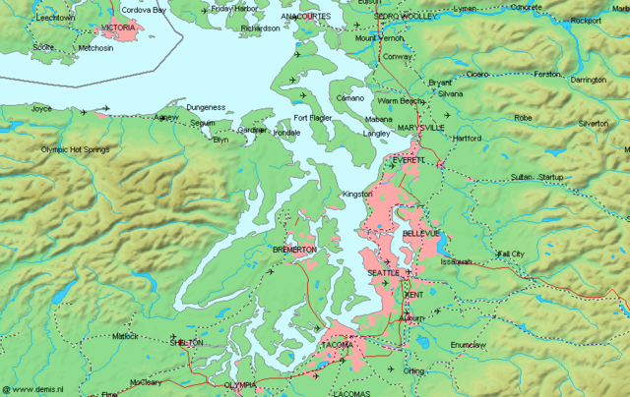
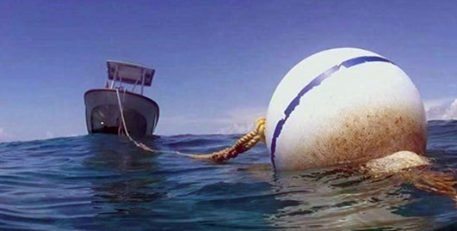
Tide Me Over!
Project output: research & a tool (to make map visualizations)
Research how tides affect water changes in Puget Sound via mooring buoy
Depth, oxygen, chlorophyll, and salinity
Build map visualizations with a time slider to show the changes
Include a search feature to narrow in on a particular location
Data
NOAA historical tide data
King County mooring buoy data
Melissa Winstanley

Slide 22

Fantastical Basketball*
Project output: reusable data (a simple web app)
Give today’s best fantasy lineup for the NBA
Daily/weekly/whole season
Option to select best=points or best=money
Show how the tool has performed for the previous week’s worth of games, relative to existing fantasy players
Data
NBA historical data from basketball-reference.com (or NBA site)
Day-by-day projection data from fantasydata.com (or other fantasy site)
* This is a VERY HARD PROBLEM. The output of the project is not a predictor that does better than existing players, but one that at least is not terrible.
Melissa Winstanley

