Slide 1
Software Design for Data Science
Style & Documentation
Melissa Winstanley
University of Washington
January 3, 2023

Slide 2



UWSEDS
Knowledge and solutions for a changing world
Advancing data-intensive discovery in all fields
Be boundless
Documentation and programming style
Dave “they call me Stylish” Beck
eScience Institute: putting the e’s back in Science.

Slide 3
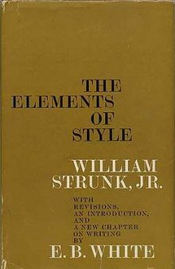
Elements of Style
AKA Strunk & White
1918 (Strunk), 1959
Doesn’t describe how to write in English
Describes how to write effectively in English
Writing is understandable and efficient

Slide 4
Elements of Style
AKA Strunk & White
“Vigorous writing is concise. A sentence should contain no unnecessary words, a paragraph no unnecessary sentences, for the same reason that a drawing should have no unnecessary lines and a machine no unnecessary parts. This requires not that the writer make all his sentences short, or that he avoid all detail and treat his subjects only in outline, but that he make every word tell.”

Slide 5
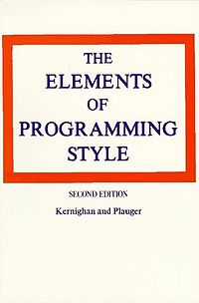
Elements of Programming Style
1974
Doesn’t describe how to write programs
Describes how to write efficient programs that can be read by computers and people
Why is it important that people can read your code?

Slide 6
Programming Style
Why is it important that people can read your code? (SURF)
Sustainable
New version of Python (4.X)
Understandable
Is it doing what you claim?
Reusable
Can it be incorporated into a larger project?
Fixable

Slide 7
Style
It doesn’t change how the code works
It makes the code a lot more approachable for the next person

Slide 8
Programming Style
Like debugging
Programming style is an important part of professional software development
Life changing experience and habit forming
Converts your code from hackish one-offs to reusable gems of useful intellectual property

Slide 9
Programming Style
Most important rule of any style
Consistency
If you make a particular decision about a style guide, use it consistently
Always
Forever

Slide 10
Python Style
There isn’t only one ‘style’
Most common: PEP8
Python Enhancement Proposal #8
https://www.python.org/dev/peps/pep-0008/
Google Python Style Guide
Python is the main dynamic language used at Google. This style guide is a list of dos and don’ts for Python programs.
“More complete” PEP8
https://google.github.io/styleguide/pyguide.html

Slide 11
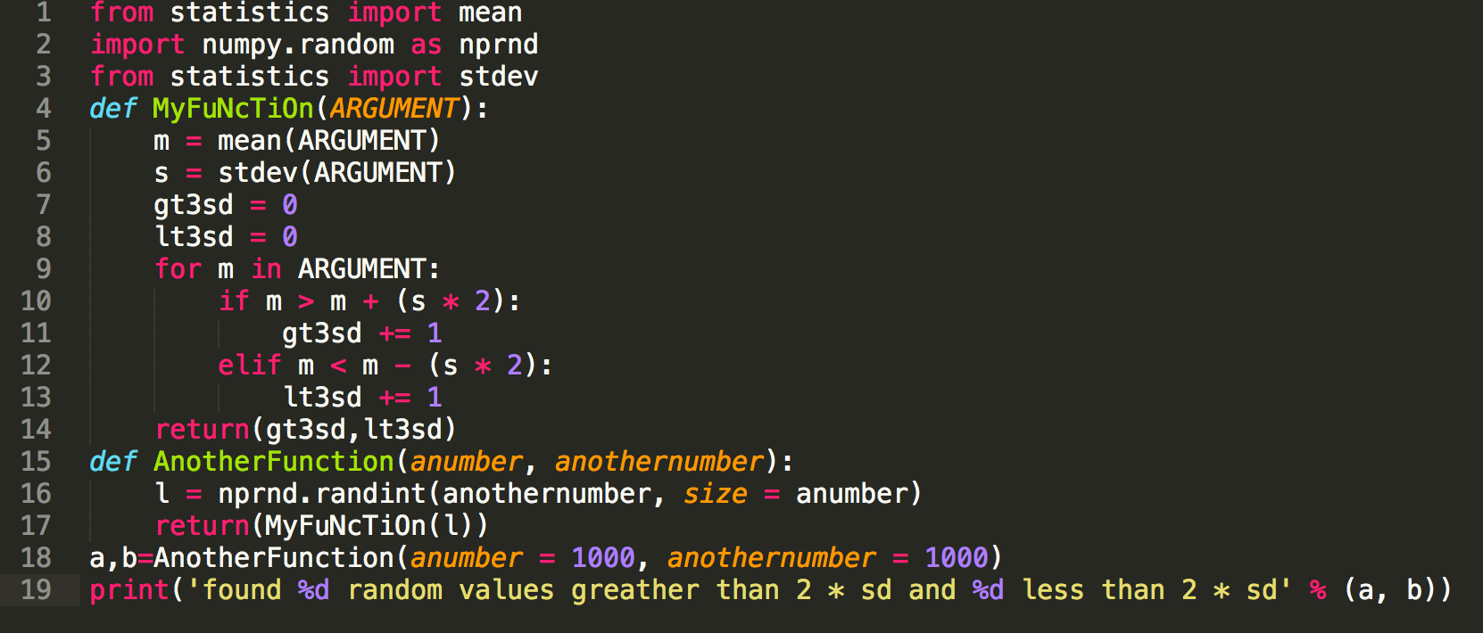
Put some color in your style
Tools for checking the style adherence
Many editors allow you to color your code
Sublime, Atom, vim, Visual Studio Code
Turn this ON if it isn’t already!

Slide 12
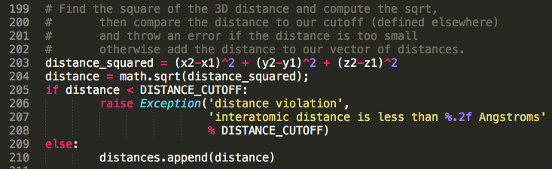
No, sorry! Those colors just don’t work together.
Play with the colors a bit…
What does your brain do when you see something like below?

Slide 13

No, sorry! Those colors just don’t work together.
Play with the colors a bit…
Your colors should never be set so that code comments are “diminished in value”
No one values my code comments.
I’m sad.

Slide 14
Tools for style checking
Tools for checking the style adherence
Simplest is pycodestyle
Formerly known as pep8
conda install pycodestyle
Also see flake8
As above with additional code checks, e.g. are imports made or variables defined that aren’t used
conda install flake8

Slide 15
Checking yourself out in the mirror
Another tool…
pylint ( http://www.pylint.org )
Extends from a tool called lint introduced for C from Bell Labs in 1976
http://citeseerx.ist.psu.edu/viewdoc/summary?doi=10.1.1.56.1841
conda install pylint

Slide 16
Getting’ some style
How to use them? Replace pylint with tool…
pylint <filename.py>
e.g. python_demo_1.py
pylint <directory with .py files>
e.g. python dssg_package

Slide 17
Ask a friend?
Other ways to check your style:
Many editors support real time style checking!
Visual Studio Code
Atom
Most default Jupyter notebook setups do not offer style checking
Know and use style until it becomes muscle memory!

Slide 18
Let’s play!
Clone the demo repository
git clone git@github.com:uwescience/programming_style_documentation.git
Enter the repository directory
cd programming_style_documentation
Try one of the style tools, e.g.
pylint python_demo_1.py
Don’t try to improve it yet!

Slide 19
This slide intentionally left blank

Slide 20
The core pieces of style
Spacing/indentation
Line length
Imports
Code constructions
Naming
Comments/documentation

Slide 21
PEP8
Indentation
Python uses “whitespace” in its syntax
Four spaces
Most editors can be set to convert a tab that you type to four spaces in the file
What about lines that wrap? Two options…
Wrap and indent to opening of parens
Hanging indent (put nothing after parens and indent only once)

Slide 22
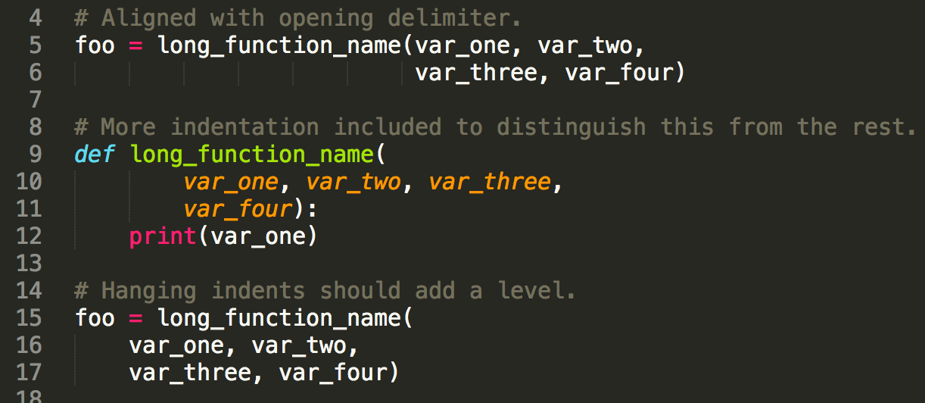
PEP8
Indentation

Slide 23
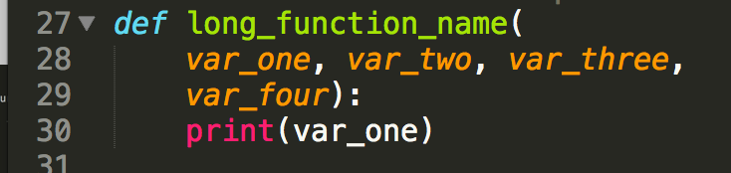

PEP8
Indentation

Slide 24
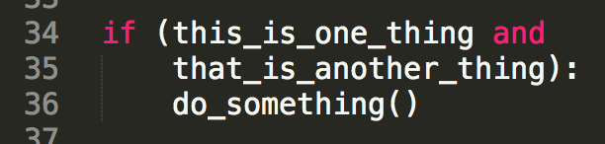
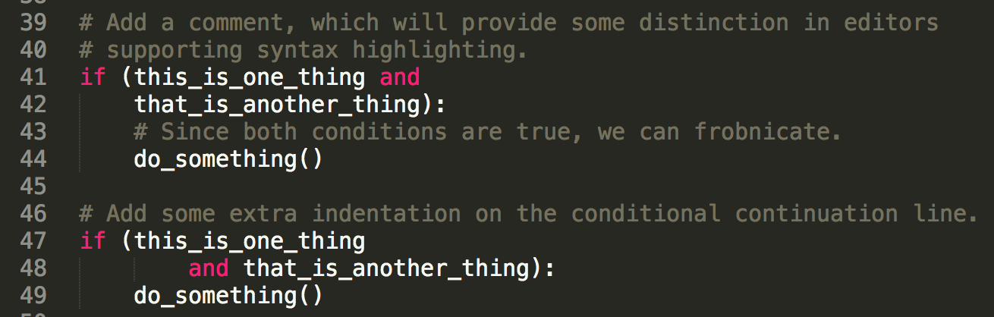
PEP8
Indentation

Slide 25
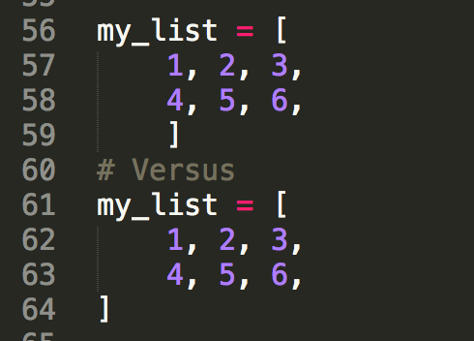
PEP8
Indentation
Equivalent, no specific recommendation

Slide 26
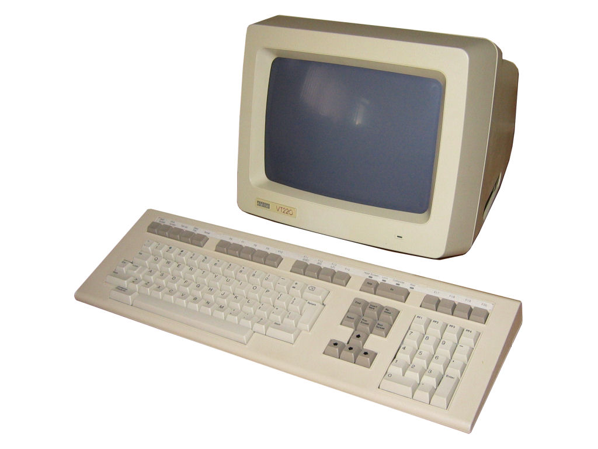
PEP8
Maximum line length?
Coding lines? Keep it to 79 characters
Most editors can show you the line position
E.g. vim, Sublime
Comments & doc strings?
72 characters
Why? My monitor is big!
Open two files side by side? History?
Some teams choose to use a different max
Python core library is 79/72

Slide 27
PEP8
Line spacing
Two blank lines around top-level functions
Two blank lines around classes
One blank line between functions in a class
One blank line between logical groups in a function (sparingly)
Extra blank lines between groups of groups of related functions (why are they in the same file?)

Slide 28
PEP8
Line spacing
Two blank lines around top-level functions
Two blank lines around classes
One blank line between functions in a class
One blank line between logical groups in a function (sparingly)
Extra blank lines between groups of groups of related functions (why are they in the same file?)

Slide 29
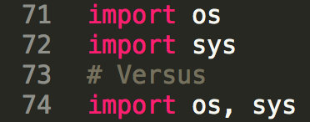
PEP8
Imports
Imports go at the top of a file after any comments
Imports for separate libraries go on separate lines

Slide 30
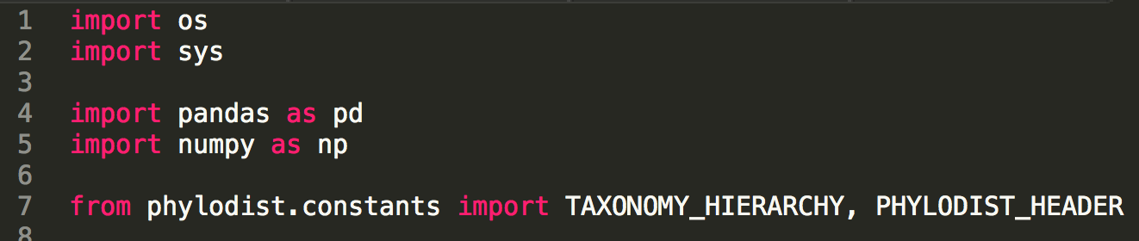
PEP8
Imports
Imports should be grouped with a blank line separating each group in the following order:
Standard library imports
os, sys, …
Related third party imports
matplotlib, seaborn, numpy, etc...
Local application / library specific imports
knn_utils

Slide 31
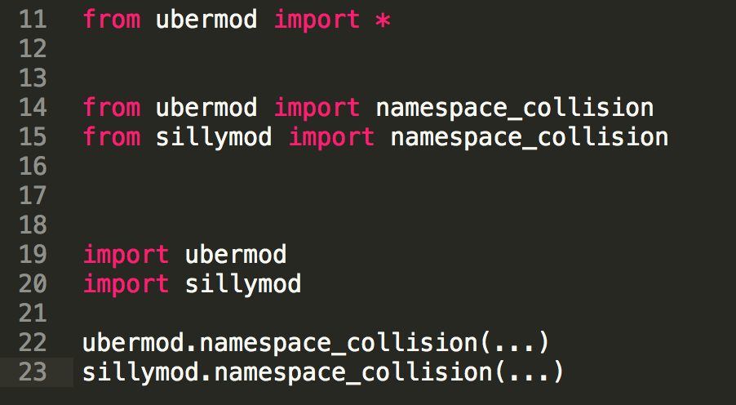
PEP8
Imports
Avoid wildcard imports
Be explicit about namespaces when necessary

Slide 32
PEP8
Quotes
When should I use single?
When should I use double?

Slide 33
PEP8
Quotes
PEP8 has no recommendation about single vs. double
Except for triple quotes strings, use double
Multiline strings, docstrings, etc.

Slide 34


PEP8
Whitespace
No trailing spaces at end of a line
Do not pad ( [ { with spaces, e.g.
Do not pad before : ; , , e.g.
What else is wrong with the above?

Slide 35
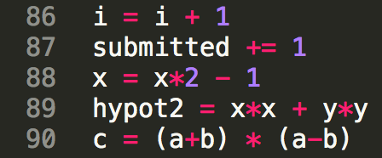
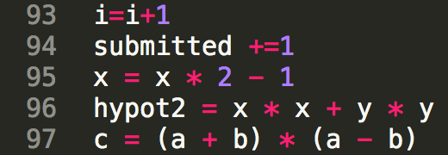
PEP8
Whitespace
Always surround =, +=, -=, == , < , > , != , <> , <= , >= , in , not in , is , is not, and, or, not with a single space
Having fun yet?

Slide 36
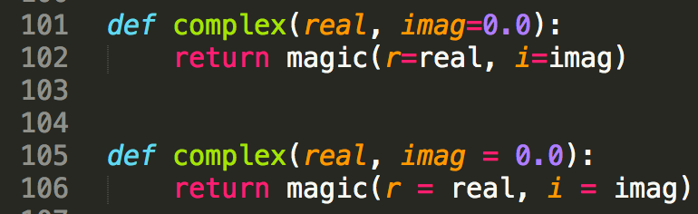
PEP8
Whitespace
Never surround = with a space as a function parameter argument
Really having fun yet?

Slide 37
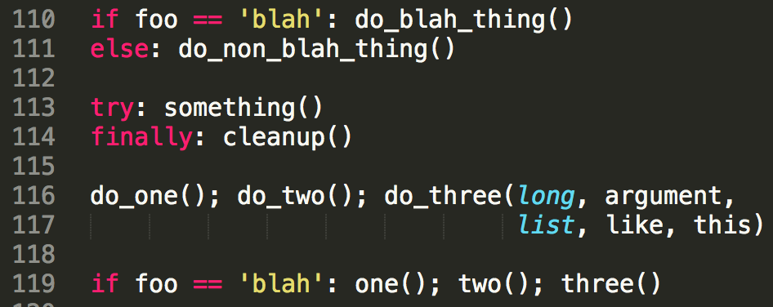
PEP8
Compound statements
Rather not

Slide 38
Remember this mess?

Slide 39
PEP8 play time, part 2!
Run pylint on the Python file in the repository,
e.g. pylint python_demo_1.py
Can you use nano or another editor to get it to at least 8/10? You can ignore documentation-related issues for now

Slide 40
Elements of Programming Style
1974
Fortran & PL/1¹
Most of the lessons are language free, e.g.
Replace repetitive expressions by calls to a common [f]unction.
Choose variable names that won't be confused.

Slide 41
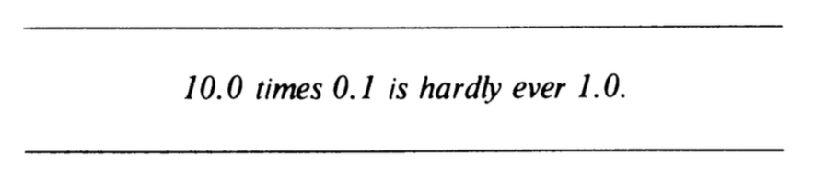
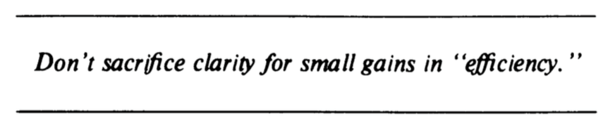
Elements of Programming Style
Also addresses
Software design
Common pitfalls, e.g.
Funny!

Slide 42
Elements of Programming Style
Choose variable names that won’t be confused.

Slide 43
PEP8
Naming conventions
How you name functions, classes, and variables can have a huge impact on readability

Slide 44
PEP8
Naming conventions
Avoid the following variable names:
Lower case L (l)
Upper case O (O)
Upper case I (I)
There are unacceptable, terrible, and awful. Why?
Can be confused with 1 and 0 in some fonts
Can be confused with each other (i.e. I and l)

Slide 45
PEP8
Naming conventions
Module names should be short, lowercase
Underscores are OK if it helps with readability
Package names should be short, lowercase
Underscores are frowned upon and people will speak disparagingly behind your back if you use them

Slide 46

PEP8
Naming conventions
Class names should be in CapWords
SoNamedBecauseItUsesCapsForFirstLetterInEachWord
Also known as CamelCase
Notice no underscore!
Much hate on the internet for
Camel_Case

Slide 47

PEP8
Naming conventions
What naming convention should I use for exceptions?
WHY?

Slide 48
PEP8
Naming conventions
Functions
Lowercase, with words separated by underscores as necessary to improve readability
mixedCase is permitted if that is the prevailing style (some legacy pieces of Python used this style)
Easy habit to fall into… Very common in style guides for other languages, e.g. R
If this is your thing, then be consistent

Slide 49
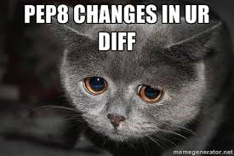
PEP8
Why be consistent from day 1?
https://goo.gl/o57K7g

Slide 50
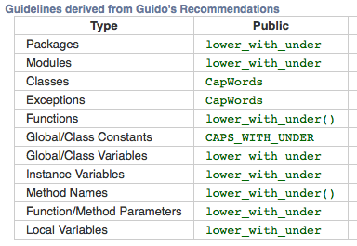
PEP8
Naming conventions
Functions

Slide 51
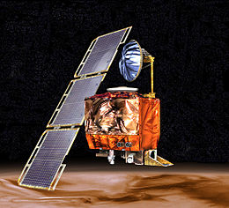
Programming Style
Functions
Where units matter, append them…
Variable names also
Things go wrong…
Mars Climate Orbiter
… on September 23, 1999, communication with the spacecraft was lost as the spacecraft went into orbital insertion, due to ground-based computer software which produced output in non-SI units of pound-seconds (lbf×s) instead of the metric units of newton-seconds (N×s) specified in the contract between NASA and Lockheed.
- Wikipedia
655.2 million dollar mistake!

Slide 52
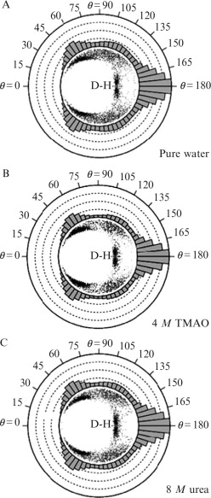

Programming Style
Functions
Where units matter, append them…
Why do you need to use different units?
Example from my work in
molecular mechanics

Slide 53
Programming Style
Functions
Some prefixes that can be used to clarify
compute
get/set
find
is/has/can
Use complement names for complement functions
get/set, add/remove, first/last
Reserve for functions that compute something sophisticated, e.g. not average
What kind of return value would you expect from a function with this kind of prefix?

Slide 54
PEP8
Naming conventions
Global variables
These shouldn’t be truly global, just global to a module’s namespace
Function variables
Function / method arguments
All the above use lower case with words separated by underscores

Slide 55
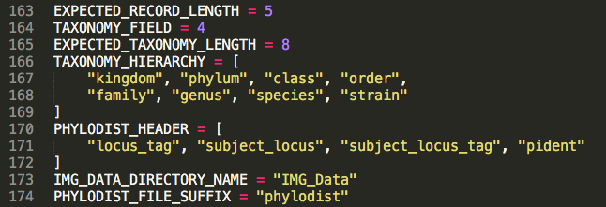
PEP8
Naming conventions
Constants
What is a constant?
Some examples of where you might use constants?
Python has no specific capability for making a variable constant; all variables are reassignable
To indicate a variable is a constant, use all CAPS, e.g.
6.0221409e+23 6.67408 × 10⁻¹¹ m³ kg⁻¹ s⁻²

Slide 56
PEP8
Naming conventions
Constants
Remember this ugly mess? What could be a constant?

Slide 57
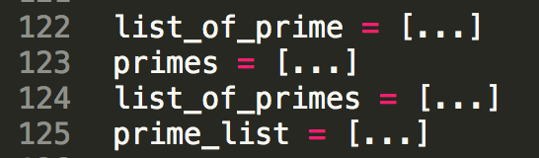
PEP8
Naming conventions
When naming functions and variables…
Be consistent about pluralization / type Ids
Which do you prefer and why?
Given your choice for the above, what would I name a variable that contained a collection of times? Users?

Slide 58
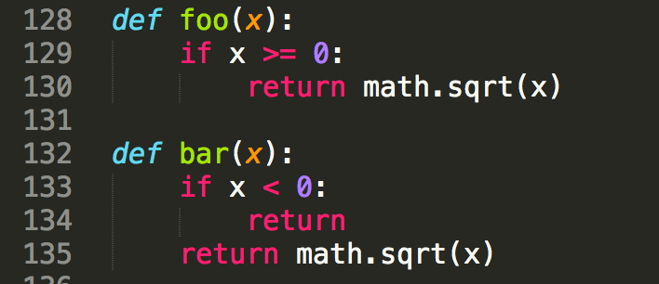
PEP8
There is a lot more detail in the PEP8 spec (on the syllabus)… E.g. Why is this not only bad style but potentially buggy?

Slide 59
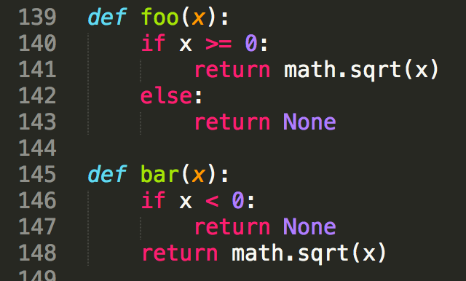
PEP8
Correct version

Slide 60


PEP8
Programming Recommendations
This section is highly recommended
https://www.python.org/dev/peps/pep-0008/#id46
E.g. Use ''.startswith() and ''.endswith() instead of string slicing to check for prefixes or suffixes.
E.g. For sequences, (strings, lists, tuples), use the fact that empty sequences are false.

Slide 61
Ignoring recommendations
Sometimes you disagree with a PEP8 recommendation
Or you made a very conscious choice to do it differently
You can tell pylint to ignore the issue with a comment on the line before:
# pylint: disable=consider-using-f-string

Slide 62
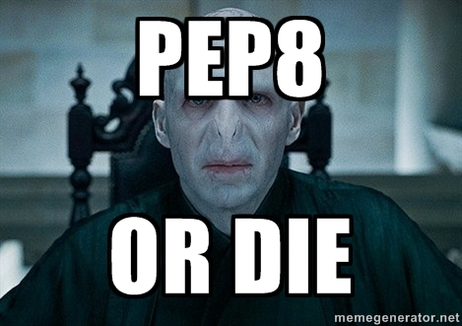
PEP8

Slide 63
PEP8
Consistency

Slide 64
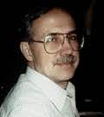
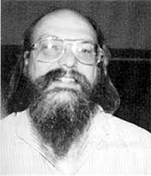
Documentation

Slide 65
Documentation
Two types
Code readers
What the code is doing and why
E.g.
Users
How to use your code
E.g.
Code comments
README.md

Slide 66
Documentation
.md
.md files are Markdown
Markdown is a lightweight text formatting language for producing mildly styled text
Ubiquitous (github.io, README.md, etc.)
E.g. Google markdown editor browser
http://dillinger.io

Slide 67
Documentation
What kind of stuff going in a repositories README.md?
https://github.com/kallisons/NOAH_LSM_Mussel_v2.0

Slide 68
Documentation
Comments
Shell script
#
Python
#

Slide 69
Documentation
Some examples of bad comments (from the ‘net)
%
% For the brave souls who get this far: You are the chosen ones,
% the valiant knights of programming who toil away, without rest,
% fixing our most awful code. To you, true saviors, kings of men,
% I say this: never gonna give you up, never gonna let you down,
% never gonna run around and desert you. Never gonna make you cry,
% never gonna say goodbye. Never gonna tell a lie and hurt you.
%
% drunk, fix later
%
% Dear maintainer:
%
% Once you are done trying to 'optimize' this routine,
% and have realized what a terrible mistake that was,
% please increment the following counter as a warning
% to the next guy:
%
% total_hours_wasted_here = 42
%
true = false;
% Happy debugging suckers
http://stackoverflow.com/questions/184618/what-is-the-best-comment-in-source-code-you-have-ever-encountered
Don’t Rick Roll your readers!
Uhm… Sigh.
Funny is funny, but don’t troll.
And what was the issue the writer encountered!
At least it is logical

Slide 70
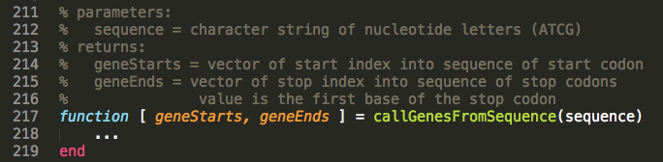
Documentation
Good comments
Make the comments easy to read
Write the comments in English
Discuss the function parameters and results

Slide 71
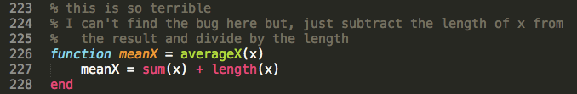
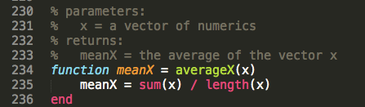
Documentation
Good comments
Don’t comment bad code, rewrite it!
Then comment it

Slide 72
Documentation
Good comments
Some languages have special function headers

Slide 73
Documentation
Good comments
Some languages have special function headers
This example is fantastic!
It describes
Calling synopsis (example usage)
The input parameters
The output variables
Aimed at coders and users

Slide 74
Documentation
Good comments
Some languages have special function headers
These comments should also describe side effects
Any global variables that might be altered
Plots that are generated
Output that is puked

Slide 75
Documentation / PEP8
Good comments
Inline comments
Comments inline with the code
Generally unnecessary (as above)
Inhibit readability

Slide 76

Documentation
Good comments
Wrong comments are bugs
When updating code, don’t forget to update the comments

Slide 77
Documentation
Good comments
Don’t insult the reader
If they are reading your code… they aren’t that dumb
Corollary: don’t comment every line!

Slide 78
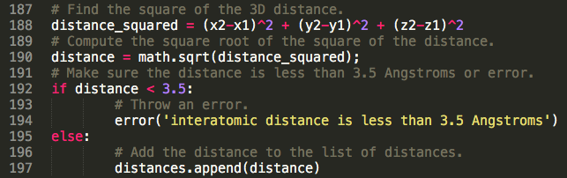
Documentation
Good comments
Don’t comment every line!

Slide 79
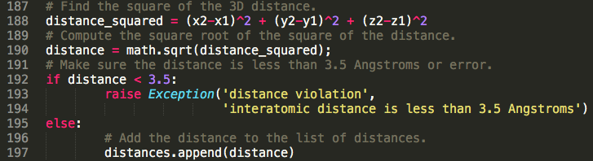
Documentation
Good comments
Problems with this code (other than excessive comments?)
Notes:
Use a constant for the value 3.5

Slide 80
Documentation
Good comments
Problems with this code (other than excessive comments?)
What happens if I want to change the cutoff distance
I have to change the code (in 2 places)
I have to change the comment

Slide 81
Documentation
Good comments
Note how the block is commented
The code itself reads clearly enough
We used an obviously marked constant whose value is displayed if an error is encountered

Slide 82

Documentation / PEP8
Good comments
Comments should be sentences. They should end with a period. There should be a space between the # and the first word of a comment.
You should use two spaces after a sentence-ending period. (Easy for those of a certain age)

Slide 83
Documentation / PEP8
Good comments
Comments should be written in English, and
follow Strunk and White.

Slide 84

Documentation / PEP 0257
Docstrings
String literal as the first statement in
Modules
Functions
Classes
https://www.python.org/dev/peps/pep-0257/

Slide 85
Documentation / PEP 0257
Docstrings
They are triple quoted strings
What kind of quotes to use?
They can be processed by the docutils package into HTML, LaTeX, etc. for high quality code documentation (that makes you look smart).
They should be phrases (end in period).

Slide 86

Documentation / PEP 0257
Docstrings
One line doc strings are OK for simple stuff.
This example (taken from PEP 0257) is crap.

Slide 87
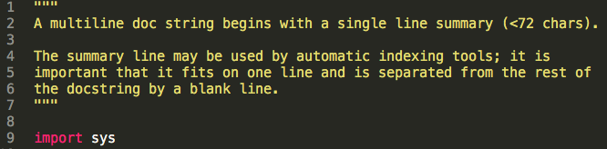
Documentation / PEP 0257
Docstrings
Multiline docstrings are more of the norm

Slide 88
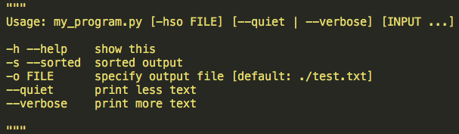
Documentation / PEP 0257
Docstrings
For scripts intended to be called from the command line, the docstring at the top of the file should be a usage message for the script.

Slide 89
Documentation / PEP 0257
Docstrings
For modules and packages, list the classes, exceptions and functions (and any other objects) that are exported by the module, with a one-line summary of each.
Looking at scikit learn and seaborn (as examples) this didn’t seem to be the norm. However,
https://github.com/numpy/numpy/blob/master/numpy/__init__.py

Slide 90
Documentation / PEP 0257
Docstrings
Most importantly… For functions and methods, it should summarize its behavior and document its arguments, return value(s), side effects, exceptions raised.
Example from scikit learn:
https://github.com/scikit-learn/scikit-learn/blob/main/sklearn/cluster/_dbscan.py

Slide 91
PEP8 play time, part 3!
Run pylint on the Python file in the repository,
e.g. pylint python_demo_1.py
Can you use nano or another editor to get it to at least 10/10 by addressing documentation issues?

