Slide 1
Software Design for Data Science
Modules, Packages, and Imports
Melissa Winstanley
University of Washington
January 31, 2023

Slide 2
Definitions
Object: Most things in Python, e.g. function, variable, class.
Module: A *.py script; carries the name as the file.
Namespace: A mapping of unique names to objects.
Package: A directory-like concept that can hold multiple Python objects, modules, or subpackages under same namespace.

Slide 3
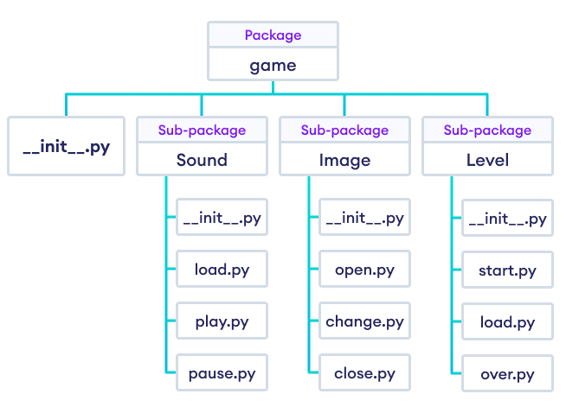
Definitions: Example
when running import game
all objects in all modules are in the game namespace
Example from https://www.programiz.com
Modules (files)

Slide 4
Imports

Slide 5
Imports
There are 4 different syntaxes for writing import statements.
import <package>
Brings <package> into the current namespace
import <module>
Brings <module> into the current namespace
from <package> import <module or subpackage or object>
Brings <module or subpackage or object> into the current namespace
from <module> import <object>
Brings <object> into the current namespace

Slide 6
Using imports
Let X be whatever name comes after import.
If X is the name of a module or package, then to use objects defined in X, you have to write X.object
# for these cases
import <package>
import <module>
from <package> import <module or subpackage>
If X is a variable name, then it can be used directly.
If X is a function name, then it can be invoked with X()
from <package> import <object>
from <module> import <object>

Slide 7
Multiple imports
from <module> import <object1>, <object2>, <object3>
OR
from <module> import (
<object1>,
<object2>,
<object3>,
)

Slide 8
Import as
Optionally, as Y can be added after any import X statement:
import X as Y
from X import (
foo as Y,
bar as Z,
)

Slide 9
Import order of search
How does Python find modules/packages to import?
Python Standard Library packages/modules (eg math, sys)
Packages/modules in sys.path:
If run with the Python interpreter (ie just python)
sys.path[0] is the empty string ’’, which means the current working directory
If run with python <module.py>:
sys.path[0] is the path to <module>.py
Directories in PYTHONPATH environment variable
Default sys.path locations - dependent on Python installation

Slide 10
Absolute vs relative imports
Absolute Imports (works in Python 2 and 3):
Import from the top-level Python package. e.g., import <package>
Relative Imports:
Import based on your sys.path location.
Explicit Relative Imports (works in Python 2 and 3):
Import using . (current directory) and .. (parent directory) notation
Implicit Relative Imports (only Python 2):
Discontinued

Slide 11
Wildcard imports
Bringing EVERYTHING from a package or module into the current namespace
from <package> import *
BAD BAD BAD! Why?
Conflicts between names defined locally and the ones imported
Reduces code readability - where did a name come from?
Clutters the local namespace, which makes debugging more difficult
Example in the materials for today

Slide 12
Directory Structure

Slide 13
Basic codebase in a git repository
myproject/
README.md
LICENSE
myproject/
__init__.py
core.py
subpackage/
__init__.py
subpackage.py
submodule/
submodule.py
tests/
__init__.py
test_core.py

Slide 14
Basic codebase in a git repository
This is your git repository, usually matching the name on Github
myproject/
README.md
LICENSE
myproject /
__init__.py
core.py
subpackage/
__init__.py
subpackage.py
submodule/
submodule.py
tests/
__init__.py
test_core.py

Slide 15
Basic codebase in a git repository
myproject/
README.md
LICENSE
myproject /
__init__.py
core.py
subpackage/
__init__.py
subpackage.py
submodule/
submodule.py
tests/
__init__.py
test_core.py
Markdown-formatted or plain text file describing the package

Slide 16
Basic codebase in a git repository
myproject/
README.md
LICENSE
myproject /
__init__.py
core.py
subpackage/
__init__.py
subpackage.py
submodule/
submodule.py
tests/
__init__.py
test_core.py
Software license specifying how others may use your code

Slide 17
Basic codebase in a git repository
myproject/
README.md
LICENSE
myproject/
__init__.py
core.py
subpackage/
__init__.py
subpackage.py
submodule/
submodule.py
tests/
__init__.py
test_core.py
The Python package, helpful for
import myproject into separate namespaces.

Slide 18
Basic codebase in a git repository
myproject/
README.md
LICENSE
myproject/
__init__.py
core.py
subpackage/
__init__.py
subpackage.py
submodule/
submodule.py
tests/
__init__.py
test_core.py
This module marks the directory as a Python package and is run upon import

Slide 19
Basic codebase in a git repository
myproject/
README.md
LICENSE
myproject/
__init__.py
core.py
subpackage/
__init__.py
subpackage.py
submodule/
submodule.py
tests/
__init__.py
test_core.py
Other modules in the package containing importable code.

Slide 20
Basic codebase in a git repository
myproject/
README.md
LICENSE
myproject/
__init__.py
core.py
subpackage/
__init__.py
subpackage.py
submodule/
submodule.py
tests/
__init__.py
test_core.py
Packages can have subpackages (and sub-subpackages, etc.) to any depth. They contain their own __init__.py files.

Slide 21
Basic codebase in a git repository
myproject/
README.md
LICENSE
myproject/
__init__.py
core.py
subpackage/
__init__.py
subpackage.py
submodule/
submodule.py
tests/
__init__.py
test_core.py
Packages can also have modules to any depth - ie without the __init__.py, this directory is just a collection of modules.

Slide 22
Basic codebase in a git repository
myproject/
README.md
LICENSE
myproject/
__init__.py
core.py
subpackage/
__init__.py
subpackage.py
submodule/
submodule.py
tests/
__init__.py
test_core.py
Unit tests go into their own subpackage

Slide 23
Basic codebase in a git repository
myproject/
README.md
LICENSE
myproject/
__init__.py
core.py
subpackage/
__init__.py
subpackage.py
submodule/
submodule.py
tests/
__init__.py
test_core.py

Slide 24
But wait - what actually goes in __init__.py?

Slide 25
1. __init__.py is empty
Example: urllib
Pros
Simple
Cons
You don’t get a namespace
You have to specify a specific submodule to import
Importing just the package is useless
Important to have good module names
Eg:
import urllib.parse
urllib.parse.urlparse(“https://google.com”)
Not
import urllib
urllib.urlparse(“https://google.com”)

Slide 26
2. __init__.py imports from subpackages/modules
Import from subpackages and submodules
Determine order of import (where that’s important)
Example: tomllib (library that parses TOML files)
Pros
Can create a helpful namespace
Interface of your package is more clear
Cons
Interface of package is not super clear

Slide 27
3. __init__.py defines the interface for the package
Define the interface for the package
Importing/piecing together submodules
Example: json
Pros
Great for someone reading your package to know where to start
Functionality is clear
Cons
What goes in __init__.py vs submodule?

Slide 28
4. __init__.py defines everything
Example: collections
Pros
One single file
Can work well for small packages
Cons
Can be unwieldy if package is big

Slide 29
Distributing a Python package

Slide 30
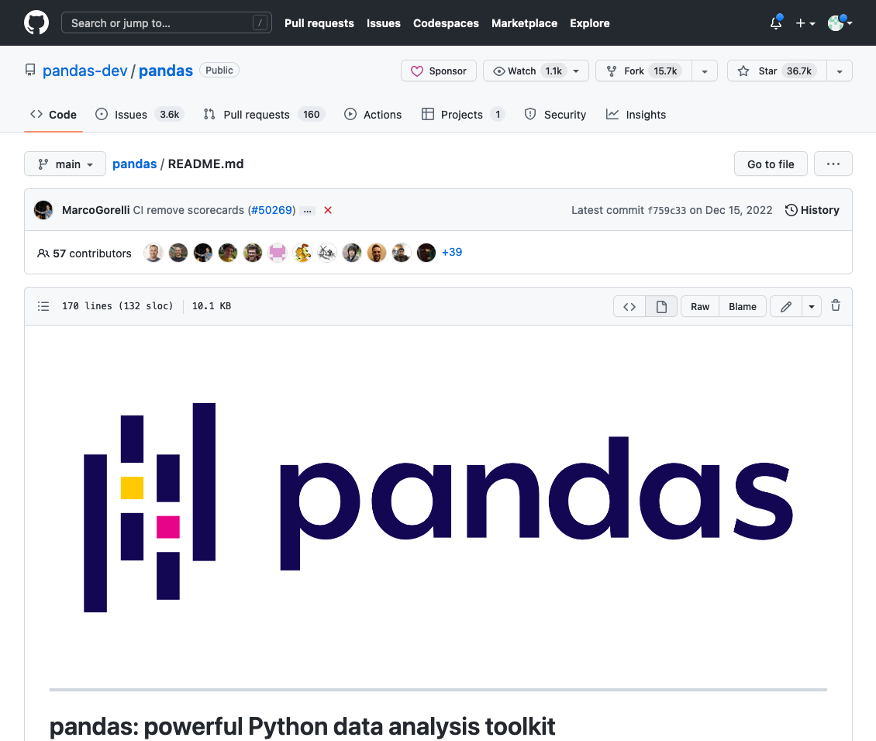

Slide 31
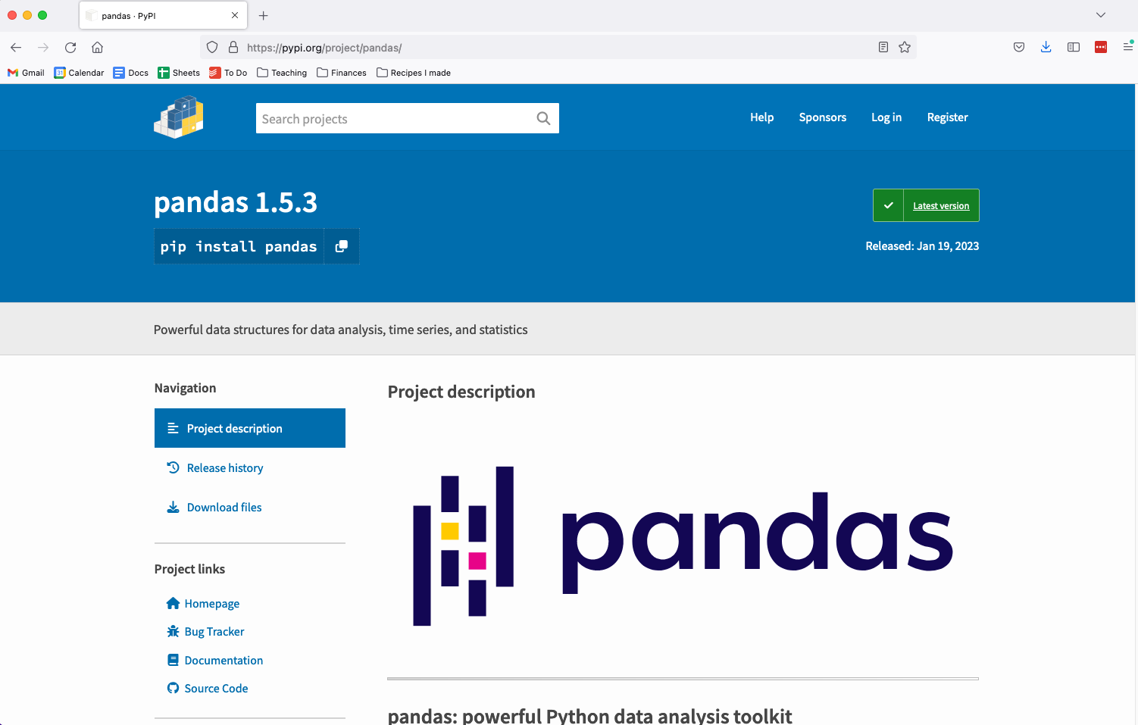
PyPI

Slide 32
Extending project structure for PyPI
myproject/
README.md
LICENSE
myproject/
__init__.py
setup.py
core.py
subpackage/
submodule/
tests/
Contains metadata for the package for PyPI. Often uses distutils or setuptools standards. Can contain abstract vital dependencies

Slide 33
Extending project structure for PyPI
myproject/
README.md
LICENSE
myproject/
__init__.py
setup.py
requirements.txt
core.py
subpackage/
submodule/
tests/
Contains absolute dependencies, especially useful if you’re publishing an application.
Can be generated using:
conda list --export > requirements.txt
OR
pip freeze > requirements.txt

Slide 34
Extending project structure for PyPI
myproject/
README.md
LICENSE
myproject/
__init__.py
setup.py
requirements.txt
MANIFEST.in
core.py
subpackage/
submodule/
tests/
Specify data and files that should also be packaged in addition to the Python modules

Slide 35
Example setup.py
import setuptools
setuptools.setup(
name="example-pkg-your-username",
version="0.0.1",
author="Example Author",
author_email="author@example.com",
description="A small example package",
install_requires=['docutils>=0.3'],
long_description=long_description,
long_description_content_type="text/markdown",
url="https://github.com/pypa/sampleproject",
packages=setuptools.find_packages(),
classifiers=[
"Programming Language :: Python :: 3",
"License :: OSI Approved :: MIT License",
"Operating System :: OS Independent",
],
)

Slide 36
More examples
Check out existing Python packages. These may be more complicated:
https://github.com/numpy/numpy
https://github.com/pandas-dev/pandas

Slide 37
Submitting your package to PyPI
Update your code and version number. Run your test suites and ensure your code works as intended. Create a PyPI account if you don’t have one already
Create your source, and if desired, binary distribution:
$ python setup.py bdist_egg upload [options]
$ python setup.py bdist_wininst [options]
$ python setup.py sdist [options]
Install twine package to submit builds to PyPI.
(Can install using conda install twine, pip install twine, etc.)
$ twine upload dist/*

