Slide 1
Software Design for Data Science
Survey Results, Jupyter, & Python
Melissa Winstanley
University of Washington
January 10, 2023

Slide 2
Project ideas?
Has anyone thought about what data or topics they might want to explore for the course project?

Slide 3
Reminder: Homework due tonight 11:59pm
https://uwdata515.github.io/syllabus.html
Software installation
Needed for today’s classroom work!
If you haven’t done it, do it as part of the first breakout
Homework 1 (on GitHub classroom)
Introductory survey (for participation)

Slide 4
Today
Survey results
Lecture: Jupyter notebooks intro
Breakout: Python math
Break: 5 minutes
Lecture: Python data types & flow control
Breakout: Python flow control
Break: 15 minutes
Lecture: numpy & pandas
Breakout: data visualization & manipulation

Slide 5
Survey Results

Slide 6
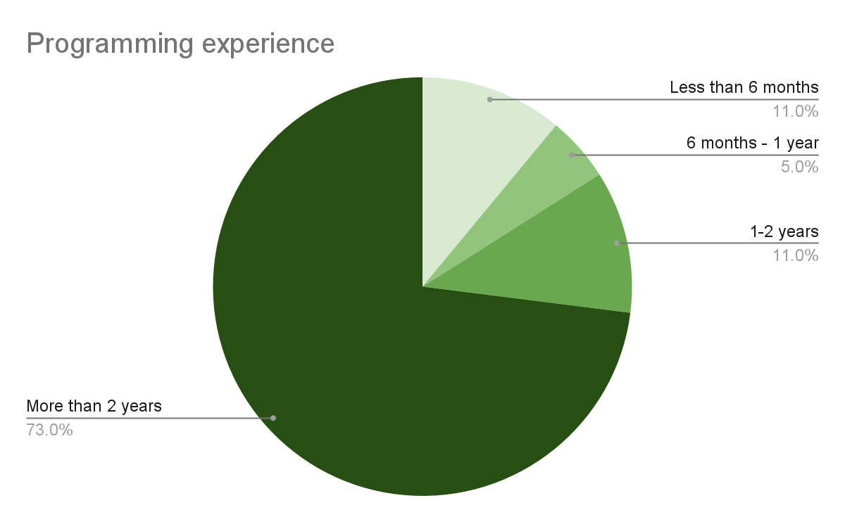
How much programming experience do you have?

Slide 7
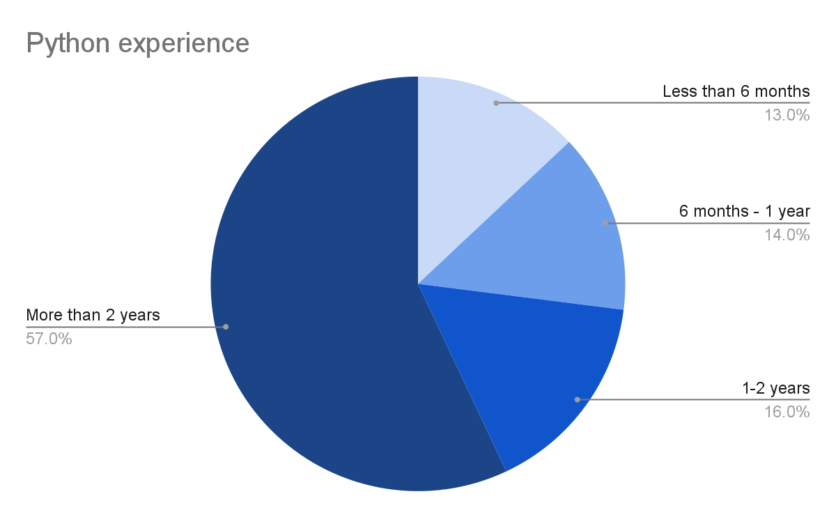
How much experience do you have with Python?

Slide 8
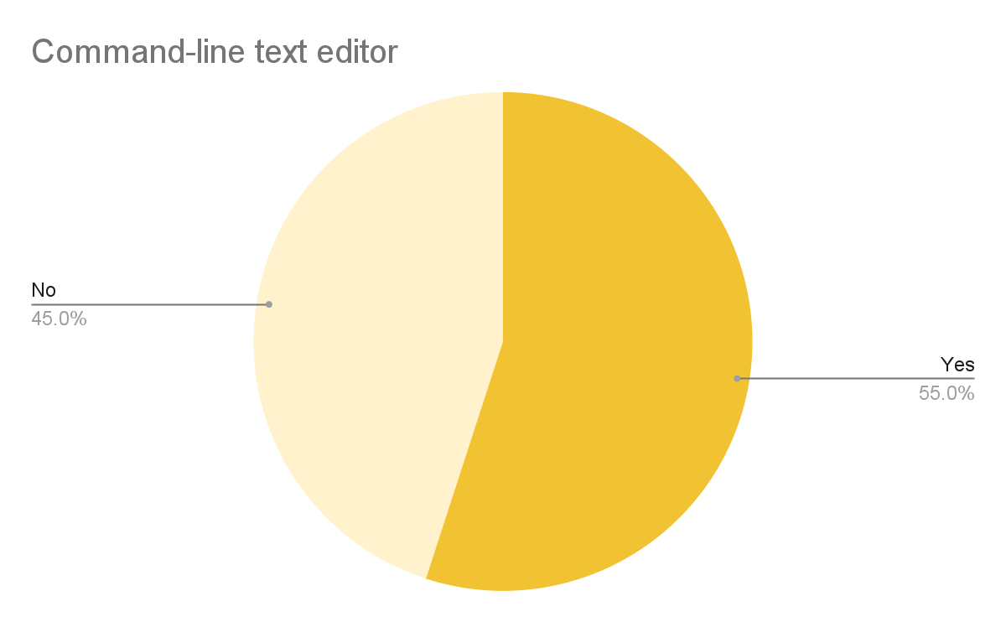
Have you used a command-line text editor?

Slide 9
Comfortable with if-statements and for-loops?
Yes!

Slide 10
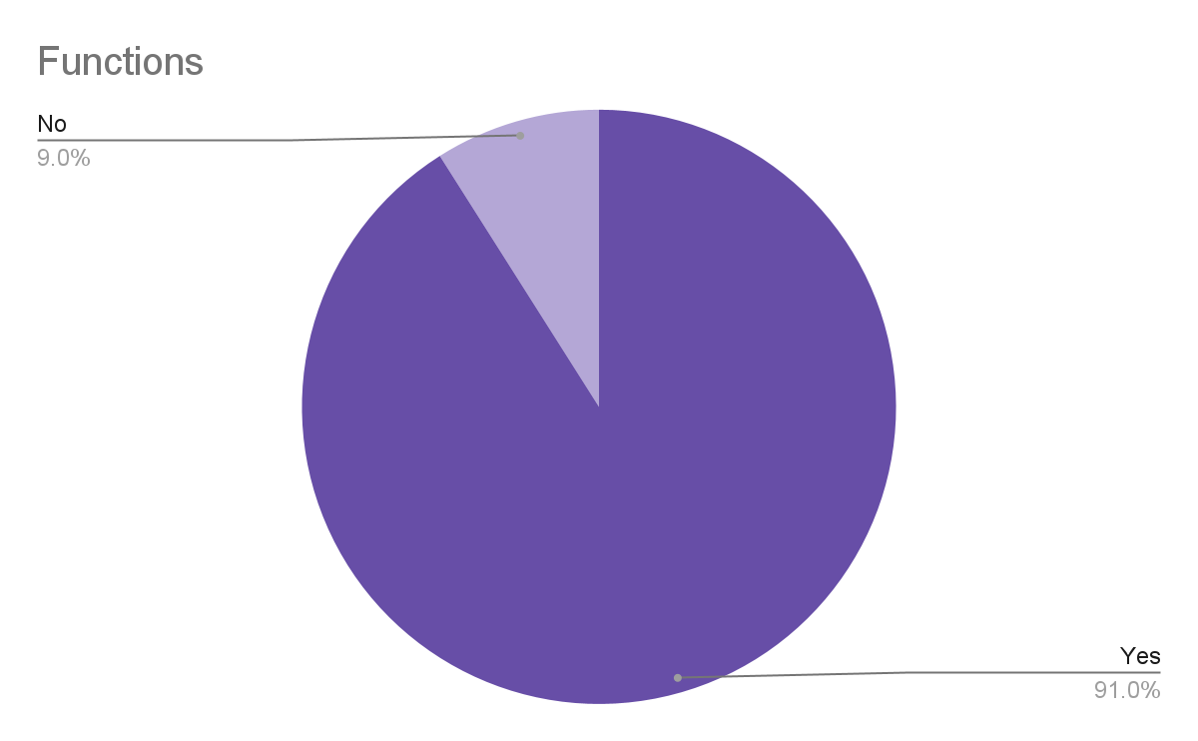
Comfortable with functions?

Slide 11
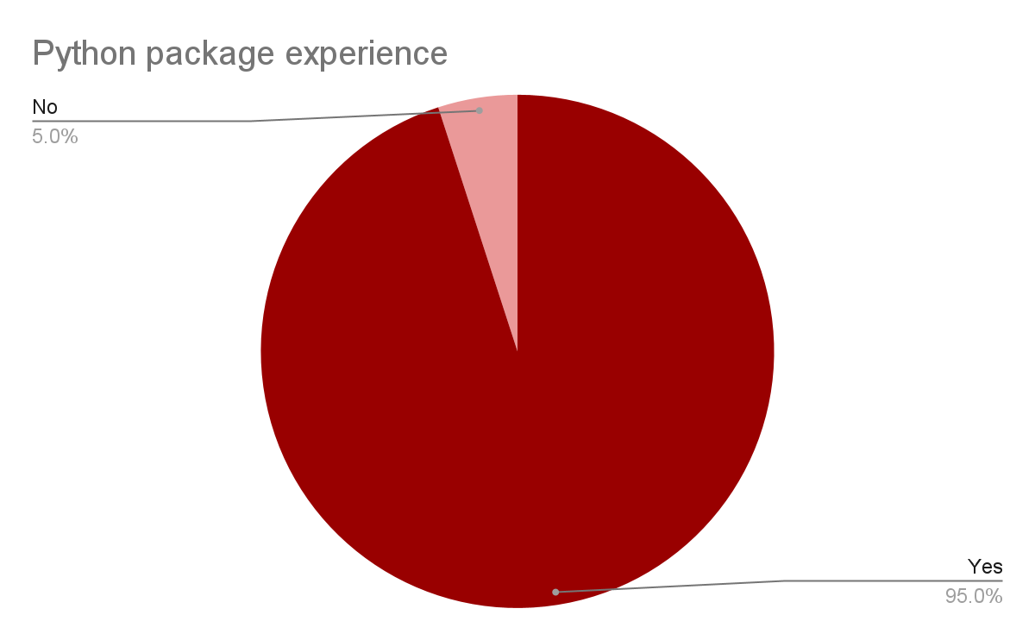
Experience with scipy, pandas, etc?

Slide 12
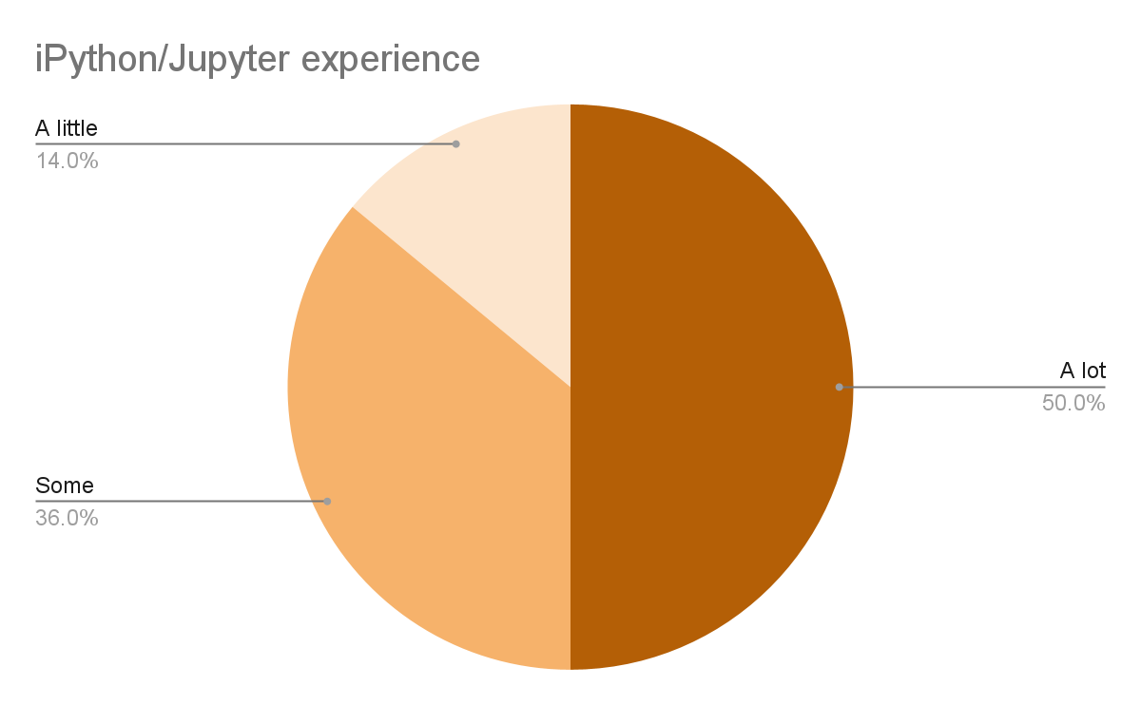
Experience with iPython/Jupyter?

Slide 13
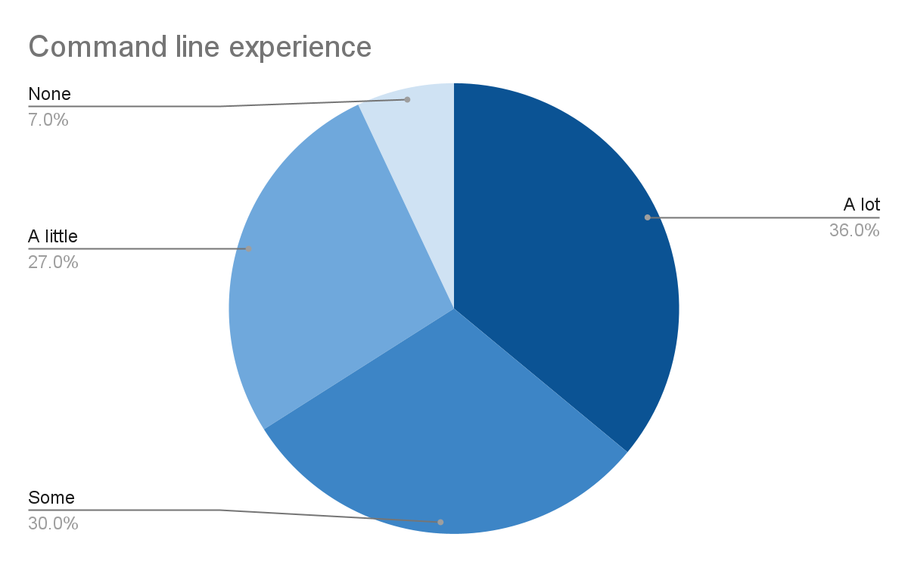
Experience with the command line?

Slide 14
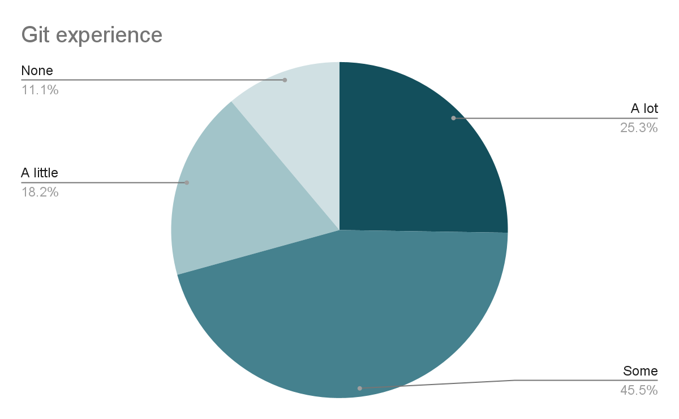
Experience with git?

Slide 15
And now - no more slides!
Jupyter, here we come!

