Slide 1
Software Design for Data Science
Git & Team Collaboration
Melissa Winstanley
University of Washington
January 25, 2024

Slide 2
Project Step 1: Due next Thursday, 2/1
Create your team in Canvas > People > Project Teams
NOW!
Create a GitHub repository
Validate your idea with your team
Add a README.md file with a project intro
Project type
Questions of interest
Goal for the project output (what are you going to produce?)
Data sources you will use
One person to submit the repository link via Canvas

Slide 3
Idea Validation
Agree as a team on what the project is
Clarity about the project type
Consensus on the problem being solved
Validate that the project is feasible and large enough
Is there an unmet need (i.e. no code already exists)?
Do you have data that can solve the problem?
Will this project take about 5-6 weeks of effort for 3-4 people to complete?

Slide 4
Intermediate Git

Slide 5
Review
How do I…
view the change history for a repository?
git log
see what files in the directory are modified since the last commit?
git status
examine the changes between modified files and the last commit?
git diff
place a modified file into the staging area?
git add <file>
move the staged files into the repository history?
git commit -m “My commit message”

Slide 6
Review
What do the following verbs do?
Push
Clone
Pull

Slide 7
Review
What is…
HEAD?
HEAD~3?

Slide 8
Exercise
Get into teams of 2-3
Identify someone to“own” a repository who will create it in their GitHub account (PUBLIC repository)
Add a README.md, LICENSE and .gitignore using the UI
Python language & MIT license are good to start
Add the other team members as collaborators to the repository
Everyone clone on their computer

Slide 9
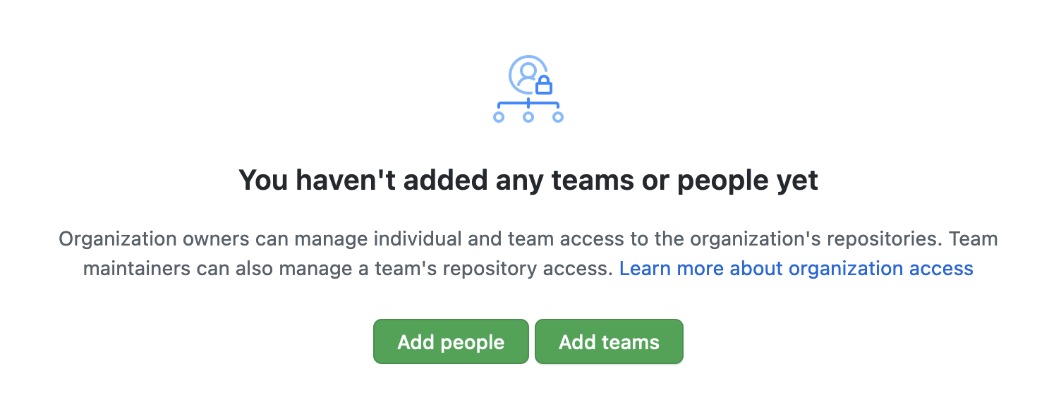
Exercise
To add collaborators to a repository
Go to the repo
Click on Settings, then Collaborators & Teams, then Add People

Slide 10
Exercise
Everyone make changes to the README.md
Status, diff, add, commit, push
What happens?

Slide 11
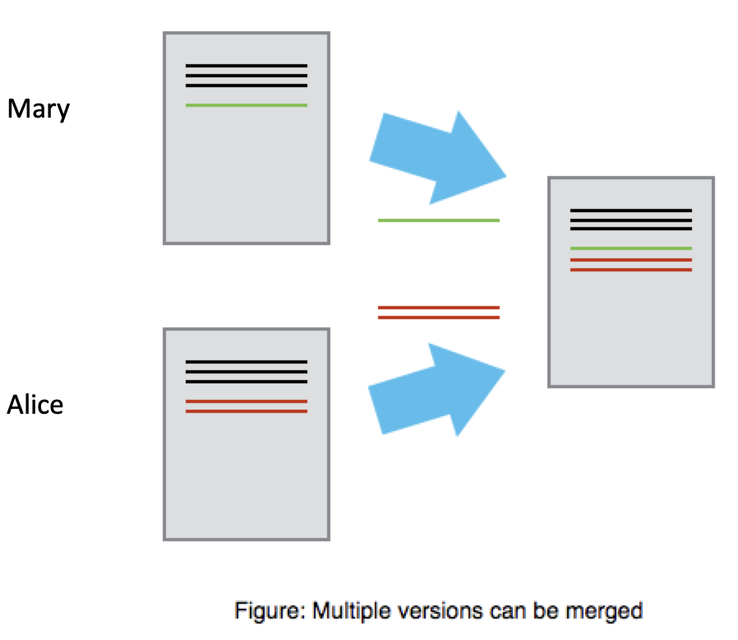

Slide 12
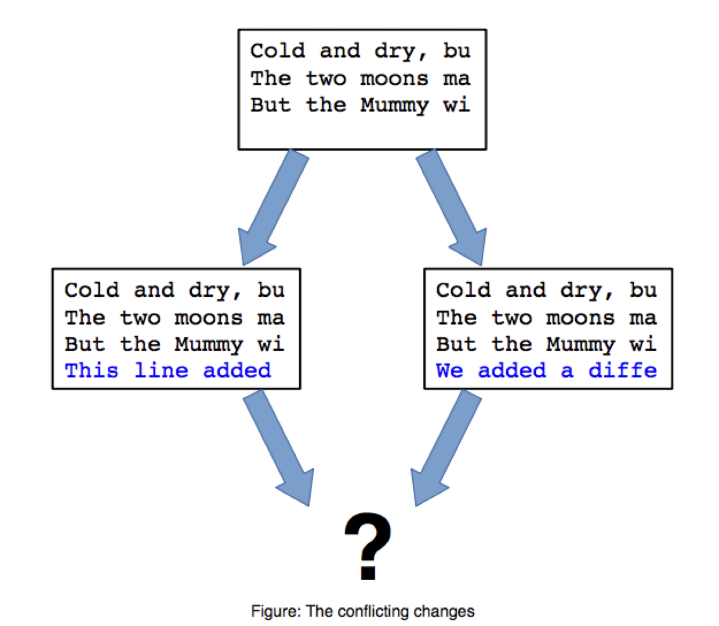

Slide 13
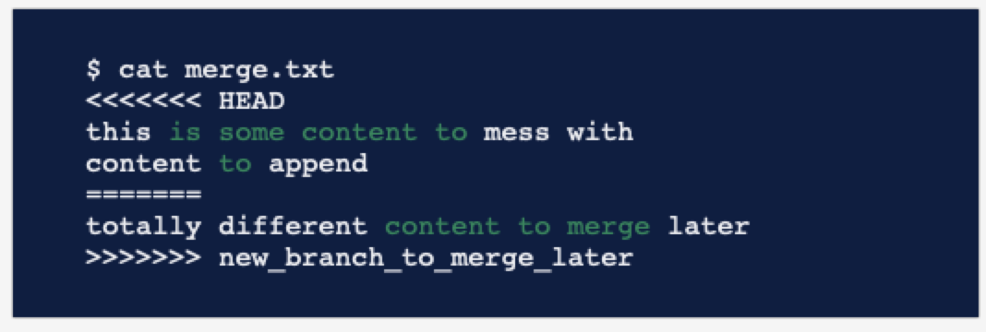
Merge conflicts

Slide 14
Fixing your merge conflict
git fetch
git merge origin
Open the files with the conflict in a text editor
Find the conflict, which always has lots of <<<<<< and >>>>>>
Rewrite the block between the brackets to what you want it to be
Remove the brackets and equals signs too
git commit

Slide 15
Collaborating Scenario
Main development trunk of codebase
Bug comes in via issue report on GitHub
You need to work on the bug but don’t want to screw up the main development trunk
What to do?

Slide 16
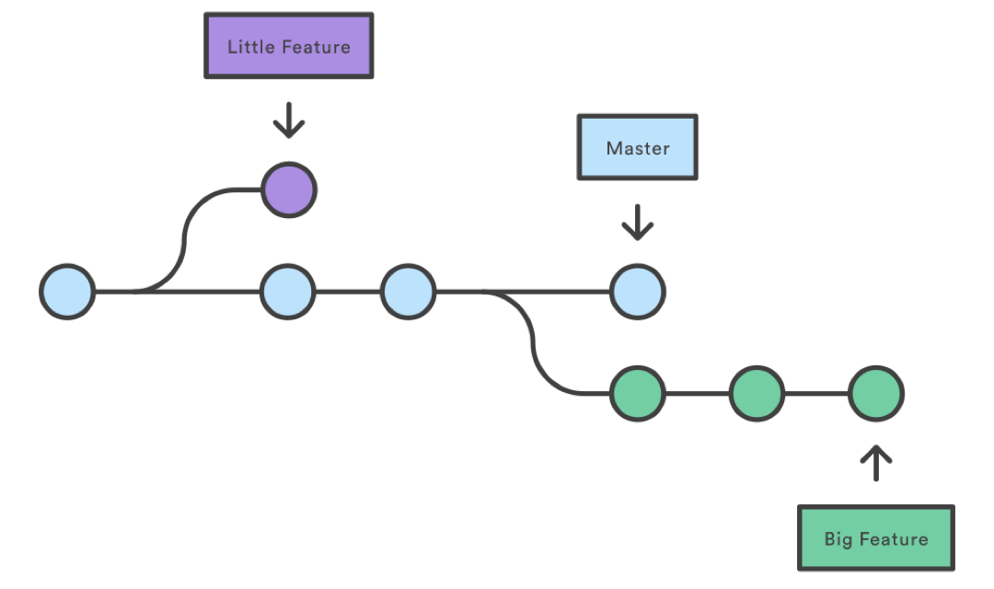
Branches
Does the name main make more sense now?
NOTE!
main vs master
git vs GitHub

Slide 17
Branch commands
Create a new branch on your local computer
git branch name-of-branch
Delete a branch
git branch -D name-of-branch
Switch to a branch (or main)
git checkout name-of-branch
git checkout main
Make a new branch and switch into it all at once
git checkout -b name-of-new-branch

Slide 18
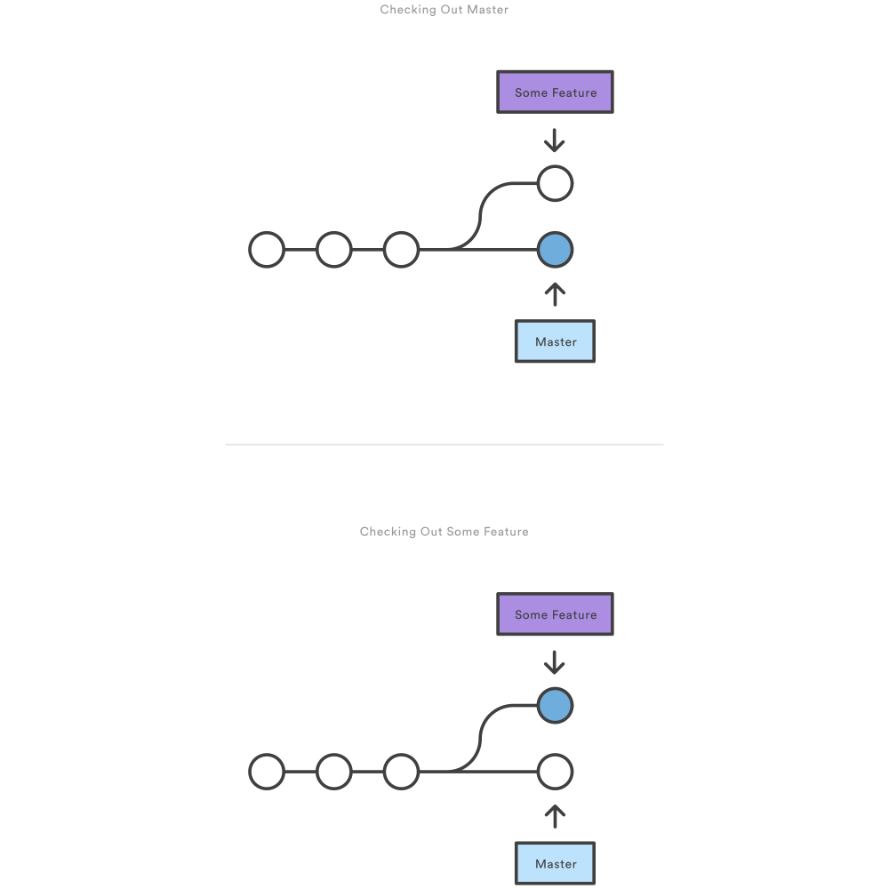
Branches: visual
After branch creation
After branch checkout

Slide 19
Merges
But how do we get our features back into main?

Slide 20
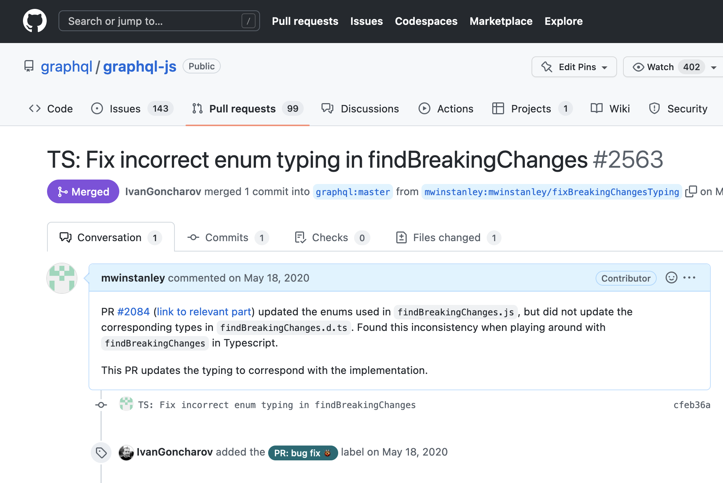
Pull requests

Slide 21
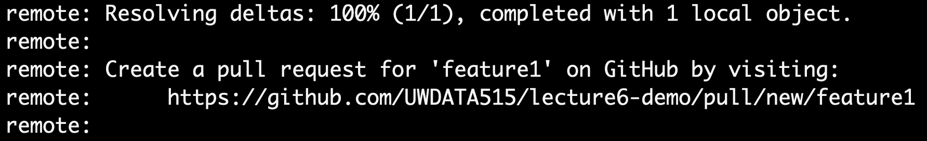
Submitting a pull request
From your branch, push the branch to GitHub:
git push
You’ll need to configure git:
git config --global --add --bool push.autoSetupRemote true
This tells git to automatically sync the proper branch with GitHub when you push
Follow the link:

Slide 22
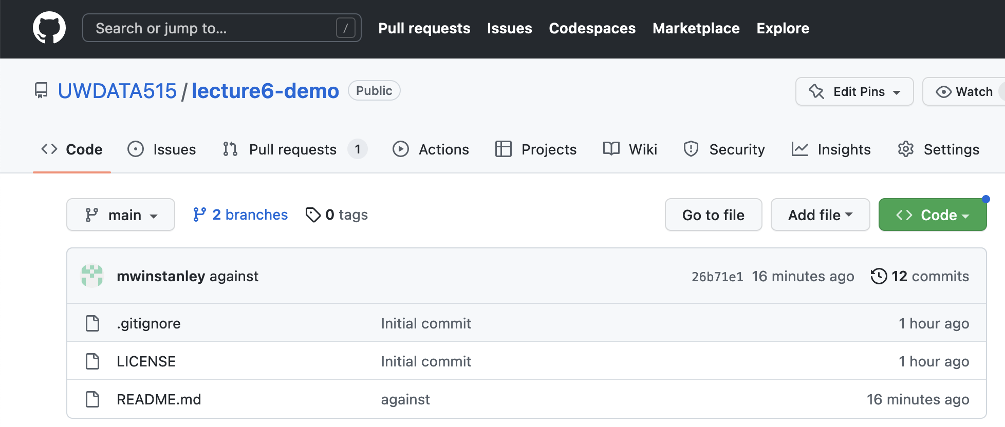
Branches on GitHub

Slide 23

Merges
Usually: via the GitHub interface in a Pull Request (more in next slide!)
Or: git merge branch-name (familiar?)

Slide 24
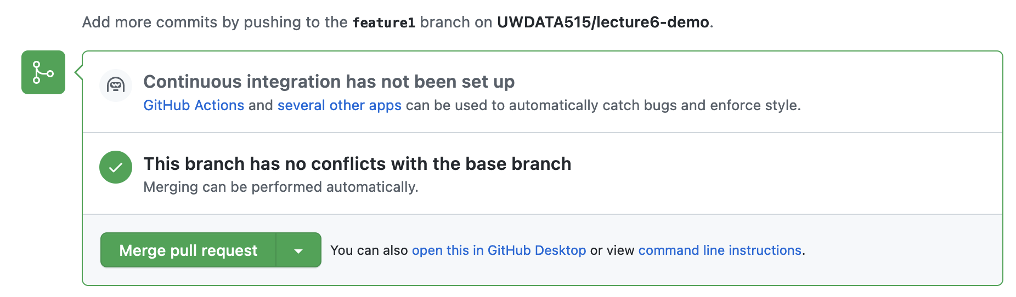
Merging through the GitHub UI for a Pull Request
Don’t forget to delete the branch when you’re done!
(or configure auto-deletion in the repo Settings)

Slide 25
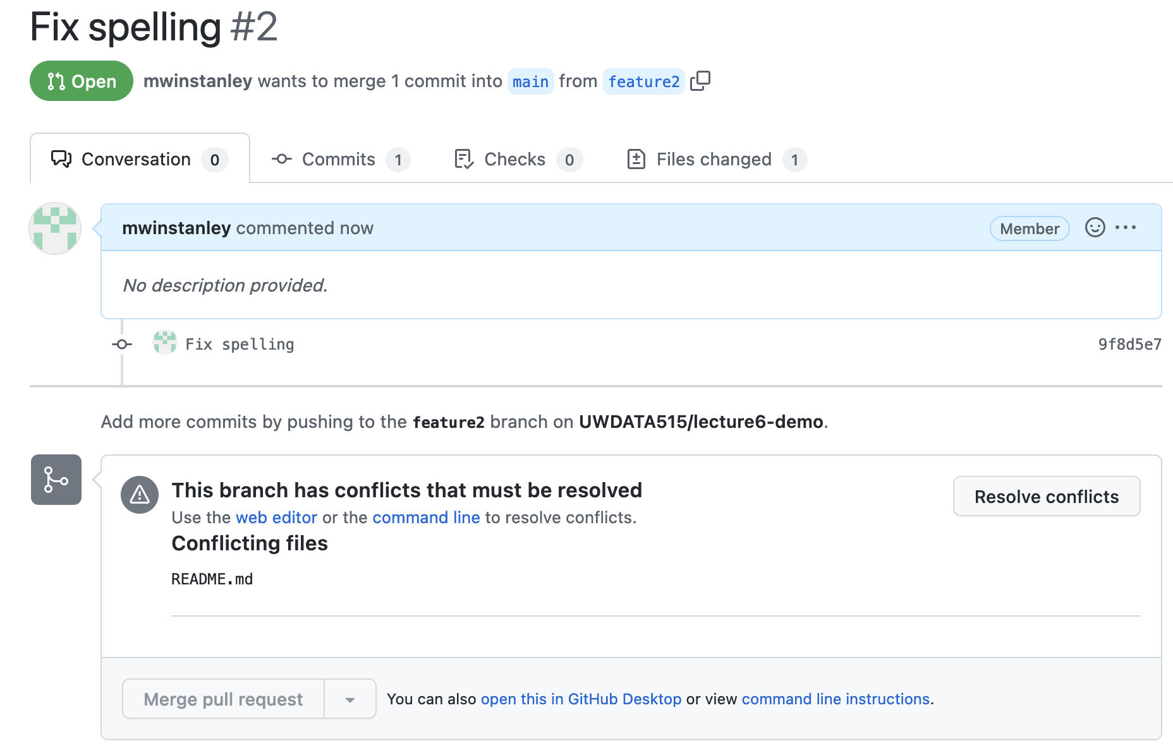
Merge conflicts
Uh oh!
Someone else merged a conflicting change so I can’t merge my branch

Slide 26
Merge conflicts: merging main into your branch
Via the GitHub interface (ONLY if simple eg Markdown files)
Or
git checkout main
git pull # pull in the conflict
git checkout your-feature-branch
git merge main
(fix merge conflicts by editing the conflicting files, git add as needed)
git commit
git push # update the remote version of your branch

Slide 27
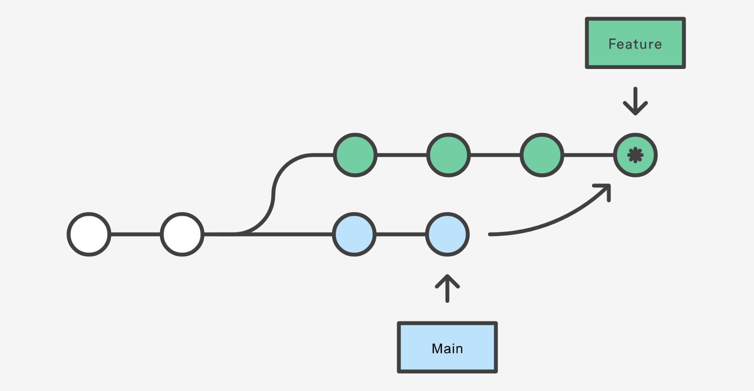

Slide 28
Merging main into your branch
Pros
Non-destructive - existing branches are not changed in any way
Cons
Extra “merge commits” in the history

Slide 29
Merge conflicts: rebasing
If you’re like me and HATE those “merge commits”
git rebase main
(fix merge conflicts by editing the conflicting files, git add as needed)
git rebase --continue
git push --force
This “rewrites history” - hence why you need to --force
More about merging vs rebasing

Slide 30
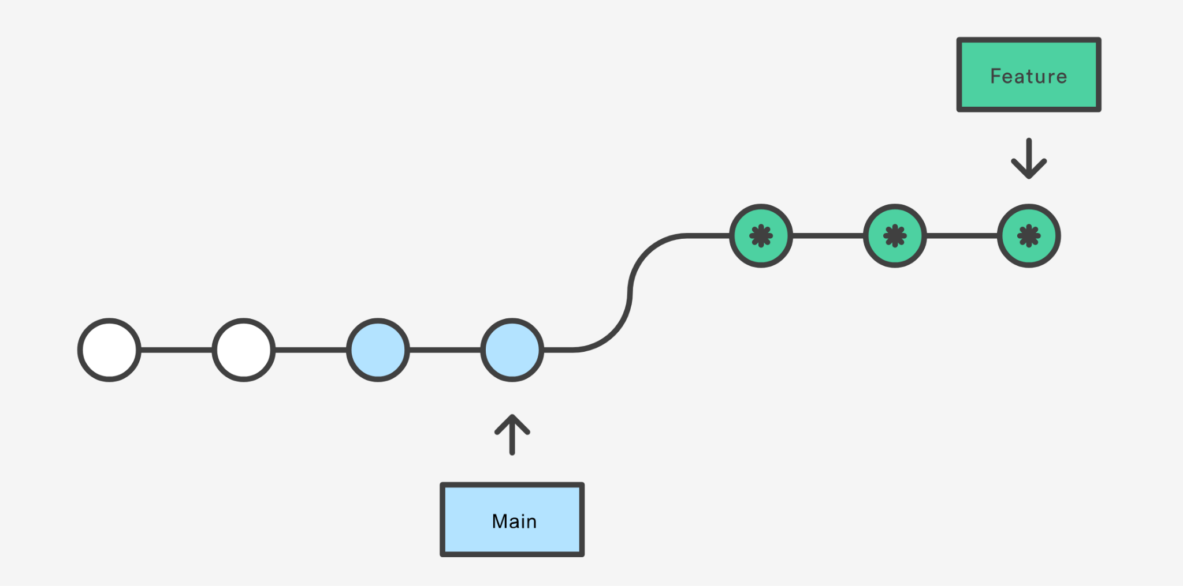

Slide 31
Rebasing
Pros
Perfectly linear history
No extraneous “merge commits” - cleaner history
Cons
Rewriting history
You can’t tell when things were rebased exactly
NEVER USE REBASING ON A PUBLIC BRANCH (ie main)
Only your own private branches

Slide 32
Rebasing
You don’t have to wait until you have an approval to rebase or merge main into your branch!
It’s a good idea if you know someone else submitted a major change that might affect yours

Slide 33
Standard Collaborative Flow
Create a new branch (git checkout -b new-branch-name)
Commit some changes
Push your branch to GitHub
Create a pull request in the UI
Pull and merge main into your branch again, resolving conflicts, if necessary (git merge main or git rebase main)
Merge the pull request using github.com and the big green button

Slide 34
Exercise
Everyone:
Follow the standard collaborative flow to make a change to README.md
Review each other’s pull requests
Everyone should merge

Slide 35
Common mistake
Oops! I forgot to switch to a new branch and now I my commits are on main!
Create a new branch where you are. This will save your commits and give then the new branch name
Checkout the main branch
Reset main back to before your commits. Count how many commits back you want to go, then reset. For example, if you’ve accidentally added 2 commits:
git reset --hard HEAD~2
Now you can checkout your new branch and continue with your changes
This says get rid of the commits entirely

Slide 36
Real-World Branch Notes
Conflicts are natural! There is nothing wrong
Name your branch something descriptive
Prefix your branch name with your user id mwinstanley/readmeUpdate
Delete your branch when you’re done
Configure auto-deletion in the repository
Settings > Automatically delete head branches

Slide 37

Forking
Another
solution!

Slide 38
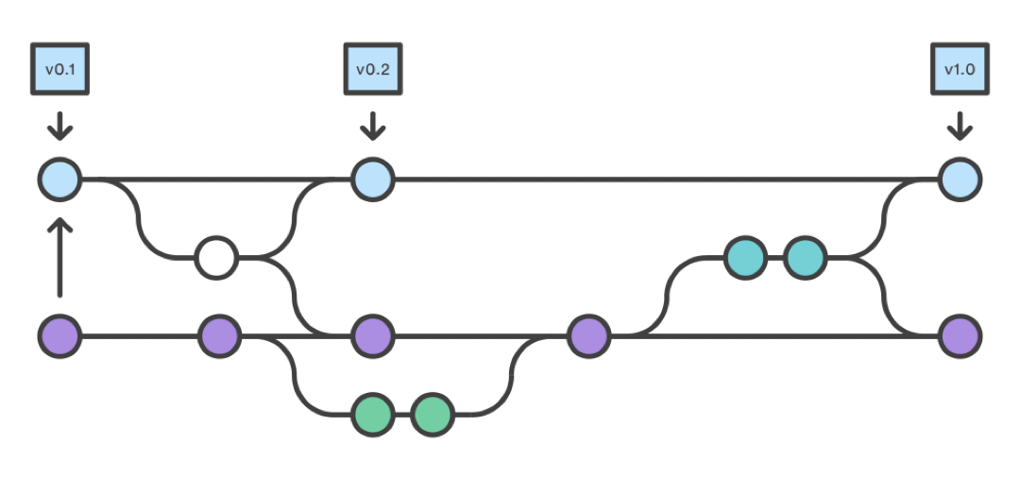
Forking
A totally new copy of the repository, which you can change and ask the original owners to “pull” back into their own version.

Slide 39
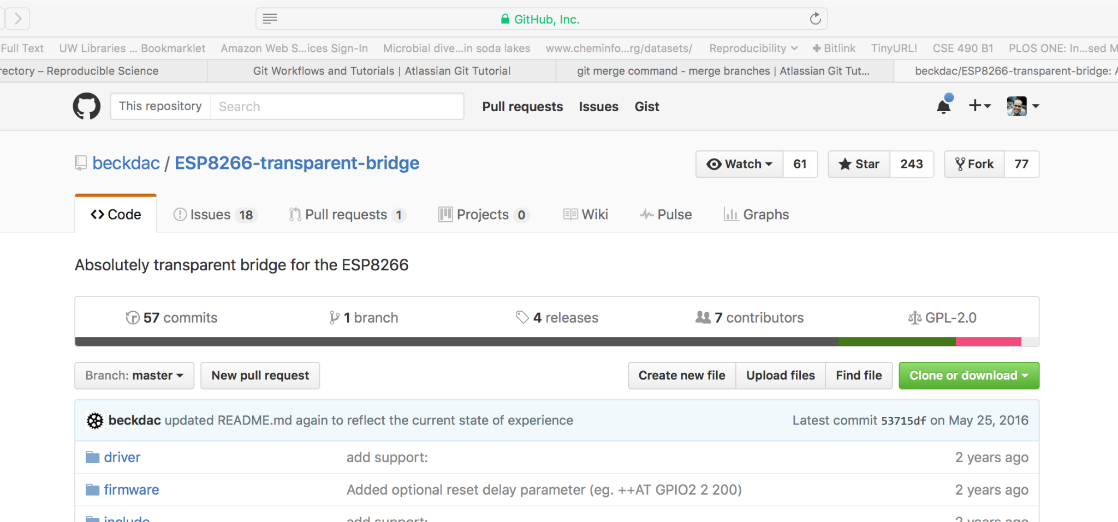
Forking

Slide 40
Forking
Probably not in this class (use branches)!
Making changes to open-source libraries

Slide 41
Team Collaboration

Slide 42
Standups
What is a standup?
1-2 minutes per person
Why standups?
Communicate status and actions within and between teams
What do I say in a standup?
Progress you’ve made since the last standup
How it compares with the plan
If behind plan, how to compensate to make plan end date
Deliverables for next period
Challenges to making next deliverables
Technology uncertainties and blockers
Team issues

Slide 43
Standups
In class!

Slide 44
GitHub Issues

Slide 45
GitHub Issues
Good way to keep track of
Milestones
Tasks
Bugs
If you link to an issue in a PR, it will auto-link the two
Use it if you like!

Slide 46
GitHub Pull Requests
Pull Request = “PR”
Yeah, it’s a confusing name: “hey repo owners, please PULL my change into main”
What’s in the description of a PR?
Background
Describe what change you are making
Describe how that change affects the application
Test plan
How did you test the code?
Include specific commands that you ran, and the output
ALWAYS!
Only push directly to main in a true emergency (not in this class!)

Slide 47
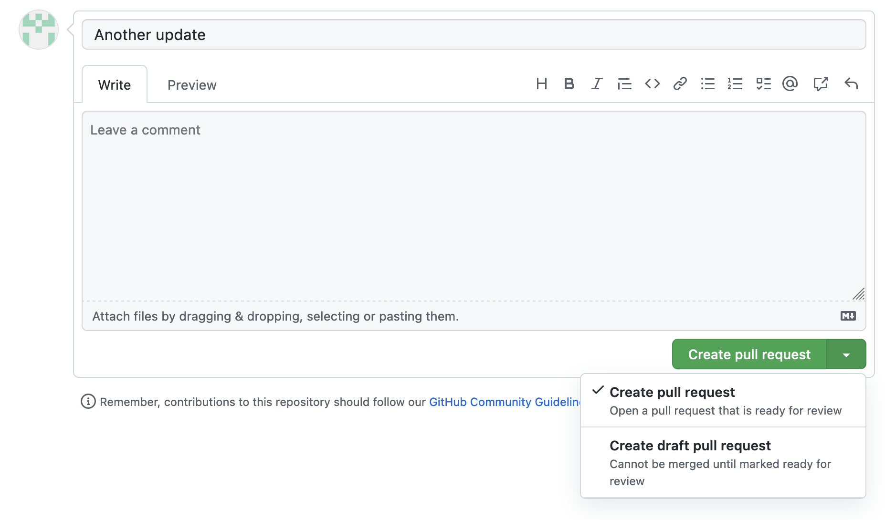
Good option: draft pull requests
If you’re not fully ready to submit it for code review

Slide 48
Code Reviews
What is code review?
Someone looks at, comments on, and approves a PR - NOT one person
Why code review?
To find bugs
To improve code quality
What do you comment on in a code review?
Bugs or missing pieces
Style
Choice of variable and function names
Code readability
If the PR doesn’t have a test plan
How to improve reuse and efficiency
How to use existing Python packages

Slide 49
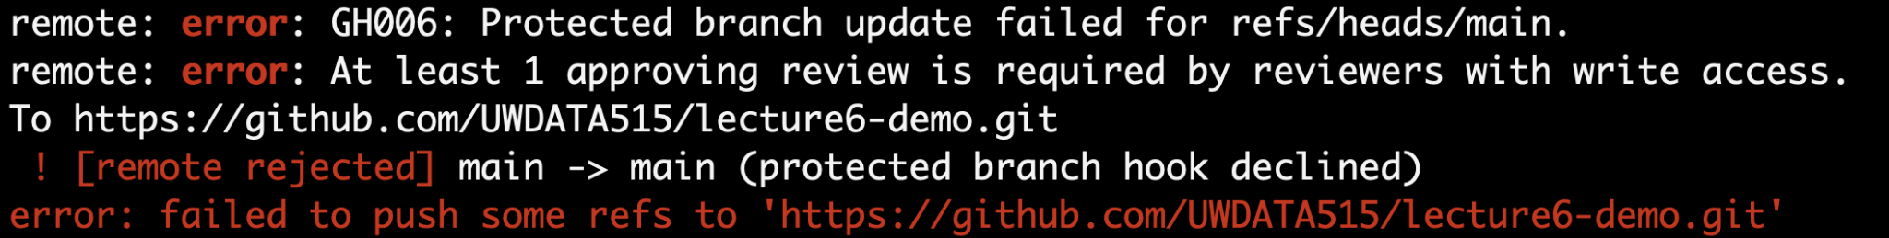
Branch Protection
Protect main against accidents!
Require pull requests and code reviews
Common in the real world

Slide 50
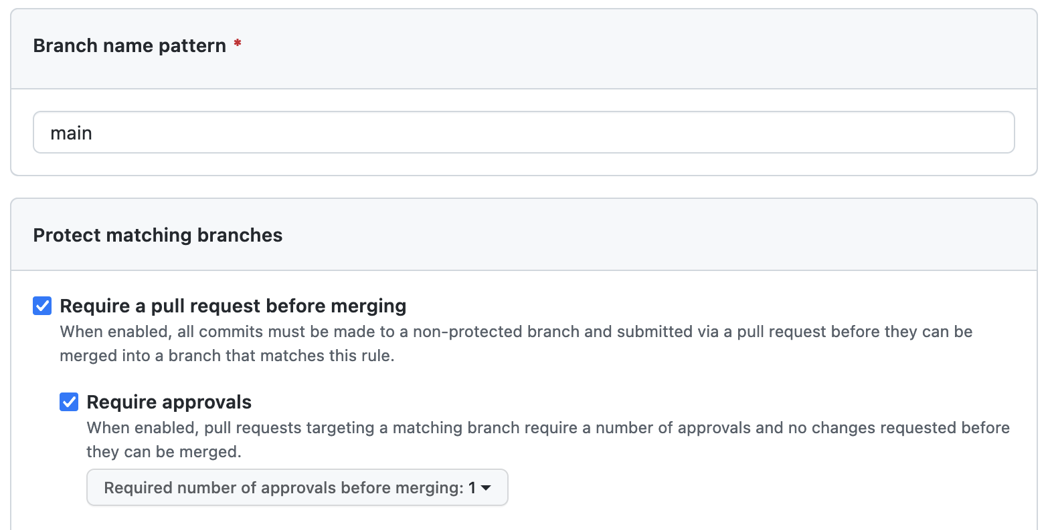
Branch Protection
GitHub Repository Page > Settings > Branches > Add branch protection rule
Do this now for your exercise repository!
Do this on your project repository!

Slide 51
Communication strategies
Use a chat mechanism for informal, quick communication
Email doesn’t really work
Slack
Microsoft Teams
Discord
Google Chat
Don’t hesitate to hop on a Zoom to follow-up
Documentation as communication
Code documentation
Pull request description

Slide 52
Pair programming
Two people, one keyboard
Fewer mistakes with more eyes
Learning for both people
Consider trying it for difficult tasks!
Swap who has hands on keyboard at least every 30 minutes
Keep talking

Slide 53
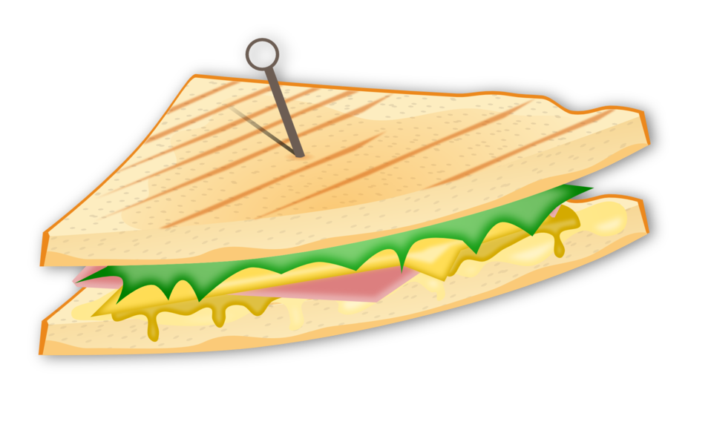
Fast feedback
Quick responses to communication
Code reviews
Emails
Chat
Constructive criticism
Consider (gently) giving teammates feedback
Make observations, not generalization
Sandwich approach
Listen to the response!
Don’t wait until the survey at the end of the quarter!

Slide 54
Collaboration Summary
Standups
GitHub issues
Pull requests
Code reviews
Chat
Pair programming
Fast feedback

