Slide 1
Software Design for Data Science
Project
Naomi Alterman
University of Washington
January 20, 2026

Slide 2


Course Project
Collaborative software engineering experience
Teams of 3 or (ideally) 4
Develop project using version control

Slide 3
Course Project
We’re not just going to build something, we’re gonna build it RIGHT 😤!!
Design (use cases, component specification)
Documentation (how to, docstrings)
Style (PEP8, pylint)
Coding, testing & milestones
Standup & code reviews

Slide 4
Course Project Types
Answer “Research” Questions
Create a Tool
Teach Analysis
Present Data

Slide 5
Project Type 1: Answer “Research” Questions
Problem statement: Answer two to three questions of business or scientific relevance
Use a Jupyter notebook and supporting python files
Example
Climate Police: Analyze effects of pollution on the planet.

Slide 6
Project Type 2: Create a Tool
Problem statement: Solve a problem common to many users
Don’t reinvent the wheel
Example
BioReactor Data Logging – Monitor and publish data from BioReactor experiments

Slide 7
Project Type 3: Teach Analysis
Problem statement: Create a system that teaches others the skills needed to do analysis
Example:
A system that teaches about logistics for businesses in the sharing economy

Slide 8
Project Type 4: Present Data
Problem statement: Create data repository with tools (e.g., search, visualization, analytics) and a user-friendly interface
Example
Car2Know: Provide car rental data to users of Car2Go (e.g., for planning trips)

Slide 9
More on the Data
At least two non-trivial data sets
Data need to be combined, joined, merged, etc. to answer the scientific questions
Have access to the data NOW!

Slide 10
Project Timeline
Week 5
Week 5-6
Week 6
Week 7-8
Week 7-10
Finals
Project Proposals & Team Selection
Idea validation
Software &
Use Case Design
(in class)
Technology Review
Ongoing project work & consultations
Presentations

Slide 11
Week 5: Project Proposals
Share what you’re passionate about and convince others to work with you:
1 slide (PowerPoint, Keynote, or Google Slides) containing:
  Title
  Project type (research, reusable data, tool)
  Short pitch - what will you do, why it is cool
  Your 2+ data sources (could be tentative)
  Your name
  Due by 12pm (noon) Tuesday 2/4 via Canvas (I need time to compile the deck!)
In-class presentation of your proposal (2 minutes)
  Participation points! If you are unable to attend, please let me know.

Slide 12
Week 5: Team Selection
During project proposals:
Take notes on what projects sound interesting to you
After project proposals:
You’ll have time in class to talk to each other and form teams around a project proposal
3-4 people per team - 1 person submits names via Canvas
If you’d prefer, I’m happy to help find a group for you, particularly if your team has just 1-2 people
If you have to miss class
  Let me know
  I will help you find a project team

Slide 13
Week 5-6: Idea Validation
Agree as a team on what the project is
  Clarity about the project type
  Consensus on the problem being solved
Validate that the project is feasible and large enough
  Is there an unmet need (i.e. no code already exists)?
  Do you have data that can solve the problem?
  Will this project take about 5-6 weeks of effort for 3-4 people to complete?
Create a git repository for your team
  README.md with result of the idea validation
  One person submits the repository link via Canvas

Slide 14
Week 6-7: Software & Use Case Design (in class)
In-class exercise to design your project:
Who are the users? What do they know?
What information do users want from the system?
Use cases - how users interact with the system
After class: complete and submit the design in your GitHub repository by 2/15

Slide 15
Week 7-8: Technology Reviews
Writeup addressing a choice of library; in-class presentation to instructors as part of the first project demo in week 8.
Stay tuned!

Slide 16
Week 7-10: Project Work
Weekly standups in class
Collaboration outside of class - code reviews & pull requests
Deliver on the milestones you’ve defined
  Functionality
  Documentation
  Style
  Testing

Slide 17
Finals: Presentations
10 minute oral presentations
  All group members should present a part
  Background
  Data
  Use cases
  Component design
  Demo
  Lessons learned
Slides + demo

Slide 18
Grading
On the course webpage*: https://uwdata515.github.io/projects.html
Organization: 10%
  Can you follow directions?
Code quality: 32%
  Test coverage, style, CI, package setup, PRs/code reviews
Documentation: 24%
  README, design documents, examples & instructions
Design: 20%
  What you built, test design, module design
Presentations: 14%
  Technology review, final presentation
*exact percentages may change slightly but will remain approximately as described

Slide 19
Some Public Data
http://drugbank.ca
https://www.nlm.nih.gov/toxnet/
https://data.seattle.gov/browse?tags=traffic&sortBy=relevance&pageSize=20
https://divvybikes.com/system-data
https://www.nyc.gov/site/tlc/about/tlc-trip-record-data.page
https://www.kaggle.com/datasets
https://www.seattle.gov/transportation/projects-and-programs/programs/new-mobility-program/scooter-bike-share-data American Fact Finder Data
European union data (World bank)
Russian federation data (World bank)
China data (World bank)

Slide 20
Project Proposal Examples
Just to get your mind working

Slide 21
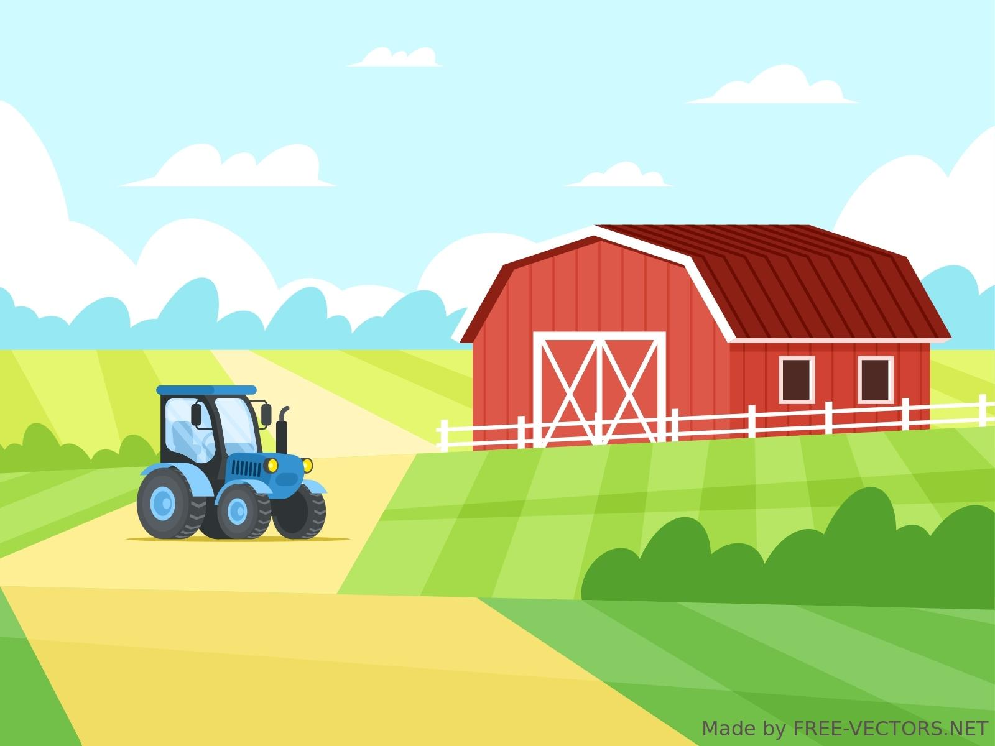

Weather Wizard for Farmers
Project output: reusable data (a simple web app)
  Give it your location (zip code?)
  Use a machine learning model to predict future temperature and precipitation for your zip code
  It will predict your last frost and whether it will be a warmer/cooler or wetter/dryer year
  It will predict which crops you (the farmer) should plant to make the most money
Data
  NOAA data
    Historical weather (temperature/precipitation) by location
    El Niño/Southern Oscillation history
    Atlantic/Pacific Multidecadal Oscillation history
    Solar Cycle history
  USDA data
    State agricultural output data by crop
Melissa Winstanley

Slide 22
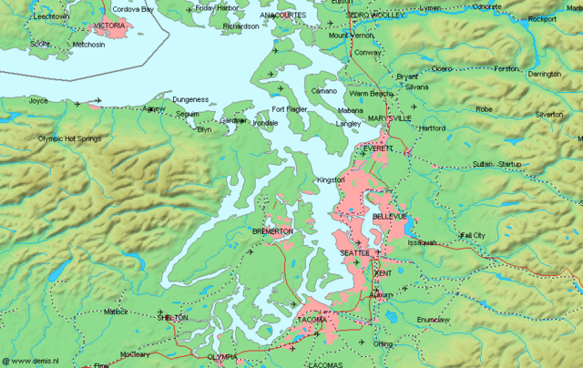
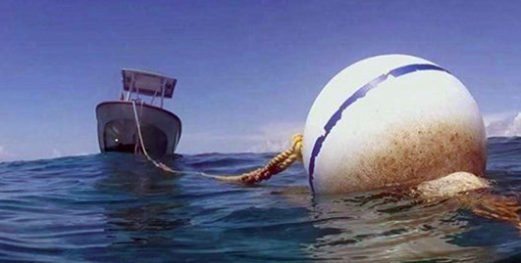
Tide Me Over!
Project output: research & a tool (to make map visualizations)
  Research how tides affect water changes in Puget Sound via mooring buoy
    Depth, oxygen, chlorophyll, and salinity
  Build map visualizations with a time slider to show the changes
  Include a search feature to narrow in on a particular location
Data
  NOAA historical tide data
  King County mooring buoy data
Melissa Winstanley

Slide 23

Fantastical Basketball*
Project output: reusable data (a simple web app)
  Give today’s best fantasy lineup for the NBA
    Daily/weekly/whole season
    Option to select best=points or best=money
  Show how the tool has performed for the previous week’s worth of games, relative to existing fantasy players
Data
  NBA historical data from basketball-reference.com (or NBA site)
  Day-by-day projection data from fantasydata.com (or other fantasy site)
* This is a VERY HARD PROBLEM. The output of the project is not a predictor that does better than existing players, but one that at least is not terrible.
Melissa Winstanley

