Slide 1
Software Design for Data Science
Software & Use Case Design
Melissa Winstanley
University of Washington
February 14, 2023

Slide 2
Today’s agenda
Lecture on design
Design exercise
Create a doc directory within the root of your project repository
Create Markdown files in the doc directory
Add/commit/push at the end of class
Finish up the design exercise for review by instructors next week

Slide 3
Software Design

Slide 4
Software Design
“…a specification of a software artifact intended to accomplish goals, using a set of primitive components and subject to constraints”
Wikipedia

Slide 5
Why software design?
"The hardest single part of building a software system is deciding precisely what to build. No other part of the conceptual work is so difficult as establishing the detailed technical requirements, including all the interfaces to people, to machines, and to other software systems. No other part of the work so cripples the resulting system if done wrong. No other part is more difficult to rectify later.
Therefore the most important function that software builders do for their clients is the iterative extraction and refinement of the product requirements."
Fred Brooks, The Mythical Man-Month

Slide 6
Fred Brooks’ suggested planning schedule
1/3 for design
1/6 for coding
1/4 for unit/component testing
1/4 for system testing

Slide 7
The Classic Dilemma
Good
Choose two
Fast
Cheap

Slide 8

The Classic Dilemma: Software Edition
Features
Choose two
Time
Resources

Slide 9

Prevent Feature Creep
Feature creep: gradual accumulation of features over time
Often has a negative overall effect on a project
Why does it happen?
Features are “fun”!
Developers like to code them
Marketers like to brag about them
Users want them
…but…
More bugs
More testing
More time

Slide 10
Improve Your Time Estimation
Time is the most valuable resource for your project
To spend your team’s time efficiently…
…you need to know what to build
…you need to know what not to build
…you need to know what order to build things
Design can help with this!
Estimating how long something is going to take is HARD!
Almost everything takes longer than you think it will
Design will help you order and parallelize your work so you aren’t surprised

Slide 11
Design Benefits
Systematic approach to a complex problem
Finds bugs before you code
Enables parallel work
Promotes testability

Slide 12
Software Design Process (for this class)
Identify the users
Who they are, what they want
High level
Functional design
What the system does
Specification
Component design
How the software will work
Implementation

Slide 13
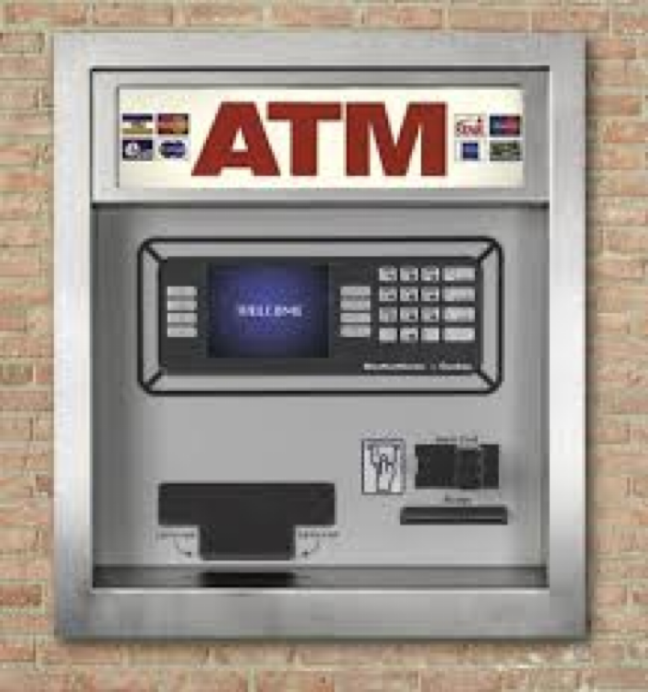
Running Example: Design an ATM

Slide 14
User Stories

Slide 15
Start with your users
Who are your users?
Researchers?
Policy makers?
Developers?
Children?
Trained monkeys?
What do they want to do with your software?
How are they interacting with it?
What needs do they have?
What skill levels do they have?

Slide 16
Example: Ram
Ram is a bank customer.
Ram wants to check his balance, deposit money, take out money.
Ram wants a safe/secure interface for interacting with the ATM.
Ram’s job does not involve technical skills and he values a simple user interface.

Slide 17
Example: ???
What might be another user story?

Slide 18
Example: Valentina
Valentina is an ATM technician.
She services ATMs as part of preventative maintenance, applies hardware and software updates, and performs emergency repairs.
For maintenance and updates she will follow a standard protocol.
For repairs, she needs access to a diagnostic interface.
Valentina is highly technical and knows how to replace standardized parts.

Slide 19
Exercise: Your User Stories
You will probably have several different kinds of “users” and a “technician” or two.
If you have a machine learning model backing your tool, don’t forget the “technician” who will train the machine learning model or update it.
Take 10 minutes to write 2-3 user stories with your team.
Use a Markdown file in the doc directory
Remember
Who
Wants
Interaction methods
Needs
Skills

Slide 20
Functional Design
(Use Cases)

Slide 21
Example: Ram
Ram is a bank customer. Ram wants to check his balance, deposit money, take out money. Ram wants a safe/secure interface for interacting with the ATM. Ram’s job does not involve technical skills and he values a simple user interface.
Check balance
Deposit checks
Deposit cash
Get cash

Slide 22
What do we do with an ATM?
Check balance
Deposit checks
Deposit cash
Get cash
These are use cases.

Slide 23
Implicit use cases
There’s an additional implicit use case in Ram’s example (not explicitly stated but understood to be the case).
User authentication!

Slide 24
Describing a use case
Objective of the user interaction
What information does the user provide?
What response does the system provide?
Usually about 3-9 clearly written steps.
This is not code!

Slide 25
Example: ATM user authentication use case
Objective: ATM validates that the user is allowed to access an account
User: insert ATM card into machine
ATM: display “Enter PIN”
User: enter pin on keypad
ATM: [if correct] show main menu
[if incorrect] display “Enter PIN”
Think about edge cases!

Slide 26
Exercise: Your Use Cases
Translate your user stories into use cases (functional designs)
Use a Markdown file in the doc directory
Remember
Explicit use cases
Implicit use cases

Slide 27
Component Design

Slide 28
What is a component?
“An individual software component is a software package, a web service, a web resource, or a module that encapsulates a set of related functions (or data).”
Wikipedia

Slide 29
Specifying components
Describe components with sufficient detail so that someone with modest knowledge of the project can implement the code for the component.
Name
What it does
Inputs (with type information)
Outputs (with type information)
Assumptions
How it uses other components
Sound familiar? Check out Lecture 3 on Interface Specifications!

Slide 30
Developing Component Specifications
What are the components in the use cases?
Packages
Modules
Resources
Data
Functions
What components are already available?
What are the sub-components needed to implement those components that aren't already available?
Do 1-2 for each such component

Slide 31
Example: ATM authentication
Components:
Database with account => PIN data
User interface to read an ATM card
User interface to read a user PIN
Control logic

Slide 32
Example: ATM authentication control logic
Name
authenticate
What it does:
Verifies a user is in the database & the pin supplied by the user is correct
Inputs (with type information)
Card number, a string that is the user’s card number
Pin, an integer
Outputs (with type information)
Boolean: True if success, False if failure
Assumptions: none

Slide 33
Example: ATM withdrawal
Components:
Database with account cash balance
User interface to read how much cash the user is requesting
Cash drawer interface to dispense cash
Control logic

Slide 34
Example: ATM withdrawal control logic
Name
withdraw
What it does:
Verifies that the withdrawn amount is available in the user’s account and debits the account if so
Inputs (with type information)
Account, the user’s account ID
Amount, an integer representing how many dollars to withdraw
Outputs (with type information)
Boolean: True if success, False if failure
Assumptions
User is already authenticated

Slide 35
Pseudocode
Helpful to gain insight into how components interact
Not really code - mostly readable English with some flow control & variables
withdraw(account, amount):
find account balance in the database
if amount <= balance
subtract amount from the balance
save the updated amount in the database
return True
else
return False
Another component!

Slide 36
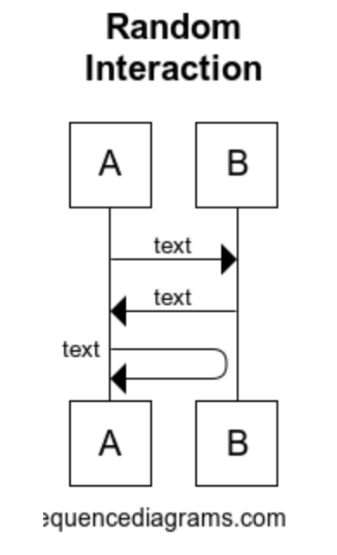
Specifying component interactions
Diagrams are very helpful!
Web tool for making these:
https://www.websequencediagrams.com/

Slide 37
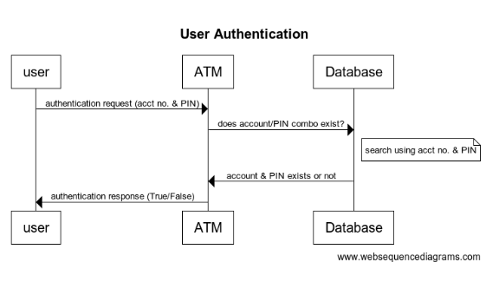
Example: user authentication component interactions

Slide 38
Example: user authentication component interactions
title User Authentication
user->ATM: authentication request (acct no. & PIN)
ATM->Database: does account/PIN combo exist?
note right of Database: search using acct no. & PIN
Database->ATM: account & PIN exists or not
ATM->user: authentication response (True/False)

Slide 39
Another diagram option: draw.io
https://app.diagrams.net/

Slide 40
Component Design: Summary
Identify components
Specify each component
Specify component interactions

Slide 41
Exercise: Your Components
Translate your use cases into components
Create a specification for each component
Potentially including pseudocode
Create interaction diagrams for how components interact
Use a Markdown file in the doc directory

Slide 42
From Design Onwards

Slide 43
Milestones
What are you actually going to do and in what order?
Are there any dependencies between components such that you must build Component A before Component B?
What will success look like?
This is not specific tasks - these are broad strokes

Slide 44
Example: ATM milestones
Build account infrastructure Success: account database and middle control layer exist that can access an account
Build user authentication flow Success: manually authenticate a user with a PIN by calling the Python functions directly
Build user interface Success: user can log onto their account with their account no. and PIN
Build account withdrawal/deposit features Success: user can fully access funds in their account

Slide 45
Implementing a component
Recommended approach:
Write the interface for the component.
Write some tests for the component.
Write the implementation of the component.
Iterate on the tests as you identify more.

Slide 46
Dividing up work
Components can be a good natural division of work
Example:
Melissa builds the user interface components
Amrit builds the machine learning model
Tara builds the control logic layer
This is not the only way to divide up work!

Slide 47
More details on expected output: https://uwdata515.github.io/projects.html

