Slide 1
Software Design for Data Science
Continuous Integration
Melissa Winstanley
University of Washington
February 20, 2025

Slide 2
A common problem
I change some code
I make a PR
Baisakhi approves my PR
I merge my PR
Whoops! I forgot to run the tests and now all the code in main is broken

Slide 3
A solution
Tests (eg unit tests)
Style checkers (eg pylint)
eg install packages
Automated building and testing of a code base
aka Continuous Integration
“CI”
Building and testing is done “continuously” as the code is developed
“Integrating” changes from developers into code

Slide 4
Actually…
Commit is pushed => Test/Build
So more like “semi continuous”

Slide 5
Going a step further…
Continuous Integration
Automated build/test on merge of PR to main
Continuous Delivery
Continuous integration PLUS…
All configuration information, data, and code is ready to be pushed to production
Continuous Deployment
Continuous delivery PLUS…
The application is automatically deployed to production
“CD”

Slide 6
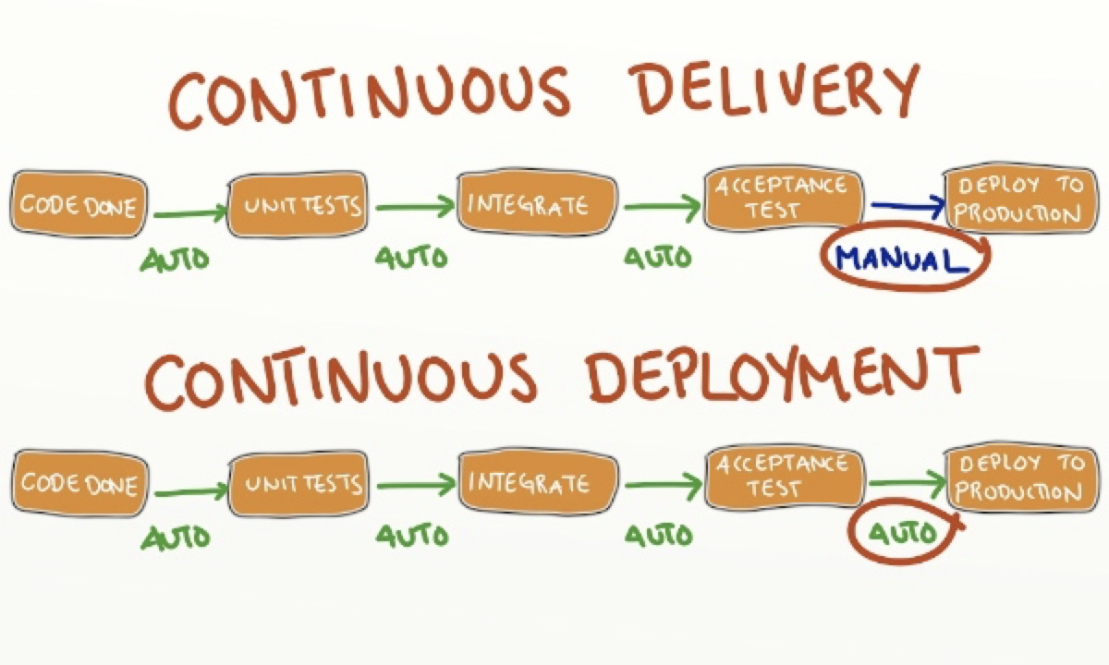
Continuous Delivery vs Deployment
http://blog.crisp.se/2013/02/05/yassalsundman/continuous-delivery-vs-continuous-deployment

Slide 7
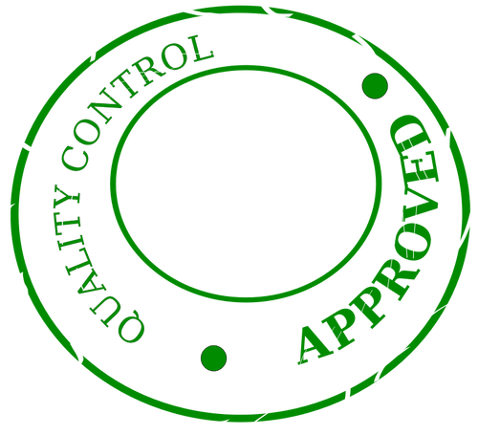


Why CI is good
Core component of
Continuous Delivery and Deployment
Rigorous quality checks on main branch
More frequent “integrations” (even before a PR is merged - stopping breakages before they happen!)
Evidence shows conflicts are resolved more rapidly

Slide 8





Why CI is good
Identifying bugs early!
Difficulty of fixing bug
Time
Notes:
Cost to fix bugs is exponentially related to when the bug is identified
Easier to identify offending code when it was written shortly before a defect was identified
You just wrote the code, it is fresh in your mind
CI checks on small units of work benefit the most from this
Some teams will run hundreds of CI checks a day

Slide 9


Why CI is good
When a defect is identified after delivery the cost is enormous.
Bug tracking, testing, re-testing, release notes, customer notification, down time
Damage to reputation or liability

Slide 10
Options for CI
TravisCI
Since 2011
Cloud-hosted
First company to provide CI to open-source projects for free
CircleCI
Since 2011
Cloud-hosted
Very similar to TravisCI, but slightly more expensive for non-open-source
Jenkins
Since 2011
Open-source software
You have to run it yourself
GitHub Actions
Since 2018
Super compatible with GitHub

Slide 11
How does it work?
Make a commit
Push to GitHub (any branch)
GitHub triggers a “workflow”
GitHub runs the build/test workflow
Notification of result
You make some commits that form a coherent body of work, e.g. implement a feature.
GitHub detects the push event, finds all workflows corresponding to that event, and starts up a virtual machine(s).
GitHub runs the commands you specify that do unit testing, coverage reports and style checks.
The team is notified of the result, usually in email. If the commands fail with an error, the build is reported as failing.
1
2
3
4
5

Slide 12
GitHub Actions Concepts
Workflow: an automated process that will run
Event: a specific activity that triggers a workflow (eg push, PR creation, etc)
Job: a sequential set of tasks that is a part of a workflow
Jobs can have dependencies on each other
Step: a single task within a job
Runner: a server (VM) that runs a workflow when it is triggered
Action: a complex, reusable step that has been coded separately
There are 3rd party actions, but you can write your own

Slide 13
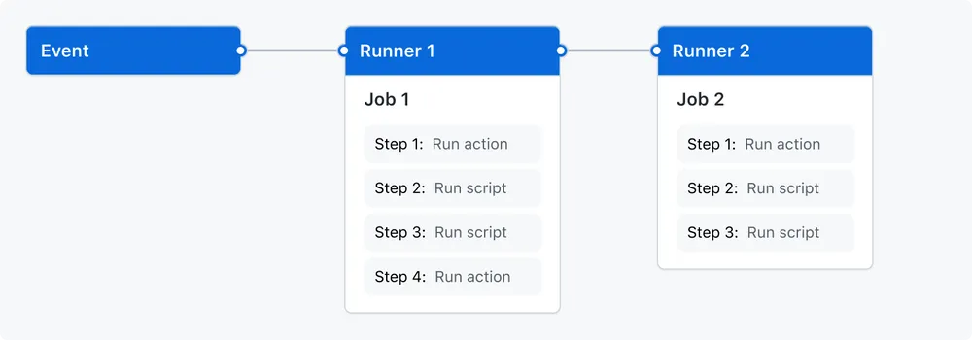
GitHub Actions Workflow

Slide 14




GitHub runners use virtual machines

Slide 15
Why do I need more than one job?
Jobs encapsulate tasks
Jobs can be run in parallel
Eg run your tests on all platforms (Windows, MacOS, Ubuntu)
Jobs can be configured to run on specific branches
So you may run the build/test job on ALL branches
But only run the deployment or package push job on the main branch
But it’s also ok to only have one job if you have a simple CI plan.

Slide 16
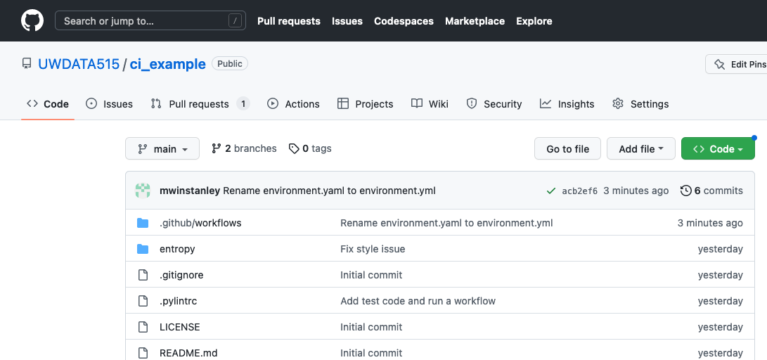
Where do I see the results of the workflow runs?

Slide 17
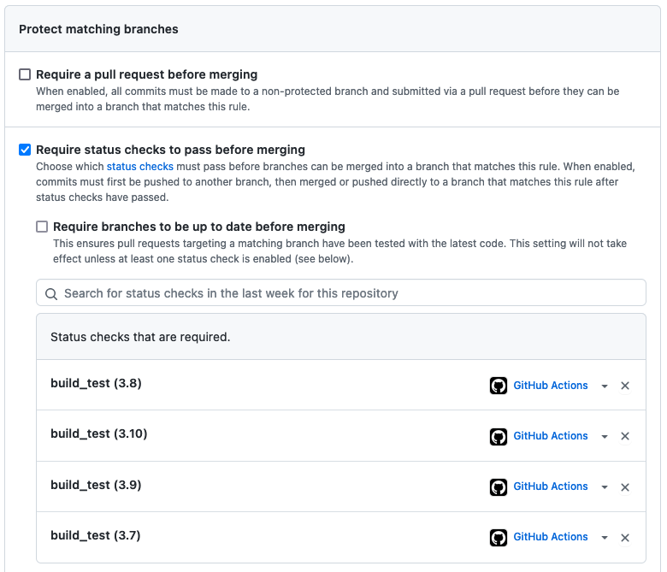
Enforcement with
branch protection
rules

Slide 18
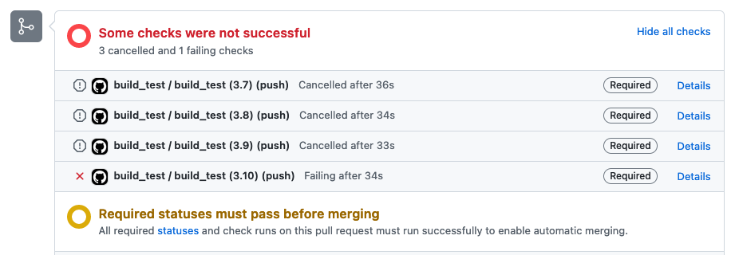
Enforcement with branch protection rules

Slide 19
A Workflow Example
https://github.com/UWDATA515/ci_example

Slide 20
More powerful features
Check out the documentation to learn all about what you can do!
https://docs.github.com/en/actions
Or for Python:
https://docs.github.com/en/actions/automating-builds-and-tests/building-and-testing-python
I can’t cover everything in this lecture, and you won’t remember anyways.

Slide 21
If you want to use another CI platform…
….you can, but we won’t provide active support.

Slide 22
Coverage
What % of your code is covered by tests.
High coverage is good
High coverage does not guarantee your code works but it helps!
Calculated using a package that we use to run the tests
For us: the coverage package
coverage run -m unittest discover
We often use a tool to report and analyze coverage
For us: Coveralls
Goal: don’t decrease your test coverage when you make a PR!

Slide 23
Exercise: Set up CI for your project repository
THIS IS REQUIRED FOR YOUR PROJECT (by the time it’s due)!
Create a new working git branch.
Create a GitHub Actions workflow to run on push and/or PRs.
Push the workflow configuration to GitHub.
Make sure the workflow runs successfully.
Create a PR to add the workflow and merge it after acceptance.
Enforce that tests pass with branch protection.
Add badges for CI status and code coverage.
Improve your test coverage! Aim for as close to 100% as possible.
AT A MINIMUM, the workflow should run tests & code coverage (style next week!)
Special applause for continuous delivery/deployment (future lecture)
Pushing to PyPI (publishing your Python package), deploying a web application

