Slide 1
Software Design for Data Science
Team Collaboration
Melissa Winstanley
University of Washington
February 6, 2025

Slide 2
Standups
What is a standup?
1-2 minutes per person
Why standups?
Communicate status and actions within and between teams
What do I say in a standup?
Progress you’ve made since the last standup
How it compares with the plan
If behind plan, how to compensate to make plan end date
Deliverables for next period
Challenges to making next deliverables
Technology uncertainties and blockers
Team issues

Slide 3
Standups
In class!

Slide 4
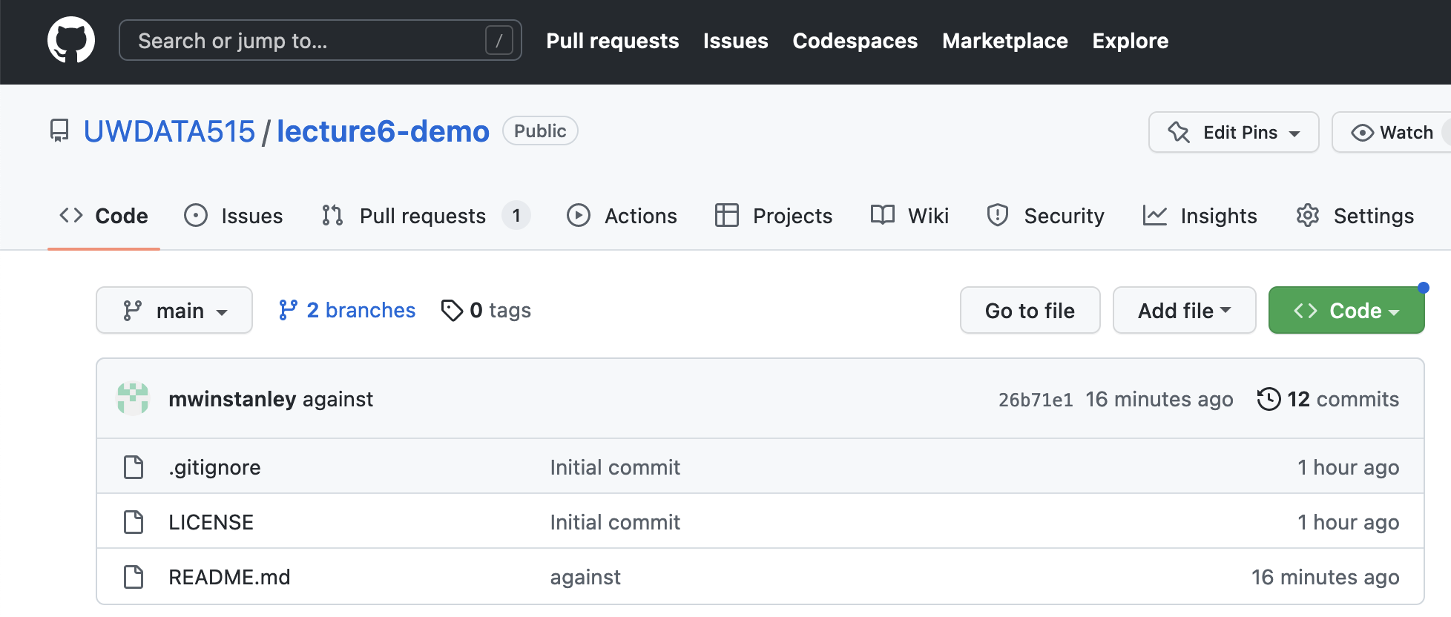
GitHub Issues

Slide 5
GitHub Issues
Good way to keep track of
Milestones
Tasks
Bugs
If you link to an issue in a PR, it will auto-link the two
Use it if you like!

Slide 6
GitHub Pull Requests
Pull Request = “PR”
Yeah, it’s a confusing name: “hey repo owners, please PULL my change into main”
What’s in the description of a PR?
Background
Describe what change you are making
Describe how that change affects the application
Test plan
How did you test the code?
Include specific commands that you ran, and the output
ALWAYS!
Only push directly to main in a true emergency (not in this class!)

Slide 7
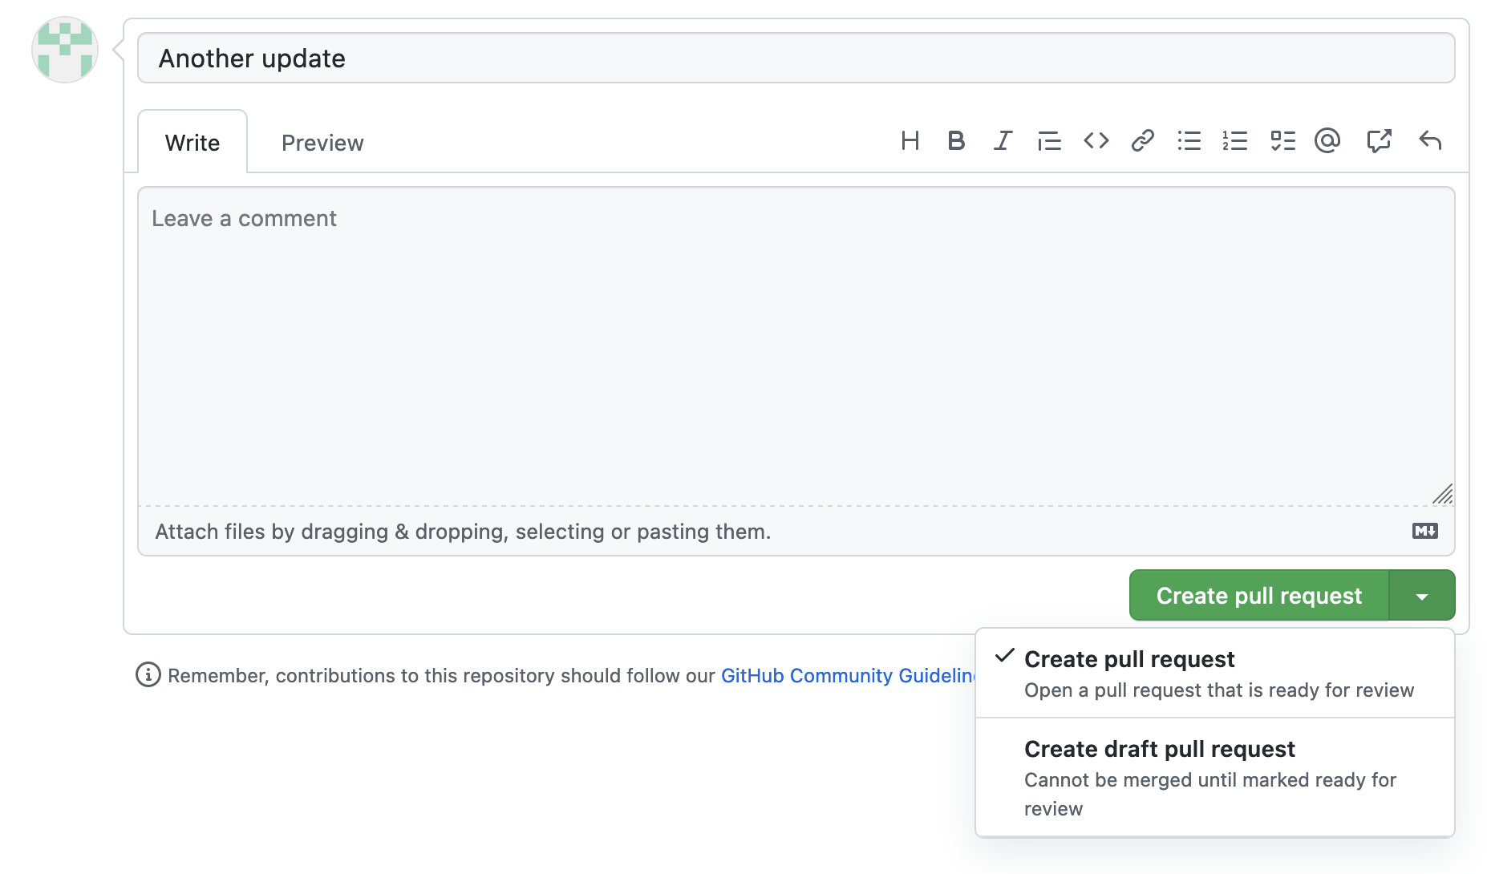
Good option: draft pull requests
If you’re not fully ready to submit it for code review

Slide 8
Code Reviews
What is code review?
Someone looks at, comments on, and approves a PR - NOT one person
Why code review?
To find bugs
To improve code quality
What do you comment on in a code review?
Bugs or missing pieces
Style
Choice of variable and function names
Code readability
If the PR doesn’t have a test plan
How to improve reuse and efficiency
How to use existing Python packages

Slide 9
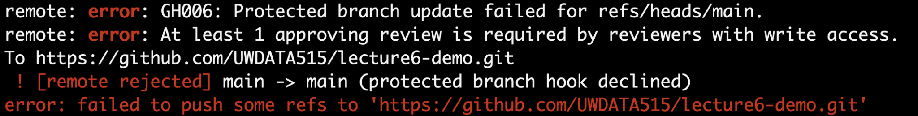
Branch Protection
Protect main against accidents!
Require pull requests and code reviews
Common in the real world

Slide 10
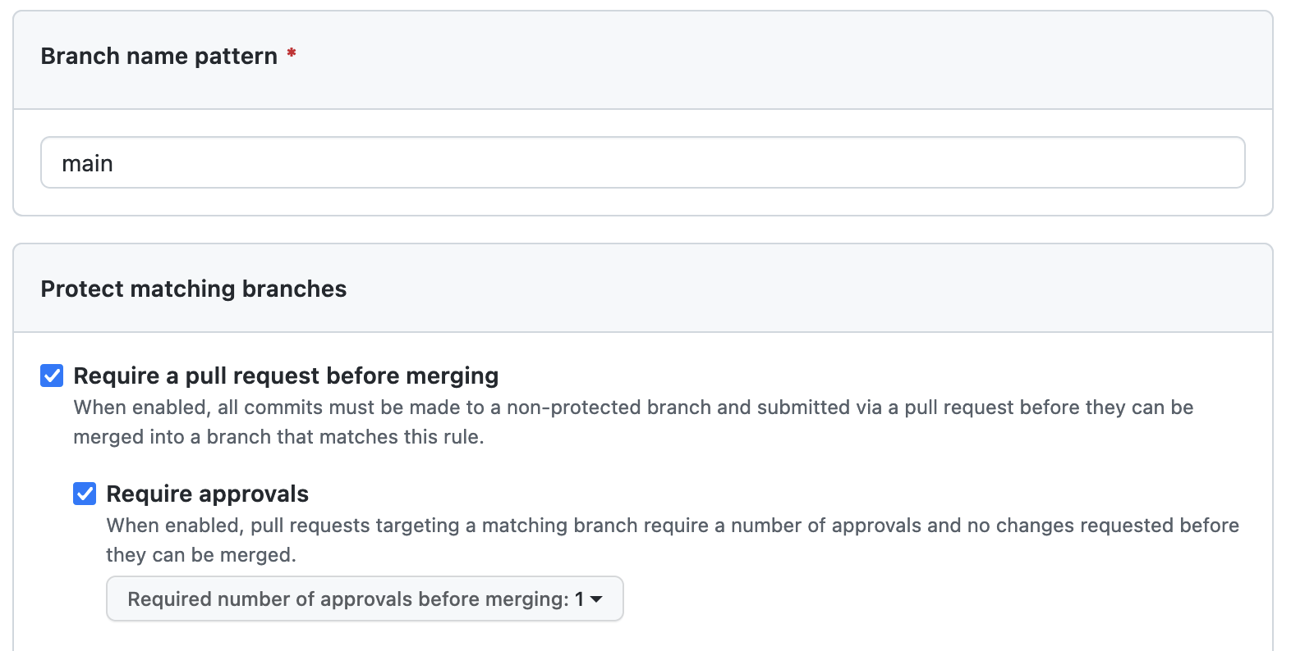
Branch Protection
GitHub Repository Page > Settings > Branches > Add branch protection rule
Do this now for your exercise repository!
Do this on your project repository!

Slide 11
Communication strategies
Use a chat mechanism for informal, quick communication
Email doesn’t really work
Slack
Microsoft Teams
Discord
Google Chat
Don’t hesitate to hop on a Zoom to follow-up
Documentation as communication
Code documentation
Pull request description

Slide 12
Pair programming
Two people, one keyboard
Fewer mistakes with more eyes
Learning for both people
Consider trying it for difficult tasks!
Swap who has hands on keyboard at least every 30 minutes
Keep talking

Slide 13
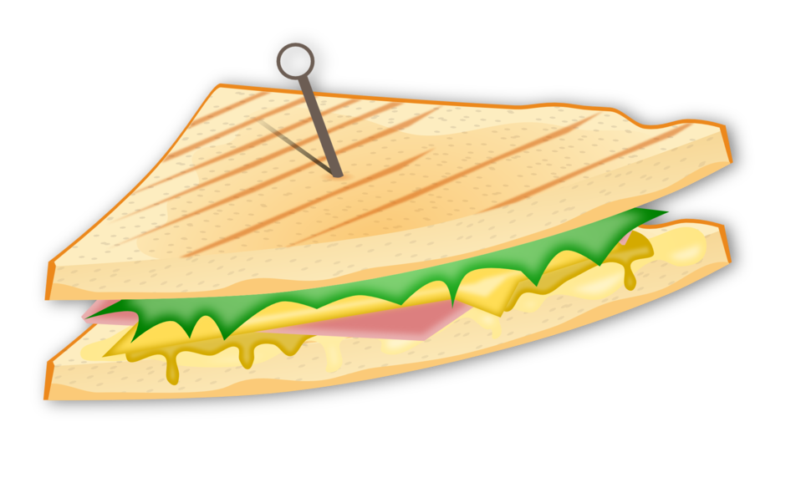
Fast feedback
Quick responses to communication
Code reviews
Emails
Chat
Constructive criticism
Consider (gently) giving teammates feedback
Make observations, not generalization
Sandwich approach
Listen to the response!
Don’t wait until the survey at the end of the quarter!

Slide 14
Collaboration Summary
Standups
GitHub issues
Pull requests
Code reviews
Chat
Pair programming
Fast feedback

