Slide 1
Software Design for Data Science
Git, Part 2
Melissa Winstanley
University of Washington
February 6, 2025

Slide 2
Review
How do I…
view the change history for a repository?
git log
see what files in the directory are modified since the last commit?
git status
examine the changes between modified files and the last commit?
git diff
place a modified file into the staging area?
git add <file>
move the staged files into the repository history?
git commit -m “My commit message”

Slide 3
Review
What do the following verbs do?
Push
Clone
Pull

Slide 4
Review
What is…
HEAD?
HEAD~3?

Slide 5
Exercise
Get into teams of 2-3
Identify someone to“own” a repository who will create it in their GitHub account (PUBLIC repository)
Add a README.md, LICENSE and .gitignore using the UI
Python language & MIT license are good to start
Add the other team members as collaborators to the repository
Everyone clone on their computer

Slide 6
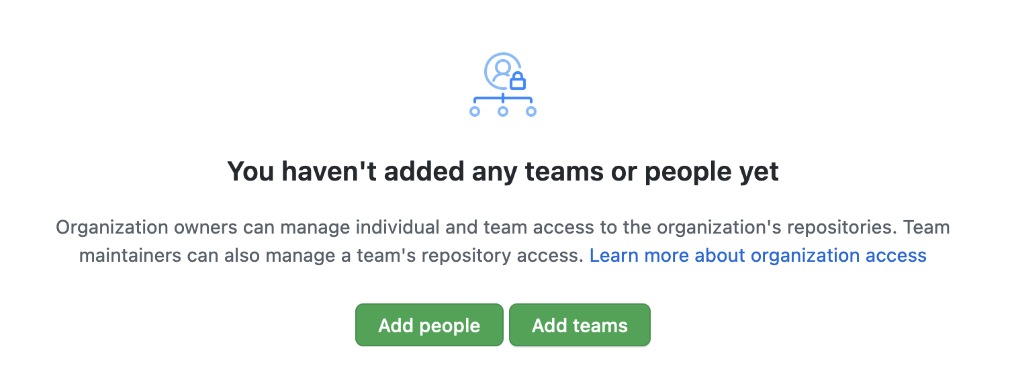
Exercise
To add collaborators to a repository
Go to the repo
Click on Settings, then Collaborators & Teams, then Add People

Slide 7
Exercise
Everyone make changes to the README.md
Status, diff, add, commit, push
What happens?

Slide 8
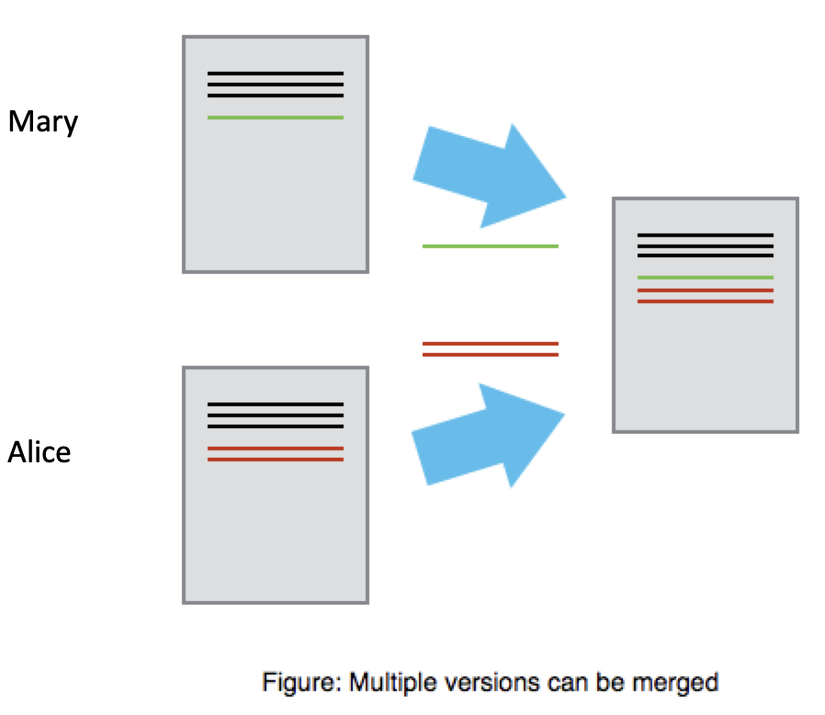

Slide 9
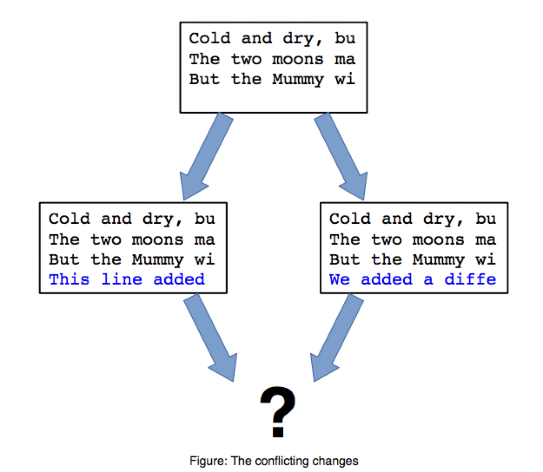

Slide 10
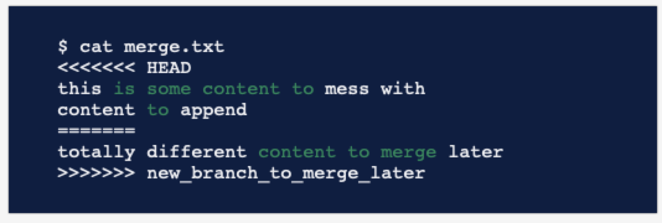
Merge conflicts

Slide 11
Fixing your merge conflict
git fetch
git merge origin
Open the files with the conflict in a text editor
Find the conflict, which always has lots of <<<<<< and >>>>>>
Rewrite the block between the brackets to what you want it to be
Remove the brackets and equals signs too
git commit

Slide 12
Collaborating Scenario
Main development trunk of codebase
Bug comes in via issue report on GitHub
You need to work on the bug but don’t want to screw up the main development trunk
What to do?

Slide 13
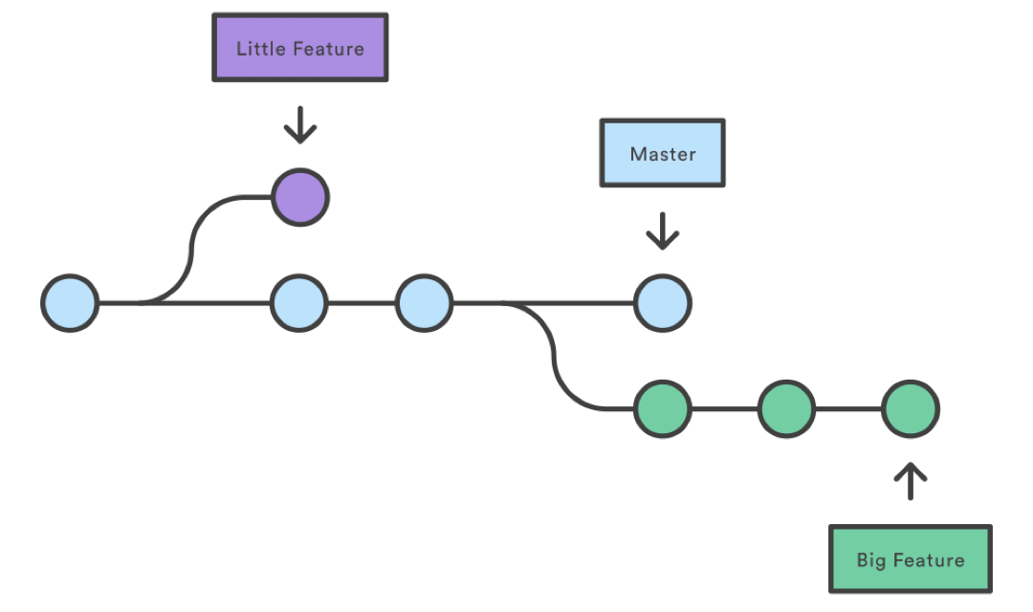
Branches
Does the name main make more sense now?
NOTE!
main vs master
git vs GitHub
Main

Slide 14
Branch commands
Create a new branch on your local computer
git branch name-of-branch
Delete a branch
git branch -D name-of-branch
Switch to a branch (or main)
git checkout name-of-branch
git checkout main
Make a new branch and switch into it all at once
git checkout -b name-of-new-branch

Slide 15
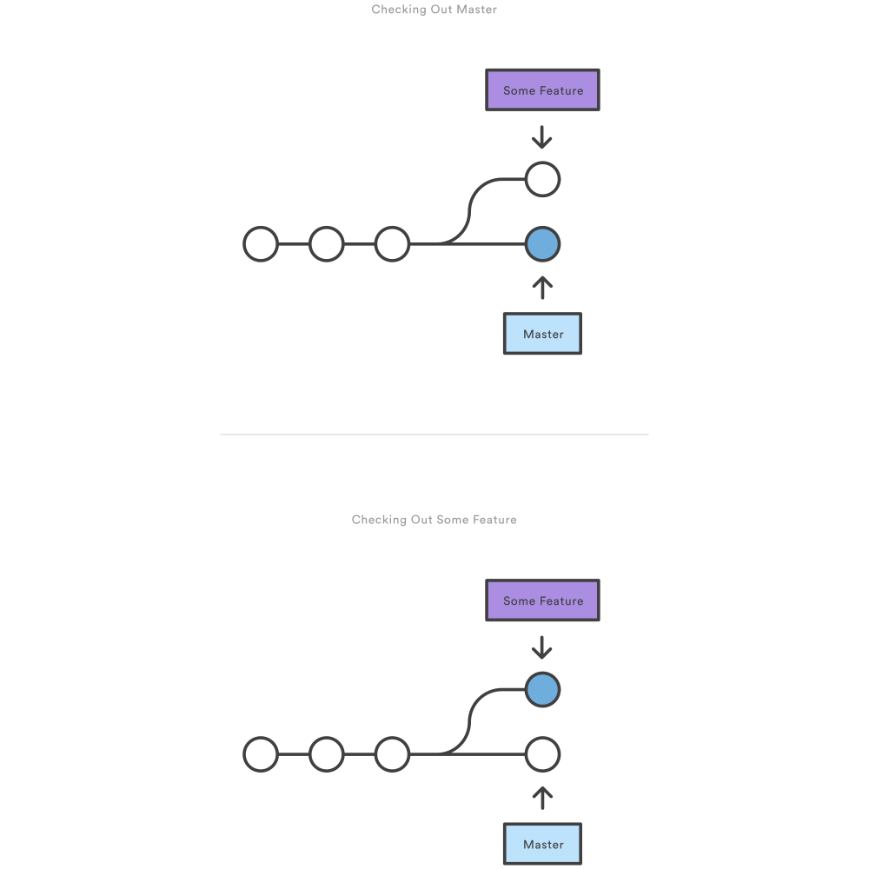
Branches: visual
After branch creation
After branch checkout
Main
Main

Slide 16
Merges
But how do we get our features back into main?
Main

Slide 17
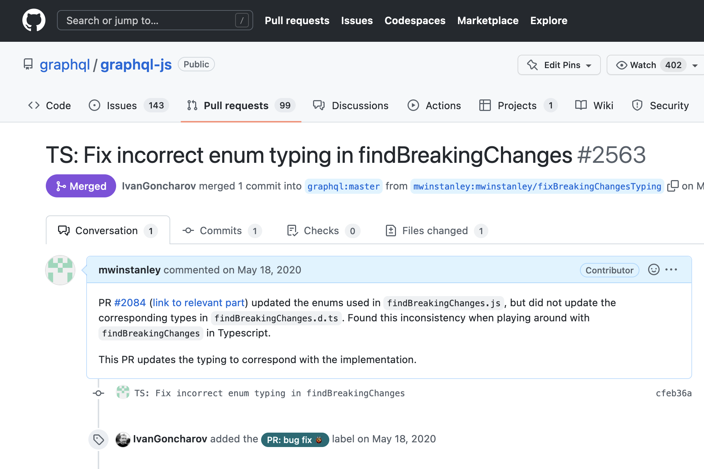
Pull requests

Slide 18
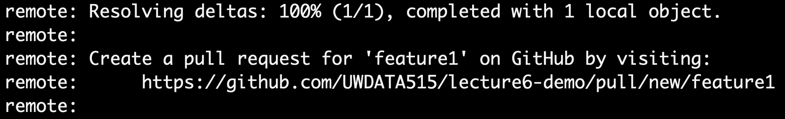
Submitting a pull request
From your branch, push the branch to GitHub:
git push
You’ll need to configure git:
git config --global --add --bool push.autoSetupRemote true
This tells git to automatically sync the proper branch with GitHub when you push
Follow the link:

Slide 19
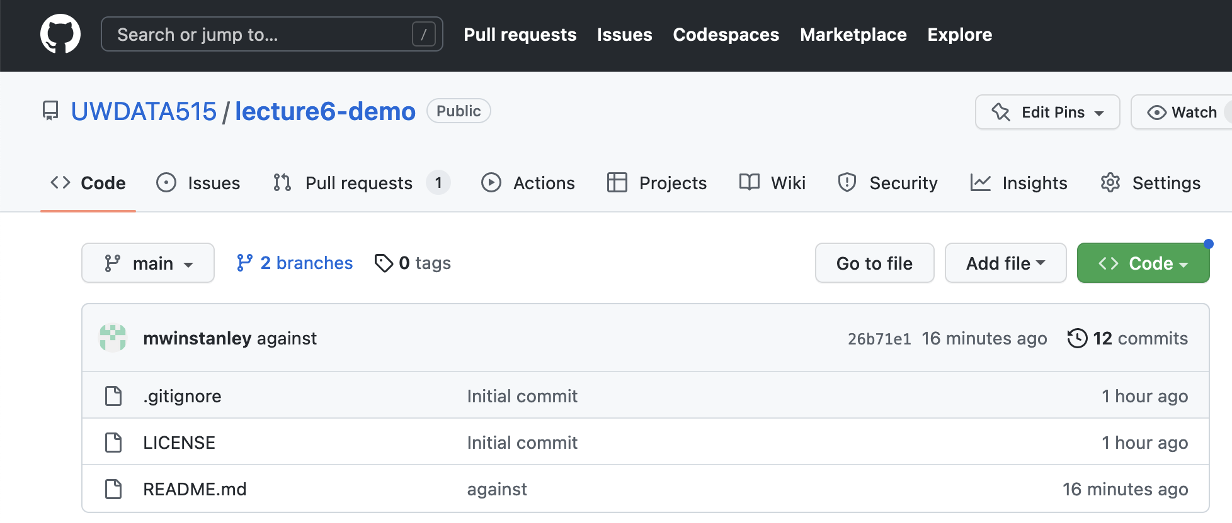
Branches on GitHub

Slide 20

Merges
Usually: via the GitHub interface in a Pull Request (more in next slide!)
Or: git merge branch-name (familiar?)

Slide 21
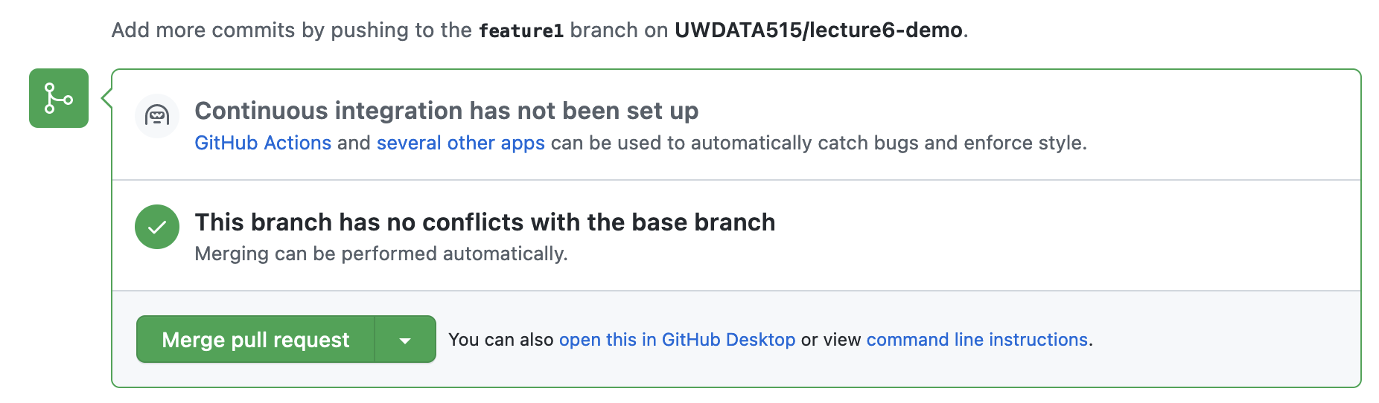
Merging through the GitHub UI for a Pull Request
Don’t forget to delete the branch when you’re done!
(or configure auto-deletion in the repo Settings)

Slide 22
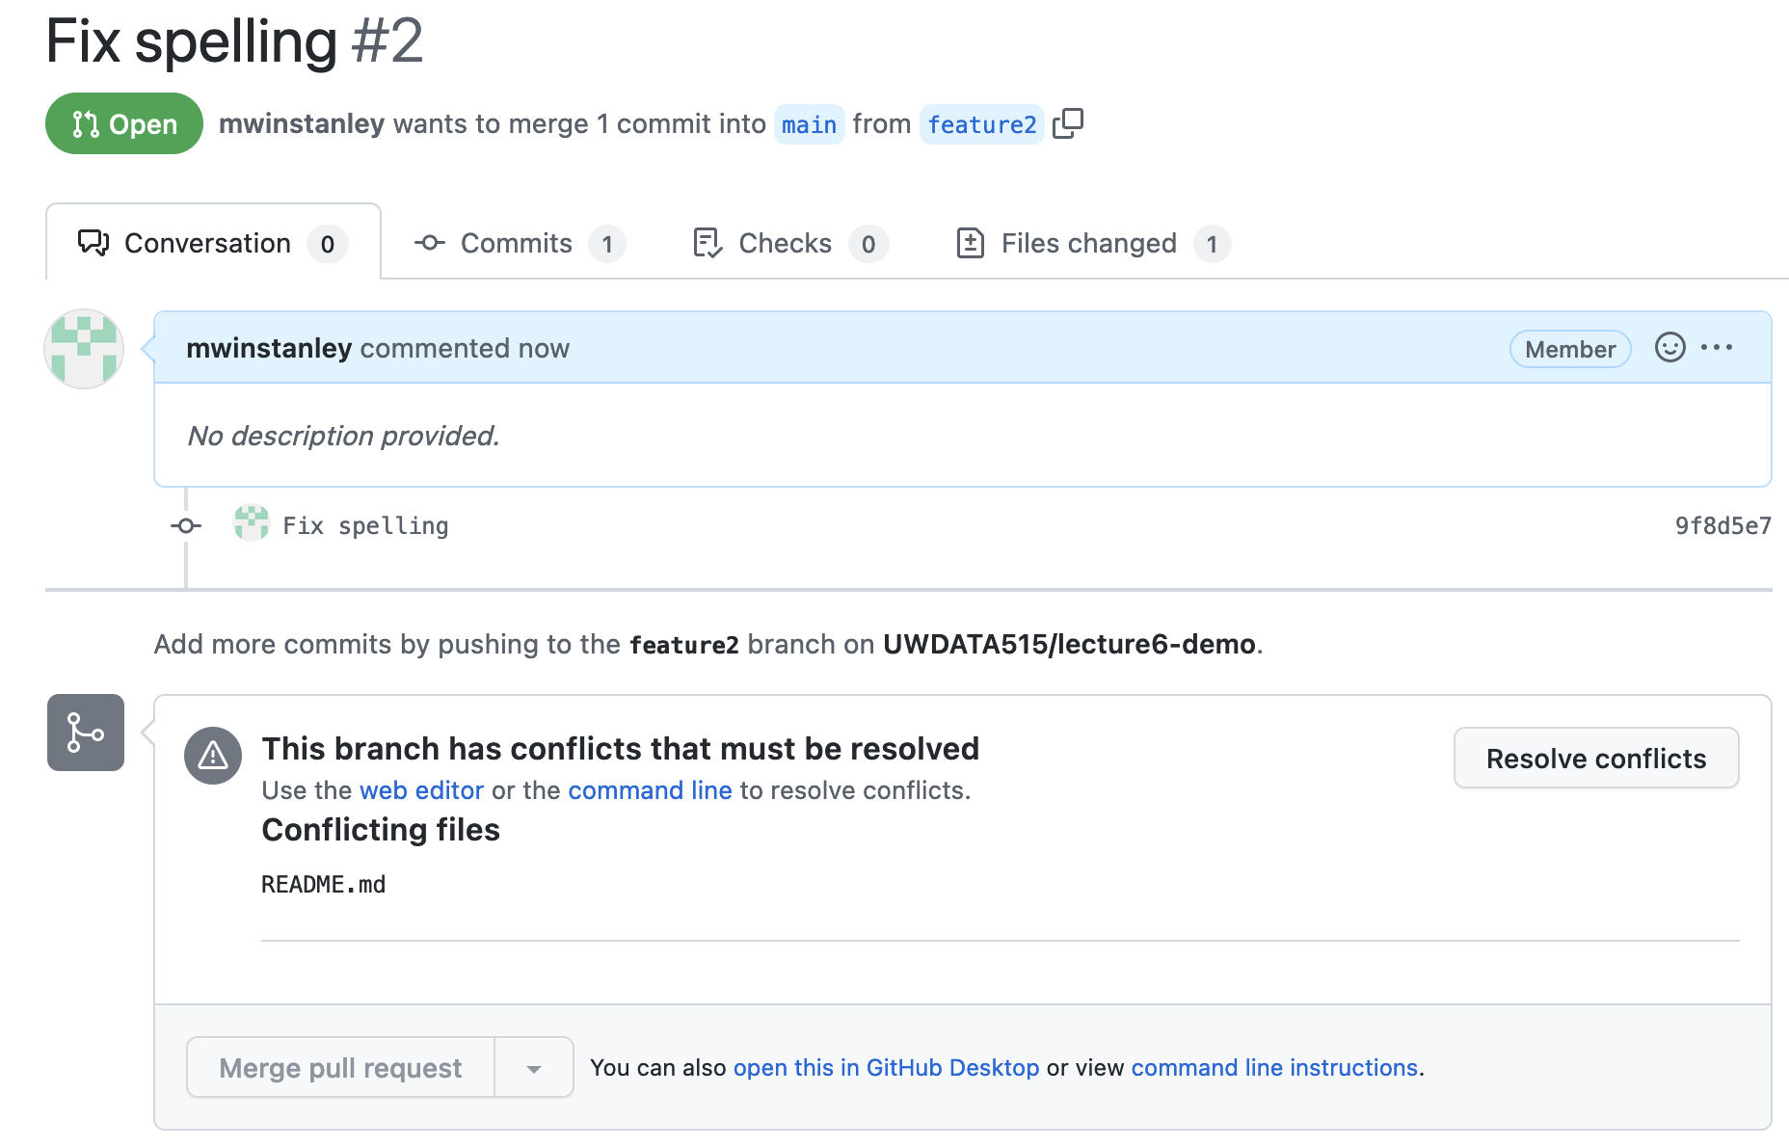
Merge conflicts
Uh oh!
Someone else merged a conflicting change so I can’t merge my branch

Slide 23
Merge conflicts: merging main into your branch
Via the GitHub interface (ONLY if simple eg Markdown files)
Or
git checkout main
git pull # pull in the conflict
git checkout your-feature-branch
git merge main
(fix merge conflicts by editing the conflicting files, git add as needed)
git commit
git push # update the remote version of your branch

Slide 24
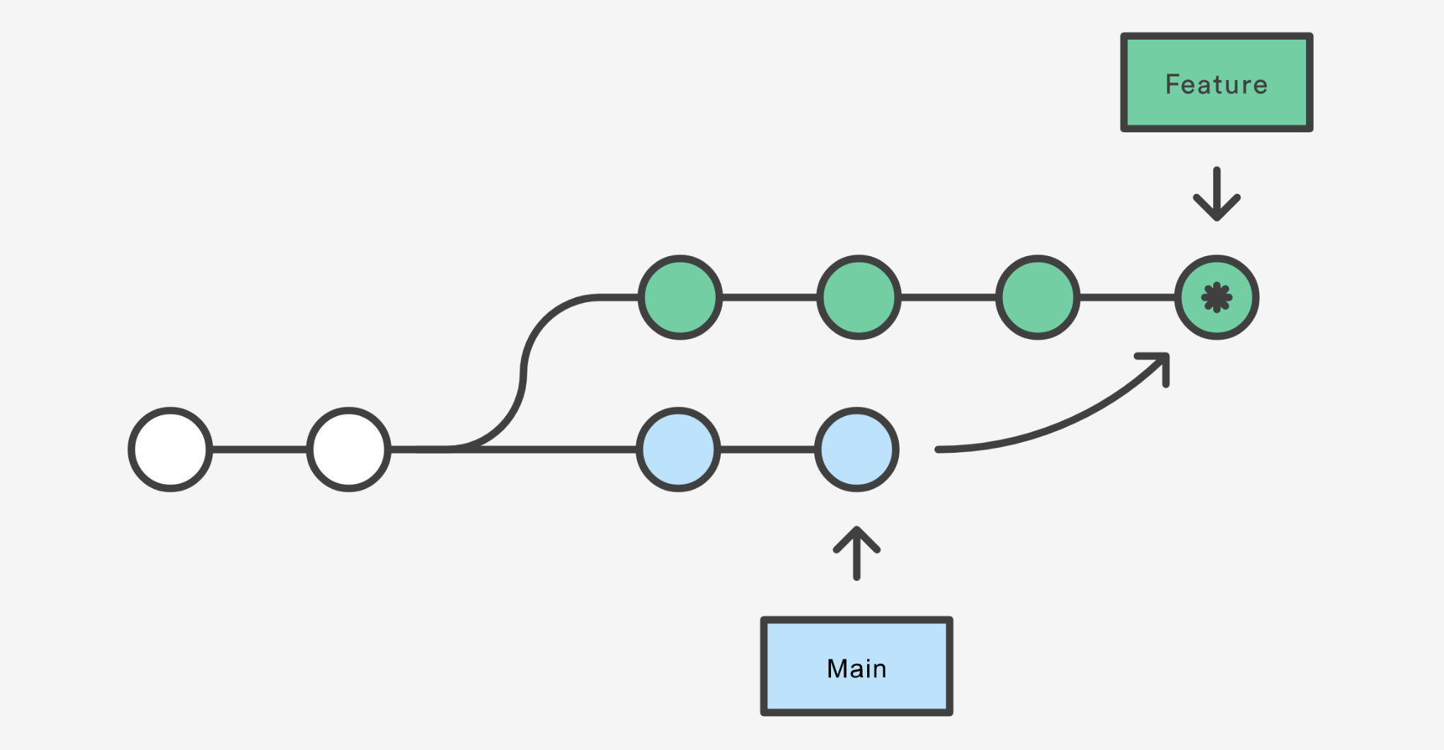

Slide 25
Merging main into your branch
Pros
Non-destructive - existing branches are not changed in any way
Cons
Extra “merge commits” in the history

Slide 26
Merge conflicts: rebasing
If you’re like me and HATE those “merge commits”
git checkout main
git pull # pull in the conflict
git checkout your-feature-branch
git rebase main
(fix merge conflicts by editing the conflicting files, git add as needed)
git rebase --continue
git push --force
This “rewrites history” - hence why you need to --force
More about merging vs rebasing

Slide 27
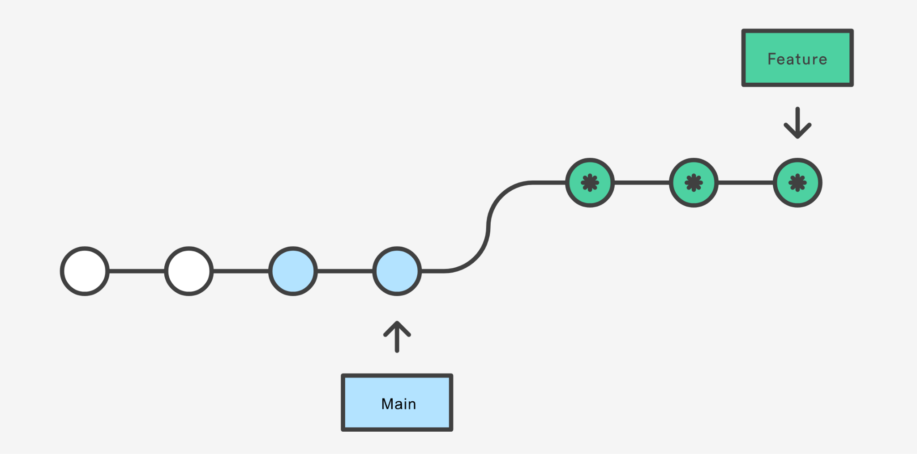

Slide 28
Rebasing
Pros
Perfectly linear history
No extraneous “merge commits” - cleaner history
Cons
Rewriting history
You can’t tell when things were rebased exactly
NEVER USE REBASING ON A PUBLIC BRANCH (ie main)
Only your own private branches

Slide 29
Rebasing
You don’t have to wait until you have an approval to rebase or merge main into your branch!
It’s a good idea if you know someone else submitted a major change that might affect yours

Slide 30
Standard Collaborative Flow
Create a new branch (git checkout -b new-branch-name)
Commit some changes
Push your branch to GitHub
Create a pull request in the UI
Pull and merge main into your branch again, resolving conflicts, if necessary (git merge main or git rebase main)
Merge the pull request using github.com and the big green button

Slide 31
Exercise
Everyone:
Follow the standard collaborative flow to make a change to README.md
Review each other’s pull requests
Everyone should merge

Slide 32
Common mistake
Oops! I forgot to switch to a new branch and now I my commits are on main!
Create a new branch where you are. This will save your commits and give then the new branch name
Checkout the main branch
Reset main back to before your commits. Count how many commits back you want to go, then reset. For example, if you’ve accidentally added 2 commits:
git reset --hard HEAD~2
Now you can checkout your new branch and continue with your changes
This says get rid of the commits entirely

Slide 33
Real-World Branch Notes
Conflicts are natural! There is nothing wrong
Name your branch something descriptive
Prefix your branch name with your user id mwinstanley/readmeUpdate
Delete your branch when you’re done
Configure auto-deletion in the repository
Settings > Automatically delete head branches

Slide 34

Forking
Another
solution!

Slide 35
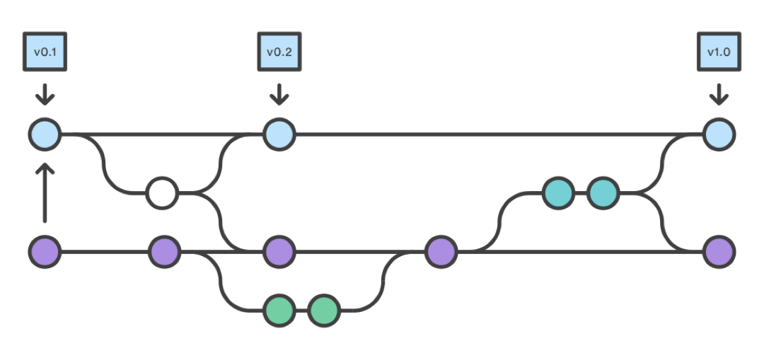
Forking
A totally new copy of the repository, which you can change and ask the original owners to “pull” back into their own version.

Slide 36
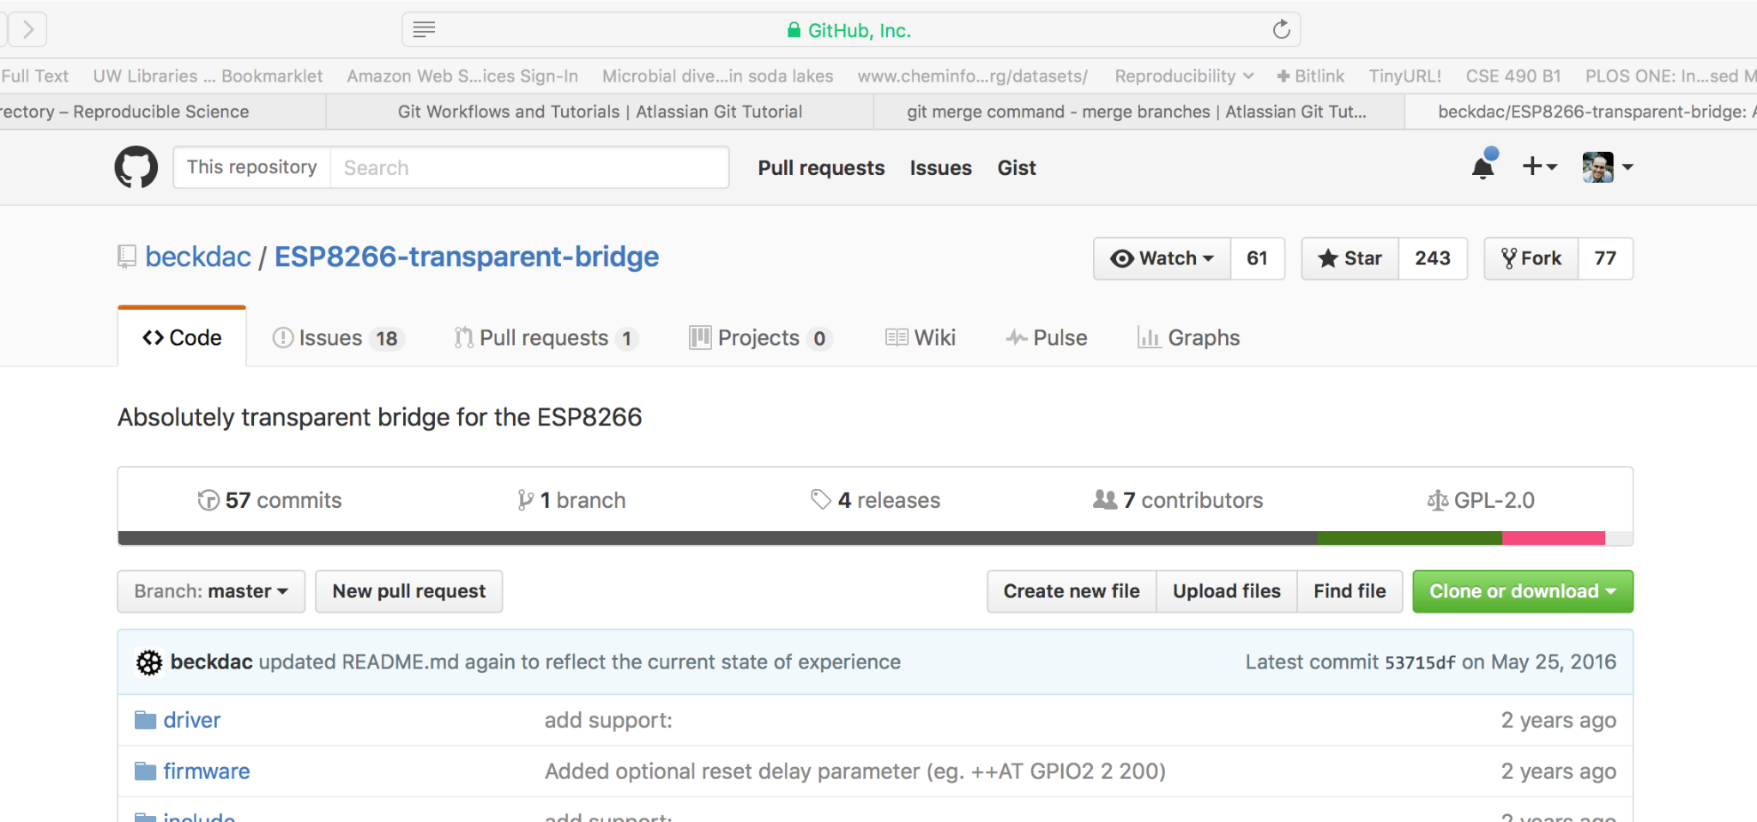
Forking

Slide 37
Forking
Probably not in this class (use branches)!
Making changes to open-source libraries

