Slide 1
Software Design for Data Science
Modules, Packages, and Imports
Melissa Winstanley
University of Washington
February 6, 2025

Slide 2
Definitions
Object: Most things in Python, e.g. function, variable, class.
Module: A *.py script; carries the name as the file.
Namespace: A mapping of unique names to objects.
Package: A directory-like concept that can hold multiple Python objects, modules, or subpackages under same namespace.

Slide 3
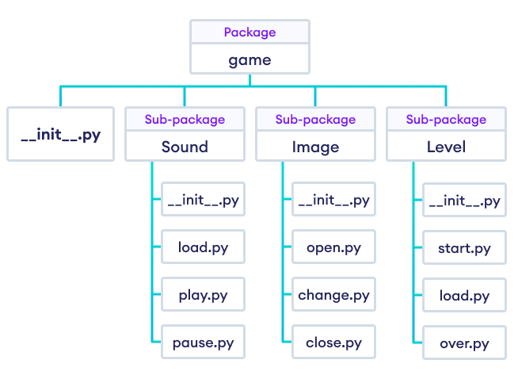
Definitions: Example
when running import game
all objects in all modules are in the game namespace
Example from https://www.programiz.com
Modules (files)

Slide 4
Imports

Slide 5
Imports
There are 4 different syntaxes for writing import statements.
import <package>
Brings <package> into the current namespace
import <module>
Brings <module> into the current namespace
from <package> import <module or subpackage or object>
Brings <module or subpackage or object> into the current namespace
from <module> import <object>
Brings <object> into the current namespace

Slide 6
Using imports
Let X be whatever name comes after import.
If X is the name of a module or package, then to use objects defined in X, you have to write X.object
# for these cases
import <package>
import <module>
from <package> import <module or subpackage>
If X is a variable name, then it can be used directly.
If X is a function name, then it can be invoked with X()
from <package> import <object>
from <module> import <object>

Slide 7
Multiple imports
from <module> import <object1>, <object2>, <object3>
OR
from <module> import (
<object1>,
<object2>,
<object3>,
)

Slide 8
Import as
Optionally, as Y can be added after any import X statement:
import X as Y
from X import (
foo as Y,
bar as Z,
)

Slide 9
Import order of search
How does Python find modules/packages to import?
Python Standard Library packages/modules (eg math, sys)
Packages/modules in sys.path:
If run with the Python interpreter (ie just python)
sys.path[0] is the empty string ’’, which means the current working directory
If run with python <module.py>:
sys.path[0] is the path to <module>.py
Directories in PYTHONPATH environment variable
Default sys.path locations - dependent on Python installation

Slide 10
Absolute vs relative imports
Absolute Imports (works in Python 2 and 3):
Import from the top-level Python package. e.g., import <package>
Relative Imports:
Import based on your sys.path location.
Explicit Relative Imports (works in Python 2 and 3):
Import using . (current directory) and .. (parent directory) notation
Implicit Relative Imports (only Python 2):
Discontinued

Slide 11
Wildcard imports
Bringing EVERYTHING from a package or module into the current namespace
from <package> import *
BAD BAD BAD! Why?
Conflicts between names defined locally and the ones imported
Reduces code readability - where did a name come from?
Clutters the local namespace, which makes debugging more difficult
Example in the materials for today

Slide 12
Directory Structure

Slide 13
Basic codebase in a git repository
myproject/
README.md
LICENSE
myproject/
__init__.py
core.py
subpackage/
__init__.py
subpackage.py
submodule/
submodule.py
tests/
__init__.py
test_core.py

Slide 14
Basic codebase in a git repository
This is your git repository, usually matching the name on Github
myproject/
README.md
LICENSE
myproject /
__init__.py
core.py
subpackage/
__init__.py
subpackage.py
submodule/
submodule.py
tests/
__init__.py
test_core.py

Slide 15
Basic codebase in a git repository
myproject/
README.md
LICENSE
myproject /
__init__.py
core.py
subpackage/
__init__.py
subpackage.py
submodule/
submodule.py
tests/
__init__.py
test_core.py
Markdown-formatted or plain text file describing the package

Slide 16
Basic codebase in a git repository
myproject/
README.md
LICENSE
myproject /
__init__.py
core.py
subpackage/
__init__.py
subpackage.py
submodule/
submodule.py
tests/
__init__.py
test_core.py
Software license specifying how others may use your code

Slide 17
Basic codebase in a git repository
myproject/
README.md
LICENSE
myproject/
__init__.py
core.py
subpackage/
__init__.py
subpackage.py
submodule/
submodule.py
tests/
__init__.py
test_core.py
The Python package, helpful for
import myproject into separate namespaces.

Slide 18
Basic codebase in a git repository
myproject/
README.md
LICENSE
myproject/
__init__.py
core.py
subpackage/
__init__.py
subpackage.py
submodule/
submodule.py
tests/
__init__.py
test_core.py
This module marks the directory as a Python package and is run upon import

Slide 19
Basic codebase in a git repository
myproject/
README.md
LICENSE
myproject/
__init__.py
core.py
subpackage/
__init__.py
subpackage.py
submodule/
submodule.py
tests/
__init__.py
test_core.py
Other modules in the package containing importable code.

Slide 20
Basic codebase in a git repository
myproject/
README.md
LICENSE
myproject/
__init__.py
core.py
subpackage/
__init__.py
subpackage.py
submodule/
submodule.py
tests/
__init__.py
test_core.py
Packages can have subpackages (and sub-subpackages, etc.) to any depth. They contain their own __init__.py files.

Slide 21
Basic codebase in a git repository
myproject/
README.md
LICENSE
myproject/
__init__.py
core.py
subpackage/
__init__.py
subpackage.py
submodule/
submodule.py
tests/
__init__.py
test_core.py
Packages can also have modules to any depth - ie without the __init__.py, this directory is just a collection of modules.

Slide 22
Basic codebase in a git repository
myproject/
README.md
LICENSE
myproject/
__init__.py
core.py
subpackage/
__init__.py
subpackage.py
submodule/
submodule.py
tests/
__init__.py
test_core.py
Unit tests go into their own subpackage

Slide 23
Basic codebase in a git repository
myproject/
README.md
LICENSE
myproject/
__init__.py
core.py
subpackage/
__init__.py
subpackage.py
submodule/
submodule.py
tests/
__init__.py
test_core.py

Slide 24
But wait - what actually goes in __init__.py?

Slide 25
1. __init__.py is empty
Example: urllib
Pros
Simple
Cons
You don’t get a namespace
You have to specify a specific submodule to import
Importing just the package is useless
Important to have good module names
Eg:
import urllib.parse
urllib.parse.urlparse(“https://google.com”)
Not
import urllib
urllib.urlparse(“https://google.com”)

Slide 26
2. __init__.py imports from subpackages/modules
Import from subpackages and submodules
Determine order of import (where that’s important)
Example: tomllib (library that parses TOML files)
Pros
Can create a helpful namespace
Interface of your package is more clear
Cons
Interface of package is not super clear

Slide 27
3. __init__.py defines the interface for the package
Define the interface for the package
Importing/piecing together submodules
Example: json
Pros
Great for someone reading your package to know where to start
Functionality is clear
Cons
What goes in __init__.py vs submodule?

Slide 28
4. __init__.py defines everything
Example: collections
Pros
One single file
Can work well for small packages
Cons
Can be unwieldy if package is big

Slide 29
Exercise: Make it work
Go to the course website.
Curl the linked file (code from Week 3), make it executable with chmod +x
Update the imports so that you can run both main.py and run/runner.py
Hint: there are multiple ways to run python code. We’ve seen
python path/to/file.py
But you can also run a module with:
python -m path.to.module
What’s the difference? The -m version keeps the path as the current directory! Try it out and print sys.path

Slide 30
Recommendation: Imports
Use the root of the package as the source of truth
Import all local modules/packages relative to the root of your overall package
Run all Python commands from that same directory
Use python -m path.to.module to run specific modules, but always from the root directory
myproject/
myproject/
__init__.py
core.py
subpackage/
__init__.py
subpackage.py
tests/
__init__.py
test_core.py
Run all Python commands in this directory;
Import all files relative to this directory

