Slide 1
Software Design for Data Science
Advanced Packages
Melissa Winstanley
University of Washington
March 6, 2025

Slide 2
Class Updates
Next week: Practice Presentations
Similar to your first demo - low stress
You should ALSO have a first draft of your presentation
Definitely does not need to be complete, but we want to see the beginning
This is also your time to have any last minute discussions with instructors

Slide 3
Project Requirements: stuff we’ve learned
Just to reiterate: you must include the following in your projects.
Tests
High test coverage
High coverage is not sufficient - make sure you write good tests
README
Updated!
Inline documentation (docstrings)
For functions/modules
examples folder
How do various users interact with your system?
How do we (the instructors) run the code and tests?
Style: pylint 100%
Continuous Integration
Pull requests & reviews
Package distribution (today!)

Slide 4
Distributing a Python package

Slide 5
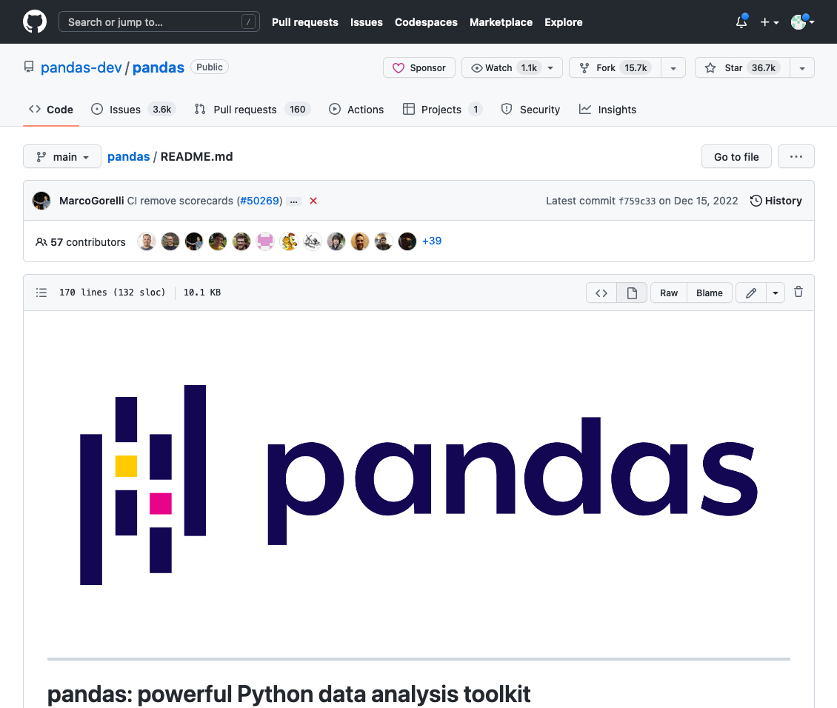

Slide 6
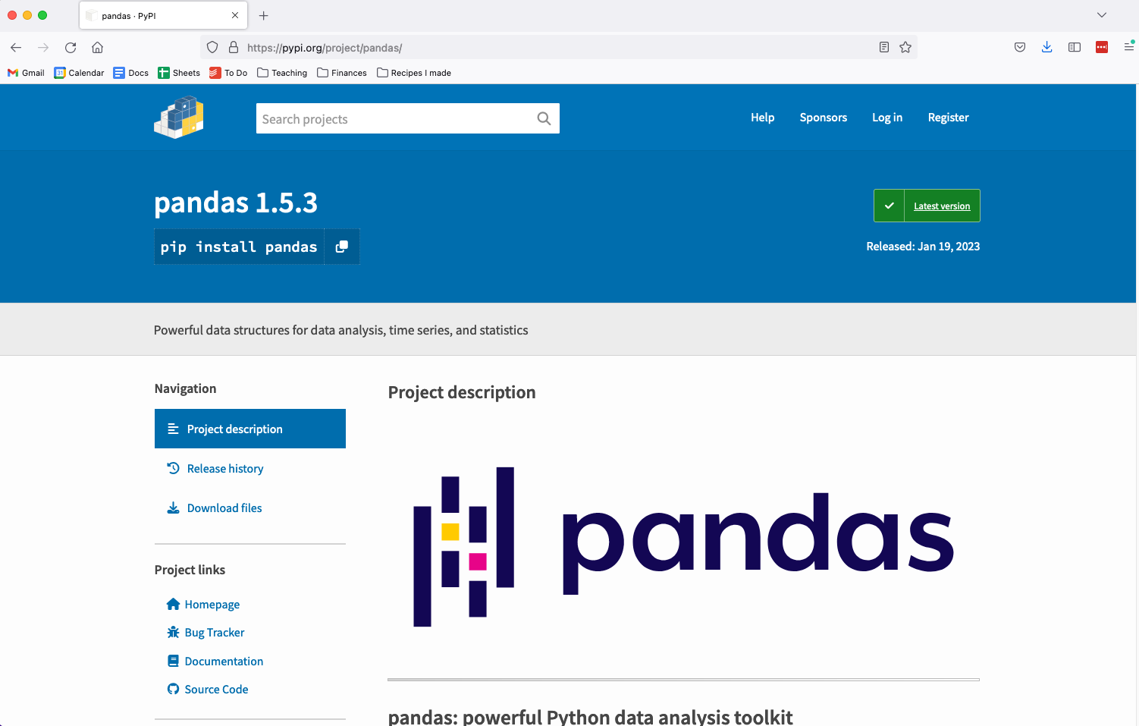
PyPI

Slide 7
Extending project structure for PyPI
myproject/
README.md
LICENSE
pyproject.toml
myproject/
__init__.py
core.py
subpackage/
submodule/
tests/
Contains metadata for the package for PyPI. This metadata is then piped to a package builder - often setuptools but there are others like hatchling
https://packaging.python.org/en/latest/tutorials/packaging-projects/

Slide 8
Extending project structure for PyPI
myproject/
README.md
LICENSE
pyproject.toml
requirements.txt
myproject/
__init__.py
core.py
subpackage/
submodule/
tests/
Contains absolute dependencies, especially useful if you’re publishing an application.
Can be generated using:
conda list --export > requirements.txt
OR
pip freeze > requirements.txt

Slide 9
Extending project structure for PyPI
myproject/
README.md
LICENSE
pyproject.toml
requirements.txt
MANIFEST.in
myproject/
__init__.py
core.py
subpackage/
submodule/
tests/
Specify data and files that should also be packaged in addition to the Python modules

Slide 10
Example pyproject.toml
https://github.com/UWDATA515/ci_example/blob/main/pyproject.toml

Slide 11
More examples
Check out existing Python packages. These may be more complicated:
https://github.com/numpy/numpy
https://github.com/pandas-dev/pandas

Slide 12
Submitting your package to PyPI
Update your code and version number. Run your test suites and ensure your code works as intended. Create a PyPI account if you don’t have one already
Create your source, and if desired, binary distribution:
$ python -m build
Install twine package to submit builds to PyPI.
(Can install using conda install twine, pip install twine, etc.)
$ twine upload dist/*
NOT REQUIRED!

Slide 13
Exercise: Set up your project’s pyproject.toml file
https://setuptools.pypa.io/en/latest/userguide/index.html
Make sure it builds!
python -m build
(remember to install the build tools as part of your environment!)
Test it out!
Move the built tar.gz from dist to a folder outside your repo
Create a new (empty) conda environment
python3 -m pip install ./<your-package-name>.tar.gz
Try running python and try importing your modules and functions

