Slide 1
Software Design for Data Science
Modules, Packages, and Imports
Melissa Winstanley
University of Washington
January 25, 2024

Slide 2
Definitions
Object: Most things in Python, e.g. function, variable, class.
Module: A *.py script; carries the name as the file.
Namespace: A mapping of unique names to objects.
Package: A directory-like concept that can hold multiple Python objects, modules, or subpackages under same namespace.

Slide 3
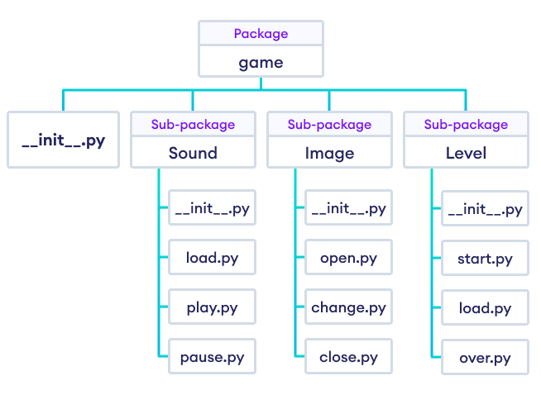
Definitions: Example
when running import game
all objects in all modules are in the game namespace
Example from https://www.programiz.com
Modules (files)

Slide 4
Imports

Slide 5
Imports
There are 4 different syntaxes for writing import statements.
import <package>
Brings <package> into the current namespace
import <module>
Brings <module> into the current namespace
from <package> import <module or subpackage or object>
Brings <module or subpackage or object> into the current namespace
from <module> import <object>
Brings <object> into the current namespace

Slide 6
Using imports
Let X be whatever name comes after import.
If X is the name of a module or package, then to use objects defined in X, you have to write X.object
# for these cases
import <package>
import <module>
from <package> import <module or subpackage>
If X is a variable name, then it can be used directly.
If X is a function name, then it can be invoked with X()
from <package> import <object>
from <module> import <object>

Slide 7
Multiple imports
from <module> import <object1>, <object2>, <object3>
OR
from <module> import (
<object1>,
<object2>,
<object3>,
)

Slide 8
Import as
Optionally, as Y can be added after any import X statement:
import X as Y
from X import (
foo as Y,
bar as Z,
)

Slide 9
Import order of search
How does Python find modules/packages to import?
Python Standard Library packages/modules (eg math, sys)
Packages/modules in sys.path:
If run with the Python interpreter (ie just python)
sys.path[0] is the empty string ’’, which means the current working directory
If run with python <module.py>:
sys.path[0] is the path to <module>.py
Directories in PYTHONPATH environment variable
Default sys.path locations - dependent on Python installation

Slide 10
Absolute vs relative imports
Absolute Imports (works in Python 2 and 3):
Import from the top-level Python package. e.g., import <package>
Relative Imports:
Import based on your sys.path location.
Explicit Relative Imports (works in Python 2 and 3):
Import using . (current directory) and .. (parent directory) notation
Implicit Relative Imports (only Python 2):
Discontinued

Slide 11
Wildcard imports
Bringing EVERYTHING from a package or module into the current namespace
from <package> import *
BAD BAD BAD! Why?
Conflicts between names defined locally and the ones imported
Reduces code readability - where did a name come from?
Clutters the local namespace, which makes debugging more difficult
Example in the materials for today

Slide 12
Directory Structure

Slide 13
Basic codebase in a git repository
myproject/
README.md
LICENSE
myproject/
__init__.py
core.py
subpackage/
__init__.py
subpackage.py
submodule/
submodule.py
tests/
__init__.py
test_core.py

Slide 14
Basic codebase in a git repository
This is your git repository, usually matching the name on Github
myproject/
README.md
LICENSE
myproject /
__init__.py
core.py
subpackage/
__init__.py
subpackage.py
submodule/
submodule.py
tests/
__init__.py
test_core.py

Slide 15
Basic codebase in a git repository
myproject/
README.md
LICENSE
myproject /
__init__.py
core.py
subpackage/
__init__.py
subpackage.py
submodule/
submodule.py
tests/
__init__.py
test_core.py
Markdown-formatted or plain text file describing the package

Slide 16
Basic codebase in a git repository
myproject/
README.md
LICENSE
myproject /
__init__.py
core.py
subpackage/
__init__.py
subpackage.py
submodule/
submodule.py
tests/
__init__.py
test_core.py
Software license specifying how others may use your code

Slide 17
Basic codebase in a git repository
myproject/
README.md
LICENSE
myproject/
__init__.py
core.py
subpackage/
__init__.py
subpackage.py
submodule/
submodule.py
tests/
__init__.py
test_core.py
The Python package, helpful for
import myproject into separate namespaces.

Slide 18
Basic codebase in a git repository
myproject/
README.md
LICENSE
myproject/
__init__.py
core.py
subpackage/
__init__.py
subpackage.py
submodule/
submodule.py
tests/
__init__.py
test_core.py
This module marks the directory as a Python package and is run upon import

Slide 19
Basic codebase in a git repository
myproject/
README.md
LICENSE
myproject/
__init__.py
core.py
subpackage/
__init__.py
subpackage.py
submodule/
submodule.py
tests/
__init__.py
test_core.py
Other modules in the package containing importable code.

Slide 20
Basic codebase in a git repository
myproject/
README.md
LICENSE
myproject/
__init__.py
core.py
subpackage/
__init__.py
subpackage.py
submodule/
submodule.py
tests/
__init__.py
test_core.py
Packages can have subpackages (and sub-subpackages, etc.) to any depth. They contain their own __init__.py files.

Slide 21
Basic codebase in a git repository
myproject/
README.md
LICENSE
myproject/
__init__.py
core.py
subpackage/
__init__.py
subpackage.py
submodule/
submodule.py
tests/
__init__.py
test_core.py
Packages can also have modules to any depth - ie without the __init__.py, this directory is just a collection of modules.

Slide 22
Basic codebase in a git repository
myproject/
README.md
LICENSE
myproject/
__init__.py
core.py
subpackage/
__init__.py
subpackage.py
submodule/
submodule.py
tests/
__init__.py
test_core.py
Unit tests go into their own subpackage

Slide 23
Basic codebase in a git repository
myproject/
README.md
LICENSE
myproject/
__init__.py
core.py
subpackage/
__init__.py
subpackage.py
submodule/
submodule.py
tests/
__init__.py
test_core.py

Slide 24
But wait - what actually goes in __init__.py?

Slide 25
1. __init__.py is empty
Example: urllib
Pros
Simple
Cons
You don’t get a namespace
You have to specify a specific submodule to import
Importing just the package is useless
Important to have good module names
Eg:
import urllib.parse
urllib.parse.urlparse(“https://google.com”)
Not
import urllib
urllib.urlparse(“https://google.com”)

Slide 26
2. __init__.py imports from subpackages/modules
Import from subpackages and submodules
Determine order of import (where that’s important)
Example: tomllib (library that parses TOML files)
Pros
Can create a helpful namespace
Interface of your package is more clear
Cons
Interface of package is not super clear

Slide 27
3. __init__.py defines the interface for the package
Define the interface for the package
Importing/piecing together submodules
Example: json
Pros
Great for someone reading your package to know where to start
Functionality is clear
Cons
What goes in __init__.py vs submodule?

Slide 28
4. __init__.py defines everything
Example: collections
Pros
One single file
Can work well for small packages
Cons
Can be unwieldy if package is big

Slide 29
Exercise: Make it work
Go to the course website and download the “imports” folder from the lecture materials for week 4. This uses code from last week.
Update the imports so that you can run both main.py and run/runner.py
Hint: there are multiple ways to run python code. We’ve seen
python path/to/file.py
But you can also run a module with:
python -m path.to.module
What’s the difference? The -m version keeps the path as the current directory! Try it out and print sys.path

