Slide 1
Software Design for Data Science
Introduction
Melissa Winstanley
University of Washington
January 9, 2025

Slide 2
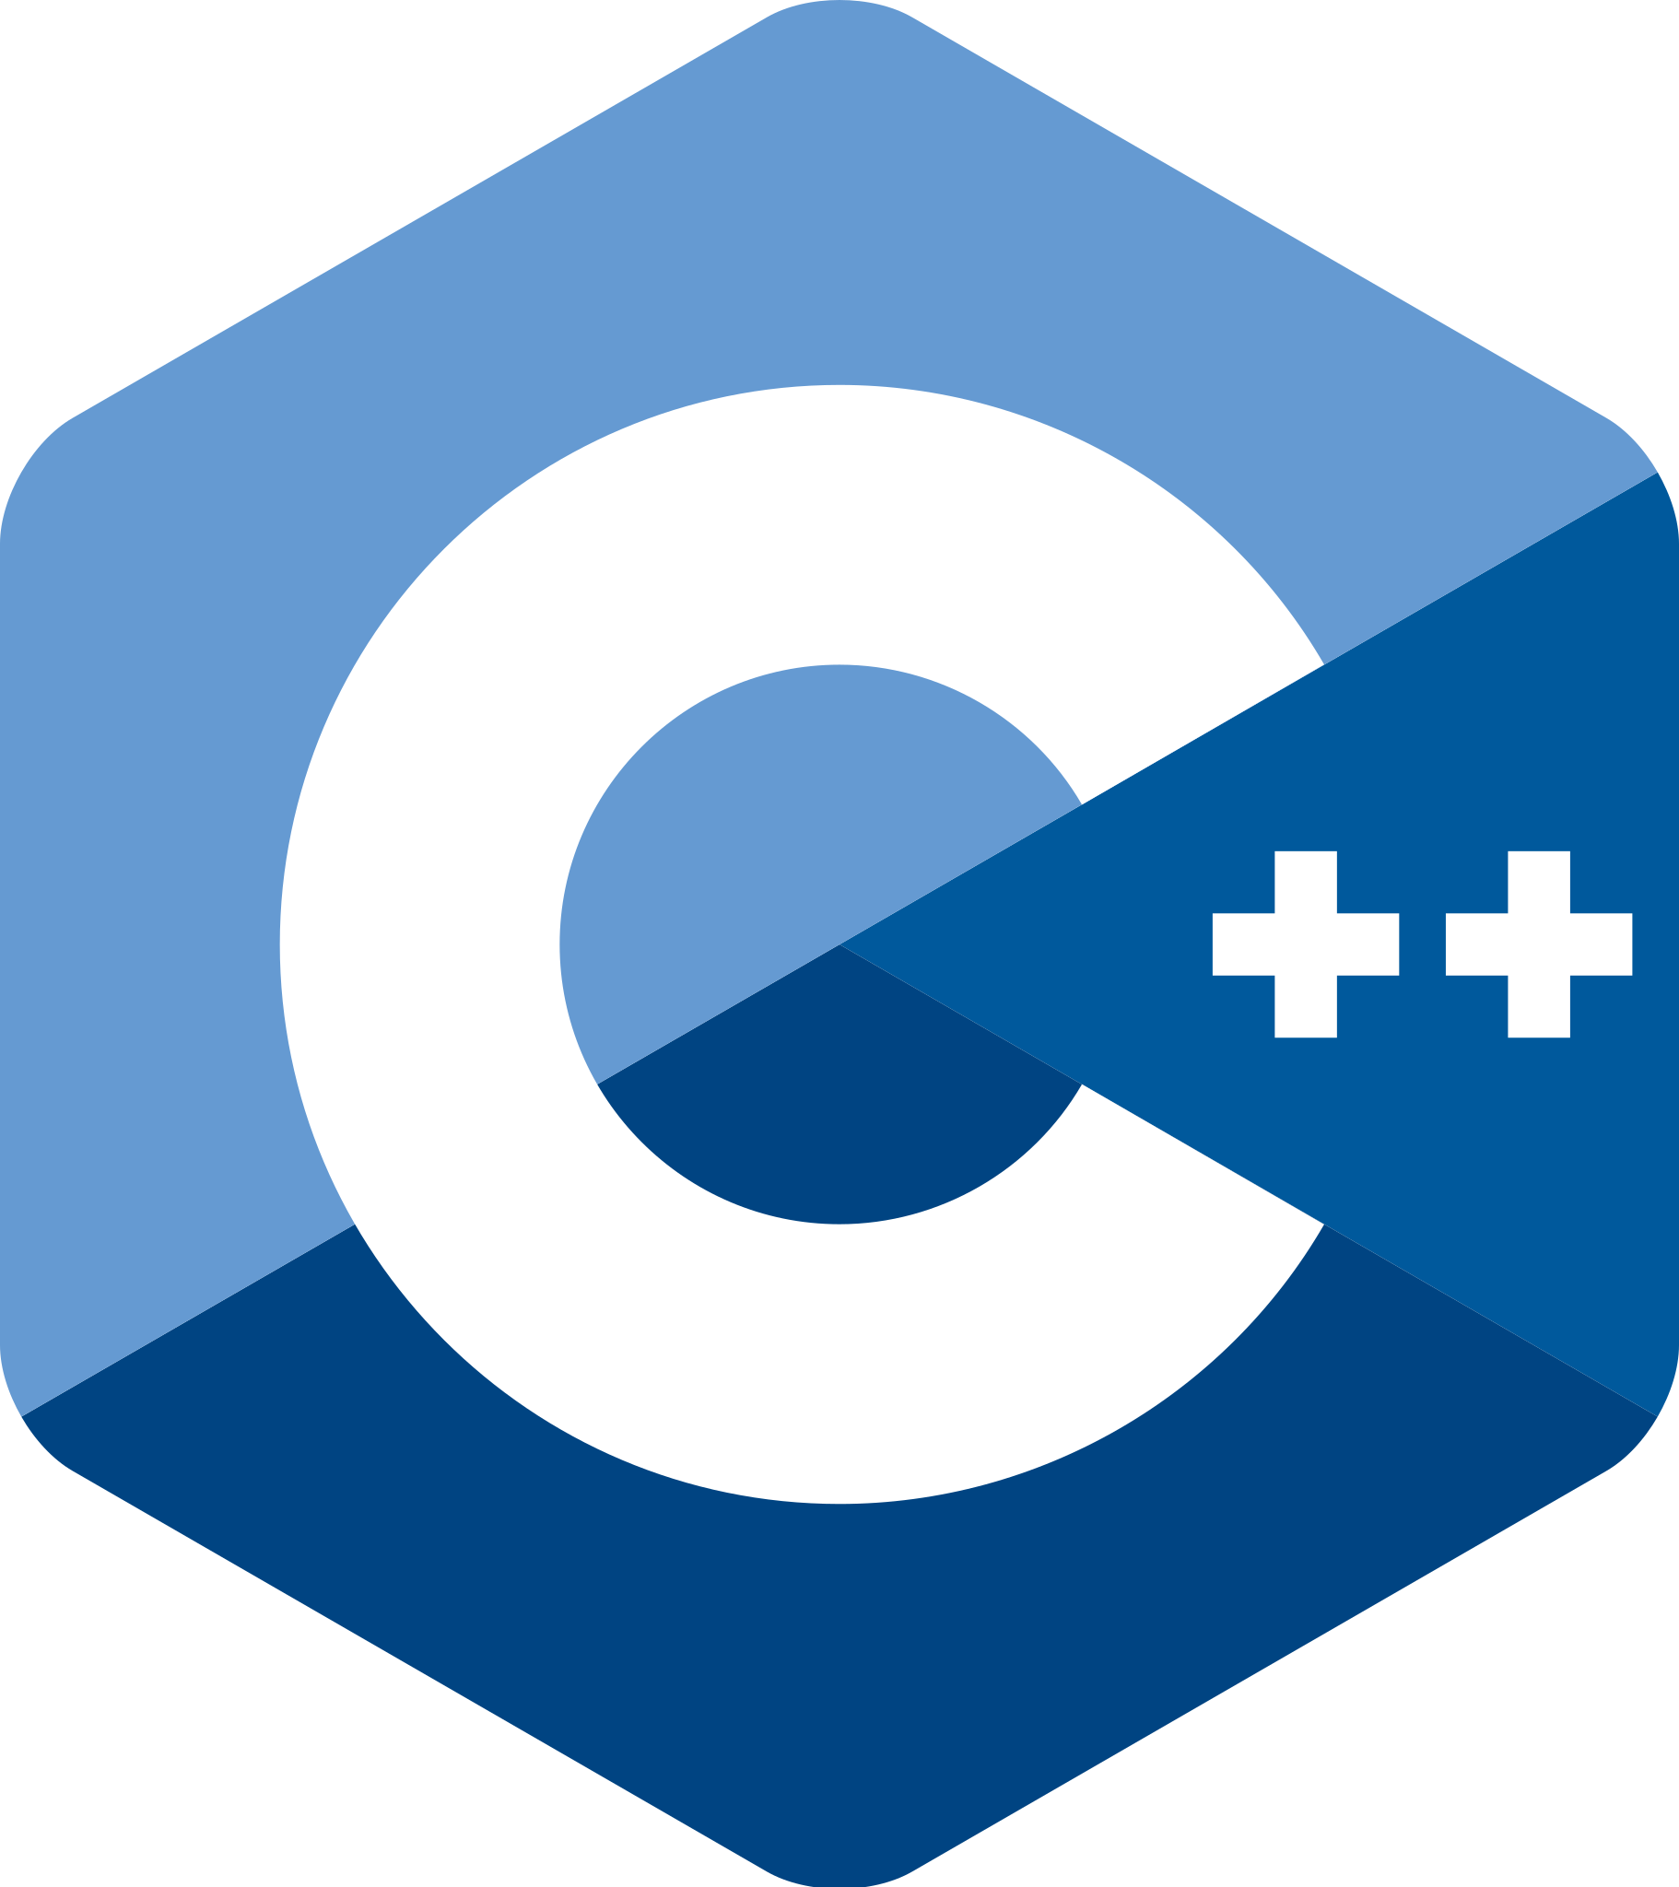




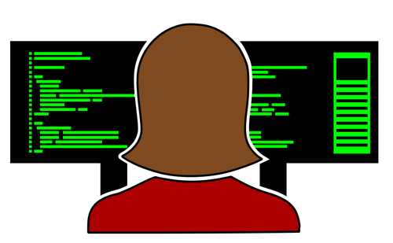
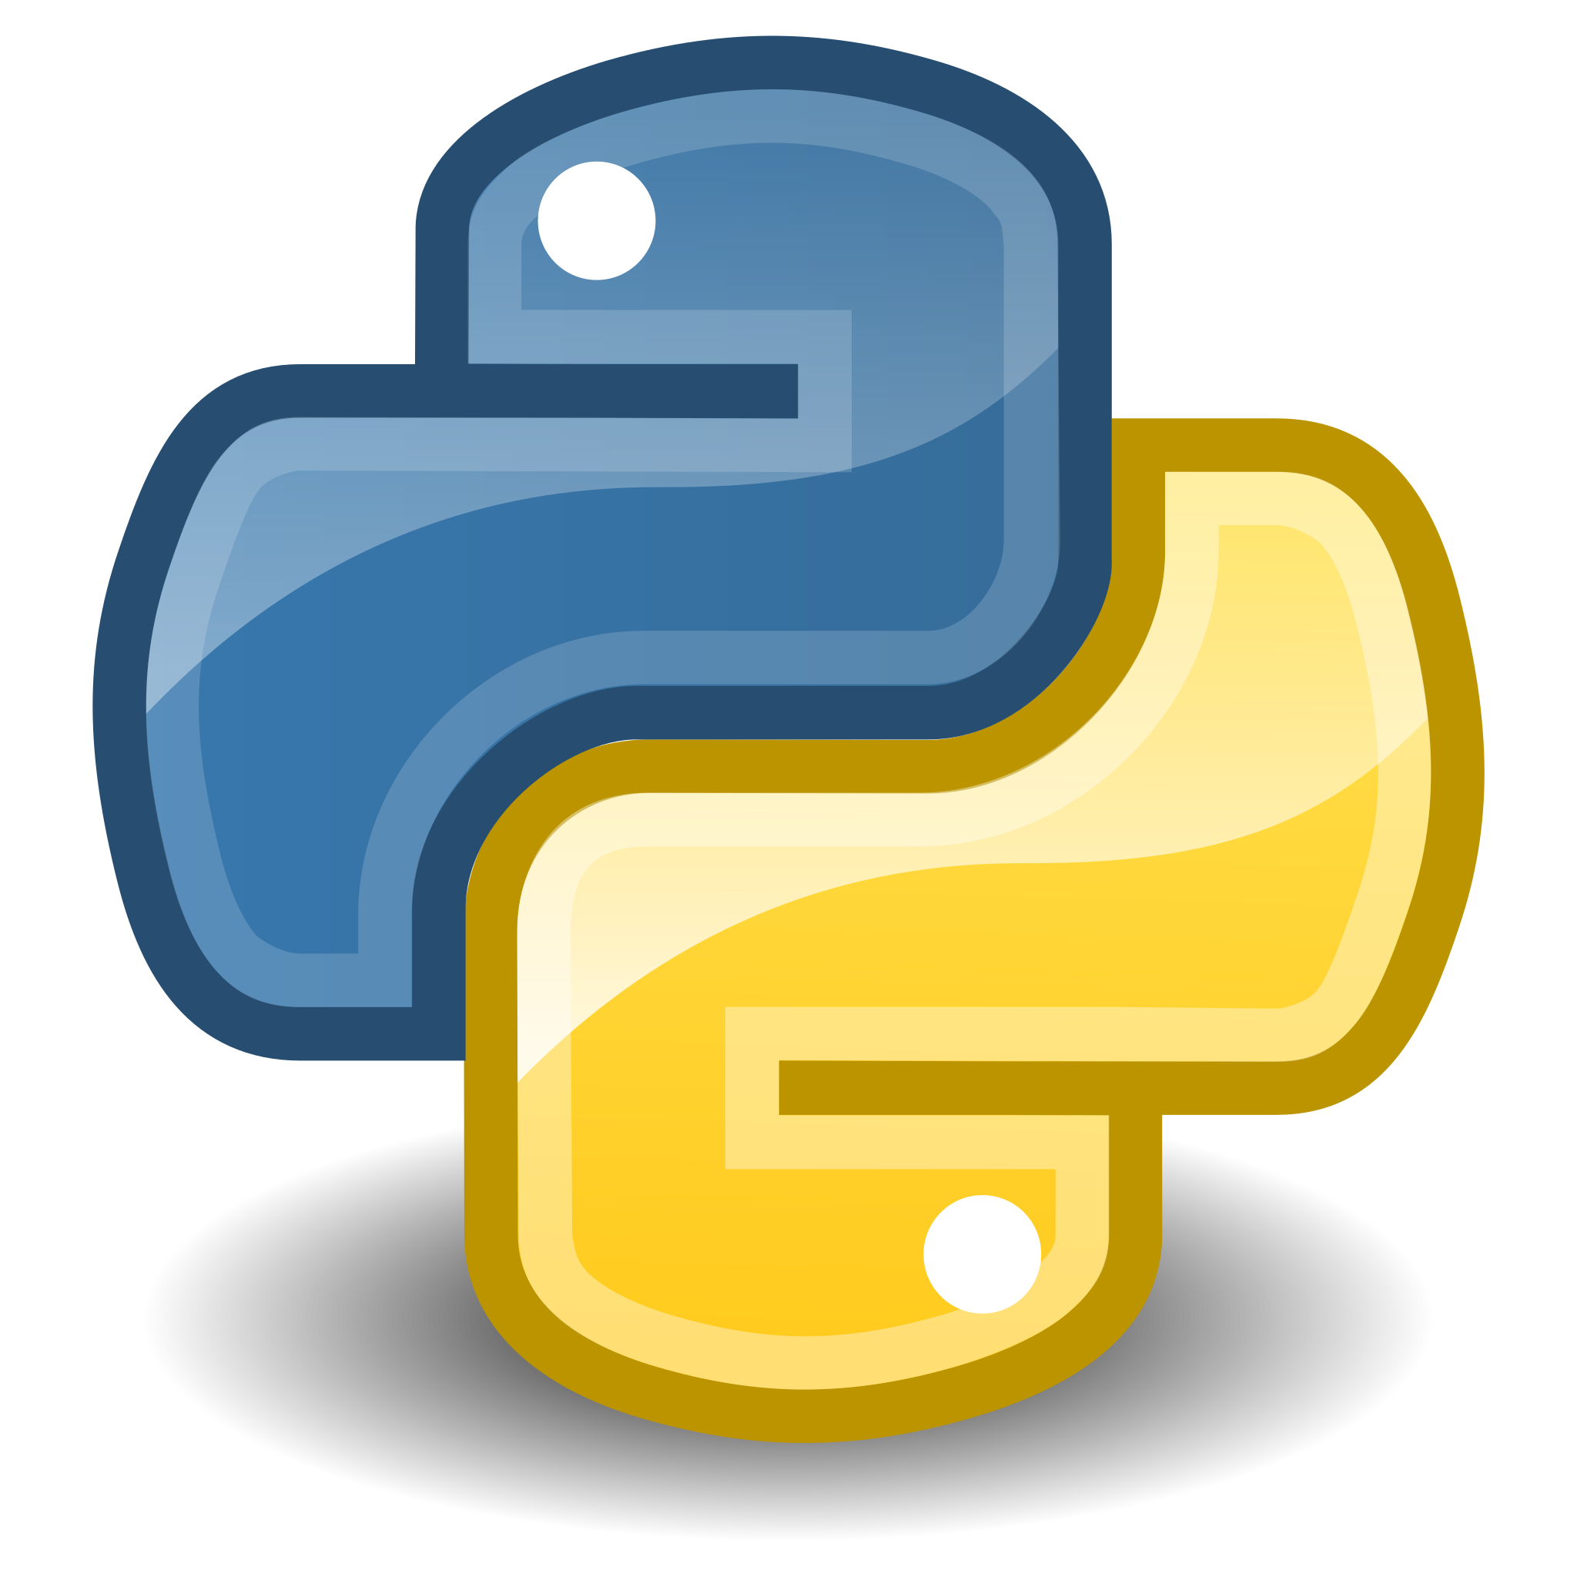




Me: your teacher
Notes:
Went to UW for undergrad + masters
Worked as a software engineer for about a decade - big company, small company
Have taught a couple classes at UW, ran the intern program for said big company - want to share what I’ve learned
Have worked with a lot of different programming languages in my career, including Python - although it isn’t the language I’ve used the most
But what I’m really good at, and want to share with you, is how to learn and search for what you need because honestly no one needs to memorize everything.

Slide 3

Your teachers
Me: software engineer
TA: data scientist
You: data scientists

Slide 4
Software Engineering vs Data Science
Python
Collaboration
Communication
Specifications
Project design
Testing
Software Engineering
Lots of programming
Lots of data
Data Science
Machine Learning
Data Engineering

Slide 5

This course
Practical
Hands-on
Useful after graduation
Focus on HOW to learn, not just the skills

Slide 6
Course Website
https://uwdata515.github.io/
Linked from MyUW
+ Canvas for grades, surveys
+ Ed Discussions
4 hours, with breaks between topics

Slide 7


Course Project
Collaborative software engineering experience
Teams of 3 to 4 with 4 being optimal
Develop project using version control

Slide 8
Course Project
Collaborative software engineering experience
Design (use cases, component specification)
Documentation (how to, docstrings)
Style (PEP8, pylint)
Coding, testing & milestones
Standup & code reviews

Slide 9
Course Project Types
Answer “Research” Questions
Create a Tool
Teach Analysis
Present Data

Slide 10
Getting Started
Step 1
Step 2
Step 3
Step 4
Students present statements of interest
Gather with like-minded students
Verify the project idea
Size the effort

Slide 11
More on the Data
At least two non-trivial data sets
Data need to be combined, joined, merged, etc. to answer the scientific questions
Have access to the data NOW!

Slide 12
Some Public Data
http://drugbank.ca
http://toxnet.nlm.nih.gov
https://data.seattle.gov/Transportation/Traffic-Flow-Counts/7svg-ds5z
https://www.divvybikes.com/data
http://www.nyc.gov/html/tlc/html/about/trip_record_data.shtml
https://www.kaggle.com
Pronto bike data
American Fact Finder Data
European union data (World bank)
Russian federation data (World bank)
China data (World bank)

Slide 13
Project Ideation
Over the first few weeks:
What areas are you interested in? E.g. social good or a job demo.
What data are available in that space?
What tools already exist in that space?
What type of project is this? (answer research question, create reusable data, create a tool, other?)
Give a one slide, 1 minute project idea pitch at the start of class #5!

Slide 14
Academic Integrity
Software development is a highly collaborative endeavor
We expect you to collaborate, but your work is your own
In software, there is rarely one correct solution to any problem
Standing around a white board brainstorming is OK
Directly copying code someone else in your class is not OK
The point is for you to learn the concepts and copying answers can defeat that point

