Slide 1
Software Design for Data Science
Virtual Environments
Naomi Alterman
University of Washington
February 17, 2026

Slide 2
The problem
Danni is working on a project.
Danni installs scikit-learn to use in the project.
Danni writes great tests, which pass!
Naomi wants to contribute to the GitHub repository
Naomi clones the repository
Nothing works for Naomi because she hasn’t installed scikit-learn (or any other packages required by the project)!

Slide 3
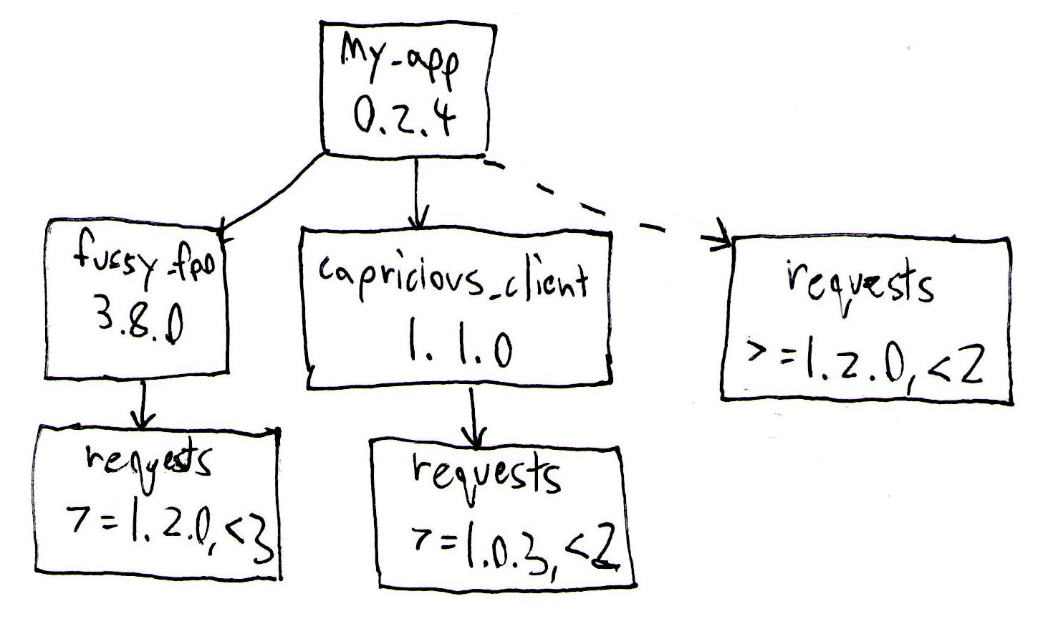
The problem: dependency hell
Dependency chains (A depends on B depends on C …)
Conflicting dependencies
Circular dependencies (A depends on B depends on A)

Slide 4
The problem, continued
Naomi and Danni may be using different systems
  Mac
  Windows
Naomi and Danni may have different versions of Python
Naomi and Danni may have different Python packages installed
We need a way so that the code will always work for both Naomi & Danni
  And for anyone else who wants to use the package!

Slide 5
Abstraction for Naomi & Danni
We want to hide away the details of the underlying system and make it so that when Naomi & Danni work on the project, they see the same things:
  The same Python version
  The same packages
  The same package versions
  etc

Slide 6
Virtualization
The act of creating a virtual (rather than actual) version of something at the same abstraction level, such as an environment, process, operating system, or hardware.

Slide 7
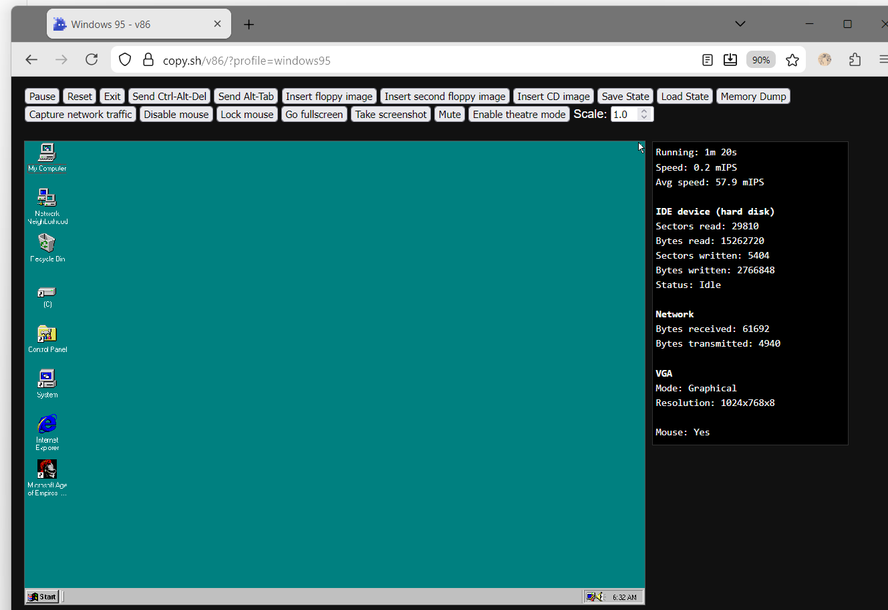

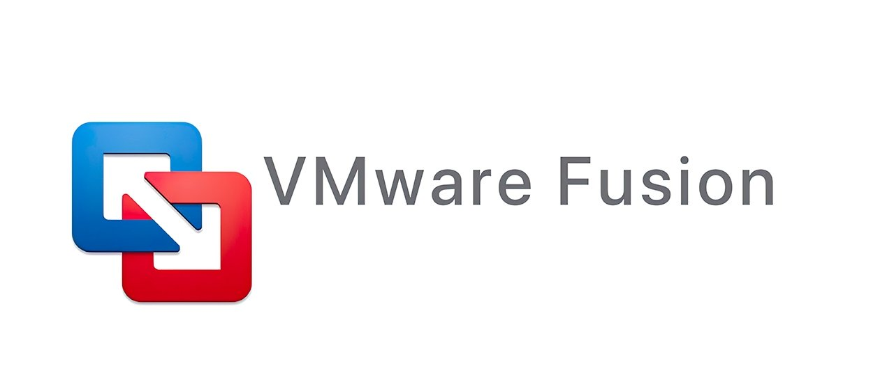
Virtual Machines
https://copy.sh/v86

Slide 8
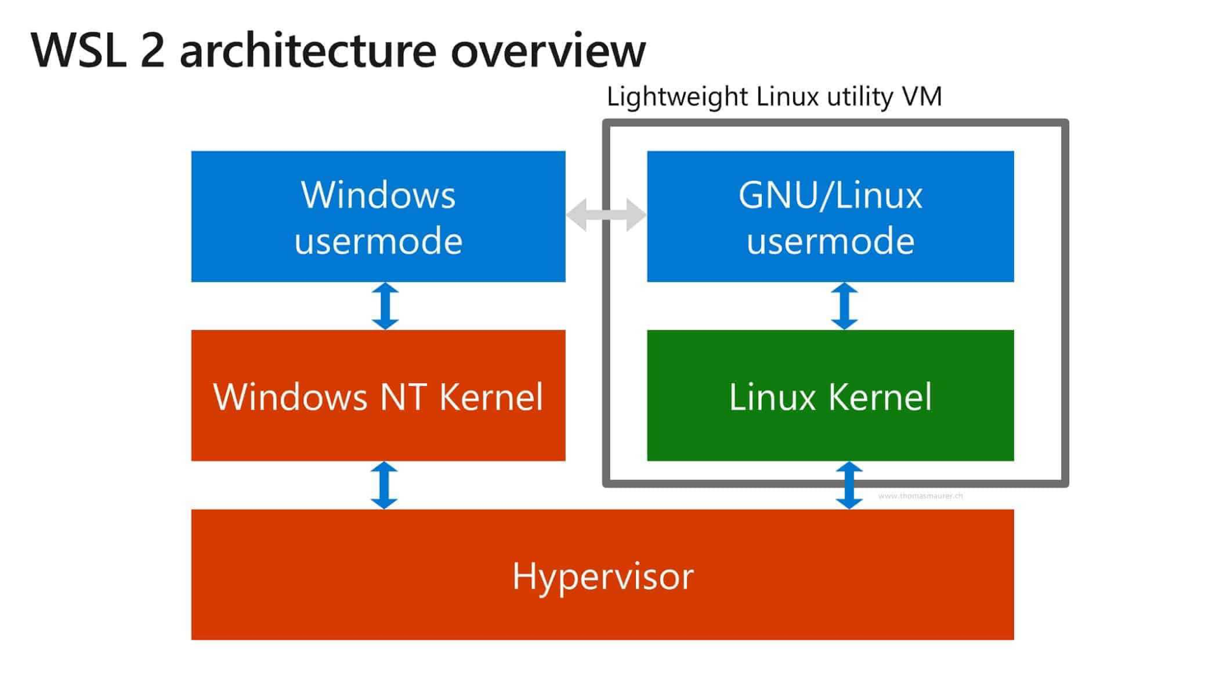
Virtual Machines - WSL

Slide 9
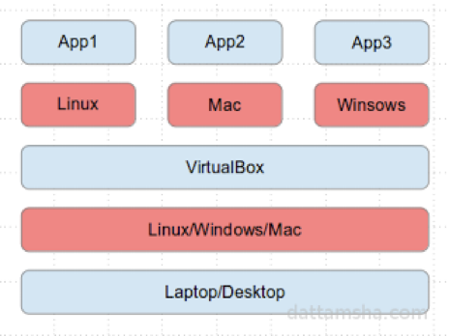
Virtual Machines - VirtualBox
https://www.virtualbox.org
Open source, free, and just works
Uses processor level virtualization instructions to operate guest operating system
Choose the right guest type
Allocate enough resources
Always install guest additions

Slide 10
Virtual Machines - EC2
Start with a base operating system image
Install software you want
Create any data volumes, etc. you want
Halt the instance
Make an Amazon Machine Image
Publish
Pay for S3 storage, use a paid AMI model...

Slide 11
Virtualization of Python environments
For Naomi & Danni, we need to virtualize environment
  Python version
  Package dependency versions
Separate your computer’s Python/packages from the project’s Python/packages
Multiple options
  venv
  uv
  poetry
  conda

Slide 12
Conda Virtual Environments
conda create -n <name>
  Creates a new environment with the given name
conda create -n <name> python==<python version>
  Creates a new environment with a specific Python version
conda activate <name>
  “Activates” the environment (“switches into it”, like a git branch)
Anything you do now will affect only the current environment
  Installing packages
  Updating package versions
conda deactivate
  “Deactivates” the environment (“switches off of it”, like switching back to git’s main branch)
conda remove --name <name> --all
  Deletes the environment
conda info --envs
  Lists all the environments that exist

Slide 13
Exercise: Create a Python Virtual Environment
Create a conda environment for SPECIFICALLY Python 3.11.6
  Hint: use conda create
  Hint: don’t forget to activate the environment!
Start a Python intrepreter Jupyter notebook and prove that it’s Python 3.11.6
  You’ll need to conda install the package for jupyterlab to start a notebook in your new environment
  Hint: check out the platform module for how you might access the Python version

Slide 14
Python Virtual Environments
What just happened?
Your computer
Conda virtual environment
Python
Conda-
installed packages
Python
Conda-
installed packages
X

Slide 15
Sharing your virtual environment
conda env export > environment.yml
  Encodes all of the Python and package information in your environment to environment.yml
  Format is YAML, a human-readable data serialization language
conda env create -f environment.yml
  Creates a new environment from a file, with all of its specified packages
conda env update -f environment.yml
  Updates your environment to match the environment.yml file
  Useful if your teammates are adding packages - do it after you pull
  Useful to upgrade packages
Always commit the environment.yml file to the repository!

Slide 16
Exercise: Create an environment.yml file
For your Python 3.11.6 environment:
Create an environment.yml file:
conda env export > environment.yml
Delete the existing environment so that we can practice creating from yml:
conda deactivate
conda remove --name <name> --all
Recreate the environment from the yml file:
conda env create -f environment.yml
Prove that it works - start up your Jupyter notebook again.

Slide 17
Generated environment.yml
Name for the environment
name: py3116
channels:
- defaults
dependencies:
- anyio=3.5.0=py38hca03da5_0
- appnope=0.1.2=py38hca03da5_1001
- argon2-cffi=21.3.0=pyhd3eb1b0_0
- argon2-cffi-bindings=21.2.0=py38h1a28f6b_0
- asttokens=2.0.5=pyhd3eb1b0_0
- attrs=22.1.0=py38hca03da5_0
- babel=2.11.0=py38hca03da5_0
- backcall=0.2.0=pyhd3eb1b0_0
- beautifulsoup4=4.11.1=py38hca03da5_0
- bleach=4.1.0=pyhd3eb1b0_0
- brotlipy=0.7.0=py38h1a28f6b_1002
…
prefix: /Users/naomialterman/opt/miniconda3/envs/py3116
Where Conda can find packages (default location)
All the packages that conda has installed in this environment
This includes transitive dependencies (ie the packages that Jupyter depends on)
A LOT!!!!
Where Conda stores the environment on your system.
Not necessary for other people

Slide 18
Simpler environment.yml
name: py3116
channels:
- defaults
dependencies:
- jupyterlab=4.5.4
- python=3.11.6
No prefix
Only explicitly needed dependencies
What does this number mean?

Slide 19
Semantic Package Versioning
Extra stuff
Extra info about release or build (eg for specifying “pre-release” or beta release)
Also known as “semver”
4.5.4
NOT ALL PACKAGES ADHERE TO THIS THOUGH! Do your research.
Major version number
This changes when the package has
BREAKING CHANGES
Minor version number
This changes when the package has new backwards-compatible features
Patch version number
This changes when the package has bug fixes

Slide 20
What I would probably do
name: py3116
channels:
- defaults
dependencies:
- jupyterlab=4
- python=3.11.6
This package adheres to semantic versioning.
This way I automatically get any new versions just by doing
conda env update
Python doesn’t adhere to semantic versioning
You don’t HAVE to do it this way - use more specific package versions if you like!
You can also omit package versions (everything after the “=”), although it’s less safe.

Slide 21
What about pip?
If you use pip to manage packages:
environment.yml => requirements.txt
  Looks similar!
Can create from the environment in a similar way
pip freeze > requirements.txt
Can reinstall all the requirements into the current environment
pip install -r requirements.txt
This does NOT create a new environment
You can combine environment.yml (for the environment) with requirements.txt (for managing packages with pip) if you like

Slide 22
Adding pip to environment.yml
name: py3116
channels:
- defaults
dependencies:
- jupyterlab=4
- python=3.11.6
- pip
- pip:
- matplotlib
- pandas
Add pip as a dependency
Add pip dependencies by adding a colon after another “pip”, then indenting an extra level, then adding the pip dependencies

Slide 23
Or with requirements.txt
name: py3116
channels:
- defaults
dependencies:
- jupyterlab=4
- python=3.11.6
- pip
- pip:
- -r requirements.txt
Tell conda to load pip dependencies from requirements.txt

Slide 24
Exercise: Simplify your environment.yml
For your Python 3.11.6 environment:
Simplify your environment.yml file.
Remove any unnecessary packages.
Simplify the version numbers if you like.
Update your environment.
conda env update -f environment.yml
Prove that it works - start up your Jupyter notebook again.

Slide 25
What about other dependencies?
Conda environments are for Python & Python packages
If you need to download other tools or infrastructure, you’ll have to do that in a separate script or with a different version manager.

Slide 26
Exercise: create a virtual environment for your project
Create an environment for your team’s project.
Create an environment.yml file for the environment.
Include any packages that you need to make your code work.
Commit, create a PR, and merge the change.
Make sure everyone on the team can create the environment from the file.
Include instructions for how to use the environment file in your documentation (README or somewhere in the docs folder).

