Slide 1
Software Design for Data Science
Software & Use Case Design
Melissa Winstanley
University of Washington
February 1, 2024

Slide 2
Today’s agenda
Lecture on design
Design exercise
Create a docs directory within the root of your project repository
Create Markdown files in the docs directory
Add/commit/push at the end of class
More exercises next week
Finish up the design exercise for review by 2/15

Slide 3
Software Design

Slide 4
Software Design
“…a specification of a software artifact intended to accomplish goals, using a set of primitive components and subject to constraints”
Wikipedia

Slide 5
Why software design?
"The hardest single part of building a software system is deciding precisely what to build. No other part of the conceptual work is so difficult as establishing the detailed technical requirements, including all the interfaces to people, to machines, and to other software systems. No other part of the work so cripples the resulting system if done wrong. No other part is more difficult to rectify later.
Therefore the most important function that software builders do for their clients is the iterative extraction and refinement of the product requirements."
Fred Brooks, The Mythical Man-Month

Slide 6
Fred Brooks’ suggested planning schedule
1/3 for design
1/6 for coding
1/4 for unit/component testing
1/4 for system testing

Slide 7
The Classic Dilemma
Good
Choose two
Fast
Cheap

Slide 8

The Classic Dilemma: Software Edition
Features
Choose two
Time
Resources

Slide 9

Prevent Feature Creep
Feature creep: gradual accumulation of features over time
Often has a negative overall effect on a project
Why does it happen?
Features are “fun”!
Developers like to code them
Marketers like to brag about them
Users want them
…but…
More bugs
More testing
More time

Slide 10
Improve Your Time Estimation
Time is the most valuable resource for your project
To spend your team’s time efficiently…
…you need to know what to build
…you need to know what not to build
…you need to know what order to build things
Design can help with this!
Estimating how long something is going to take is HARD!
Almost everything takes longer than you think it will
Design will help you order and parallelize your work so you aren’t surprised

Slide 11
Design Benefits
Systematic approach to a complex problem
Finds bugs before you code
Enables parallel work
Promotes testability
Build an understandable, extendable, maintainable system

Slide 12
Software Design Process (for this class)
Identify the users
Who they are, what they want
High level
Functional design
What the system does
Specification
Component design
How the software will work
Implementation

Slide 13
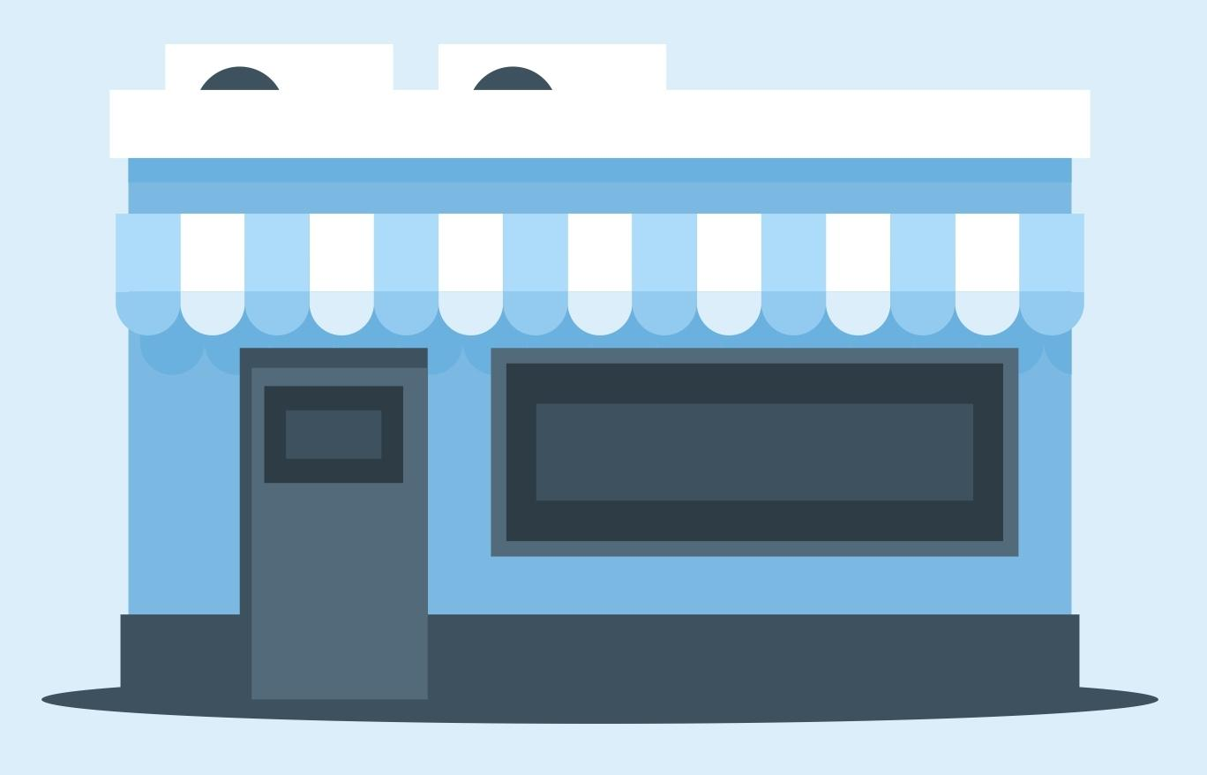
Running Example: Inventory Management
Data: historical product inventory

Slide 14
User Stories

Slide 15
Start with your users
Who are your users?
Researchers?
Policy makers?
Developers?
Children?
Trained monkeys?
What do they want to do with your software?
How are they interacting with it?
What needs do they have?
What skill levels do they have?

Slide 16
Example: Ram
Ram is a buyer for a store (he puts in orders to suppliers).
Ram wants to see current inventory of items.
Ram wants to see predictions of future purchase trends.
Ram needs to order items from suppliers.
Ram’s job does not involve technical skills and he values a simple user interface.

Slide 17
Example: ???
What might be another user story?

Slide 18
Example: Valentina
Valentina is a data scientist.
She keeps the software running and responds to bug reports.
She needs to update the inventory periodically.
She needs to iterate on the prediction model to improve accuracy.
Valentina is highly technical and knows basic programming skills.

Slide 19
Example: Taylor
Taylor is the store manager.
She needs to see current inventory and predictions.
She wants to see orders that have been placed.
She wants to see current purchase trends.
Taylor’s job does not involve technical skills and she values a simple user interface.

Slide 20
Exercise: Your User Stories
You will probably have several different kinds of “users” and a “technician” or two.
If you have a machine learning model backing your tool, don’t forget the “technician” who will train the machine learning model or update it.
Take 10 minutes to write 2-3 user stories with your team.
Use a Markdown file in the docs directory
Remember
Who
Wants
Interaction methods
Needs
Skills

Slide 21
Functional Design
(Use Cases)

Slide 22
Example: Ram
Ram is a buyer for a store. Ram wants to see current inventory of items. Ram wants to see predictions of future purchase trends. Ram needs to order items from suppliers. Ram’s job does not involve technical skills and he values a simple user interface.
View inventory
View predictions for an item
Make order

Slide 23
What do we do with inventory management systems?
View inventory
View predictions for an item
Make order
View purchase history graph
These are use cases - from the point of view of a user, how will they use your system?

Slide 24
Implicit use cases
There’s an additional implicit use case in Ram’s example (not explicitly stated but understood to be the case).
User authentication!

Slide 25
Describing a use case
Objective of the user interaction
What information does the user provide?
What response does the system provide?
Usually about 3-9 clearly written steps.
This is not code!

Slide 26
Example: System user authentication use case
Objective: System validates that the user is allowed to access an account
User: access login page
System: display “enter username and password”
User: enter username and password on keypad
System: [if correct] show inventory screen
[if incorrect] display “incorrect username or password, please try again”
Think about edge cases!

Slide 27
Example: View inventory
Objective: System displays accurate inventory information that the user needs
User: access inventory page
System: display first 100 items with inventory quantity
User: selects a filter on product category, quantity, or name
System: shows subset of items
User: selects “next page”
System: shows next 100 filtered items

Slide 28
Exercise: Your Use Cases
Translate your user stories into use cases (functional designs)
Use a Markdown file in the docs directory
Remember
Explicit use cases
Implicit use cases

Slide 29
Component Design

Slide 30
What is a component?
“An individual software component is a software package, a web service, a web resource, or a module that encapsulates a set of related functions (or data).”
Wikipedia

Slide 31
Specifying components
Describe components with sufficient detail so that someone with modest knowledge of the project can implement the code for the component.
Name
What it does
Inputs (with type information)
Outputs (with type information)
Assumptions
How it uses other components
Sound familiar? Check out Lecture 3 on Interface Specifications!

Slide 32
Developing Component Specifications
What are the components in the use cases?
Packages
Modules
Resources
Data
Functions
What components are already available?
What are the sub-components needed to implement those components that aren't already available?
Do 1-2 for each such component

Slide 33
Example: System authentication use case
Components:
Database with username => password data
User interface to prompt for a username/password
Control logic

Slide 34
Example: System authentication control logic
Name
authenticate
What it does:
Verifies a user is known & the password supplied by the user is correct
Inputs (with type information)
Username, a string that is the user’s account identifier
Password, a string
Outputs (with type information)
Boolean: True if success, False if failure
Assumptions: none

Slide 35
Example: View inventory use case
Components:
Data manager with inventory
User interface with filters and inventory display
Control logic

Slide 36
Example: View inventory control logic
Name
viewInventory
What it does:
Verifies that the withdrawn amount is available in the user’s account and debits the account if so
Inputs (with type information)
Page, which set of 100 items the user is viewing
Filters, a dictionary of { filterName: filterValue }
Outputs (with type information)
Boolean: True if success, False if failure
Assumptions
User is already authenticated

Slide 37
Pseudocode
Helpful to gain insight into how components interact
Not really code - mostly readable English with some flow control & variables
viewInventory(page=0, filters=None):
translate filters into data model equivalents
select item and quantity from data manager
where filters match
skip the first 100*page
maximum 100
Another component!

Slide 38
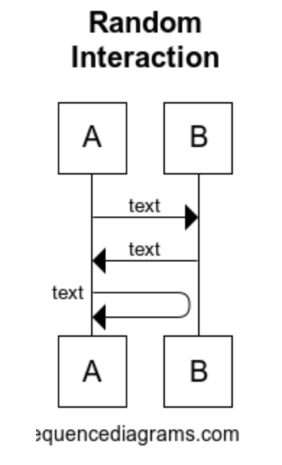
Specifying component interactions
Diagrams are very helpful!
Web tool for making these:
https://www.websequencediagrams.com/

Slide 39
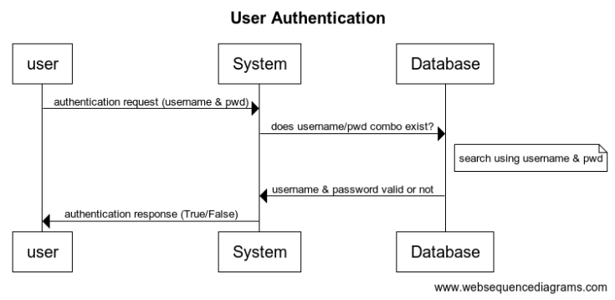
Example: user authentication component interactions

Slide 40
Example: user authentication component interactions
title User Authentication
user->System: authentication request (username & pwd)
System->Database: does username/pwd combo exist?
note right of Database: search using username & pwd
Database->System: username & password valid or not
System->user: authentication response (True/False)

Slide 41
Another diagram option: draw.io
https://app.diagrams.net/
We’re not picky on the format you use!

Slide 42
Component Design: Summary
Identify components
Specify each component
Specify component interactions

Slide 43
Next week: common architecture patterns

Slide 44
From Design Onwards

Slide 45
Milestones
What are you actually going to do and in what order?
Are there any dependencies between components such that you must build Component A before Component B?
What will success look like?
This is not specific tasks - these are broad strokes

Slide 46
Example: Inventory Management System milestones
Build account infrastructure Success: account database/middle control layer exist that can access an account
Build user authentication flow Success: authenticate user/password by calling the Python functions directly
Build user interface Success: user can log onto their account with their username and password
Build inventory view feature Success: user can view current inventory (no filters or pages)
Build inventory view extra features Success: user can filter and paginate through the current inventory
…

Slide 47
Breaking down a milestone
Once you have milestones, you need to break them down into tasks:
Which components do you need to implement?
What packages do you need to incorporate?
What tests or validation do you need to do?
Suggestion: use GitHub Issues!

Slide 48
Implementing a component
Recommended approach:
Write the interface for the component.
Write some tests for the component (coming up in lecture!).
Write the implementation of the component.
Iterate on the tests as you identify more.

Slide 49
Dividing up work
Components can be a good natural division of work
Example:
Melissa builds the user interface components
Mithali builds the machine learning model
Yash builds the control logic layer
This is not the only way to divide up work!

Slide 50
Dividing up responsibilities
Besides actual coding work, there are other responsibilities to divvy up. Everyone is encouraged to contribute to everything as they like, but dividing up who is ultimately accountable for making sure everyone does their part of the project is helpful. Common roles:
Designers (system design, documents, communication)
Keep everyone accountable for documentation, design, & communication with instructors
Developers ("devs")
Focus on making sure everyone makes good implementation decisions
Testers
Ensure everyone keeps up with good code testing and style practices
A project manager a.k.a. "PM"
Run standups & keep track of milestone progress

Slide 51
Project Software Design Requirements
Functional Specification (user stories & use cases)
Component Specification
Milestones
More details on expected output: https://uwdata515.github.io/projects.html

Slide 52
Exercise: Your Components
Translate your use cases into components
Create a specification for each component
Potentially including pseudocode
Create interaction diagrams for how components interact
Use a Markdown file in the docs directory
Go as deep as you can!

