Slide 1
Software Design for Data Science
Introduction
Melissa Winstanley
University of Washington
January 4, 2024

Slide 2
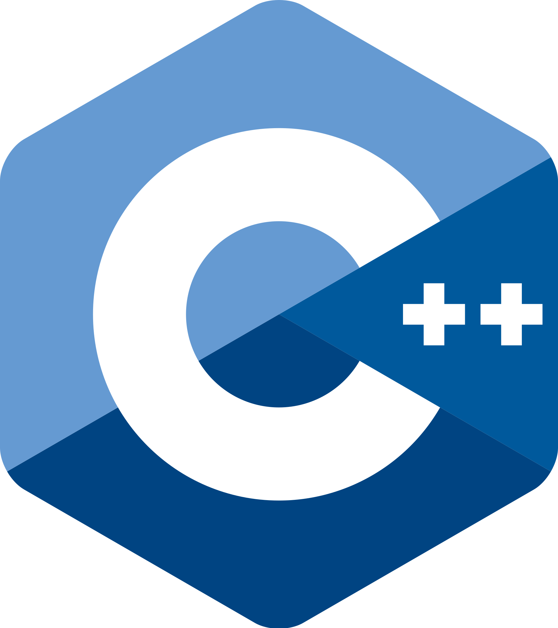

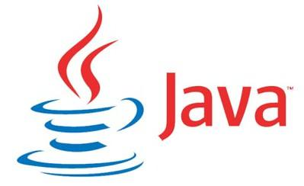


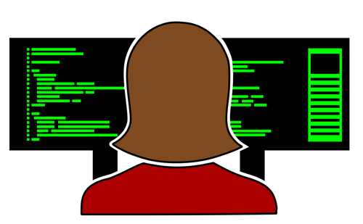
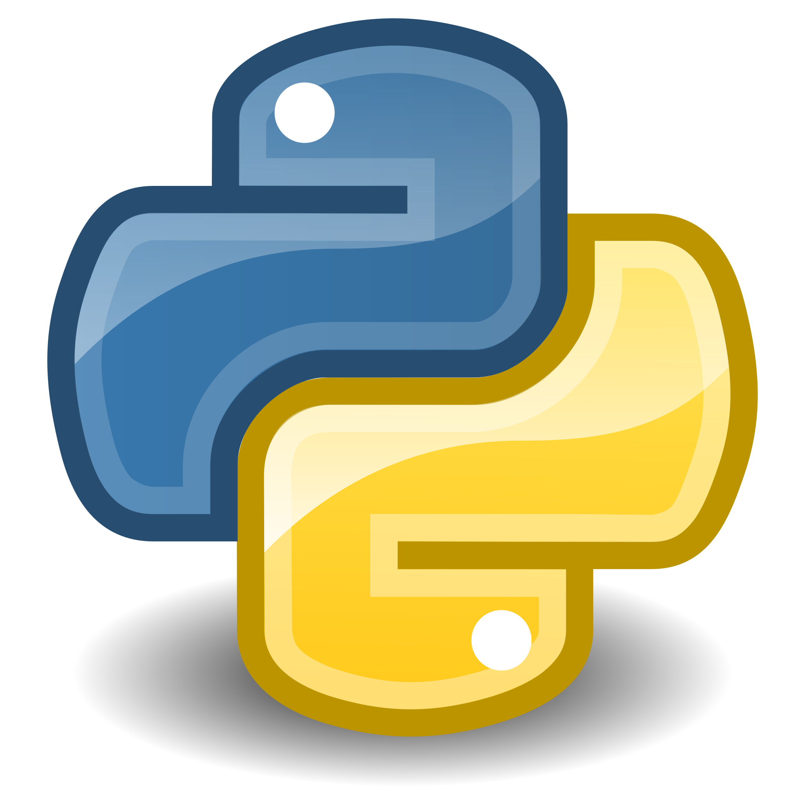
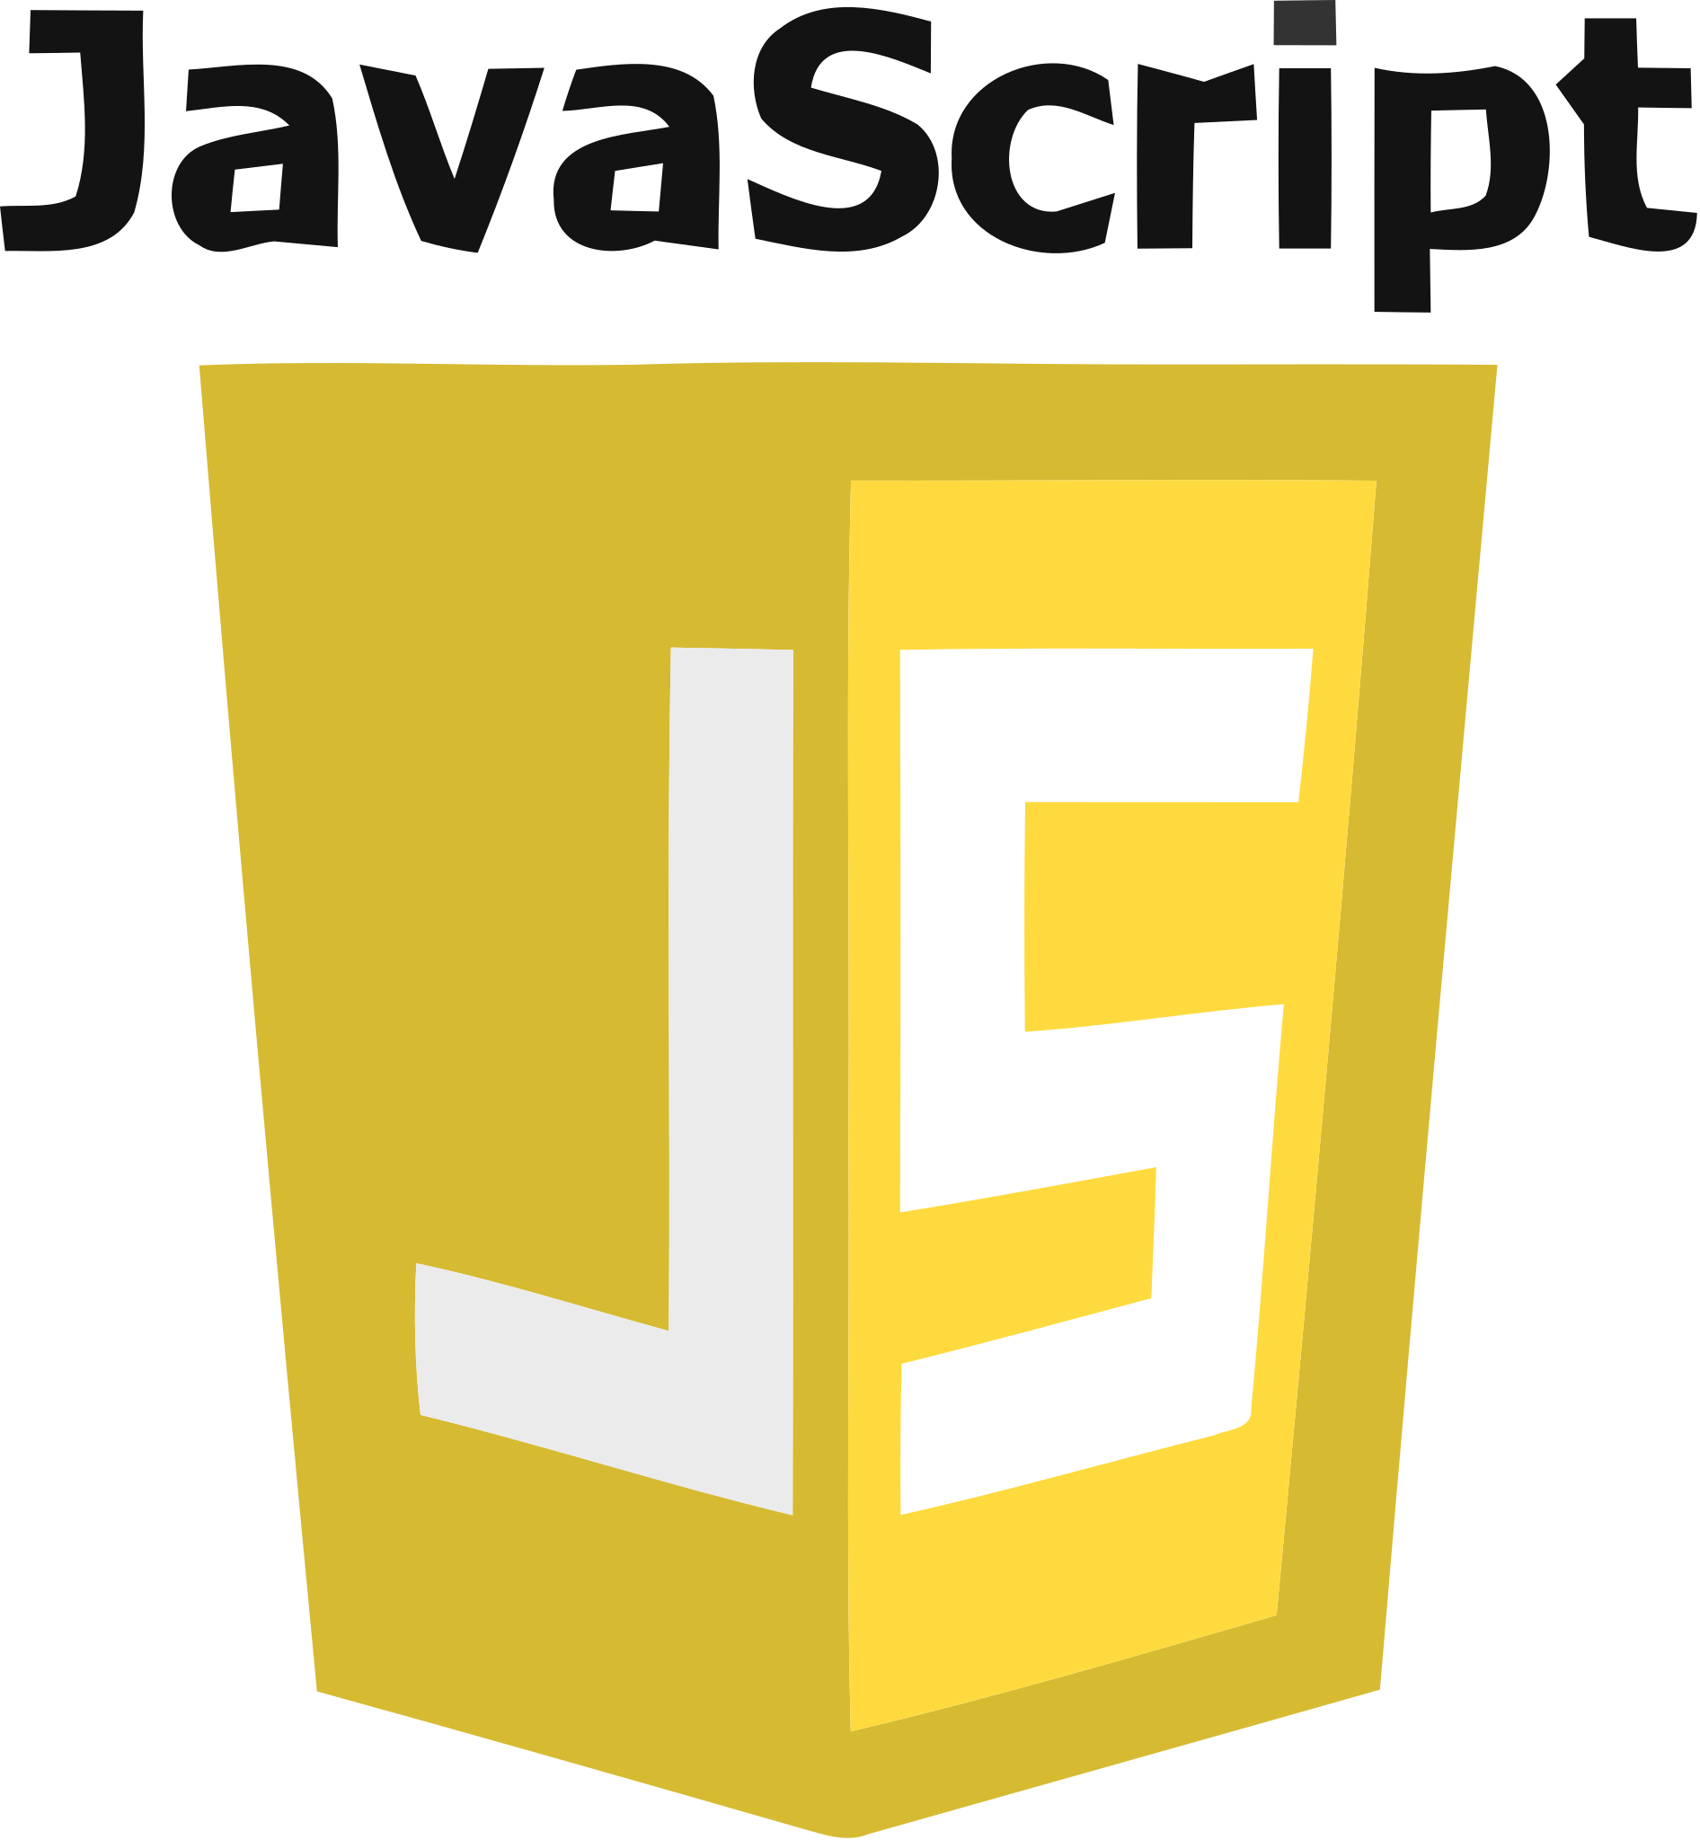
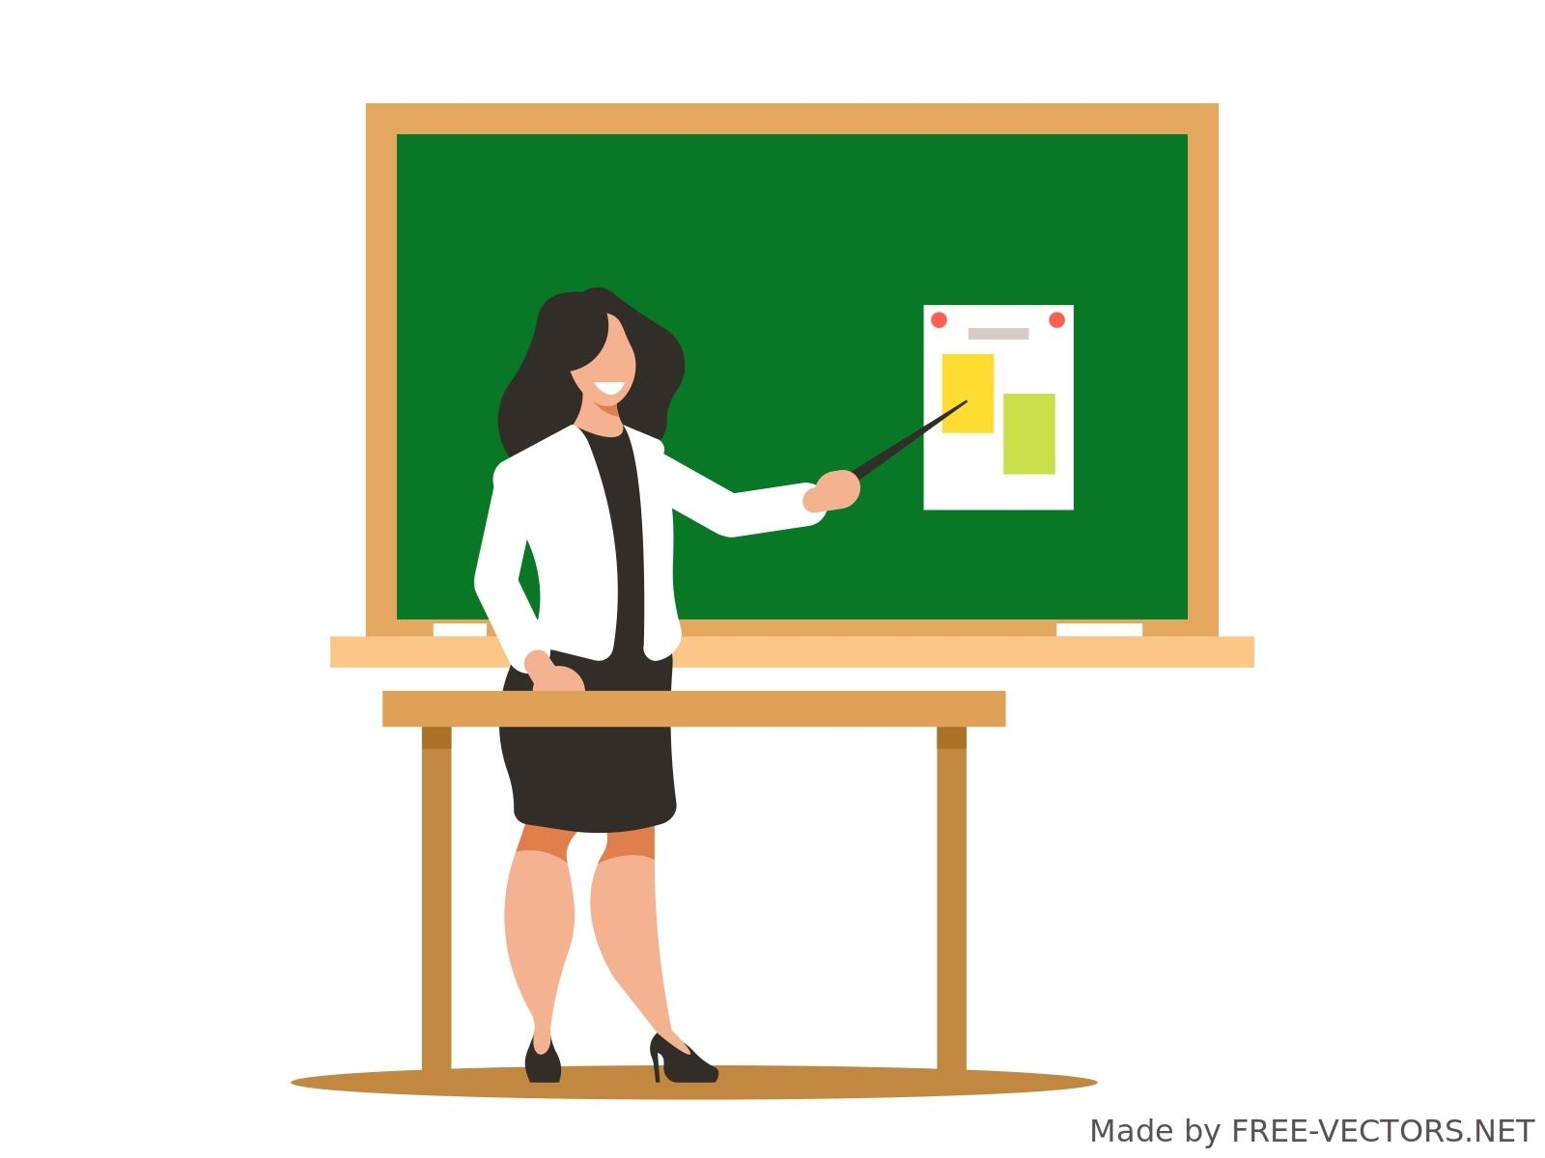

Me: your teacher
Notes:
Went to UW for undergrad + masters
Worked as a software engineer for about a decade - big company, small company
Have taught a couple classes at UW, ran the intern program for said big company - want to share what I’ve learned
Have worked with a lot of different programming languages in my career, including Python - although it isn’t the language I’ve used the most
But what I’m really good at, and want to share with you, is how to learn and search for what you need because honestly no one needs to memorize everything.

Slide 3

Your teachers
Me: software engineer
TAs: data scientists
You: data scientists

Slide 4
Software Engineering vs Data Science
Python
Collaboration
Communication
Specifications
Project design
Testing
Software Engineering
Lots of programming
Lots of data
Data Science
Machine Learning
Data Engineering

Slide 5

This course
Practical
Hands-on
Useful after graduation
Focus on HOW to learn, not just the skills

Slide 6
Course Website
https://uwdata515.github.io/
Linked from MyUW
+ Canvas for grades, surveys
+ Ed Discussions

Slide 7


Course Project
Collaborative software engineering experience
Teams of 3 to 4 with 4 being optimal
Develop project using version control

Slide 8
Course Project
Collaborative software engineering experience
Design (use cases, component specification)
Documentation (how to, docstrings)
Style (PEP8, pylint)
Coding, testing & milestones
Standup & code reviews

Slide 9
Project Type 1: Answer “Research” Questions
Problem statement: Answer two to three questions of business or scientific relevance
Use a Jupyter notebook and supporting python files
Example
Climate Police: Analyze effects of pollution on the planet.

Slide 10
Project Type 2: Create Reusable Data
Problem statement: Create data repository with tools (e.g., search, visualization, analytics)
Example
Car2Know: Provide car rental data to users of Car2Go (e.g., for planning trips)

Slide 11
Project Type 3: Create a Tool
Problem statement: Solve a problem common to many users
Don’t reinvent the wheel
Example
BioReactor Data Logging – Monitor and publish data from BioReactor experiments

Slide 12
Getting Started
Step 1
Step 2
Step 3
Step 4
Students present statements of interest
Gather with like-minded students
Verify the project idea
Size the effort

Slide 13
Things to Think About
Topics of interest
Is there an unmet need (i.e. no code already exists)?
Is there only commercial software available for a task?
What is the potential user base?
Data you have access to NOW
How much you’ve used the data
Code you have to access the data
How clean the data are

Slide 14
Verify the Project Idea
Is there an unmet need (i.e. no code already exists)?
Clarity about the project type?
Consensus on the problem being solved.
Do you have data that can solve the problem?

Slide 15
More on the Data
At least two non-trivial data sets
Data need to be combined, joined, merged, etc. to answer the scientific questions
Have access to the data NOW!

Slide 16
Some Public Data
http://drugbank.ca
http://toxnet.nlm.nih.gov
https://data.seattle.gov/Transportation/Traffic-Flow-Counts/7svg-ds5z
https://www.divvybikes.com/data
http://www.nyc.gov/html/tlc/html/about/trip_record_data.shtml
https://www.kaggle.com
Pronto bike data
American Fact Finder Data
European union data (World bank)
Russian federation data (World bank)
China data (World bank)

Slide 17
Data! Data! Data!
At least two non-trivial data sets
Data need to be combined, joined, merged, etc.
Think about your data NOW!

Slide 18
Project Ideation
Over the first few weeks:
What areas are you interested in? E.g. social good or a job demo.
What data are available in that space?
What tools already exist in that space?
What type of project is this? (answer research question, create reusable data, create a tool, other?)
Volunteer to give a one slide, 5 minute project idea pitch at the start of class!

Slide 19
Academic Integrity
Software development is a highly collaborative endeavor
We expect you to collaborate, but your work is your own
In software, there is rarely one correct solution to any problem
Standing around a white board brainstorming is OK
Directly copying code someone else in your class is not OK
The point is for you to learn the concepts and copying answers can defeat that point

