Slide 1
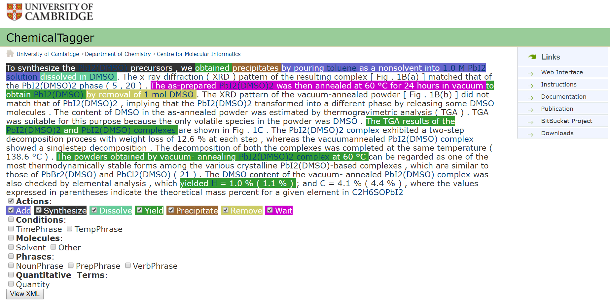
Chemical Tagger
Hawizy et al. Journal of Cheminformatics 2011, 3:17
http://www.jcheminf.com/content/3/1/17
How the package works?
Text normalization – preprocessing
Tokenization – split into elements
Tagging – chemical entities, chemistry related, parts-of-speech
Phrase parsing – assign structure to text
Action phrase identification – e.g. add, dissolve, stir
Appeal
Separates out action steps, synthesis parameters/conditions etc. in a structured database output
Drawbacks
Java

