Slide 1



Software Engineering for Data Scientists
Knowledge and solutions for a changing world
Advancing data-intensive discovery in all fields
Be boundless
UW DIRECT
(Daringly Insisting Real Elephants Can Tango)
https://uwdirect.github.io
David A. C. Beck (dacb)
Chemical Engineering & eScience Institute

Slide 2
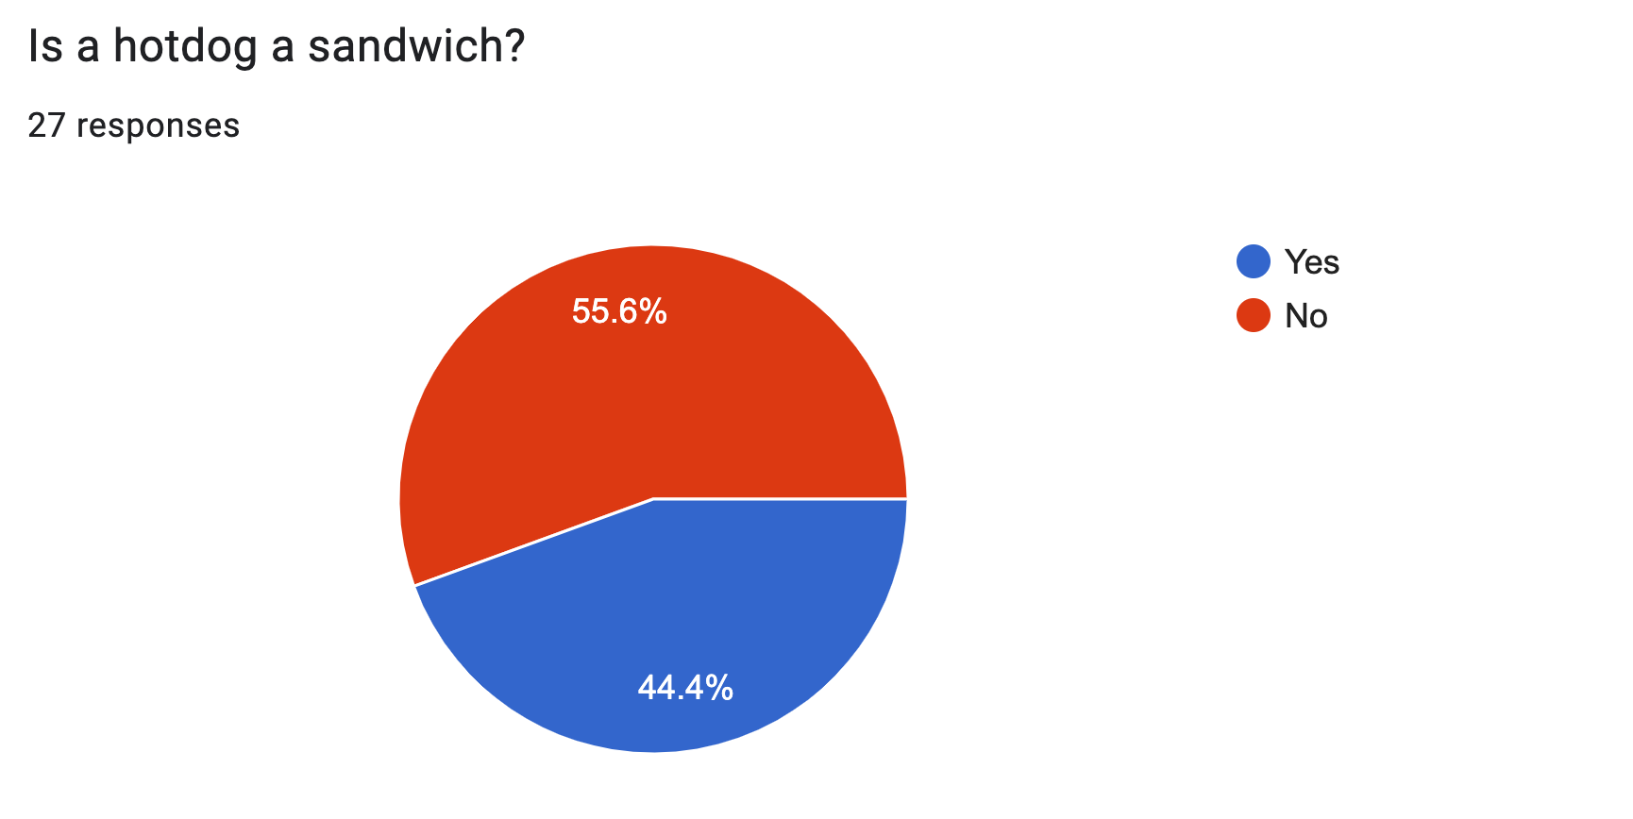
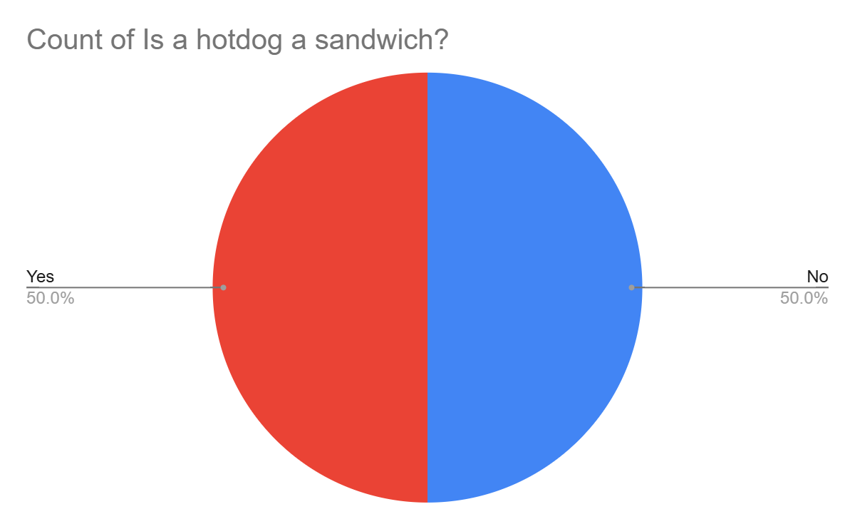
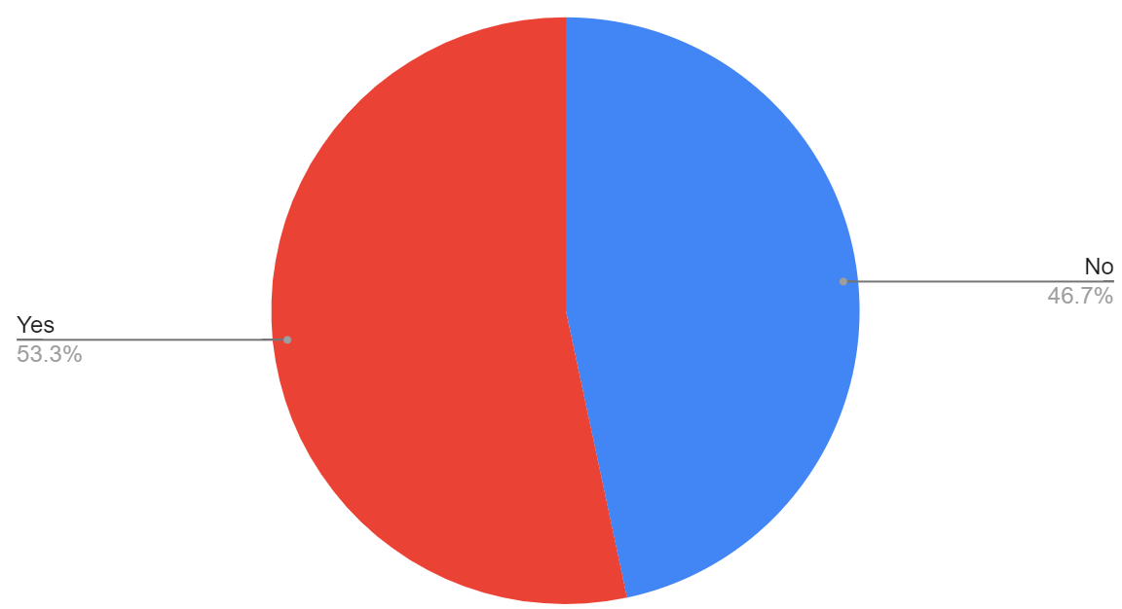
Before we begin…
Thank you for filling in the GitHub to Student survey – never before have exactly half of you been wrong!
24 responses

Slide 3
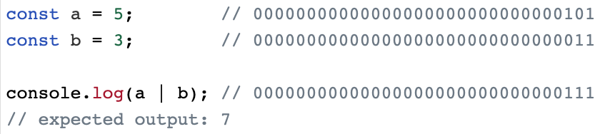
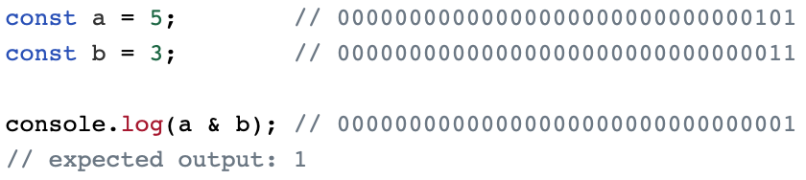
On bits and bytes
8421

Slide 4
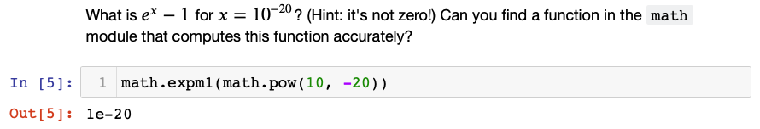
e^{x}-1 for x=10⁻²⁰

Slide 5
What is version control?
Writing a manuscript…
Use undo to revert to a previous state
Use track changes when sharing doc with your advisor

Slide 6
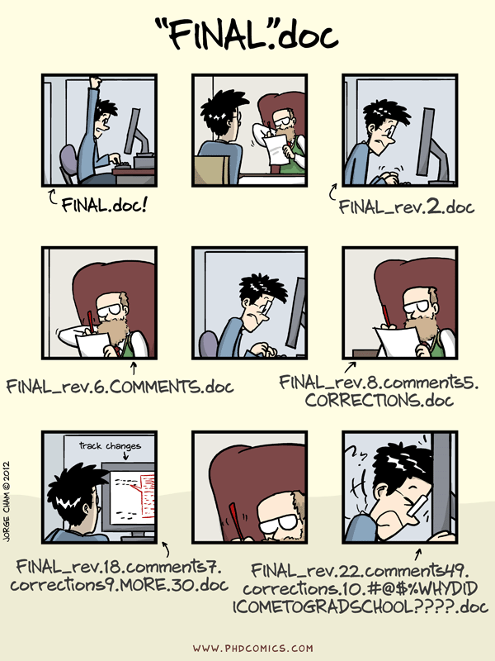

Slide 7
What is version control
Version control is like a combination of undo and track changes for your code
You can revert to previous versions of code
You can easily identify who contributed what
Version control is about tracking versions of code and developing software with people

Slide 8
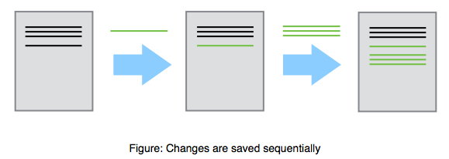
What is version control?

Slide 9
Why do I need version control?
You have a working piece of software
You add some new features
Everything is broken
You want to revert to the last known working version

Slide 10
Why do I need version control?
You are developing software with other people
You want to be able to identify and resolve conflicts during code development
Two people working on the same function at the same time
You need to be able to identify who is responsible for what pieces of code

Slide 11
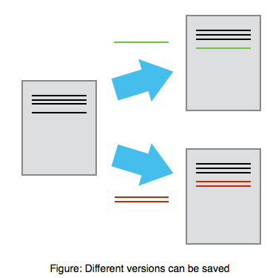
Why do I need version control?

Slide 12
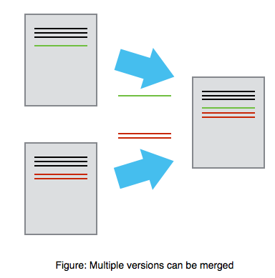
Why do I need version control?
Mary
Alice

Slide 13
Why else?
You want a job
No one will hire a software developer that doesn’t know how to use version control

Slide 14
What is git?
Git is the most popular version control software
Git is open source
Git runs on every platform
even Plan 9 From Outer Space
Git is better than all previous version control tools (in my opinion, and I’ve used quite a few)

Slide 15
What is GitHub?
‘Git in the cloud’
Your git repository lives on GitHub.com
Other people can download and use your code
There is an issue tracker for your code
You can develop code collaboratively using GitHub

Slide 16
Hands on demo!
Open a terminal!

Slide 17
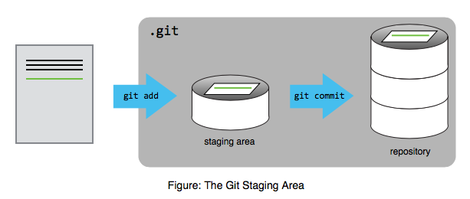

Slide 18
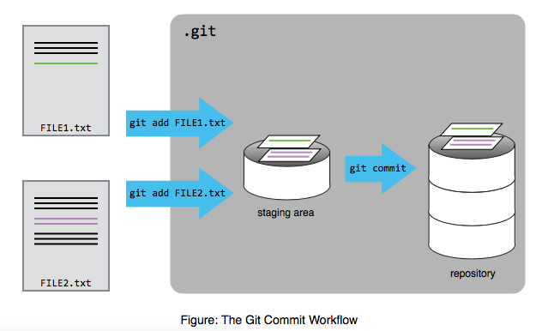

Slide 19
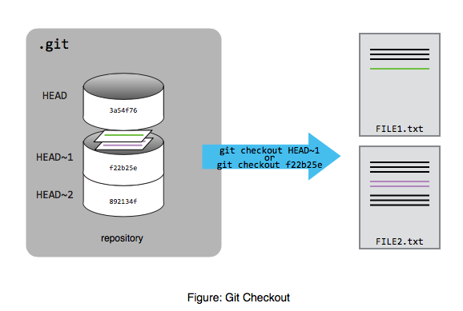

Slide 20
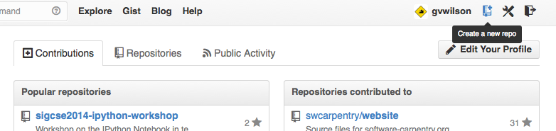

Slide 21
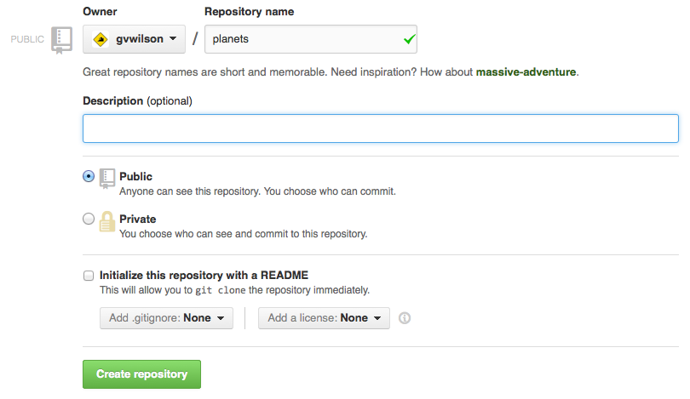

Slide 22
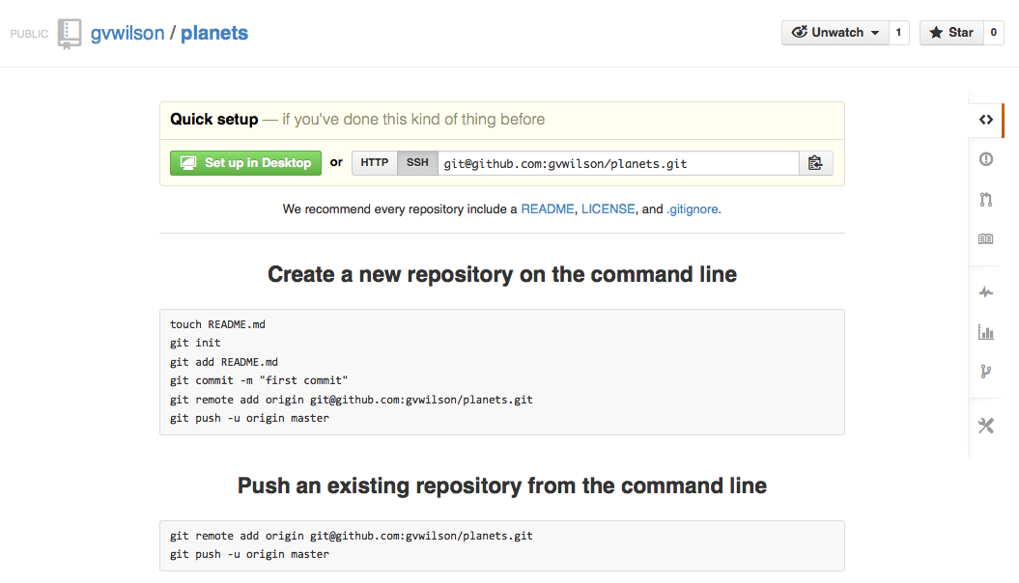

Slide 23
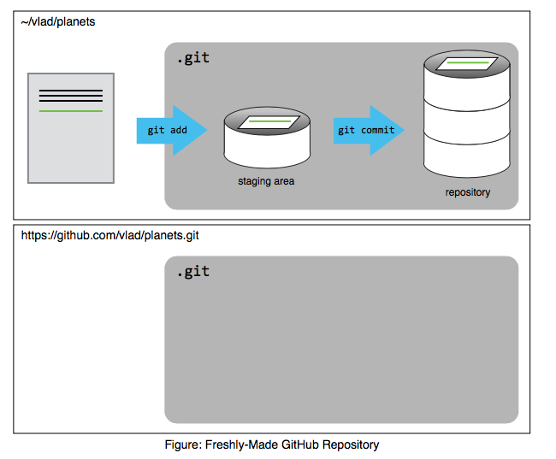

Slide 24
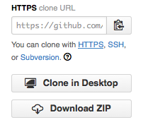

Slide 25
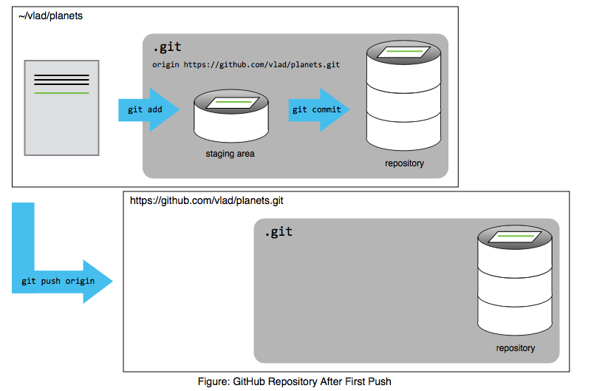

Slide 26
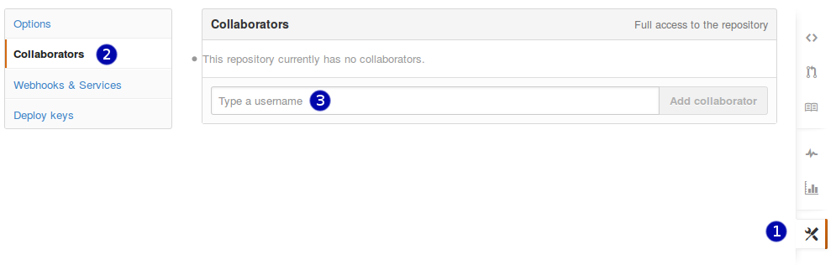

Slide 27
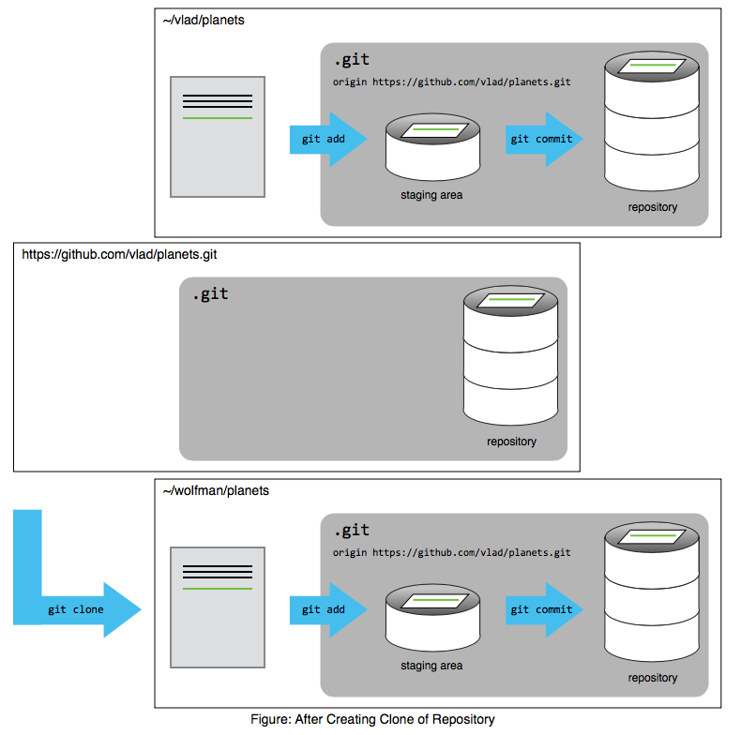

Slide 28
