Slide 1
Software (design) for Data Scientists ISEA Session 3 David Beck University of Washington 2.7.2024

Slide 2
Questions
For 2025, is there a better example than an ATM?
Yours?

Slide 3
Overview of last week and today
Review of last week
Users and their stories inform design
Use cases describe the function of software
Components implement the use cases
Testing and testing strategies
Debugging
Continuous integration
User stories
Use cases
(functional design)
Component design
Notes:
Question: From the perspective of evolutionary biology, are organisms designed? Why or why not?

Slide 4

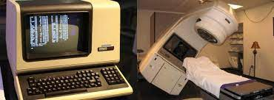
Design & testing fails
Atomic Energy of Canada Limited (AECL)
Therac-25
Built in 1982, 6 accidents from 1985-1987
Design did not specify what limits were set in hardware vs. software (why not both?!?!)
Patients were hit with 100x intended radiation dose (50% fatal)
Error handling was a mess
“Oh Error-54 occurred again? I’ll just clear it.”
AECL had never tested the Therac-25 with the combination of software and hardware until it was assembled at the hospital.
https://en.wikipedia.org/wiki/Therac-25

Slide 5
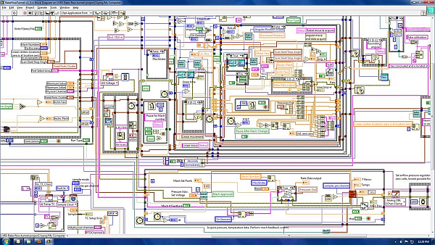
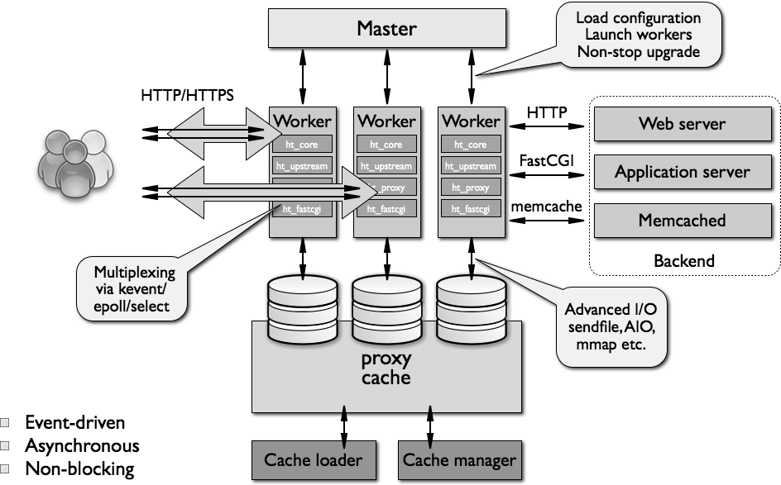
What makes a design understandable?
Few components with clear roles
Few interactions between components
Carefully choose the features and interfaces
Similarity with other designs
Uses design patterns (user interfaces, parallel computing, message observers, …)
Simple where possible is better

Slide 6
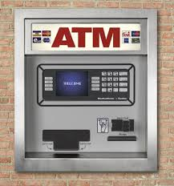
Running Example: Design of ATM

Slide 7
Start by writing a user story
Who is the user. What do they want to do with the tool. What needs and desires do they want for the tool. What is their skill level.

Slide 8
Start by writing a user story
Ram is a bank customer. Ram wants to check his balance, deposit money. He rarely uses cash. Ram wants a safe and secure interface for interacting with the ATM. Ram’s job does not involve technical skills and he values a simple user interface.

Slide 9
Start by writing a user story
Ram is a bank customer. Ram wants to check his balance, deposit money. He rarely uses cash. Ram wants a safe and secure interface for interacting with the ATM. Ram’s job does not involve technical skills and he values a simple user interface.
How are Ram and Asma the same?
How are Ram and Asma different?
What are the key takeaways from their user stories?
Asma is a bank customer. Asma wants to check her balance and take out cash. She uses auto-deposit for her paychecks. She wants a safe and secure interface for interacting with the ATM. Asma is quite technical, but she wants to minimize her time interacting with the ATM and values a simple interface

Slide 10
Use Cases
Functional Design

Slide 11
How to find use cases? In the user stories!
Ram is a bank customer. Ram wants to check his balance, deposit money. He rarely uses cash. Ram wants a safe and secure interface for interacting with the ATM. Ram’s job does not involve technical skills and he values a simple user interface.
Check balances
Deposit checks

Slide 12
What do we do with ATMs?
Check balances
Deposit checks
Get cash
These are examples of Use Cases.
They describe the functional potential of software.
Ram and Asma
Asma

Slide 13
Describing a Use Case (one way)
What are the inputs and what are the outputs?
Adding two numbers
Inputs: two numbers
Outputs: one number, the sum of the two inputs
Can we add more detail? What kind of numbers? Positive and negative?

Slide 14
Describing a Use Case (Check Balance)
What are the inputs and what are the outputs?
Check balance
Input: User selects an account
Output: ATM displays the current account balance
The account information is looked up in the account database and the current balance is retrieved.

Slide 15
Describing a Use Case (Authentication)
What information the user provides (inputs)
What responses the system provides (outputs)
Authenticate User Use Case
User: Put ATM card in reader
ATM: Display 'Enter PIN'
User: Enters PIN on keyboard
ATM: [if correct] Show main menu
[if incorrect] Display 'Enter PIN'

Slide 16
Component Design

Slide 17
What is a component?
Software (or other kinds) components “do the work”
Components store data
Components calculate values
Components “interact” with each other
Components “interact” with the user
Components can be functions, databases, interfaces, external web sites, ..

Slide 18
Developing component specifications
Use case by use case: what are the components required for this use case?
Are those components used for another use case?
Good, we can reuse them!
Can the component be further divided in complexity for sub-components?
Good, we can simplify them!

Slide 19
Specification of a component
Describe components with sufficient detail so that someone with modest knowledge of the project can implement the code for the component.
Name
What it does
Inputs (with type information)
Outputs (with type information)
How it uses other components
Side effects

Slide 20
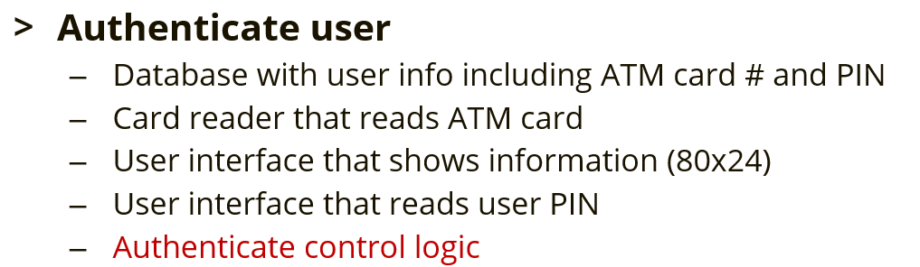
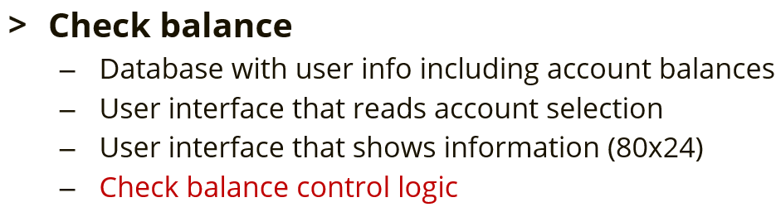
Identify shared components
User interface (output)?
User interface (input)?
Database?
Control logic?

Slide 21
Identify shared components
User interface (output)? Yes!
User interface (input)? Yes!
Database? After subcomponents.
Control logic? No!

Slide 22
Overview of today
Review of last week
Users and their stories inform design
Use cases describe the function of software
Components implement the use cases
Testing and testing strategies
Debugging
Continuous integration
Notes:
Question: From the perspective of evolutionary biology, are organisms designed? Why or why not?

Slide 23
Identify components for a Use Case
Some use cases appear to only have one component
Use case “add numbers”
Adding two numbers
Inputs: two numbers
Outputs: one number, the sum of the two inputs
What components are necessary?
“Add numbers function”
Others?

Slide 24
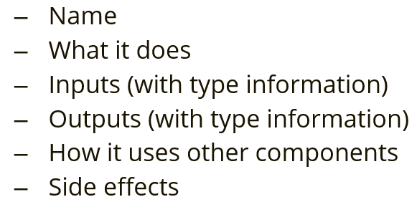
Specify a component
Name: Add numbers function
What it does:
Computes the sum of two numbers. The numbers can be integers or numbers with decimals. They may be positive or negative.
Inputs (with type information)
a, a number which can be an integer, decimal, positive & negative, must be finite and real
b, a number which can be an integer, decimal, positive & negative, must be finite and real
Outputs (with type information)
sum, a number (integer, decimal, positive, negative, finite, real) that is the sum of a and b
Components used: None.
Side effects: None.

Slide 25
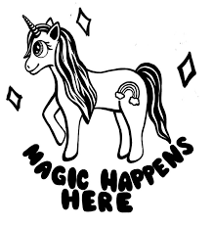
ATM components by Use Case
Authenticate user
Database with user info including ATM card # and PIN
Card reader that reads ATM card
User interface that shows information (80x24)
User interface that reads user PIN
Authenticate control logic
What is this?
1
1. https://www.deviantart.com/love-rainbowflower/art/Magic-Happens-Here-lineart-292524154

Slide 26
Specify components
Authenticate user control logic
Take 2-3 minutes to sketch out a specification for the authenticate user control logic component.

Slide 27
Specify components
Name: Authenticate user control logic
What it does:
Verifies a user is in the database and that the PIN supplied by the user matches the PIN in the database
Inputs (with type information)
Card number, a string that is the user’s card number
PIN, an integer
Outputs (with type information)
Boolean: True if success, False if failure
Components used: ATM card reader supplies Card number input, user inputs PIN via keypad, verification is performed by database
Side effects: If successful, all other bank customer use cases are enabled for the User matching the Card number.

Slide 28
Specify components
Check balance control logic
Take 2-3 minutes to sketch out a specification for the check balance control logic component.

Slide 29
Specify components
Name: Check balance control logic
What it does:
Looks up a user's account that they provided in the account database and returns the current balance associated with that account in the database.
Inputs (with type information)
Account number, a string that is the user’s account number
Outputs (with type information)
False if account does not exist or a floating-point number equal to the account balance
Components used: User selects an Account Number shown on the display with keypad input and the verification and balance lookup is provided by the database
Side effects: None.

Slide 30
Digression: Card number as a string?
Bank card number, e.g.
5534 1234 1234 1234
Should / could this be a number?
Should / could this be a string?
Test for equality
Use the ordinality?
Test for number of digits
>>> a = "5534123412341234"
>>> b = 5534123412341234
>>> len(a)
16
>>> len(b)
[…]
TypeError: object of type 'int' has no len()

Slide 31
Specify components
Name: Check balance control logic
What it does:
Looks up a user's account that they provided in the account database and returns the current balance associated with that account in the database.
Inputs (with type information)
Account number, a string that is the user’s account number
Outputs (with type information)
False if account does not exist or a floating-point number equal to the account balance
Components used: User selects an Account Number shown on the display with keypad input and the verification and balance lookup is provided by the database
Side effects: None.
Erases the current content on the user facing display.

Slide 32


Steps in Design¹
Iterate. Iterate. Iterate.
Identify the users and their needs
Functional design
Describe what the system does (use cases)
Component design
Components are the “software artifacts” that implement the specific features of the use cases
Components are often hierarchical and reused
1. There are many paradigms of software design. This is one. It is focused on humans.

Slide 33
Overview of today
Review of last week
Users and their stories inform design
Use cases describe the function of software
Components implement the use cases
Testing and testing strategies
Debugging
Continuous integration
Notes:
Question: From the perspective of evolutionary biology, are organisms designed? Why or why not?

Slide 34
Component specifications get you to code
Code needs review
Notes:
Question: From the perspective of evolutionary biology, are organisms designed? Why or why not?

Slide 35
Code Review Template
Dispassionate third party
Tour of the code with necessary context
Improving code quality and find bugs with questions
“Why did you call this variable Snuffleupagus when it stores the average grade?”
“This code is repeated, can it be a function?”
“What is happening HERE?!!?!”
Background
Describe what the application does
Describe the role of the code being reviewed
Comment or question
Choice of variable and function names
Readability of the code
How improve reuse and efficiency
How use external software packages

Slide 36
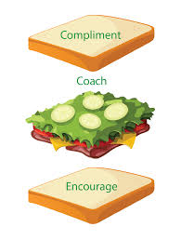
Code Review Template
Dispassionate third party
Tour of the code with necessary context
Improving code quality and find bugs with questions
Background
Describe what the application does
Describe the role of the code being reviewed
Comment or question
Choice of variable and function names
Readability of the code
How improve reuse and efficiency
How use external software packages
Assume good will
https://www.teamwork.com/blog/disagreeing-sandwich-technique/

Slide 37
Component specifications get you to code
Code needs review
Code needs testing
Has this happened to you:
You wrote some code. It works! You are happy.
You add a neat little feature. You think it works. You are happy.
It doesn’t work, but you don’t know. You will be sad.
You found out before anything bad happened.
Notes:
Question: From the perspective of evolutionary biology, are organisms designed? Why or why not?

Slide 38
What is software testing?
Code that checks if other code (code under test) is working properly
If the “code under test”
Runs successfully
Fails gracefully (as expected, when expected)
The tests pass and the code is “accepted” as working

Slide 39
What is software testing?
def code_under_test(a, b):
return a + b
What is the code under test?
What is the code under test doing?
Could we name the code under test function better?

Slide 40
What is software testing?
if add(0, 0) == 0:
return True
else:
return False
def add(a, b):
return a + b
What is a test we can do for add?
Is this sufficient? Why or why not?

Slide 41
What is software testing?
if add(0, 1) == 1:
return True
else:
return False
def add(a, b):
return a + b
Can we test a different a, b pair?
Is this sufficient?
if add(0, 2) == 2:
return True
else:
return False

Slide 42
What is software testing?
for i in range(10):
if add(0, i) != i:
return False
def add(a, b):
return a + b
Can we test many a, b pairs?
Is this sufficient?
Testing is hard! Testing is FUN!

Slide 43

Some “types” of testing
“Smoke” testing
Does it “catch fire and burn” when you try to run the “code under test”
Most basic, limited information about system
Code under test
Test code
def add(a, b):
return a + b
add(0, 0)

Slide 44
Some “types” of testing
“One-shot” testing
Does the code under test perform correctly for a specific set of inputs
Tests the correctness of code
Code under test
Test code
def add(a, b):
return a + b
if add(0, 0) == 0:
return True
else:
return False

Slide 45
Some “types” of testing
“Pattern” testing
Does the code under test perform correctly for a pattern of input cases
Tests the correctness of code across a range of inputs
Code under test
Test code
def add(a, b):
return a + b
for i in range(10):
if add(0, i) != i:
return False
return True

Slide 46
Some “types” of testing
“Edge” testing
Does the code under test perform correctly for invalid and “special” inputs
Tests the error handling and “singular” value handling
Code under test
Test code
def add(a, b):
return a + b
if add(“4”, 0) != 0:
return True
else:
return False

Slide 47
Some “types” of testing
“Edge” testing
Does the code under test perform correctly for invalid and “special” inputs
Tests the error handling and “singular” value handling
Code under test
Test code
def add(a, b):
return a + b
assertRaises(TypeError,
add(“4”, 0))

Slide 48
Some “types” of testing
“Smoke” test
Calling the code under test to see if it “catches fire”
“One-shot” test
Calling the code under test with known inputs expecting specific outputs
“Pattern” test
Calling the code under test with a pattern of known inputs expecting a pattern of outputs
“Edge” test
Calling the code under test in “edge cases” and in predefined failure modes to make sure it fails gracefully. FUN!
These names are for our convenience.

Slide 49
How many tests for each component?
There is no magic number
Patterns > One-shot > Smoke
Not all tests offer the same “value” in testing
Patterns reveal more possible failure modes
Number of tests is less important than code coverage
Test coverage and code coverage is an important concept in software engineering and can make and break job interviews.

Slide 50
What is code coverage?
Fraction (%) of lines of code “exercised” by a test
How many lines in add?
What percentage of those lines are executed by our test?
100% (1 of 1 lines of add were executed)
Code under test
Test code
def add(a, b):
return a + b
add(0, 0)
1.

Slide 51
What is code coverage?
Fraction (%) of lines of code “exercised” by a test
What percentage of those lines are executed by our test?
100% (1 of 1 lines of add were executed)
Code under test
Test code
def add(a, b):
return a + b
if add(0, 0) == 0:
return True
else:
return False
1.

Slide 52
What is code coverage?
Fraction (%) of lines of code “exercised” by a test
What percentage of those lines are executed by our test?
100% (1 of 1 lines of add were executed)
Code under test
Test code
def add(a, b):
return a + b
for i in range(10):
if add(0, i) != i:
return False
return True
1.

Slide 53
What is code coverage?
Code under test
def add_or_multiply(op, a, b):
1. if op == “+”:
2. return a + b
3. else:
4. return a * b
Code coverage?
50%
Test code
if add_or_multiply(“+”, 0, 1) != 1:
return False

Slide 54
What is code coverage?
Code under test
def add_or_multiply(op, a, b):
1. if op == “+”:
2. return a + b
3. else:
4. return a * b
Code coverage?
75%
Test code
if add_or_multiply(“*”, 0, 1) != 0:
return False

Slide 55
What is code coverage?
Code under test
def add_or_multiply(op, a, b):
1. if op == “+”:
2. return a + b
3. else:
4. return a * b
Code coverage?
100%
Test code
if add_or_multiply(“+”, 0, 1) != 0:
return False
if add_or_multiply(“*”, 0, 1) != 0:
return False

Slide 56
Is code coverage alone enough?
Code under test
def add_or_multiply(op, a, b):
1. if op == “+”:
2. return a + b
3. else:
4. return a * b
Code coverage?
100%
Test code
if add_or_multiply(“+”, 0, 1) != 0:
return False
if add_or_multiply(“/”, 0, 1) == 0:
return False

Slide 57
Testing is hard! Testing is fun!
Mode of thinking: How can I break this?
Want to get better?
Practice!
“Software engineer in test” is a specific job
Software development engineering in test (SDET)
U.S. Bureau of Labor Statistics predicts > 25% job growth
Pathway to a Software Development Engineer

Slide 58
Testing is only as good as your imagination!
“Software engineer in test” is a specific job
Software tester walks into a bar...
Software tester run into a bar...
Software tester crawls into a bar…
Software tester walks into a bar and orders a drink…
Software tester runs into a bar and orders a drink…
Software tester crawls into a bar and orders a drink…
…
User walks into a bar and asks for the bathroom.

Slide 59
What does this look like in files?
One source file for code, one source file for tests
math.py has an accompanying test_math.py
math.py
test_math.py
def add(a, b):
…
def multiply(a, b):
…
def test_add():
…
def test_multiply():
…

Slide 60
What does this look like in files?
math.py
test_math.py
def add(a, b):
return a+b
def multiply(a, b):
…
def test_add():
…
def test_multiply():
…
def test_add():
for i in range(10):
assert add(0, i) == i

Slide 61
What does this look like in projects?
my_project/
test/
math.py
test_math.py
def add(a, b):
return a+b
def multiply(a, b):
…
def test_add():
…
def test_multiply():
…

Slide 62
What does this look like in real projects?
my_project/
test/
math.py
student.py
test_math.py
test_student.py
def add(a, b):
return a+b
def multiply(a, b):
…
def lookup(id):
…
def score(id, ans):
…
def test_add():
…
def test_multiply():
…
def test_lookup():
…
def test_score():
…

Slide 63
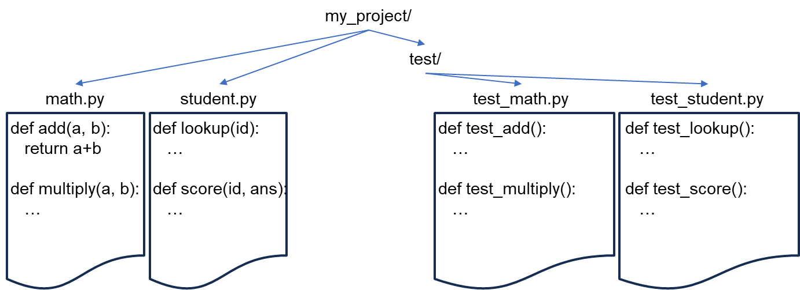
What does this look like in day to day?
After each change to a function or file (e.g. math.py)
Rerun the tests (test_math.py)
Do we need to run all tests?
Yes! Maybe?

Slide 64
What does this look like in day to day?
After each change to a function or file (e.g. math.py)
Rerun the tests (test_math.py)
Do we need to run all tests?
The design should tell us
Component specification includes component interactions
Component specification includes side effects

Slide 65
Testing is highly automated with tooling
After each change to a function or file (e.g. math.py)
Rerun the tests (test_math.py)
Do we need to run all tests?
If components in math.py call components in student.py, yes
If components in student.py call components in math.py, yes

Slide 66
Testing can be a big lift for large software
After each change to a function or file (e.g. math.py)
Rerun all the tests (test_math.py, test_student.py)
Testing is automated, so run them all
Big software projects
Testing can be expensive (money & time)
Automated tests can be run 100s of times a day

Slide 67
Test-driven development
Testing is automated
pytest, nosetest, python –m unittest
Tests can be written from component specifications
Tests can be written without “code under test”

Slide 68
Test-driven development
Tests can be written without “code under test”
Code under test
Test code
Test code output
def test_add():
for i in range(10):
assert add(0, i) == i
>>> test_add()
[…]
NameError: name 'add' is not defined

Slide 69
Test-driven development
Tests can be written with empty “code under test”
Code under test
def add(a, b):
pass
Do nothing, take no action, no operation, return None
Test code
Test code output
def test_add():
for i in range(10):
assert add(0, i) == i
>>> test_add()
[…]
AssertionError

Slide 70
Test-driven development
Tests can be written to drive writing “code under test”
Code under test
def add(a, b):
return a + b
Test code
Test code output
def test_add():
for i in range(10):
assert add(0, i) == i
>>> test_add()
>>>
No errors so a success

Slide 71
Test-driven development
Tests are written against the component specification
All components are implemented as ‘pass’
All tests:
FAIL!
Write code until all tests pass
Release software bug free!
def add(a, b):
pass

Slide 72
Overview of today
Review of last week
Users and their stories inform design
Use cases describe the function of software
Components implement the use cases
Testing and testing strategies
Debugging
Continuous integration
Notes:
Question: From the perspective of evolutionary biology, are organisms designed? Why or why not?

Slide 73
When tests fail: Debugging
What is a bug?
“A software bug is an error, flaw, failure, or fault in a computer program or system that causes it to produce an incorrect or unexpected result, or behave in unintended ways.” – Wikipedia
Where did the term come from?
Thomas Edison (1878, letter to associate) - Wikipedia
... difficulties arise—this thing gives out and [it is] then that "Bugs"—as such little faults and difficulties are called—show themselves

Slide 74
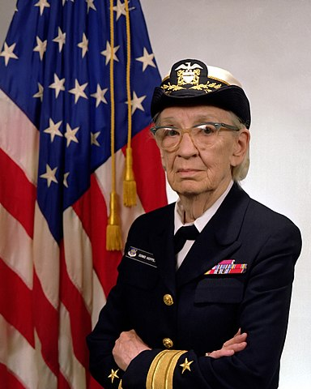
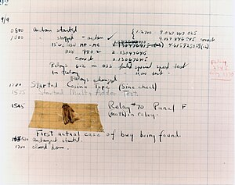
When tests fail: Debugging
Where did the term come from?
Grace Hopper, USN rear admiral, 1906-1992
Two PhDs, developed the UNIVAC I, COBOL
1947
Mark II mechanical computer
Her team discovered a moth stuck in a relay
The relay would not function until the moth was removed
Thus, a computer was “debugged”
Wikipedia

Slide 75
When tests fail: Debugging
Two types of debugging
Print debugging
Using print statements to inspect the state of your code
Debugger based tools
Using tooling to inspect the state of your code at run time

Slide 76
When tests fail: Debugging
Two types of debugging
Print debugging
def add_or_multiply(op, a, b):
if op == “+”:
return a + b
else:
return a * b

Slide 77
When tests fail: Debugging
def add_or_multiply(op, a, b):
print(“add_or_multiply called”)
print(op)
print(a)
print(b)
if op == “+”:
print(“we are adding”)
return a + b
else:
print(“we are multiplying”)
return a * b
Two types of debugging
Print debugging

Slide 78
When tests fail: Debugging
def add_or_multiply(op, a, b):
print(“add_or_multiply called”)
print(op)
print(a)
print(b)
if op == “+”:
print(“we are adding”)
return a + b
else:
print(“we are multiplying”)
return a * b
Two types of debugging
Print debugging
>>> add_or_multiply(“+”, 0, 0)
add_or_multiply called
+
0
0
we are adding

Slide 79
When tests fail: Debugging
Two types of debugging
Print debugging
WORKS!!!!!
Time consuming
def add_or_multiply(op, a, b):
print(“add_or_multiply called”)
print(op)
print(a)
print(b)
if op == “+”:
print(“we are adding”)
return a + b
else:
print(“we are multiplying”)
return a * b
def add_or_multiply(op, a, b):
if op == “+”:
return a + b
else:
return a * b

Slide 80
When tests fail: Debugging
Two types of debugging
Debugger based tools
Using tooling to inspect the state of your code at run time
def add_or_multiply(op, a, b):
1. if op == “+”:
2. return a + b
3. else:
4. return a * b

Slide 81
When tests fail: Debugging
Two types of debugging
Debugger based tools
Using tooling to inspect the state of your code at run time
add_or_multiply(“/”, 0, 0)
def add_or_multiply(op, a, b):
1. if op == “+”:
2. return a + b
3. else:
4. return a * b

Slide 82
When tests fail: Debugging
What line is executed next?
Two types of debugging
Debugger based tools
Using tooling to inspect the state of your code at run time
add_or_multiply(“/”, 0, 0)
Variables
op = “/”
a = 0
b = 0
def add_or_multiply(op, a, b):
1. if op == “+”:
2. return a + b
3. else:
4. return a * b

Slide 83
When tests fail: Debugging
What line is executed next?
Two types of debugging
Debugger based tools
Using tooling to inspect the state of your code at run time
add_or_multiply(“/”, 0, 0)
Variables
op = “/”
a = 0
b = 0
def add_or_multiply(op, a, b):
1. if op == “+”:
2. return a + b
3. else:
4. return a * b

Slide 84
When tests fail: Debugging
What line is executed next?
Two types of debugging
Debugger based tools
Using tooling to inspect the state of your code at run time
add_or_multiply(“/”, 0, 0)
Variables
op = “/”
a = 0
b = 0
def add_or_multiply(op, a, b):
1. if op == “+”:
2. return a + b
3. else:
4. return a * b

Slide 85
When tests fail: Debugging
Two types of debugging
Print debugging
Using print statements to inspect the state of your code
Easy at first, slow and difficult later
Debugger based tools
Using tooling to inspect the state of your code at run time
Hard at first, easy and fast later
Career progression in SDE will require Debugger skill

Slide 86
Overview of today
Review of last week
Users and their stories inform design
Use cases describe the function of software
Components implement the use cases
Testing and testing strategies
Debugging
Continuous integration
Notes:
Question: From the perspective of evolutionary biology, are organisms designed? Why or why not?

Slide 87
What is continuous software testing?
add(a, b)
multiply(a, b)
In version 2, we want to support complex numbers. How can we be sure that our changes don’t break things?
“Continuous integration” or continuously integrating new code into your software after testing.
The tests pass and the code is “accepted” as working
Version 1 of our simple math library

Slide 88
Homework for next week
Thinking about your assignment and homework for Session 2, can you
Identify a software component for the design you proposed last week
Can you subdivide the component?
Why or why not?
Describe, using the standard types of tests introduced, the testing challenges and strategies you might opt to employ for that component
Are there pattern tests available? Are you sure? Really?
What edge tests are appropriate?

