Slide 1


Ruby
Week 10

Slide 2


Last Class!!
Drinks/Dinner/Fun @ Elephant and Castle
Walk over with me after class

Slide 3
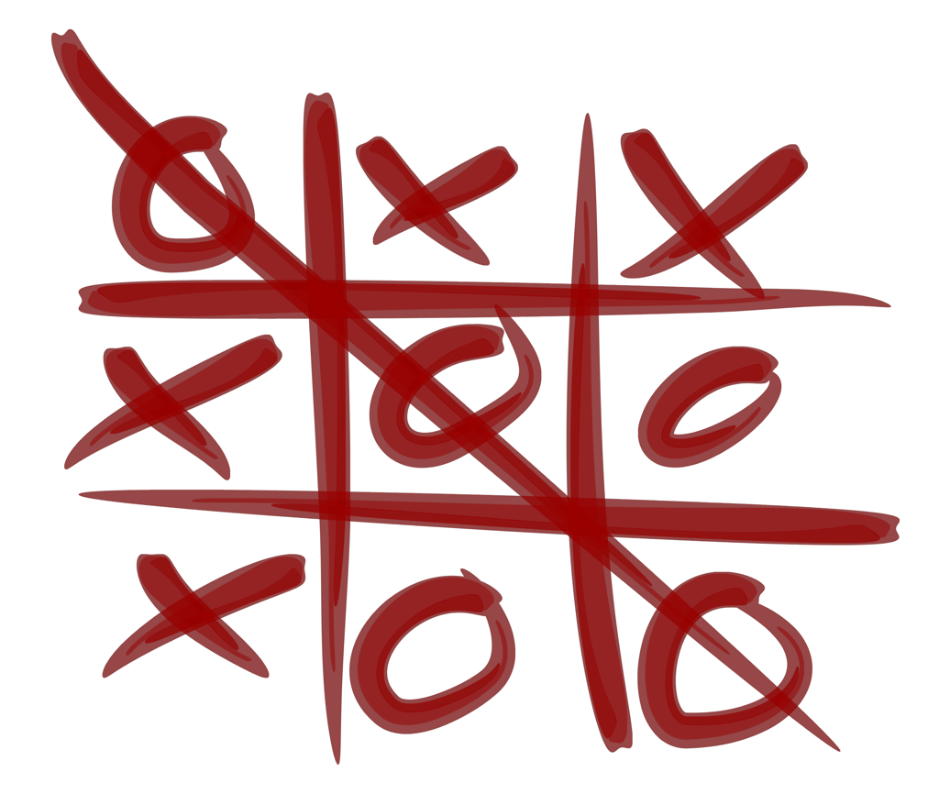
Tic-Tac-Toe
Pull Request to Github
Mine needs Refactoring!!
  Contributors Welcome!
Release it as a Gem?

Slide 4

Sinatra
Ruby Gem for quick Web-Apps
No Framework, just Routes and Ruby Code!
Uses WEBrick (Ruby’s web-server)

Slide 5
Struct
When you need an object, but don’t have one!
Great for Forms! (You’ll see this in Rails)
I used this today...

Slide 6
Struct.new
Struct.new(‘Person’, :full_name, :email)
p = Struct::Person.new(‘Renee’, ‘renee@nird.us’)
        OR
Person = Struct.new(:full_name, :email)
p = Person.new(‘Renee’, ‘renee@nird.us’)

Slide 7

Materials
Anything you are missing?
Last questions/topics/resources?
Slides, Videos, Homework Answers

Slide 8

Gem Projects Demo!
Please email me a link to your gem on RubyGems, the source on Github, and Travis
Volunteers?

Slide 9
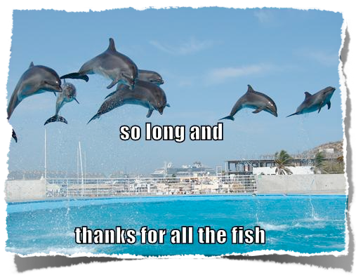
Thanks!

Slide 10

Surveys!!!
on Paper... I know.... In a RoR class....

