Slide 1
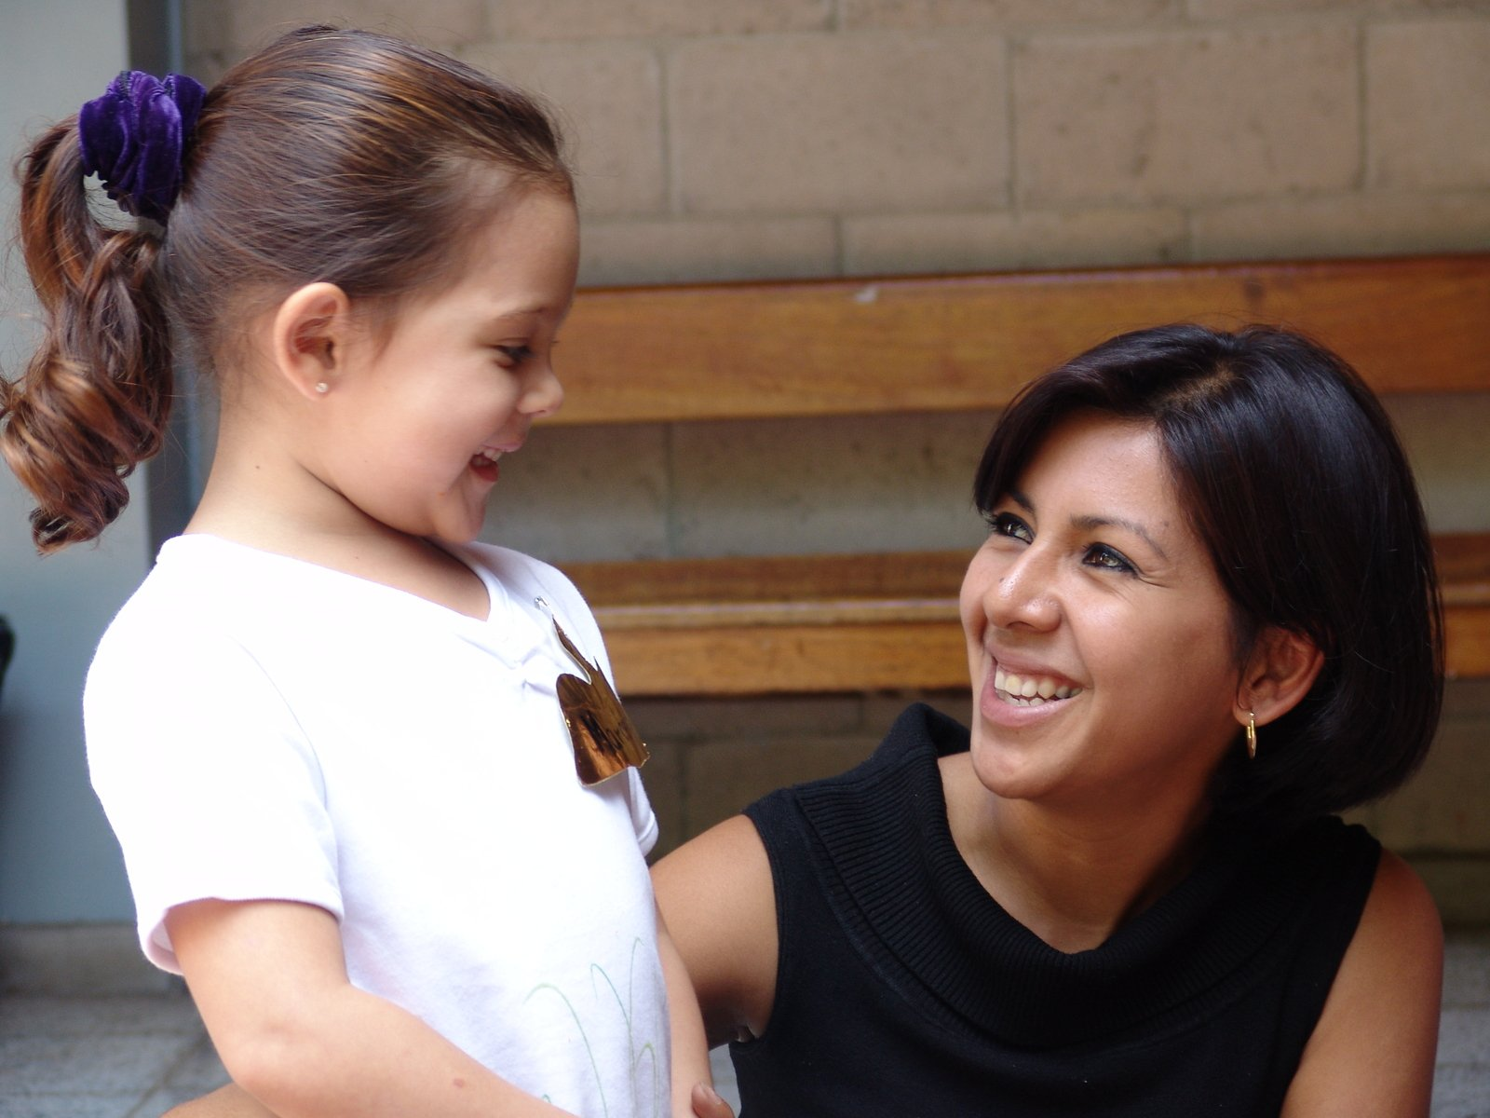
User Persona for Adopt-a-Dog
Name: Sarah Greenleaf
Age: 32
Location: Bellevue, WA
Family: Husband and 2 young daughters
Occupation: School District Educational Program Manager
Activities: Hiking, camping, going to the beach, walks around the city and the park, social media, volunteering.
Other details:
Uses a (2) year-old 13.3” screen MacBook for personal use and a (2) year-old 15.5” PC for work. Personal and work phones are both iPhone XRs (a year old each).
Wants to teach her daughters about social and environmental responsibility.
Has adopted dogs before and can handle dogs with behavioral or abandonment issues.
Interested in seeing pictures of dogs and learning their histories.
Loves reading blogs and making connections with others.
Enjoys supporting local businesses.

