Slide 1
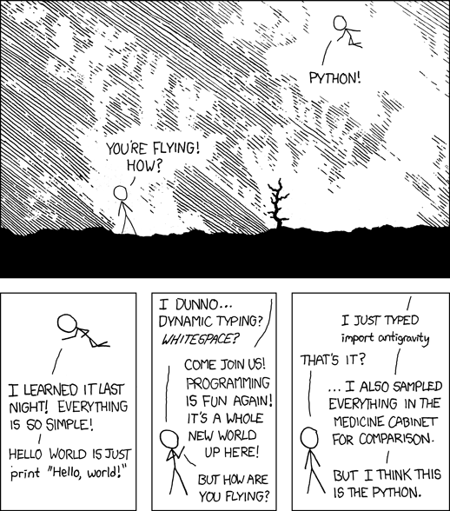
An Introduction to Python
Sudo Soldiers
Oct 27, 2013

Slide 2
Reach Me
karan@goel.im
Github: thekarangoel
www: goel.im

Slide 3
What is Python?
Open source general-purpose language.
Object Oriented, Procedural, Functional
Easy to interface with C/ObjC/Java/Fortran
Easy-ish to interface with C++ (via SWIG)
Great interactive environment

Slide 4
What You'll Need?
Python 2.7 Runtime (Pre-installed in Unix, Mac) – python.org
Optional: A text editor of choice

Slide 5
Who uses Python?
Reddit
Pinterest
BitBucket
Disqus
Quora

