Slide 1
Sampling Methods and Sample Size
Techniques and considerations for research data collection
Notes:
AI-generated content may be incorrect. ---

Slide 2
Introduction to Sampling
Notes:
What is Sampling?

Slide 3

What is Sampling?
Definition of Sampling
Sampling selects a subset from a larger population to make broader inferences about the whole group.
Purpose and Benefits
Sampling reduces cost and time by avoiding the need to study every population member in research.
Applications Across Fields
Sampling is widely used in market research, public health, and social sciences for drawing conclusions.
Ensuring Representativeness
Careful sample selection ensures findings are reliable and generalizable to the entire population.
Notes:
Sampling is the process of selecting a subset of individuals from a larger population to make inferences about the whole. It is a fundamental concept in statistics and research methodology, allowing analysts to gather insights without the need to study every member of a population. This approach significantly reduces the cost and time associated with data collection. Sampling is used in various fields such as market research, public health, and social sciences to draw conclusions about population behaviors, preferences, or characteristics. By carefully choosing a representative sample, researchers can ensure that their findings are generalizable and reliable.

Slide 4
Types of Sampling Methods
Notes:
Simple Random Sampling, Stratified Sampling, Systematic Sampling, Cluster Sampling

Slide 5

Simple Random Sampling
Equal Chance Selection
Every individual in the population has an equal chance of being selected, minimizing bias in the sample.
Implementation in Python
The random sample function in Python is used to select a specified number of items randomly from a dataset.
Limitations in Subgroup Representation
Simple random sampling may not guarantee representation of all subgroups, especially with small samples.
Notes:
Simple random sampling is a method where every individual in the population has an equal chance of being selected. This technique is straightforward and minimizes bias, making it ideal for general-purpose surveys. In Python, this can be implemented using the random.sample function, which selects a specified number of items randomly from a dataset. While simple random sampling is unbiased, it may not guarantee representation of all subgroups within the population, especially if the sample size is small. Therefore, it is best used when the population is homogeneous or when subgroup representation is not critical.

Slide 6

Stratified Sampling
Dividing Population into Strata
Stratified sampling divides populations into distinct subgroups like age, gender, or region for representative sampling.
Proportional Sampling
Samples are drawn proportionally from each stratum to ensure all subgroups are adequately represented.
Application in Python
Python’s groupby and apply functions enable stratified sampling by sampling fractions from each group.
Benefits of Stratified Sampling
This method improves accuracy and precision, especially in heterogeneous populations with varied subgroup characteristics.
Notes:
Stratified sampling involves dividing the population into distinct subgroups or strata, such as gender, age, or region, and then sampling proportionally from each stratum. This method ensures that all relevant subgroups are adequately represented in the sample, improving the accuracy and reliability of the results. In Python, stratified sampling can be performed using groupby and apply functions to sample a fraction from each group. This technique is particularly useful in heterogeneous populations where subgroup characteristics significantly influence the outcome of interest. Stratified sampling enhances the precision of estimates and is commonly used in demographic studies and opinion polls.

Slide 7

Systematic Sampling
Sampling Method Overview
Systematic sampling selects every k-th individual after a random start, ensuring coverage across the population.
Python Implementation
In Python, systematic sampling can be implemented efficiently using slicing syntax like data[::k].
Potential Bias Issues
Systematic sampling may cause bias if data has periodic patterns aligning with the sampling interval.
Practical Applications
Widely used in quality control and industry for its simplicity, speed, and good approximation of random sampling.
Notes:
Systematic sampling selects every k-th individual from a list after a random starting point. For example, if k=10, every 10th person is chosen. This method is easy to implement and ensures a spread across the population. In Python, it can be done using slicing techniques like data[::k]. However, systematic sampling may introduce bias if the data has periodic patterns that align with the sampling interval. Despite this limitation, it is widely used in quality control and industrial processes where simplicity and speed are essential. It provides a good approximation of random sampling when the population is randomly ordered.

Slide 8
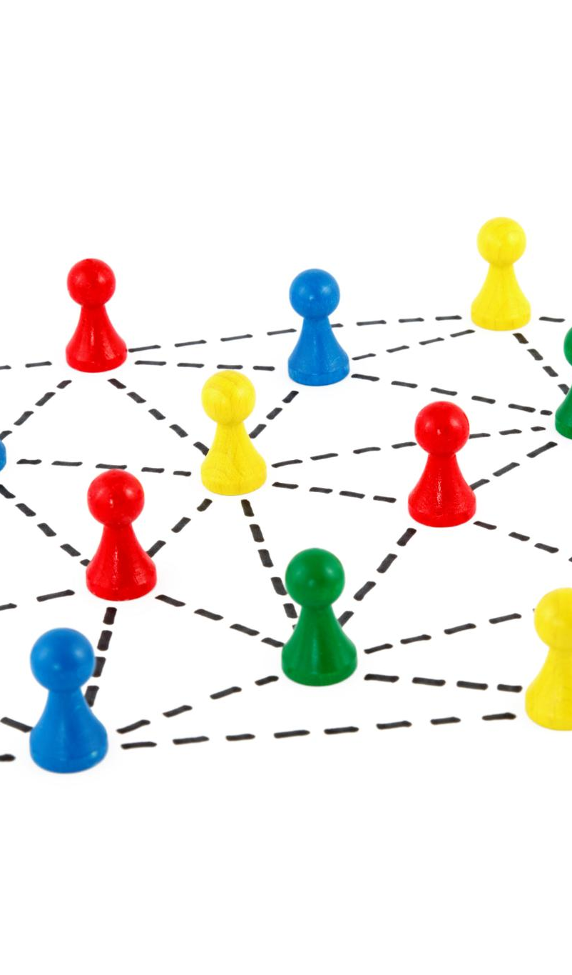
Cluster Sampling
Definition and Process
Cluster sampling divides the population into clusters and randomly selects entire clusters for the study.
Advantages of Cluster Sampling
It is cost-effective and practical for geographically dispersed populations, reducing travel and administrative costs.
Disadvantages and Limitations
Cluster sampling can lead to less precise estimates due to similarities within clusters, affecting accuracy.
Implementation in Python
Implemented by filtering data using randomly selected cluster identifiers in programming environments.
Notes:
Cluster sampling involves dividing the population into clusters, such as schools or regions, and then randomly selecting entire clusters for study. All individuals within the chosen clusters are included in the sample. This method is cost-effective and practical when the population is geographically dispersed. In Python, cluster sampling can be implemented by filtering data based on randomly selected cluster identifiers. While cluster sampling reduces travel and administrative costs, it may lead to less precise estimates due to intra-cluster homogeneity. It is commonly used in large-scale surveys and field research where accessing the entire population is impractical.

Slide 9
Sample Size Determination
Notes:
Sample Size Formula

Slide 10

Sample Size Formula
Importance of Sample Size
Appropriate sample size ensures reliable and valid statistical inferences in research studies.
Sample Size Formula
The formula n = (Z^2 * p * (1 - p)) / E^2 calculates the required sample size based on confidence level and margin of error.
Balancing Precision and Resources
The formula helps balance precision and resource constraints by avoiding overly large or small samples.
http://www.raosoft.com/samplesize.html
Notes:
Determining the appropriate sample size is crucial for ensuring the reliability of statistical inferences. The standard formula for sample size is n = (Z^2 * p * (1 - p)) / E^2, where Z is the Z-score corresponding to the desired confidence level, p is the estimated proportion of the population, and E is the margin of error. For example, with Z=1.96 (95% confidence), p=0.5, and E=0.05, the required sample size is approximately 384. This formula helps balance precision and resource constraints, ensuring that the sample is large enough to detect meaningful differences or trends without being unnecessarily large.

Slide 11

Simple Random Sampling in Python
Using random.sample Function
The random.sample function in Python selects a specified number of random items from a dataset without replacement.
Purpose and Use Cases
Simple random sampling provides quick and unbiased data subsets for exploratory analysis and testing scenarios.
Notes:
In Python, simple random sampling can be performed using the random.sample function. This function selects a specified number of items randomly from a dataset. For example, sample = random.sample(data, 10) selects 10 random entries from the data. This method is useful for quick and unbiased sampling when subgroup representation is not a concern. It is widely used in exploratory data analysis and testing scenarios where a representative subset is needed for initial insights or validation.

Slide 12
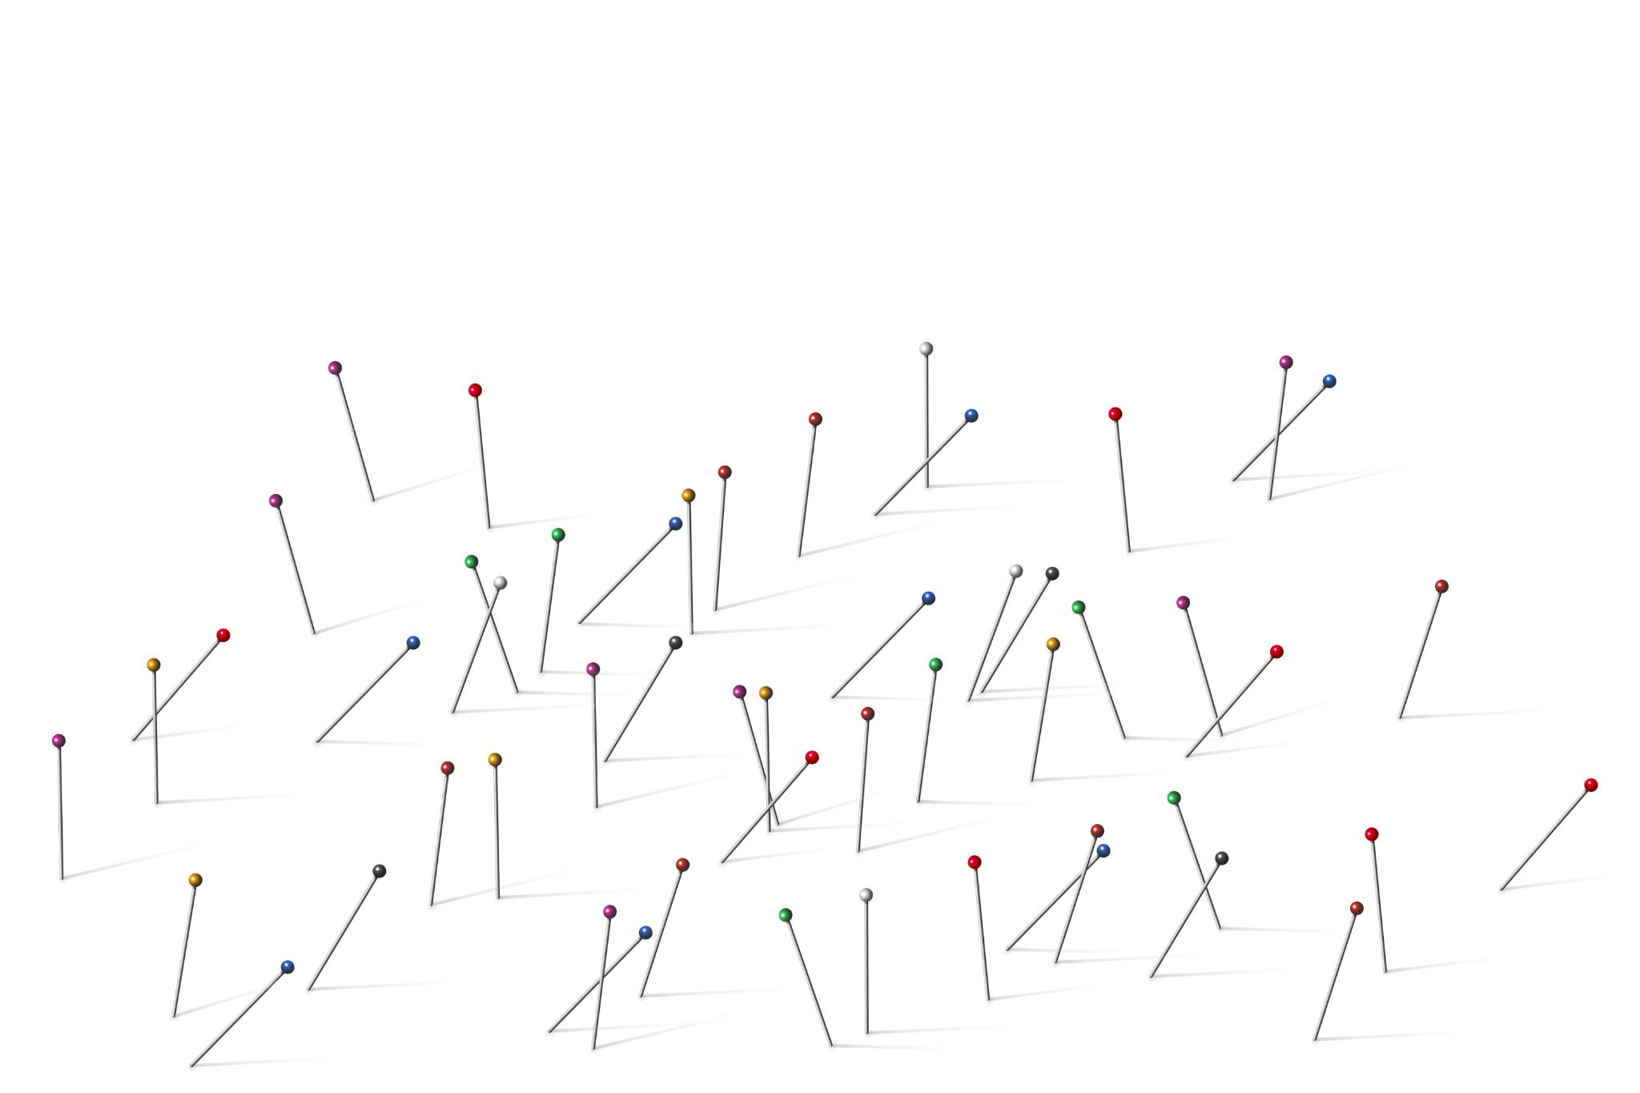
Stratified Sampling in Python
Implementation with groupby
Stratified sampling uses groupby and apply functions to sample proportional data from each subgroup.
Ensuring Proportional Representation
This method guarantees proportional subgroup representation improving accuracy of statistical analysis.
Applications of Stratified Sampling
Commonly applied in demographic studies, customer segmentation, and policy evaluation for better insights.
Notes:
Stratified sampling in Python can be implemented using the groupby and apply functions. For instance, grouped = data.groupby('Gender'); sample = grouped.apply(lambda x: x.sample(frac=0.1)) samples 10% from each gender group. This approach ensures that each subgroup is proportionally represented in the sample, enhancing the accuracy of statistical estimates. It is particularly useful in datasets with categorical variables where subgroup differences are significant. Stratified sampling is commonly applied in demographic analysis, customer segmentation, and policy evaluation.

Slide 13

Summary and Questions
Importance of Sampling
Sampling enables efficient, cost-effective insights into large populations for accurate data analysis results.
Sampling Methods
Methods like simple random, stratified, systematic, and cluster sampling address diverse research needs.
Sample Size Validity
Understanding sample size formula ensures statistically valid and reliable sample data.
Python Tools for Sampling
Python provides powerful tools to implement sampling methods accessible to analysts and researchers.
Notes:
Sampling is a vital technique in data analysis that enables efficient and cost-effective insights into large populations. Various methods such as simple random, stratified, systematic, and cluster sampling cater to different research needs and population structures. Understanding the sample size formula ensures that samples are statistically valid and reliable. Python provides powerful tools for implementing these sampling methods, making it accessible for analysts and researchers. By applying the appropriate sampling technique and ensuring adequate sample size, one can achieve accurate and meaningful results. Questions and discussions are encouraged to clarify concepts and explore practical applications.

