Slide 1

Understanding Overfitting & Hyperparameter Tuning
Improving model accuracy and avoiding training errors

Slide 2
What Is Overfitting?
Notes:
Definition and Key Indicators

Slide 3
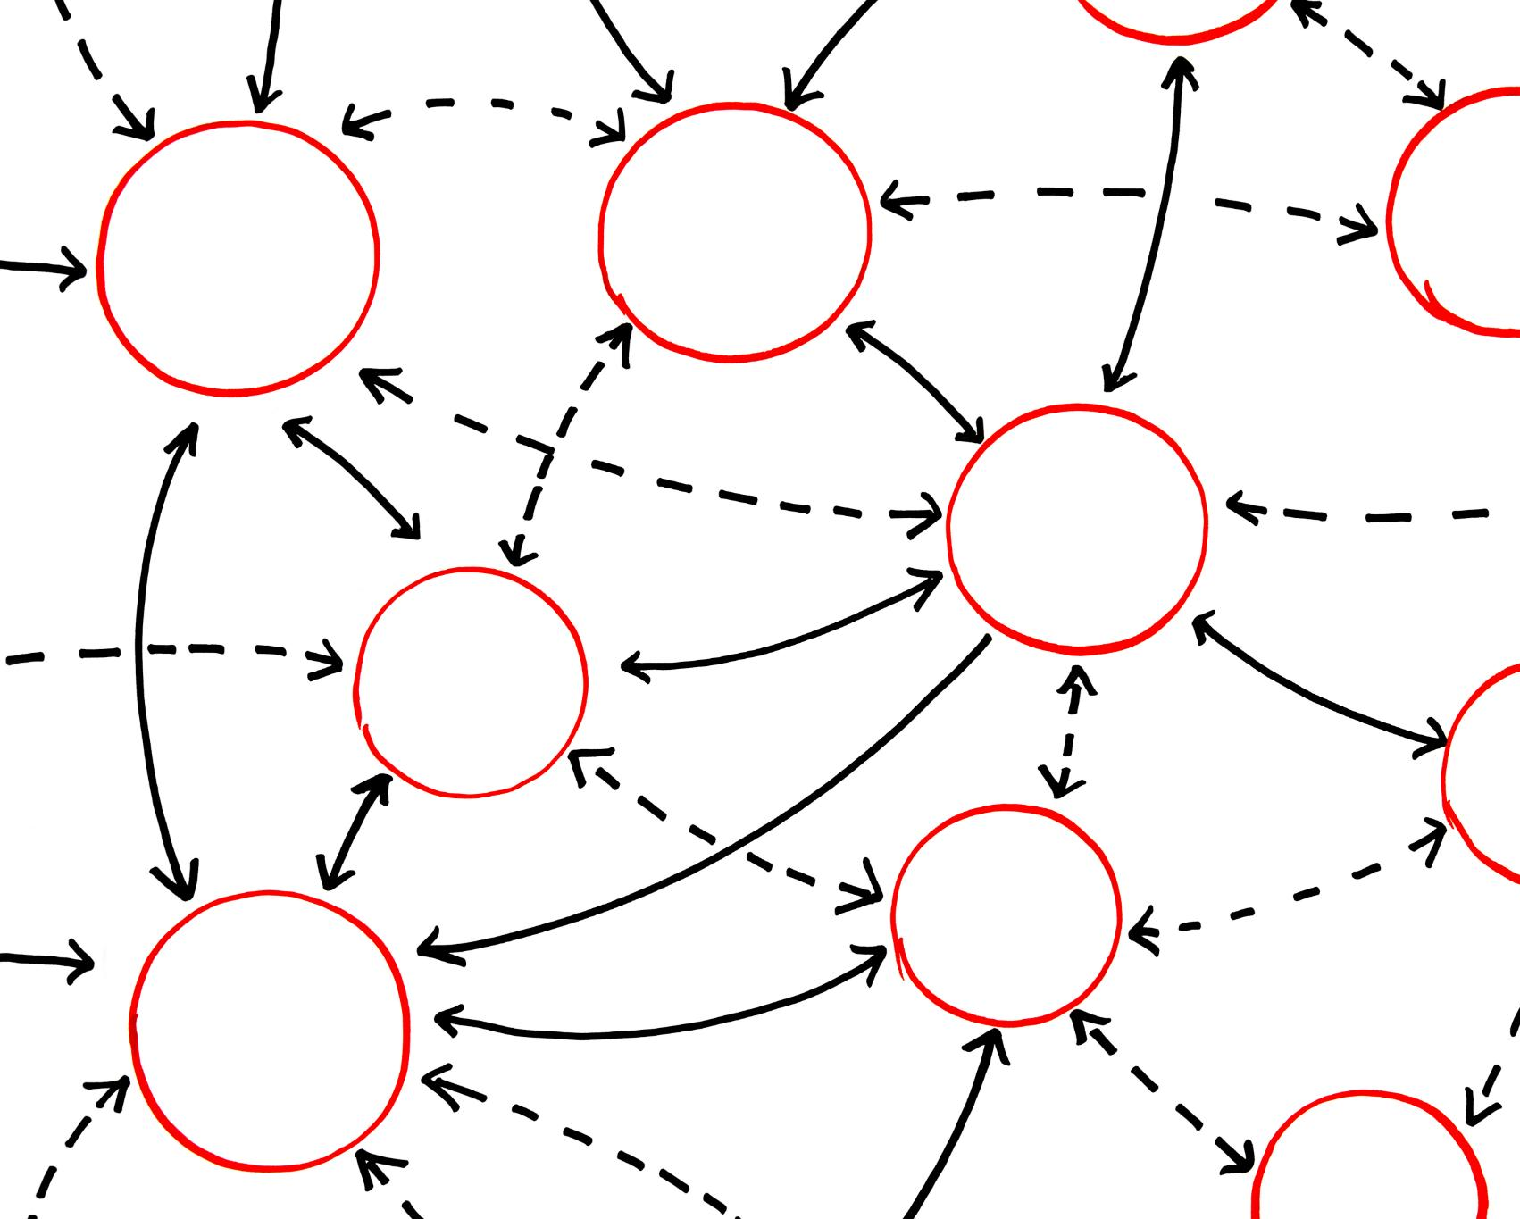
Definition and Key Indicators
Overfitting Explained
Overfitting is when a model memorizes training data noise instead of learning general patterns.
Key Indicators
Large gap between high training accuracy and low validation accuracy indicates overfitting.
Model Complexity Issue
Using overly complex models on small datasets often causes overfitting and poor generalization.
Learning Curves Insight
Learning curves show training score high while validation score stagnates or declines over time.
Notes:
Overfitting occurs when a machine learning model learns the training data too well, including noise and outliers, rather than capturing generalizable patterns. This leads to excellent performance on the training set but poor performance on unseen data. Key indicators of overfitting include a significant gap between training and validation accuracy, where training accuracy is very high while validation accuracy is much lower. Another sign is when the model's complexity is disproportionate to the size of the dataset, such as using a deep decision tree for a small dataset. In the context of the penguins dataset, imagine a decision tree that memorizes every individual penguin's measurements instead of learning species-level patterns. Such a model will predict perfectly on the training set but fail on new penguins. Overfitting undermines the model's ability to generalize, which is the ultimate goal of machine learning. It is important to emphasize that overfitting is not just a technical issue but a conceptual one: the model is essentially 'cheating' by memorizing answers rather than learning rules. This concept can be illustrated by plotting learning curves, where the training score remains high while the validation score stagnates or declines as training progresses. Understanding these symptoms helps learners recognize when a model is overfitting and why it is problematic for real-world applications.

Slide 4
Why Overfitting Happens
Notes:
Causes and Contributing Factors

Slide 5
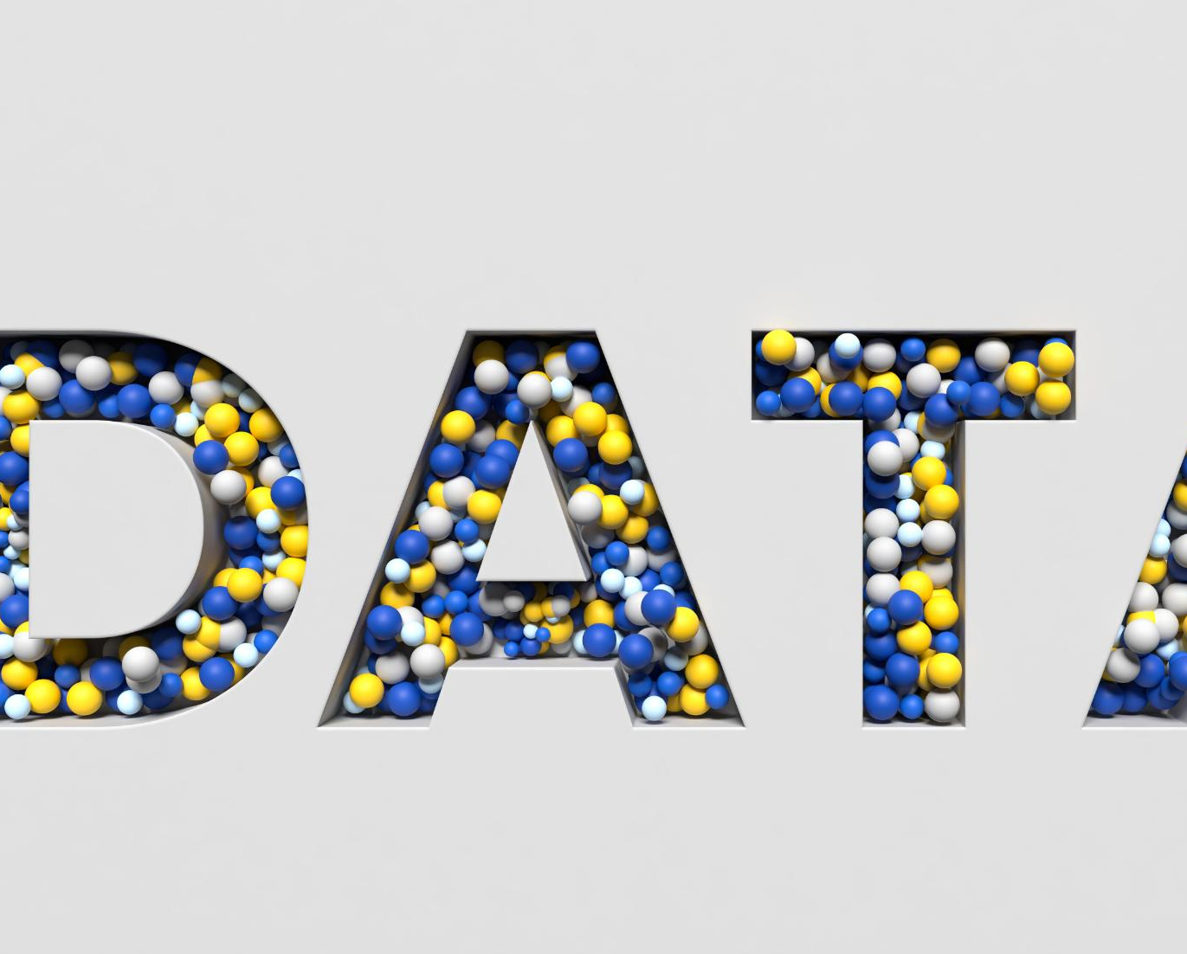
Causes and Contributing Factors
Model Complexity Issues
Excessive model complexity, like deep decision trees, causes overfitting by memorizing training data instead of generalizing.
Insufficient Training Data
Too few examples make it easy for models to memorize data patterns, increasing risk of overfitting.
Noisy or Irrelevant Features
Including many irrelevant features causes the model to fit noise, reducing its ability to generalize.
Lack of Regularization
Weak or absent regularization allows over-flexible models, increasing the chance of overfitting.
Notes:
Overfitting typically arises from excessive model complexity relative to the amount of available data. For example, a decision tree with unlimited depth can create highly specific rules that perfectly classify the training data but fail on new samples. Other causes include having too few training examples, which makes it easier for the model to memorize patterns rather than generalize. Including too many irrelevant or noisy features can also lead to overfitting because the model tries to account for every minor variation. Additionally, aggressive hyperparameter tuning without proper validation can push the model toward configurations that optimize training performance at the expense of generalization. In the penguins dataset scenario, if we allow a tree to split until every leaf represents a single penguin, the model will have zero training error but will likely misclassify new penguins. Overfitting can also occur when regularization is absent or too weak, allowing the model to become overly flexible. These factors highlight the importance of balancing complexity and simplicity. A useful analogy is drawing a boundary around data points: a simple boundary captures the overall trend, while a highly convoluted boundary fits every point perfectly but fails to predict new ones. Recognizing these causes helps learners understand why overfitting is a common challenge and why preventive strategies are essential.

Slide 6
Hyperparameter Tuning
Notes:
Strategies to Prevent Overfitting

Slide 7

Strategies to Prevent Overfitting
Hyperparameter Tuning Basics
Hyperparameters are set before training and control model complexity and learning aspects to improve generalization.
Search Strategies
Grid Search explores all hyperparameter combinations systematically, while Random Search samples combinations for efficiency.
Cross-Validation Importance
Cross-validation evaluates model on multiple data subsets, reducing overfitting risk to a single validation set.
Regularization Techniques
Methods like limiting tree depth and dropout reduce model complexity to prevent overfitting effectively.
Notes:
Hyperparameter tuning is the process of selecting the best configuration settings for a machine learning model to improve its performance and generalization. Unlike model parameters, which are learned during training, hyperparameters are set before training begins and control aspects such as model complexity, learning rate, and regularization strength. Effective tuning helps prevent overfitting by finding a balance between underfitting and overfitting. Common strategies include Grid Search, which systematically explores all combinations of specified hyperparameters, and Random Search, which samples combinations randomly for efficiency. Cross-validation is critical during tuning because it evaluates model performance on multiple subsets of data, reducing the risk of overfitting to a single validation set. Regularization techniques, such as limiting tree depth in decision trees or adding dropout in neural networks, also play a key role in controlling complexity. In the penguins dataset example, tuning the 'max_depth' parameter of a decision tree can prevent the model from becoming overly complex. If the depth is too large, the tree memorizes training data; if too shallow, it underfits. The goal is to find the 'sweet spot' where the model performs well on both training and unseen data. Automated tools like Bayesian optimization and AutoML can further streamline this process. By teaching these methods, learners understand that hyperparameter tuning is not about maximizing training accuracy but about achieving robust generalization.

