Slide 1
Introduction to Databases for Data Scientists (MySQL)
Fundamentals of database management for data analysis
Notes:
AI-generated content may be incorrect. ---

Slide 2
Introduction to Databases for Data Scientists
Notes:
Foundations for Data Management and Analysis

Slide 3

Foundations for Data Management and Analysis
Role of Databases in Data Science
Databases provide structured storage and efficient access to large data essential for data science tasks.
Importance of Database Knowledge
Understanding databases helps data scientists perform data cleaning, preprocessing, and feature engineering effectively.
MySQL and SQL Tools
MySQL is a popular open-source relational database with powerful SQL tools for managing and querying data.
Enhancing Analytical Workflows
Leveraging databases and SQL enhances workflows and analytical capabilities for data scientists.
Notes:
Databases are a fundamental component of data science, providing structured storage and efficient access to vast amounts of data. For data scientists, understanding how databases work is crucial for tasks such as data cleaning, preprocessing, and feature engineering. MySQL, a widely-used open-source relational database, offers robust tools for managing data through SQL (Structured Query Language). This presentation introduces the core concepts of databases, focusing on MySQL, and explores how data scientists can leverage these tools to enhance their workflows and analytical capabilities.

Slide 4
Importance of Databases in Data Science
Notes:
Why Databases Matter for Data Science

Slide 5

Why Databases Matter for Data Science
Efficient Data Storage and Retrieval
Databases enable efficient storage and retrieval of large datasets, essential for handling big data in data science.
Structured Querying and Aggregation
Structured querying supports complex operations like joins and filtering critical for meaningful data analysis.
Integration with Analytics and ML
Databases integrate seamlessly with analytics and machine learning workflows, powering scalable data pipelines.
Empowering Data Scientists
Understanding databases empowers data scientists to manage real-world data effectively and build scalable solutions.
Notes:
Databases play a critical role in data science by enabling efficient storage, retrieval, and manipulation of large datasets. They allow structured querying and aggregation, which are essential for data analysis. MySQL, as a relational database, supports complex operations such as joins and filtering, which help data scientists extract meaningful insights. Additionally, databases integrate seamlessly with analytics and machine learning workflows, providing a reliable backend for data pipelines. Understanding how to interact with databases empowers data scientists to handle real-world data more effectively and build scalable solutions.

Slide 6
Database Fundamentals
Notes:
What is a Database?

Slide 7
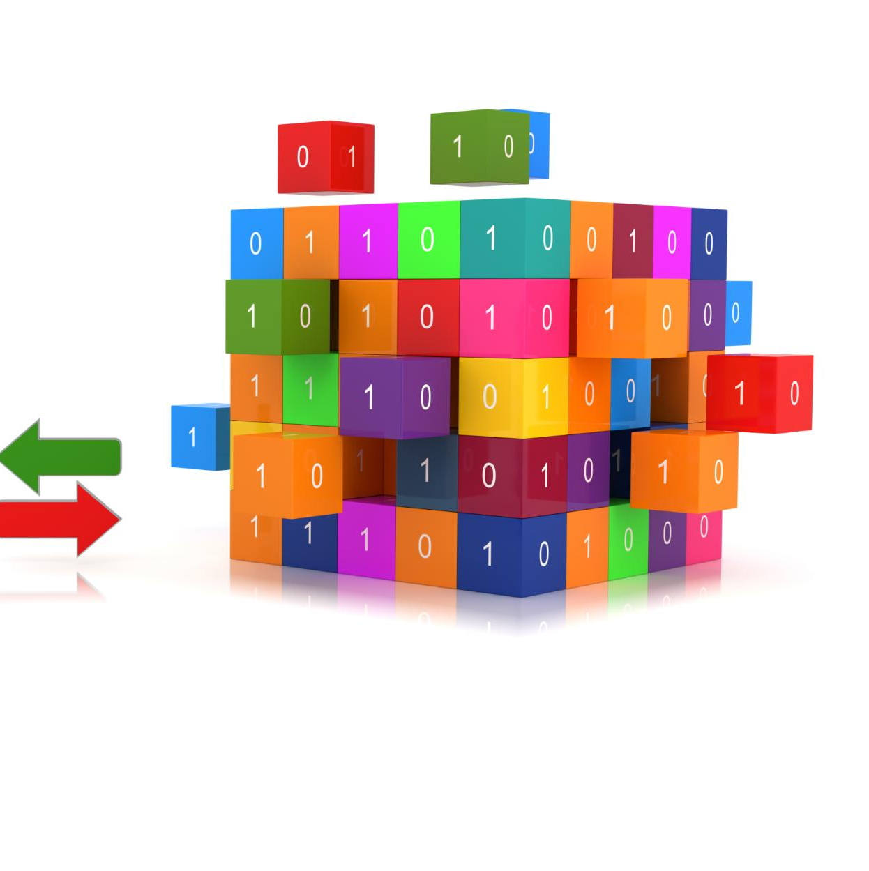
What is a Database?
Database Definition
A database is an organized collection of data enabling efficient storage, retrieval, and management.
Relational Databases
Relational databases store data in tables with rows and columns, supporting relationships between data entities.
Non-relational Databases
Non-relational databases are flexible, handling unstructured data suited for various modern applications. Eg: (MongoDB)
Importance for Data Science
Understanding databases is crucial for data scientists managing large and complex datasets.
Notes:
A database is an organized collection of data that allows for efficient storage, retrieval, and management. Databases can be categorized into relational and non-relational types. Relational databases, like MySQL, store data in tables with rows and columns, making it easy to maintain relationships between different data entities. Non-relational databases, such as NoSQL, are more flexible and suitable for unstructured data. MySQL is a popular open-source relational database that supports SQL for querying and managing data. Understanding the structure and functionality of databases is essential for data scientists working with large and complex datasets.

Slide 8
MySQL Overview
Notes:
MySQL Basics

Slide 9

MySQL Basics
MySQL Overview
MySQL is an open-source relational database system using SQL for data interaction and management. Other types include (PostgreSQL, MariaDB, Oracle, SQL Server)
SQL Command Categories
MySQL supports DDL for structure, DML for data operations, and DCL for access control commands.
Architecture and Integration
MySQL's scalable and reliable architecture integrates well with multiple programming languages for data analysis.
Notes:
MySQL is a powerful open-source relational database management system that uses SQL (Structured Query Language) for interacting with data. It supports three main categories of SQL commands: Data Definition Language (DDL), Data Manipulation Language (DML), and Data Control Language (DCL). DDL is used to define and modify database structures, DML handles data operations such as insertion and updates, and DCL manages access permissions. MySQL's architecture allows for scalability, reliability, and integration with various programming languages, making it a valuable tool for data scientists who need to manage and analyze structured data efficiently.

Slide 10
SQL Command Categories
Notes:
Data Definition Language (DDL)

Slide 11
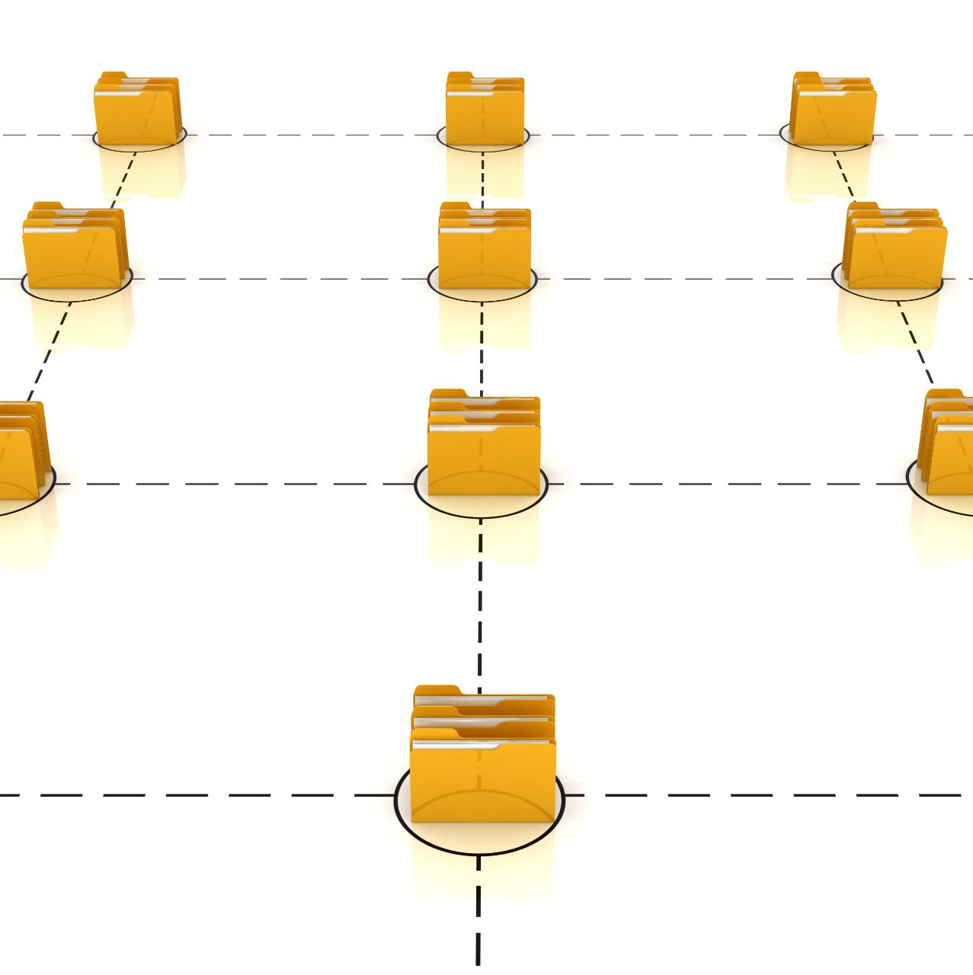
Data Definition Language (DDL)
Purpose of DDL
DDL defines and manages database structures such as tables, schemas, and indexes efficiently.
Common DDL Commands
Key DDL commands include CREATE, ALTER, and DROP for creating, modifying, and deleting database objects.
Importance for Data Scientists
Understanding DDL is vital for designing and maintaining effective databases in data science projects.
Notes:
Data Definition Language (DDL) is a subset of SQL used to define and manage the structure of database objects such as tables, schemas, and indexes. Common DDL commands include CREATE, ALTER, and DROP. For example, the CREATE TABLE command allows users to define a new table with specified columns and data types. ALTER is used to modify existing table structures, and DROP deletes database objects. These commands are essential for setting up the database schema and ensuring that the data is organized in a way that supports efficient querying and analysis. Understanding DDL is crucial for data scientists who need to design and maintain databases for their projects.

Slide 12
Manipulating Data
Notes:
Data Manipulation Language (DML)

Slide 13

Data Manipulation Language (DML)
INSERT Command
INSERT adds new records to database tables, enabling data growth and updates.
UPDATE Command
UPDATE modifies existing records to correct or change stored data effectively.
DELETE Command
DELETE removes outdated or irrelevant records, maintaining database accuracy and relevance.
DML in Data Science
DML commands help data scientists dynamically manage datasets for analysis and modeling.
Notes:
Data Manipulation Language (DML) is a category of SQL commands used to manage data within database tables. The primary DML commands are INSERT, UPDATE, and DELETE. INSERT adds new records to a table, UPDATE modifies existing records, and DELETE removes records. These operations are fundamental for maintaining and updating the data stored in a database. For example, a data scientist might use INSERT to add new observations, UPDATE to correct errors, and DELETE to remove outdated information. Mastery of DML enables data scientists to interact dynamically with their datasets and prepare data for analysis and modeling.

Slide 14
Controlling Access
Notes:
Data Control Language (DCL)

Slide 15

Data Control Language (DCL)
Purpose of DCL
DCL manages database access permissions and security ensuring controlled user privileges.
GRANT Command
GRANT assigns specific privileges like SELECT, INSERT, or UPDATE to users.
REVOKE Command
REVOKE removes previously granted privileges to restrict user access.
Role-Based Access
DCL supports role-based permissions to maintain data security based on responsibilities.
Notes:
Data Control Language (DCL) consists of SQL commands that manage access permissions and security within a database. The main DCL commands are GRANT and REVOKE. GRANT provides specific privileges to users, such as the ability to SELECT, INSERT, or UPDATE data. REVOKE removes these privileges. For example, a database administrator might grant a data scientist permission to read and write data in a specific table while restricting access to sensitive information. Understanding DCL is important for maintaining data security and ensuring that users have appropriate access levels based on their roles and responsibilities.

Slide 16
Integration with Python
Notes:
Connecting MySQL to Python

Slide 17

Connecting MySQL to Python
Integration Libraries
Libraries like mysql-connector and SQLAlchemy simplify Python and MySQL integration for efficient data handling.
Connection Setup
Establishing a connection to MySQL database from Python is essential for executing SQL queries and data retrieval.
Data Analysis Automation
Connecting MySQL to Python enables automation of data workflows and integration with machine learning pipelines.
Notes:
Data scientists often use Python to interact with MySQL databases for data extraction and analysis. Libraries such as mysql-connector and SQLAlchemy facilitate this integration. The process involves installing the connector, establishing a connection to the database, and executing SQL queries through Python scripts. This allows for seamless data retrieval and manipulation within Python environments like Jupyter Notebooks. By connecting MySQL to Python, data scientists can automate data workflows, perform complex analyses, and integrate database operations into machine learning pipelines, enhancing productivity and scalability.

Slide 18
Applications in Data Science
Notes:
Practical Use Cases for Data Scientists

Slide 19

Practical Use Cases for Data Scientists
Data Cleaning and Preprocessing
MySQL queries help identify and correct data inconsistencies during cleaning and preprocessing stages.
Feature Engineering with SQL
Aggregating and transforming relational data enables effective feature engineering for machine learning.
Handling Large Datasets
MySQL efficiently manages large datasets with filtering, joining, and grouping operations before modeling.
Building Data Pipelines
Leveraging MySQL ensures data integrity and streamlines analytical workflows into actionable insights.
Notes:
MySQL databases are widely used in data science for various practical applications. These include data cleaning and preprocessing, where structured queries help identify and correct inconsistencies. Feature engineering often involves aggregating and transforming data stored in relational tables. Additionally, MySQL supports efficient handling of large datasets, enabling data scientists to perform operations such as filtering, joining, and grouping before feeding data into machine learning models. By leveraging MySQL, data scientists can build robust data pipelines, ensure data integrity, and streamline the analytical process from raw data to actionable insights.

Slide 20
Conclusion and Next Steps
Notes:
Summary and Learning Path

Slide 21

Summary and Learning Path
MySQL Data Management
MySQL offers a powerful platform for managing structured data essential to data science workflows.
SQL Command Categories
DDL, DML, and DCL commands allow users to define structures, manipulate data, and control access.
Integration with Python
Connecting MySQL with Python enhances data analysis and expands analytical capabilities.
Advanced Learning Path
Explore joins, subqueries, indexing, and connect MySQL to BI tools for visualization and reporting.
Notes:
In summary, MySQL provides a powerful and flexible platform for data management, essential for data scientists working with structured data. Key SQL command categories—DDL, DML, and DCL—enable users to define database structures, manipulate data, and control access. Integrating MySQL with Python further enhances analytical capabilities. As a next step, data scientists are encouraged to explore advanced SQL topics such as joins, subqueries, and indexing, and to experiment with connecting MySQL to business intelligence tools for visualization and reporting. Mastery of these skills will significantly improve data handling and analytical efficiency.

