Slide 1

Steps to Develop a Machine Learning Classification Model
Essential phases involved in building accurate classification systems
Notes:
---

Slide 2
Introduction to ML Classification Model Development
Notes:
Define the Problem, Collect Data, Preprocess Data, Split Data, Choose Model, Train Model, Evaluate Model, Deploy Model

Slide 3

Define the Problem
Clarify Objective
Clearly identify the problem objective and what needs to be predicted or classified.
Identify Classification Type
Determine whether the problem is binary, multi-class, or multi-label classification.
Set Measurable Goals
Establish clear and measurable success criteria to guide model development.
Consider Constraints
Account for time, computational resources, and data availability in problem definition.
Notes:
The first step in developing a machine learning classification model is to clearly define the problem you aim to solve. This involves identifying the objective, understanding the business context, and specifying what needs to be predicted or classified. For example, you might want to classify emails as spam or not spam, or predict whether a customer will churn. Defining the problem also includes determining the type of classification—binary, multi-class, or multi-label—and setting measurable goals for success. A well-defined problem ensures that subsequent steps are aligned with the desired outcome and prevents wasted effort on irrelevant tasks. Additionally, it is important to consider constraints such as time, computational resources, and data availability during this stage. By articulating the problem clearly, you create a roadmap that guides data collection, model selection, and evaluation criteria throughout the project.

Slide 4
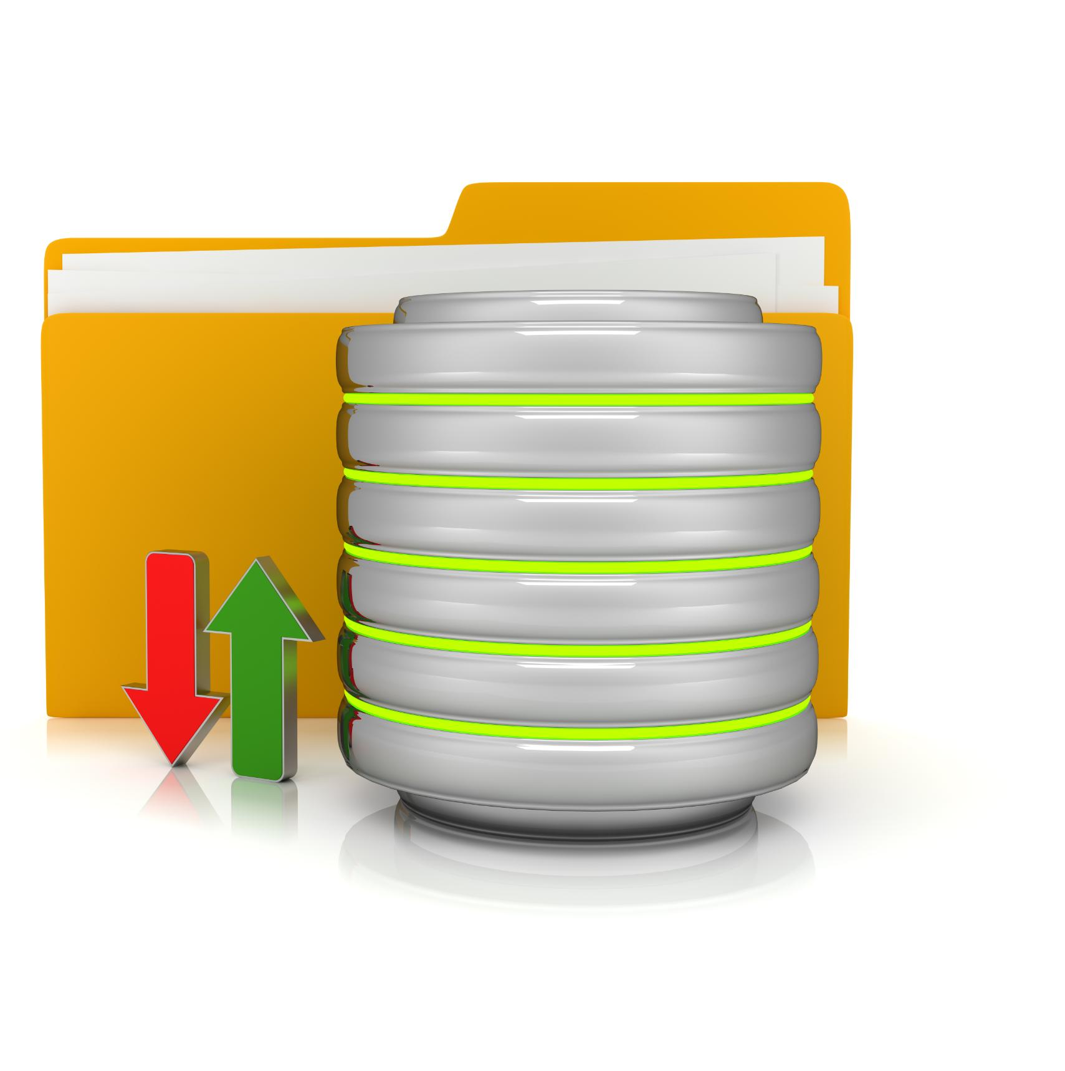
Collect Data
Data Sources and Relevance
Gather data from varied sources ensuring it represents the problem domain and key features for classification.
Data Quality and Bias Avoidance
Handle missing values, merge datasets, and ensure balanced class coverage to prevent bias.
Notes:
Data collection is the foundation of any machine learning project. The quality and quantity of data directly impact the performance of your classification model. Sources of data can include internal databases, public datasets, APIs, or data generated through sensors and user interactions. It is essential to gather data that is representative of the problem domain and includes all relevant features for classification. During this step, you should also consider ethical and legal aspects, such as data privacy and compliance with regulations like GDPR. Data collection may involve merging multiple datasets, handling missing values, and ensuring that the data covers all classes adequately to avoid bias. A robust data collection process sets the stage for accurate predictions and minimizes issues related to overfitting or underfitting later in the modeling process.

Slide 5

Preprocess Data
Data Cleaning Essentials
Remove duplicates, handle missing values, and fix inconsistencies to prepare data for analysis.
Feature Engineering
Create new variables during preprocessing to enhance model performance and insights.
Normalization and Encoding
Normalize data to a similar scale and encode categorical variables into numerical formats.
Outlier Handling
Detect and remove outliers to prevent skewed results and improve model accuracy.
Notes:
Preprocessing is a critical step that transforms raw data into a format suitable for modeling. This includes cleaning the data by removing duplicates, handling missing values, and correcting inconsistencies. Feature engineering is often performed during preprocessing to create new variables that enhance model performance. Normalization or standardization may be applied to ensure that features are on a similar scale, which is particularly important for algorithms sensitive to feature magnitude. Encoding categorical variables into numerical formats, such as one-hot encoding, is also common. Additionally, outlier detection and removal can prevent skewed results. Effective preprocessing improves model accuracy, reduces noise, and ensures that the algorithm can learn meaningful patterns from the data. Without proper preprocessing, even the most advanced algorithms may fail to deliver reliable results.

Slide 6
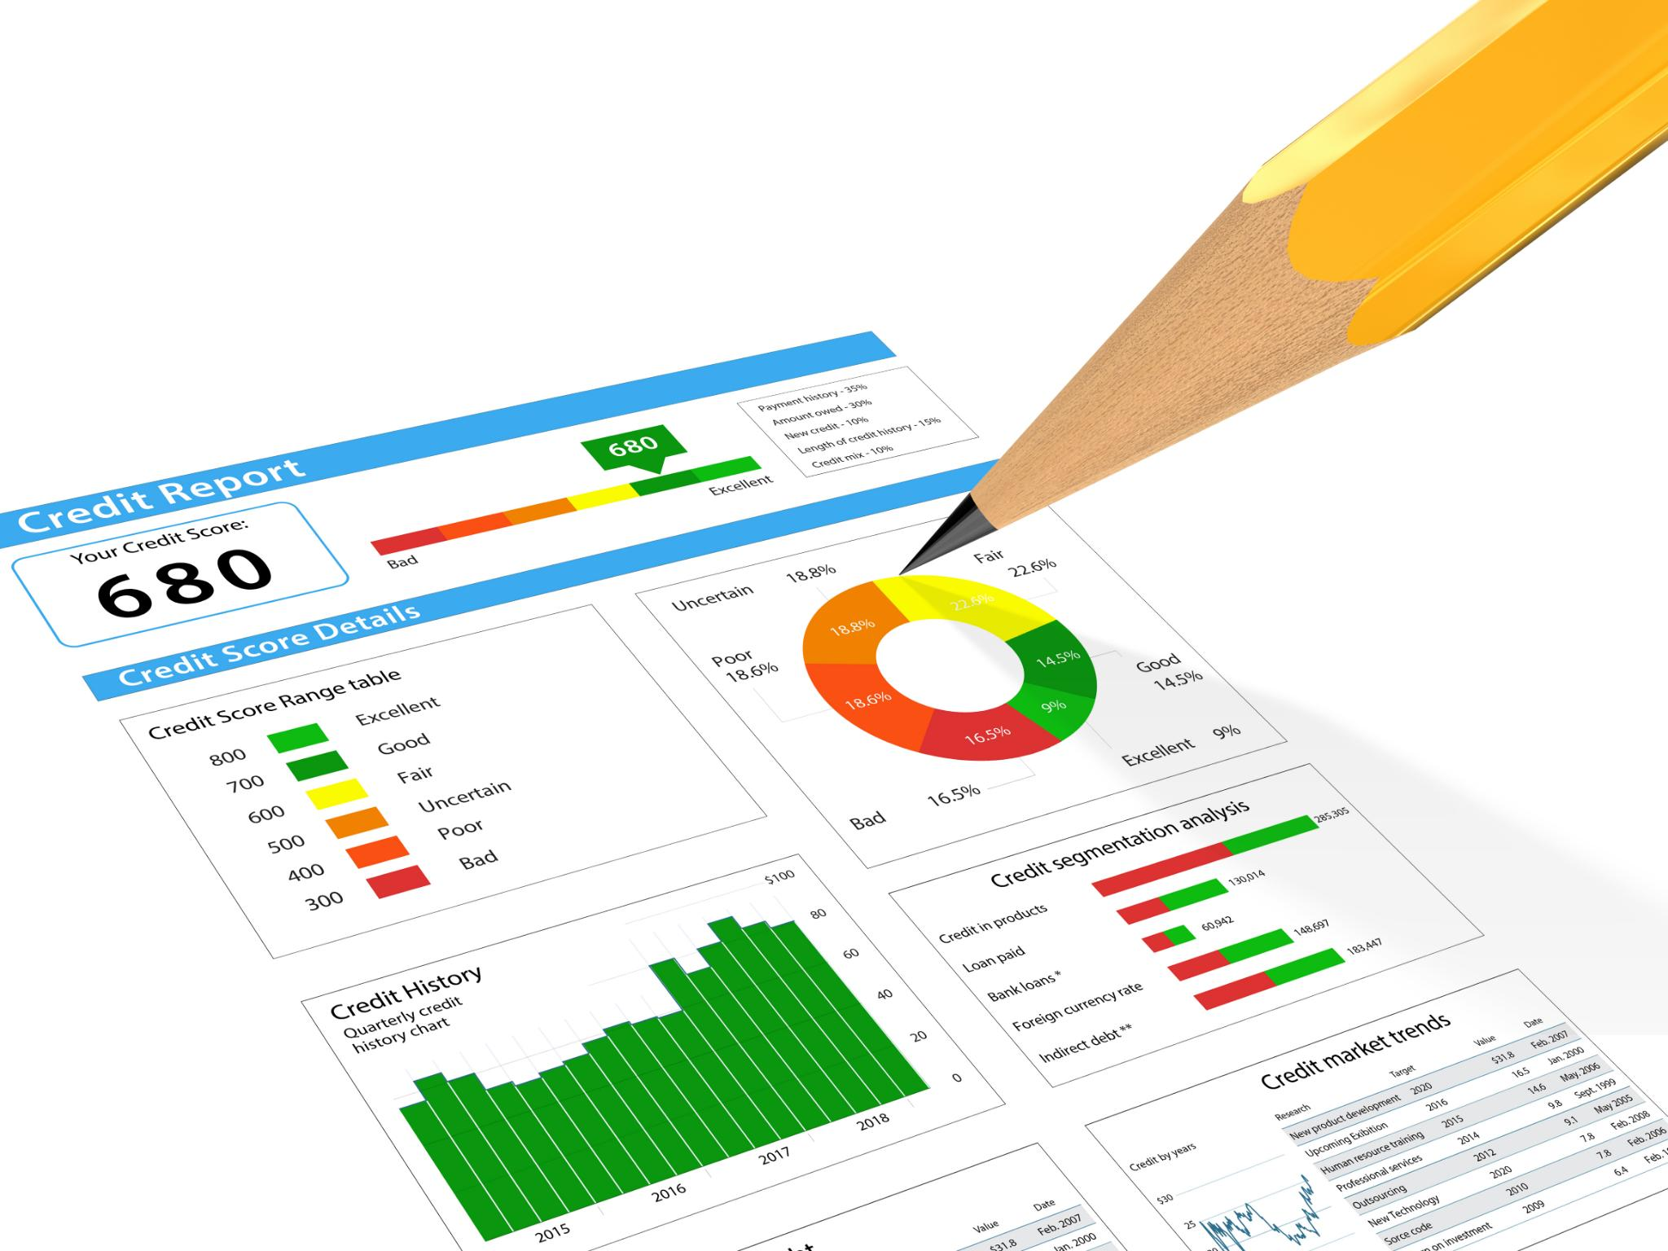
Split Data
Dataset Splitting Purpose
Splitting data into training, validation, and test sets ensures reliable model evaluation and tuning.
Common Split Ratios
A typical split is 80% training, and 20% testing, adjustable by dataset size.
Stratified Sampling
Stratified sampling preserves class distribution in splits, important for imbalanced datasets.
Preventing Overfitting
Proper data splitting helps prevent overfitting and supports generalization to new data.
Notes:
Splitting the dataset into training, validation, and test sets is essential for evaluating the performance of your classification model. Typically, the data is divided so that the training set is used to fit the model, the validation set helps tune hyperparameters, and the test set assesses final performance. A common split ratio is 70% for training, 15% for validation, and 15% for testing, though this can vary based on dataset size. Proper splitting ensures that the model generalizes well to unseen data and prevents overfitting. Techniques such as stratified sampling can be used to maintain class distribution across splits, which is crucial for imbalanced datasets. By reserving a portion of the data for unbiased evaluation, you gain confidence that the model will perform effectively in real-world scenarios.

Slide 7
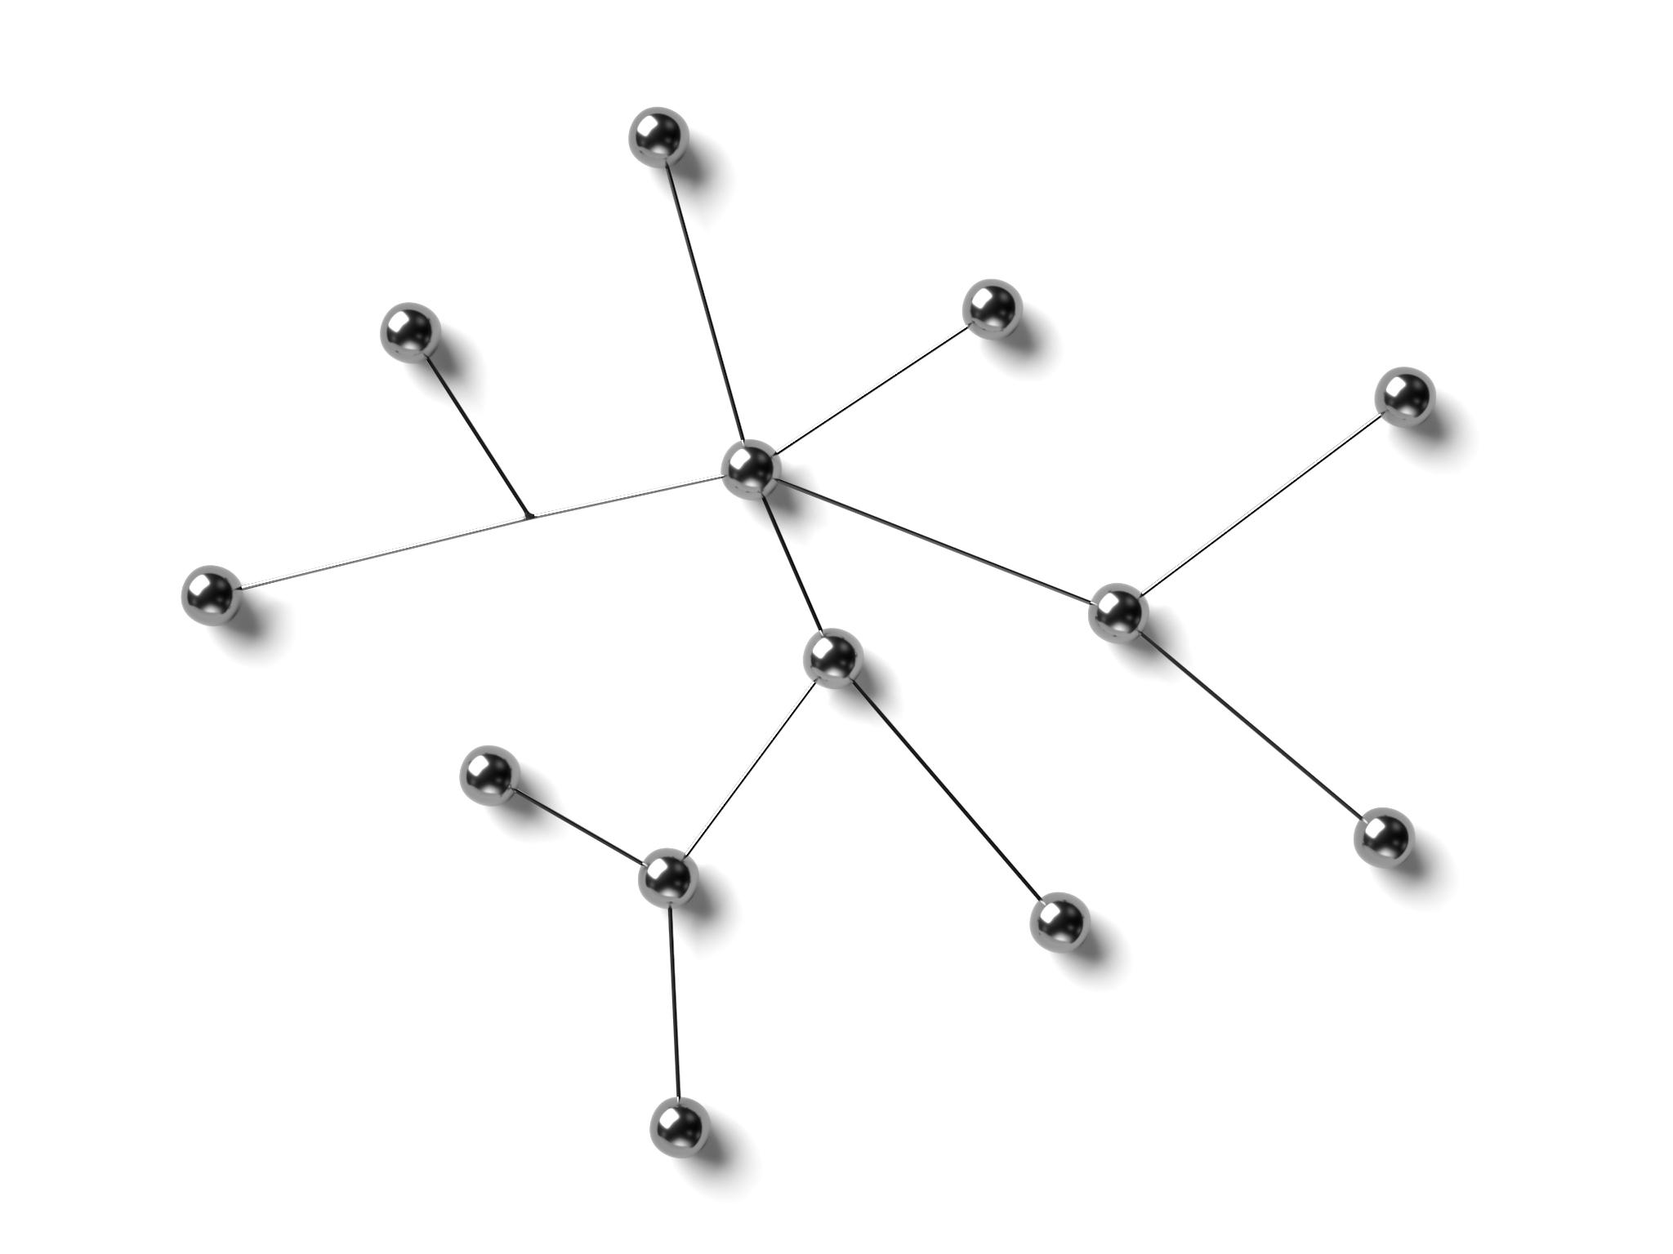
Choose Model
Common Classification Algorithms
Popular algorithms include Logistic Regression, Decision Trees, KNeighborsClassifier, Random Forests, Support Vector Machines, and Neural Networks.
Factors Influencing Choice
Algorithm choice depends on dataset size, feature types, interpretability, and computational resources available.
Model Complexity vs. Interpretability
Simple models like logistic regression are interpretable, while neural networks handle complex patterns but need more resources.
Performance Evaluation
Experimenting with multiple algorithms and validating performance helps find the best model for your problem.
Notes:
Selecting the right algorithm for your classification task is a key decision. Common algorithms include Logistic Regression, Decision Trees, K-Neighbors, Random Forests, Support Vector Machines, and Neural Networks. The choice depends on factors such as dataset size, feature types, interpretability requirements, and computational resources. For example, logistic regression is simple and interpretable, while neural networks can handle complex patterns but require more data and processing power. It is often beneficial to experiment with multiple algorithms and compare their performance using validation data. Additionally, consider whether the model needs to handle imbalanced classes, high-dimensional data, or non-linear relationships. Choosing an appropriate model ensures that you strike the right balance between accuracy, complexity, and scalability for your specific problem.

Slide 8

Train Model
Model Learning and Parameter Adjustment
The model learns to distinguish classes by adjusting parameters to minimize error using training data.
Hyperparameter Tuning
Adjusting hyperparameters like learning rate and tree depth significantly impacts the model's performance.
Cross-Validation and Overfitting Prevention
Cross-validation ensures model robustness and early stopping prevents overfitting during training.
Notes:
Training the model involves feeding the algorithm with the training data and allowing it to learn patterns that distinguish different classes. During this process, the model adjusts its parameters to minimize error based on a chosen loss function. Hyperparameter tuning, such as adjusting learning rates or tree depths, can significantly impact performance. Techniques like cross-validation help ensure that the model is robust and not overfitted to the training data. It is also important to monitor training metrics and use early stopping if necessary to prevent overfitting. Training can be computationally intensive, especially for large datasets or complex models, so efficient resource management and optimization strategies are crucial. A well-trained model forms the backbone of accurate predictions and reliable classification outcomes.

Slide 9

Evaluate Model
Classification Metrics
Key classification metrics include accuracy, precision, recall, F1-score, and AUC to assess model performance comprehensively.
Confusion Matrix Visualization
Confusion matrices visualize classification results and help identify false positives and false negatives in model predictions.
Test Set Evaluation
Evaluating models on a separate test set ensures unbiased performance estimates on unseen data.
Handling Imbalanced Data
Metrics like precision-recall curves and weighted accuracy provide better insights for imbalanced dataset evaluations.
Notes:
Evaluation determines how well the model performs on unseen data. Common metrics for classification include accuracy, precision, recall, F1-score, and area under the ROC curve (AUC). These metrics provide insights into different aspects of performance, such as how well the model handles false positives and false negatives. Confusion matrices are useful for visualizing classification results across classes. It is important to evaluate the model on the test set, which was not used during training or validation, to obtain an unbiased estimate of performance. For imbalanced datasets, metrics like precision-recall curves or weighted accuracy may be more informative than overall accuracy. Thorough evaluation ensures that the model meets the defined objectives and is ready for deployment in real-world applications.

Slide 10

Deploy Model
Integration into Production
Deploying the trained model involves integrating it into a real-time or batch production environment to make predictions on new data.
Infrastructure and Security
Setting up scalable infrastructure, containerizing models with tools like Docker, and implementing security are key deployment steps.
Monitoring and Maintenance
Continuous monitoring detects model drift and performance degradation, enabling retraining or automated updates to maintain accuracy.
Notes:
Deployment is the final step where the trained model is integrated into a production environment to make predictions on new data. This involves setting up infrastructure for real-time or batch predictions, ensuring scalability, and monitoring performance over time. Deployment may require creating APIs, containerizing the model using tools like Docker, and implementing security measures to protect data and model integrity. Continuous monitoring is essential to detect performance degradation due to changing data distributions, a phenomenon known as model drift. Retraining the model periodically or implementing automated pipelines can help maintain accuracy. Successful deployment transforms the model from a theoretical solution into a practical tool that delivers value to users and stakeholders.

