Slide 1

MatLab-like Python
Introduction to Python Class – October 14th, 2014

Slide 2
MatPlotLib vs. NumPy & SciPy
Plotting functionality is beyond the scope of NumPy and SciPy, which focus on numerical objects and algorithms:
Several packages exist that integrate closely with NumPy to produce high quality 2D plots, such as the immensely popular Matplotlib
Like 2D plotting, 3D graphics is beyond the scope of NumPy and SciPy, but just as in the 2D case, packages exist that integrate with NumPy. Matplotlib provides basic 3D plotting in the mplot3d subpackage
(http://www.scipy.org/scipylib/faq.html)

Slide 3
NumPy vs. SciPy
NumPy is a Python extension module that provides efficient operation on arrays of homogeneous data:
It allows python to serve as a high-level language for manipulating numerical data, much like IDL, MATLAB, or Yorick
SciPy is a set of open source (BSD licensed) scientific and numerical tools for Python:
It currently supports special functions, integration, ordinary differential equation (ODE) solvers, gradient optimization, parallel programming tools, an expression-to-C++ compiler for fast execution, and others
Difference: In an ideal world, NumPy would contain nothing but the array data type and the most basic operations: indexing, sorting, reshaping, basic elementwise functions, et cetera. All numerical code would reside in SciPy.
However, one of NumPy’s important goals is compatibility, so NumPy tries to retain all features supported by either of its predecessors. Thus NumPy contains some linear algebra functions, even though these more properly belong in SciPy
(http://www.scipy.org/scipylib/faq.html)

Slide 4
PyLab
PyLab is part of matplotlib (in matplotlib.pylab) and tries to give you a MatLab like environment. matplotlib has a number of dependencies, among them NumPy which it imports under the common alias np.
If you run ipython --pylab an automatic import will put all symbols from matplotlib.pylab into global scope. NumPy gets imported under the np alias. Symbols from Matplotlib are available under the mpl alias.
(http://stackoverflow.com/questions/12987624/confusion-between-numpy-scipy-matplotlib-and-pylab)

Slide 5
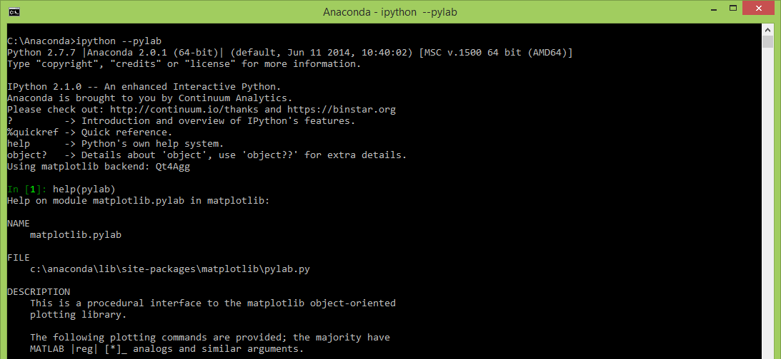
Launching iPython With PyLab

Slide 6
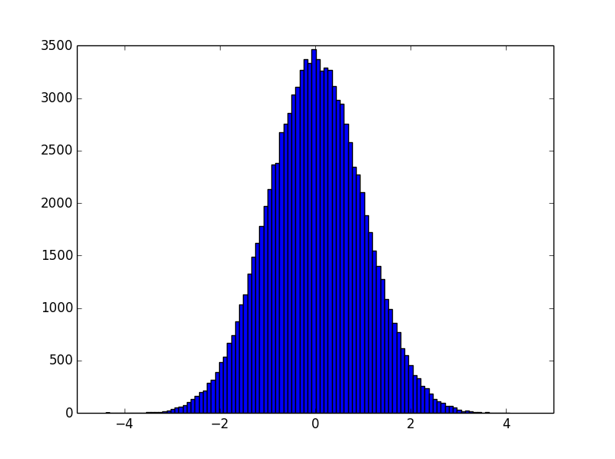
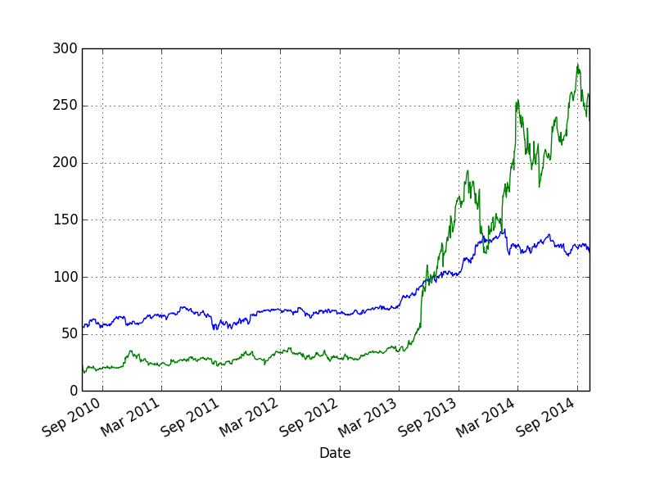
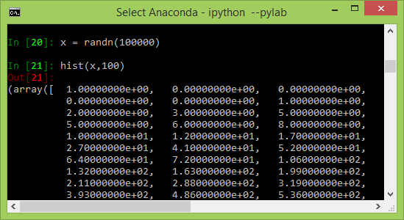
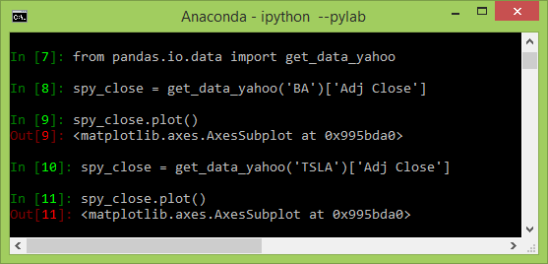
Simple Examples*
(Requires Pandas package)
(*) Examples from “python for data analysis”, Wes McKinney, 2012

Slide 7
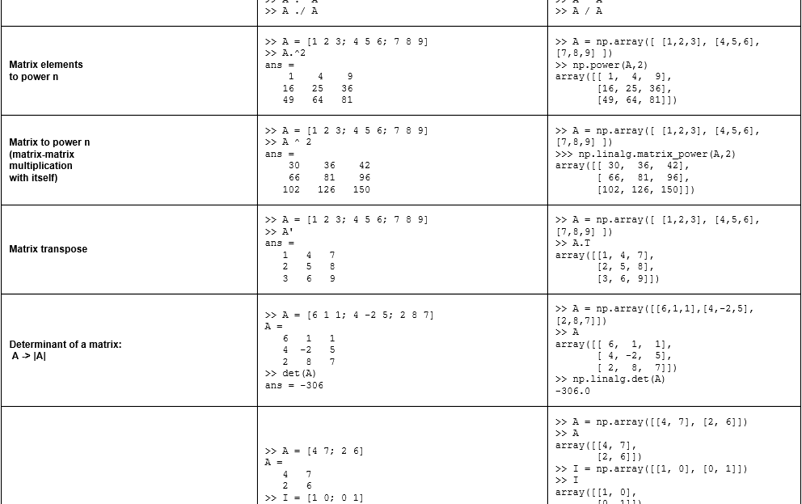
From MatLab To NumPy (1/2)
MatLab
Python
Matrix operations in MatLab can be replicated in Python using the NumPy package
(http://sebastianraschka.com/Articles/2014_matlab_vs_numpy.html)

Slide 8
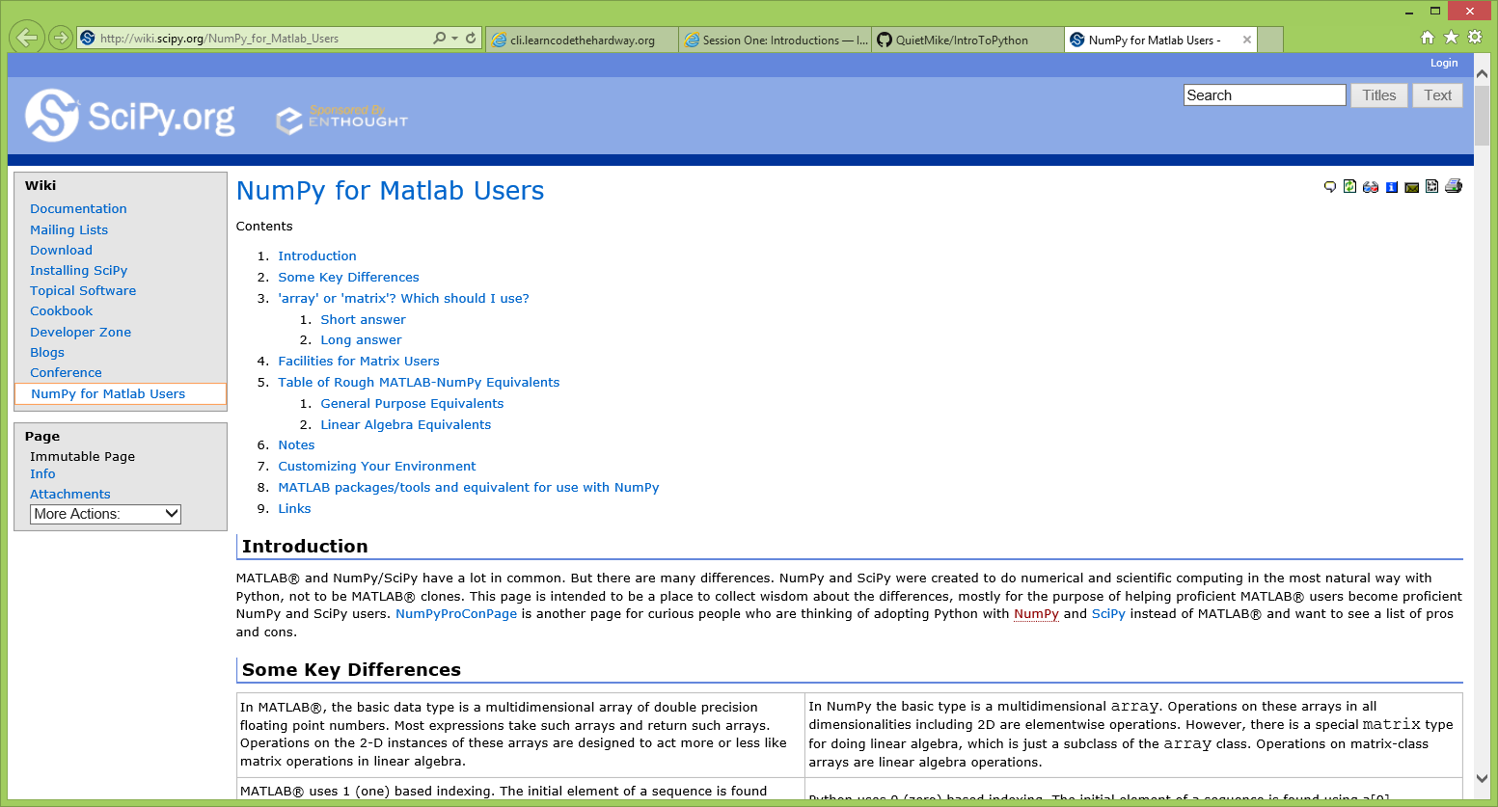
From MatLab To NumPy (2/2)
SciPy site has a web page dedicated to NumPy for MatLab users
(http://wiki.scipy.org/NumPy_for_Matlab_Users)
Notes:
http://wiki.scipy.org/NumPy_for_Matlab_Users

