Slide 1

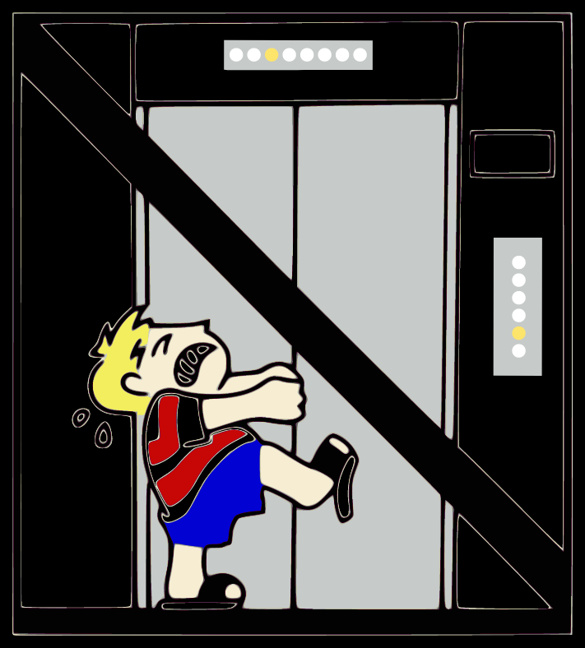







To loading dock
Elevators
Sink
PPE
TSQ
Toolbox
Eye Wash
HPLC
LTQ
HPLC
Shower
First aid and Spill kit
under sink
Packing station
Shared space
LTQ-FT
Fire
Extinguisher
Speed
vac
-20 ºC
PC
PC
B59
PC
Laser puller
HPLC
QE
Glass ware
Exploris 480
Lumos
HPLC
HPLC
HPLC
UWPR
Bruce Lab
Flammable
storage
PC
HPLC
Fusion
HPLC
PC
HPLC
HPLC
LTQ-FT
LN2
100L
HPLC
Shelf
Exploris 480
HPLC
HPLC
QE
TSQ
LN2
100L
Toolbox
Utility
UWPR Office
Electrical
LTQ
LTQ
HPLC
N

