Slide 1

Simulation Parameters in GROMACS
Xin Qi
MolSim115
2-5-2020

Slide 2
What completes an all-atom simulation?
Initial configuration:
atom type, charge, connection, position, and simulation cell
Rules for atoms to move:
Integrator: connecting time, position and sometimes velocity
Force fields: determining force among atoms, thus potential and kinetic energies
Neutral atom interactions (i.e. LJ) and electrostatic interactions
Rules to search neighbors:
Where to truncate the list of atoms within the “interactive range” and how often to update it
Periodic Boundary Condition (PBC)
Rules to conserve ”state(s)”:
Energy (microcanonical - NVE)
Thermostats for temperature (canonical - NVT) and/or barostats for pressure (Gibbs- NPT)
Other more coarse-grained approaches: Brownian dynamics, Langevin dynamics etc.
Additional advanced techniques:
accelerating simulations, biased sampling, long-range interactions and other dynamics
This class

Slide 3
Why we need thermostat and/or barostats?
Left to its own devices, molecular dynamics conserves energy (NVE)
Often, if not always, we would like to simulate a system according to a reference ”real” condition with particular T and/or P
Due to simulation feasibility, pressure adjustment is less concerned than T in some cases.
T
Find it out in your HW!
t
Heat bath at T_{ref}
T
t

Slide 4
Available thermostats in GROMACS
In your run.mdp file, you specify the thermostat under tcoupl option
berensen
nose-hoover
andersen
andersen-massive
v-rescale
tcoupl = nose-hoover

Slide 5
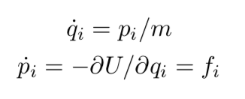
andersen and v-rescale
andersen
A fictitious thermo bath randomly selects a portion of atoms and supplies impulse forces to boost up velocities according to a Maxwell-Boltzmann distribution
Because the velocities are reset randomly:
If resetting (large tau-t) is done too slowly, we are unlikely to sample a “canonical distribution”
If resetting is done too frequently (small tau-t), the system is performing actual “random walk” such that it is not going anywhere
v-rescale
An upscaled version of the original “velocity rescale” to target a canonical kinetic energy distribution, instead of an exact mean kinetic energy
Therefore meaningful fluctuation
Between rescalings, system is evolved using the Hamiltonian’s equations
POOR EFFICIENCY

Slide 6
berensen and nose-hoover
berensen
Most commonly used to quickly equilibrate the system
This thermostat corrects an instantaneous kinetic energy to a specific target value. Therefore, while being very efficient, it does NOT product fluctuations.
Its measurements on average properties are still correct.
nose-hoover
The derivation of the thermostat is beyond the scope of this class
People usually say this is the most “physical” thermostat, majorly because it gives most meaningful fluctuations
Can only be used with integrator = md-vv (Verlet integration in GROMACS)
NOT recommended to relax the system (i.e. equilibrating).

Slide 7
Use thermostats in GROMACS
Apply v-rescale for the entire system
tau-t is the characteristic time for exponential decay. Note the difference between tau-t and nsttcouple.
integrator = md ; leap-frog
tcoupl = v-rescale
tc_grps = system
tau_t = 0.1 ; temperature damping parameter, ps
ref_t = 298.0
Apply v-rescale separately
Apply nose-hoover for the entire system
integrator = md
tcoupl = v-rescale
tc_grps = water protein
tau_t = 0.1 1.0
ref_t = 298.0 310.0
integrator = md-vv ; velocity Verlet
tcoupl = nose-hoover
tc_grps = system
tau_t = 0.1 ; if dt = 0.001
ref_t = 298.0
***Need to specify the ”groups” water and protein in system.ndx file and include “-n system.ndx” in mdrun
***Nose-hoover will not work well with any arbitrary tau-t. The rule of thumb is 100 timesteps.

Slide 8
Available barostats in GROMACS
In your run.mdp file, you specify the thermostat under pcoupl option
Berensen
Parrinello-Rahman
MTTK
pcoupl = Berendsen
When you don’t want to use pressure coupling
pcoupl = no
You will always need thermostat; barostat does not do anything to the T in NPT

Slide 9
Which one to use
***Finite size effect on pressure coupling
Because your system is small, even you set your reference pressure to 1.0 bar, you will see pressure fluctuation +/- 1000 bar.
This does not mean your pressure coupling is not working as expected. An NPT simulation would be fine as long as the box size fluctuation is small.
Equilibration
Production
berendsen
Always use berensen to relax your system to the right box size, otherwise you can wait for months.
Even berensen may not be efficient enough when your initial configuration is too dilute. Thus, a more realistic initial configuration is more important than a good choice of thermostat or coupling time.
Parrinello-Rahman or MTTK
Like nose-hoover thermostat, a reasonable choice of damping parameter tau-p is needed.

Slide 10
Use barostats in GROMACS
Apply berendsen in an isotropic liquid system
pcoupl = Berendsen
pcoupltype = isotropic
tau_p = 2
compressibility = 4.5e-05
ref_p = 1
Apply MTTK to a solid-liquid interface and only compress the z-axis
integrator = md-vv
pcoupl = MTTK
pcoupltype = anisotropic
tau-p = 1.0 ; if dt = 0.1
ref-p = 1.0 1.0 1.0 0.0 0.0 0.0
compressibility = 0.0 0.0 4.5e-5 0.0 0.0 0.0
***MTTK will not work well with any arbitrary tau-p. The rule of thumb is 1000 timesteps.

Slide 11
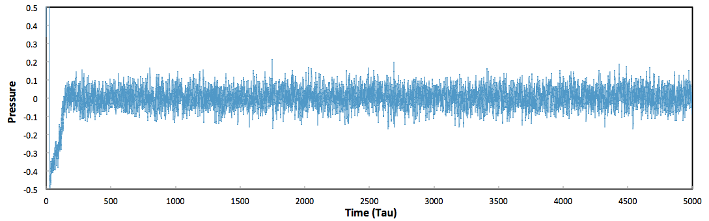
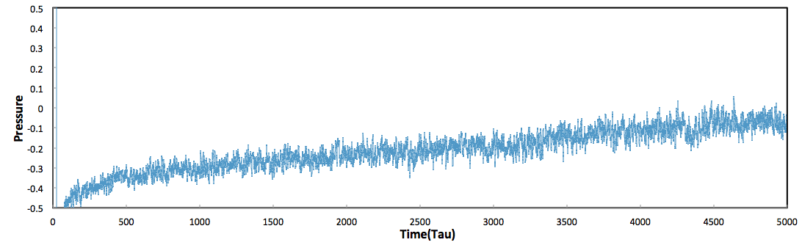
What does tau mean
tau-p = 0.1
tau-p= 1.0

Slide 12
Neighbor searching rules
step = 0
step = 5
Verlet scheme
A method to save computation power
For a Verlet list, we choose a length rl slightly larger than the cutoff distance rc (e.g., rl = 2.7σ with rc = 2.5σ for a Lennard-Jones potential), and for each particle make a list of all other particles closer than rl.
GROMACS will only need to pick atoms within the cutoff range from the list, instead of all the other atoms.
If the list is updated in very 10 steps, we do not need to update the Verlet list until 10 steps have been reached; otherwise, the computer will need to find atoms within the cut off in every single step.
This is probably the part most computational resources are spent.
Let’s do an exercise
2.7σ
2.5σ
step = 10
step = 15

Slide 13
Neighbor searching rules
step = 0
step = 5
cutoff-scheme = Verlet
rlist = 1.30 ; list distance
nstlist = 10 ; update list every 10 steps
ns_type = grid ; efficiently check atoms the list
pbc = xyz ; simulation box is 3D periodic
periodic_molecules = no
2.7σ
2.5σ
step = 10
step = 15

Slide 14
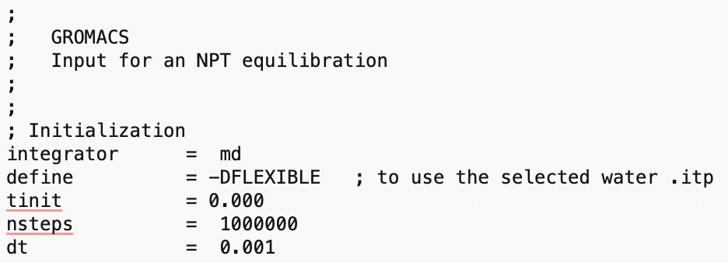
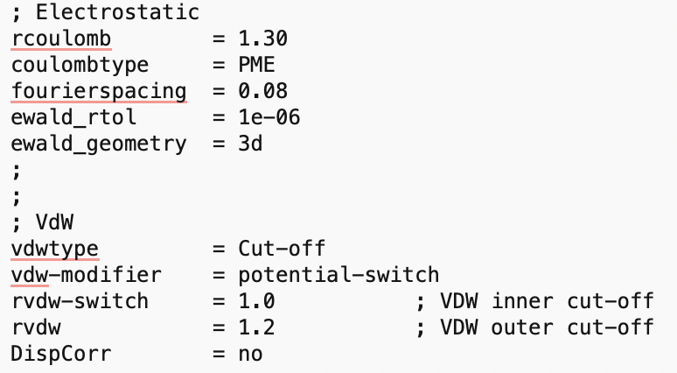
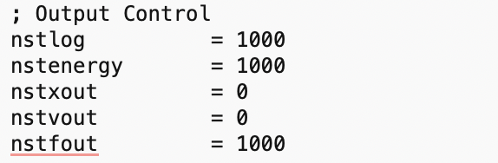
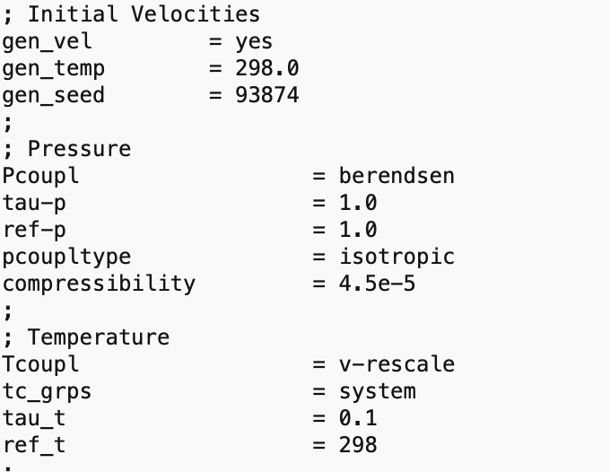
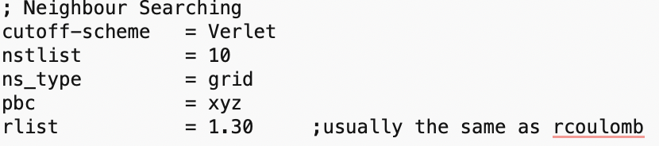
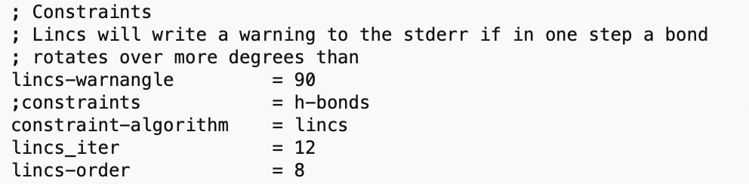
An example .mdp file

