Slide 1
Classical MD – A Quick Start Guide
Janani Sampath
2/15/19

Slide 2
Molecular Dynamics – Recap
Put particles in a box and specify interactions (energies) between them
Calculate the force on particles
F = -dE/dx
Most time consuming step, N² loop where N is the # of particles
As particles are classical, they obey Newton’s EOM: a = F/m
Integration is done using an efficient algorithm, velocity-Verlet is most popular
Move atoms: v(t+dt) = v(t) + a dt
and update atom positions
Does the system meet certain conditions?
Has the system run for an adequate amount of time (converged) or reached a certain temp/pressure…
Calculate properties of interest by averaging over trajectories
Notes:
Hence more particles, better statistics

Slide 3
What Goes into a Simulation
Initial Information:
Where the particles are at the start of a simulation
Chemical “type” of each particle
Pairwise Interaction (aka ‘Forcefields’):
Bonds, angles, dihedrals – Bonded parameters
Short and long ranged potentials between different atoms – Non-bonded parameters
Box size, Boundary Conditions, Ensemble, Timestep, DETAILS! (only focus on the crucial ones)

Slide 4
Molecular Dynamics Engine (not an exhaustive list)
GROMACS (GROningen MAchine for Chemical Simulations)
LAMMPS (Large-scale Atomic/Molecular Massively Parallel Simulator)
CP2K (Car-Parinello 2000??)
AMBER
CHARMM
More popular as classical force fields for proteins than as MD engines
Notes:
How are these things parameterized?

Slide 5
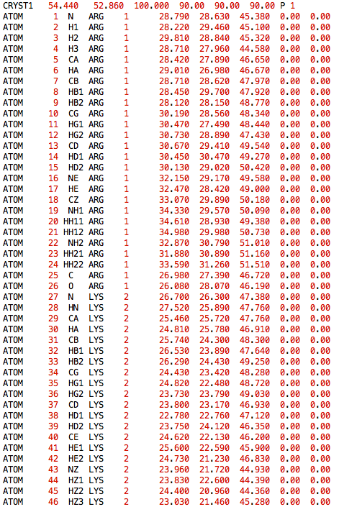
Input Script - GROMACS
Specified as .pdb or as .gro
Valid for any input script, for any system
Box dimensions
Atom index
Atom type
Molecule type
Molecule index
Pay attention to units! (.pdb is in Angstrom, whereas default gromacs units is nm)
x, y, z
Notes:
Taken care of the where and the

Slide 6

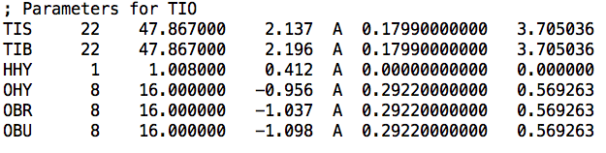
Forcefield Parameters – Where are They?
There are many classical forcefields out there for biological molecules
There are 10 or so in-built forcefields in GROMACS (AMBER, GROMOS, CHARMM)
However, if you wish to modify forcefield parameters or if you need to use a very specific one, you’d have download the forcefield (freely available)
Charmm36→ ffnonbonded.itp , ffbonded.itp
Type_i Type_j b0 Kb
Type At.# Mass Charge Sigma Epsilon
Notes:
These are parameterized from first principle calculation, QM

Slide 7
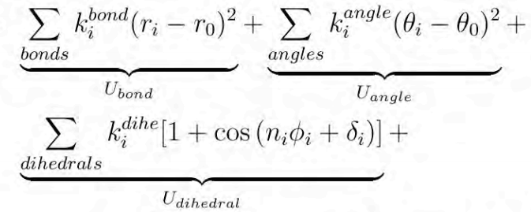
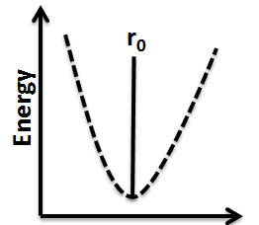
Forcefield Parameters: Bonded Interactions
E_{total} = E_{bonded} + E_{nonbonded}
E_{bonded} =
r₀/θ₀
Distance, r
Angle, θ
Tosrsion, ϕ
Notes:
Little bit of wiggle room

Slide 8
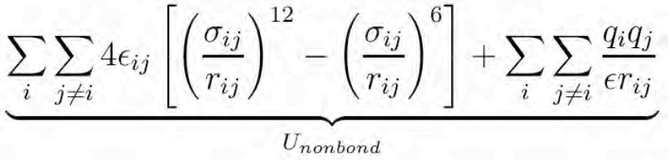
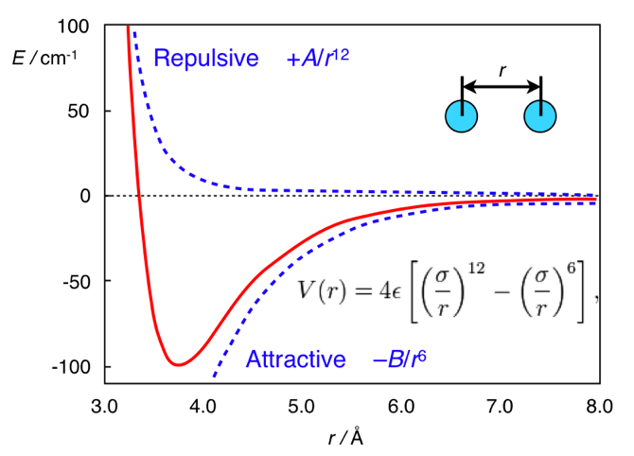
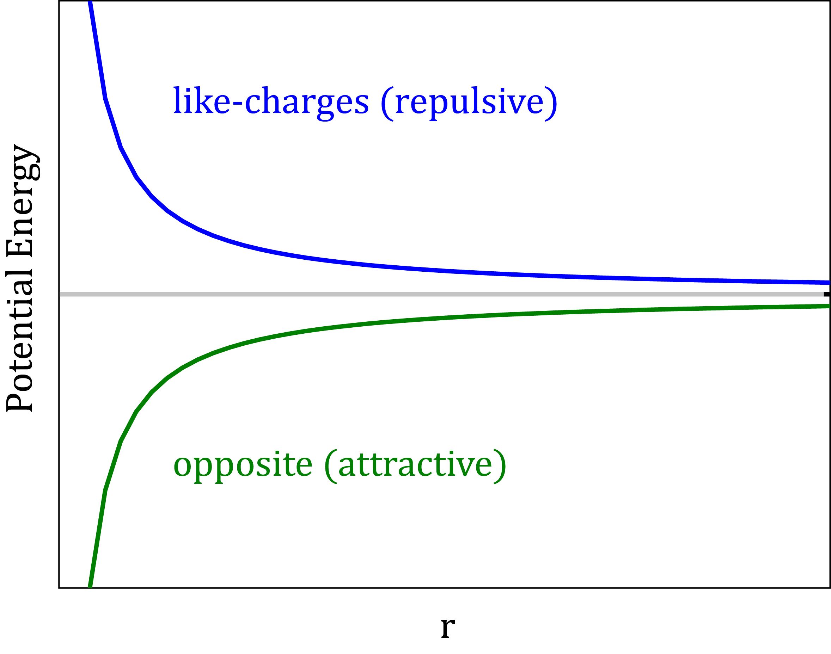
Forcefield Parameters: Non-bonded Interactions
E_{total} = E_{bonded} + E_{nonbonded}
E_{non-bonded} =

Slide 9
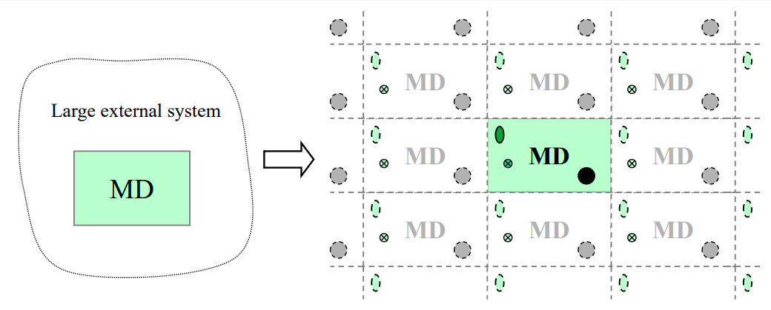
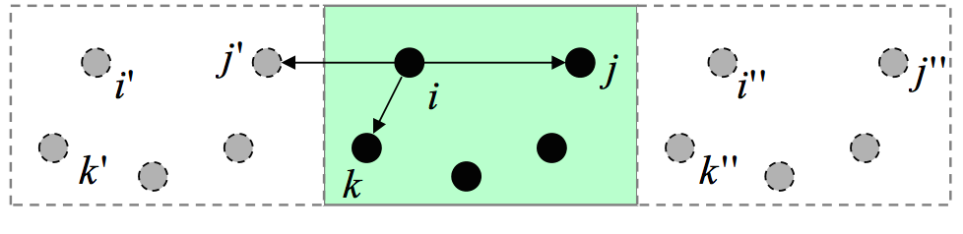
Periodic Boundary Conditions
Used to simulate a small part of a large system
Each particle interacts with with other particles in the box and their images in the adjacent boxes
Characteristic size of structural features in the system
‘Minimum Image Convention’ – closest image may not belong to the computational cell
Notes:
Things behave very differently at interfaces → the idea behind PBC very simply is to trick the system into thinking that it’s part of the bulk, that there are no walls (but we’re still only following the trajectories of a few with particles, it’s just that now they are in ‘bulk’)
We are not interested in simulating a droplet, in most cases

Slide 10
Number of Particles
Initial coordinates – Check
Atom and Molecule Type – Check
Forcefield – Check
Newtonian Physics and Basic Calculus – Double check
BUT
Real, macroscopic systems contain at least 10²³ particles (# of atoms present in 1 Mole of a substance)
It’s impossible to specify the initial conditions, and track the changes of a system this large
Typical classical MD systems only contain 10⁴ particles!
What are we even simulating?!?
Notes:
How can the statistics at the microscopic level, correspond to a macroscopic quantity

Slide 11
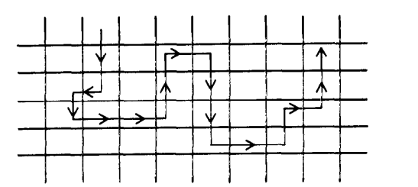
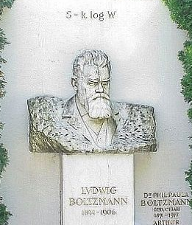
Statistical Mechanics (#42 of physics)
Basis of everything that we do – framework that relates microscopic fluctuations (i.e. simulations) and observable macroscopic properties!!!
Phase space – all possible states of a system subject to certain constraints
In MD, these constraints could be N,V,E,T or P
In MD, we are calculating the number of times a systems visits a certain state (probability)
Trajectory in phase space with each box representing a different state
An ensemble is the assembly of all possible microstates – i.e. all states consistent with the constraints with which we characterize the system macroscopically
Keeping track of the time evolution of each particle through phase space is impossible
A system is ergodic if time average = ensemble average

Slide 12
Microcanonical Ensemble (NVE) – Isolated system
If all forces are related to the potential energy of the system, then the total energy (E = E_{kin}+E_{pot}) is conserved. If N and V are also constant, then the simulation is said to be performed in NVE ensemble.
This is not recommended because temperature cannot be controlled
But if during the data collection step, you want to eliminate perturbations brought about by maintaining constant temperature or pressure, then this ensemble can be useful
Entropy
TdS = dU + PdV leads to averages expressed as derivatives of lnΩ, where Ω is the number of distinct states accessible to the system

Slide 13
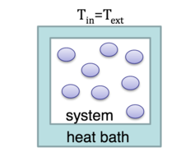
Canonical Ensemble (NVT)- Contact with heat bath
Assembly of all microstates with fixed N and V. The energy can fluctuate, and the system is kept in equilibrium by being in contact with a heat bath
There are many ways by which temperature can be controlled in a simulation. They are all referred to as thermostats, not unlike a real experiment
Helmholtz’s free energy
dF = -SdT - PdV leads to averages expressed as derivatives of lnQ, where Q is the canonical partition function

Slide 14
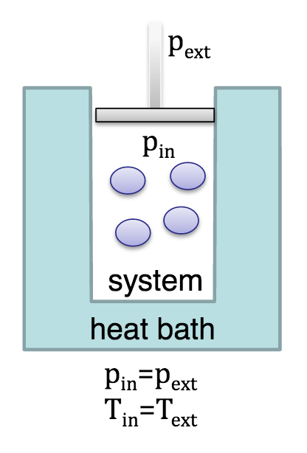
Ensemble 3: Isothermal-Isobasric Ensemble (NPT)
Most real experiments are carried out under controlled pressure and temperature conditions, hence this is a popular choice to mimic real experiments
System is free to completely transform to the lowest Gibbs free energy state and is not restricted by finite size effects
Gibbs free energy
dG = -SdT + VdP leads to averages expressed as derivatives of lnΔ, where Δ is the isothermal-isobaric partition function

Slide 15
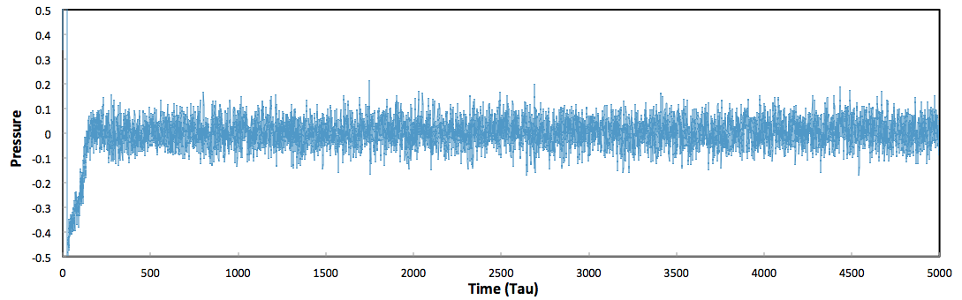
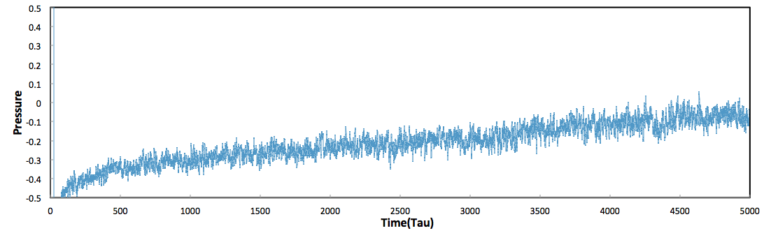
Nose – Hoover Thermostat & Barostat
Heat bath is represented by some fictitious degrees of freedom s, and this fictitious heat bath is connected to the real system. Together, they form the extended system which is microcanonical.
There is some heat exchange between the real system and heat bath, which is controlled by Q, a fictitious mass.
Small Q produces high frequency oscillations and frequent collisions with the heat bath. Large Q takes a very long time to bring the system to desired temperature
Damping Constant = 10.0
Damping Constant = 1000.0

Slide 16
Demo!
Why didn’t a timestep of 0.02 work?

Slide 17
Finally ….
All models are wrong, but some are useful!

Slide 18
Books to Read
Computer Simulation of Liquids – Allen & Tildesley
Introduction to Modern Stat Mech – David Chandler
Understanding Molecular Simulations – Frenkel & Smit
Statistical Mechanics for Engineers – Isamu Kusaka

Slide 19
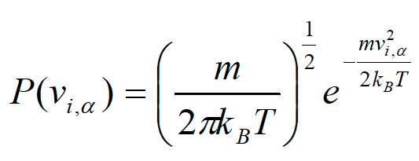

Thermostat 1: Velocity Rescaling
Most straightforward way of temperature control. The distribution of velocities is drawn from Maxwell-Boltzmann distribution, and we know that the kinetic energy is related to temperature as
This does not reproduce a trajectory you might expect from a canonical ensemble, as the temperature is fixed, with no fluctuations.
Usually used for equilibration purposes when a new distribution of velocities is produced at every time step and scaled to a prescribed temperature
Notes:
12 05

Slide 20
Thermostat 2: Andersen Thermostat (Stochastic Coupling )
Each atom at each integration step is subject to small probability to experience ‘collision’ with heat bath
Probability of next collision event is given by a Poisson distribution
If an atom collides with the heat bath, it’s velocity is drawn from a MB distribution. In this way, velocities of other atoms are not affected
Has shown to reproduce canonical trajectory very accurately
However, it cannot be used to compute dynamic quantities
Notes:
12 15

