Slide 1
Molsim Final Project
KALP₁₅ peptide in biphasic system
Kailei Liu

Slide 2
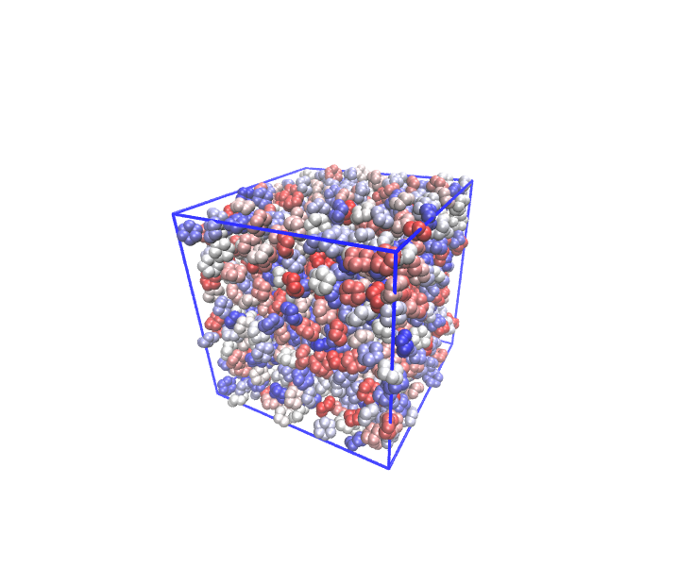
Biphasic System
Construction
construct a box filled with water and cyclohexane
gmx_mpi insert-molecules -ci chx.gro -nmol 1200 -box 5 5 5 -o chx_box.gro

Slide 3
Biphasic System
equilibrate with em npt nvt, change all force to Cut-off
gmx_mpi grompp -f ./mdp_files/em.mdp -c chx_box.gro -p chx.top
gmx_mpi mdrun
mv confout.gro npt.gro
gmx_mpi grompp -f ./mdp_files/npt.mdp -c npt.gro -p chx.top
gmx_mpi mdrun
mv confout.gro nvt.gro
gmx_mpi grompp -f ./mdp_files/nvt.mdp -c nvt.gro -p chx.top
gmx_mpi mdrun
mv confout.gro chx_eq_box.gro

Slide 4
Biphasic System
fix the box in case molecules are wrapped across z direction
gmx_mpi trjconv -f chx_eq_box.gro -o pbcfix.gro -pbc whole
modify vdwradii.dat C = 0.55, then expand box and solvate with water
gmx_mpi editconf -f pbcfix.gro -o chx_newbox.gro -box 5.80691 5.80691 11.61382
-center 2.903455 2.903455 2.903455
gmx_mpi solvate -cp chx_newbox.gro -cs spc216.gro -p chx.top -o chx_solv.gro

Slide 5
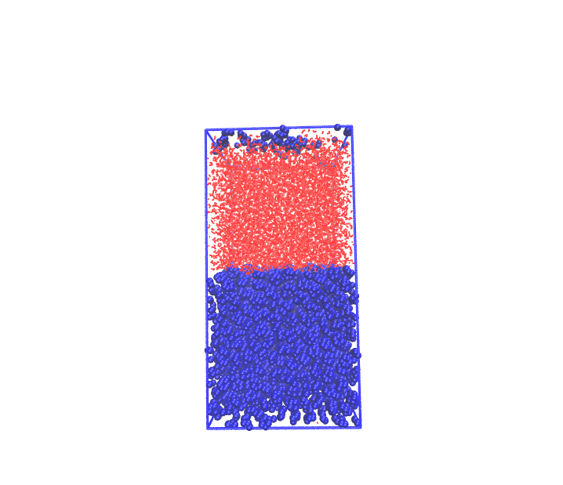
Biphasic System
switch force to PME, equilibrate the system
gmx_mpi grompp -f ./mdp_files/em.mdp -c chx_solv.gro -p chx.top
gmx_mpi mdrun
mv confout.gro npt.gro
gmx_mpi grompp -f ./mdp_files/npt.mdp -c npt.gro -p chx.top
gmx_mpi mdrun
mv confout.gro nvt.gro
gmx_mpi grompp -f ./mdp_files/nvt.mdp -c nvt.gro -p chx.top
gmx_mpi mdrun
mv confout.gro chx_eq_solv.gro

Slide 6
Biphasic System
Scaling
2 nodes
Walkers | MPI | ns/day/walker | Total ns/day
2 | 16 | 36.545 | 73.089
4 | 8 | 19.360 | 77.440
8 | 4 | 10.540 | 84.318

Slide 7
Biphasic System
Scaling
1 nodes, but fourierspacing = 0.26
Walkers | MPI | ns/day/walker | Total ns/day
2 | 8 | 44.368 | 88.736
4 | 4 | 22.878 | 91.510
8 | 2 | 11.939 | 95.515

Slide 8
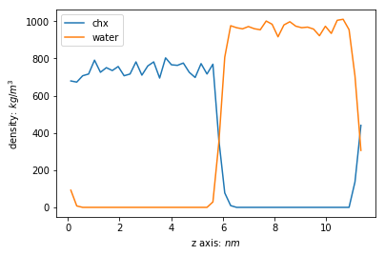
Biphasic System
Density plot along z axis
There are some water molecules at the bottom of the box and some chx at the top. This may caused by the periodic boundary.

Slide 9
Peptide In Water
construct a box filled with water and cyclohexane
gmx_mpi insert-molecules -ci chx.gro -nmol 1200 -box 5 5 5 -o chx_box.gro
equilibrate with em npt nvt, change all force to Cut-off
gmx_mpi grompp -f ./mdp_files/em.mdp -c chx_box.gro -p chx.top
gmx_mpi mdrun
mv confout.gro npt.gro
gmx_mpi grompp -f ./mdp_files/npt.mdp -c npt.gro -p chx.top
gmx_mpi mdrun
mv confout.gro nvt.gro
gmx_mpi grompp -f ./mdp_files/nvt.mdp -c nvt.gro -p chx.top
gmx_mpi mdrun
mv confout.gro chx_eq_box.gro

Slide 10
Peptide In Water
fix
gmx_mpi trjconv -f chx_eq_box.gro -o pbcfix.gro -pbc whole
execute protein
gmx_mpi pdb2gmx -f KALP-15_princ.pdb -o KALP-15_processed.gro -ignh -ter -water spc
note down the demension of pbcfix.gro, then put protein into box
gmx_mpi editconf -f KALP-15_processed.gro -o peptide_newbox.gro -box 5.85084 5.85084 11.70168 -center 2.92542 2.92542 8.77626
modify vdwradii.dat C = 0.55
gmx_mpi editconf -f pbcfix.gro -o chx_newbox.gro -box 5.85084 5.85084 11.70168 -center 2.92542 2.92542 2.92542

Slide 11
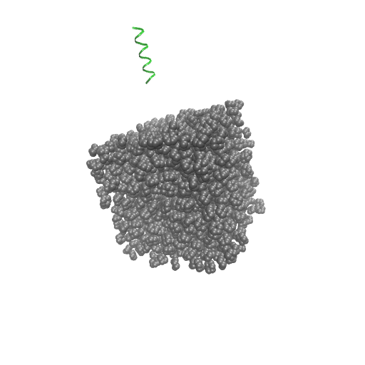
Peptide In Water
combine protein box with chxbox
gmx_mpi solvate -cp peptide_newbox.gro -cs chx_newbox.gro -p topol.top -o peptide_chx.gro
change chx.top into chx.itp, solvate with water
gmx_mpi solvate -cp peptide_chx.gro -cs spc216.gro -p topol.top -o pep_solv.gro
add ions to peptide
gmx_mpi grompp -f ions.mdp -c pep_solv.gro -p topol.top -o ions.tpr
gmx_mpi genion -s ions.tpr -o pep_solv_ions.gro -p topol.top -pname NA -nname CL -neutral

Slide 12
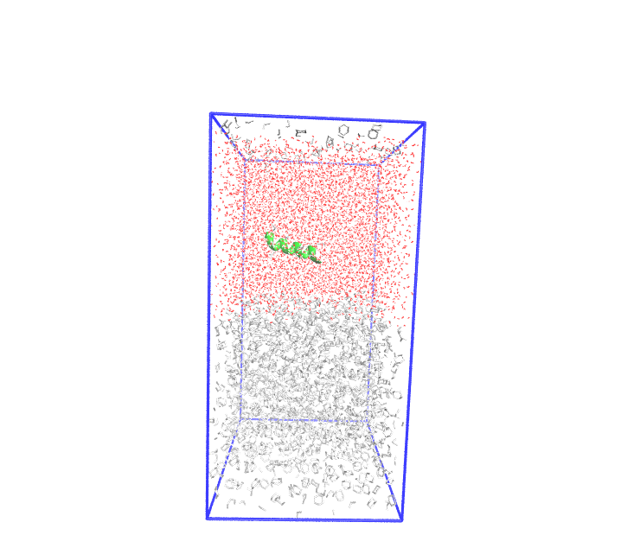
Peptide In Water
switch force to PME, equilibrate the system
gmx_mpi grompp -f ./mdp_files/em.mdp -c chx_solv.gro -p chx.top
gmx_mpi mdrun
mv confout.gro npt.gro
gmx_mpi grompp -f ./mdp_files/npt.mdp -c npt.gro -p chx.top
gmx_mpi mdrun
mv confout.gro nvt.gro
gmx_mpi grompp -f ./mdp_files/nvt.mdp -c nvt.gro -p chx.top
gmx_mpi mdrun
mv confout.gro chx_eq_solv.gro

Slide 13
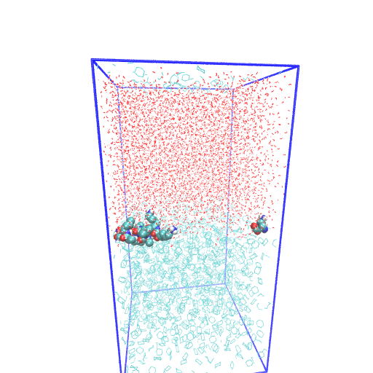
Peptide In Water
After MD run for 10 ns

Slide 14
Peptide In Cyclohexane
construct a box filled with water and cyclohexane
gmx_mpi insert-molecules -ci chx.gro -nmol 1200 -box 5 5 5 -o chx_box.gro
equilibrate with em npt nvt, change all force to Cut-off
gmx_mpi grompp -f ./mdp_files/em.mdp -c chx_box.gro -p chx.top
gmx_mpi mdrun
mv confout.gro npt.gro
gmx_mpi grompp -f ./mdp_files/npt.mdp -c npt.gro -p chx.top
gmx_mpi mdrun
mv confout.gro nvt.gro
gmx_mpi grompp -f ./mdp_files/nvt.mdp -c nvt.gro -p chx.top
gmx_mpi mdrun
mv confout.gro chx_eq_box.gro

Slide 15
Peptide In Cyclohexane
fix
gmx_mpi trjconv -f chx_eq_box.gro -o pbcfix.gro -pbc whole
execute protein
gmx_mpi pdb2gmx -f KALP-15_princ.pdb -o KALP-15_processed.gro -ignh -ter -water spc
put protein into box
gmx_mpi editconf -f KALP-15_processed.gro -o peptide_newbox.gro -box 5.82930 5.82930 11.6586 -center 2.91465 2.91465 2.91465
modify vdwradii.dat C = 0.55, write down the demension of pbcfix.gro
gmx_mpi editconf -f pbcfix.gro -o chx_newbox.gro -box 5.82930 5.82930 11.6586 -center 2.91465 2.91465 2.91465

Slide 16
Peptide In Cyclohexane
combine protein box with chxbox
gmx_mpi solvate -cp peptide_newbox.gro -cs chx_newbox.gro -p topol.top -o peptide_chx.gro
change chx.top into chx.itp, modify vdwrdii.dat, then solvate with water
gmx_mpi solvate -cp peptide_chx.gro -cs spc216.gro -p topol.top -o pep_solv.gro
add ions to peptide
gmx_mpi grompp -f ions.mdp -c pep_solv.gro -p topol.top -o ions.tpr
# removed 114 solvent atoms which overlapped
gmx_mpi genion -s ions.tpr -o pep_solv_ions.gro -p topol.top -pname NA -nname CL -neutral

Slide 17
Peptide In Cyclohexane
switch force to PME, equilibrate the system
gmx_mpi grompp -f ./mdp_files/em.mdp -c chx_solv.gro -p chx.top
gmx_mpi mdrun
mv confout.gro npt.gro
gmx_mpi grompp -f ./mdp_files/npt.mdp -c npt.gro -p chx.top
gmx_mpi mdrun
mv confout.gro nvt.gro
gmx_mpi grompp -f ./mdp_files/nvt.mdp -c nvt.gro -p chx.top
gmx_mpi mdrun
mv confout.gro pep_eq_solv_2.gro

Slide 18
Peptide In Cyclohexane
execute protein
gmx_mpi pdb2gmx -f KALP-15_princ.pdb -o KALP-15_processed.gro -ignh -ter -water spc
put peptide into a cubic
gmx_mpi editconf -f KALP-15_processed.gro -o peptide_box.gro -box 5 5 5 -center 2.5 2.5 2.5
change chx.top into chx.itp, then solvate with chx
gmx_mpi solvate -cp peptide_box.gro -cs chx.gro -p topol.top -o pep_chx.gro

Slide 19
Peptide In Cyclohexane
modify vdwradii.dat C = 0.55, expand box and solvate with water
gmx_mpi editconf -f pep_chx.gro -o pep_chx_new.gro -box 5 5 10 -center 2.5 2.5 2.5
gmx_mpi solvate -cp pep_chx_new.gro -cs spc216.gro -p topol.top -o pep_solv.gro
add ions to peptide
gmx_mpi grompp -f ions.mdp -c pep_solv.gro -p topol.top -o ions.tpr
gmx_mpi genion -s ions.tpr -o pep_solv_ions.gro -p topol.top -pname NA -nname CL -neutral

Slide 20
Peptide In Cyclohexane
switch force to PME, equilibrate the system
gmx_mpi grompp -f ./mdp_files/em.mdp -c pep_solv_ions.gro -p topol.top
gmx_mpi mdrun
mv confout.gro npt.gro
gmx_mpi grompp -f ./mdp_files/npt.mdp -c npt.gro -p topol.top
gmx_mpi mdrun
mv confout.gro nvt.gro
gmx_mpi grompp -f ./mdp_files/nvt.mdp -c nvt.gro -p topol.top
gmx_mpi mdrun
mv confout.gro pep_eq_solv_2.gro

Slide 21
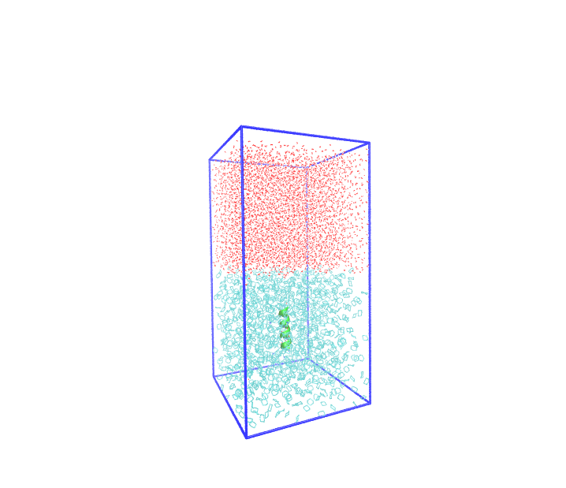
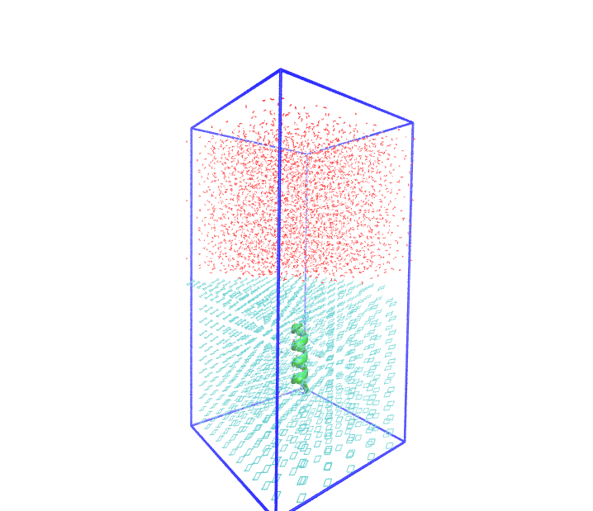
Peptide In Cyclohexane
Compare – after solvation

Slide 22
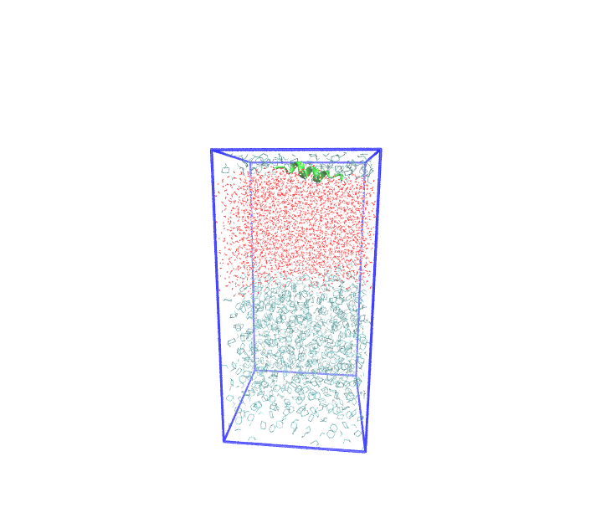
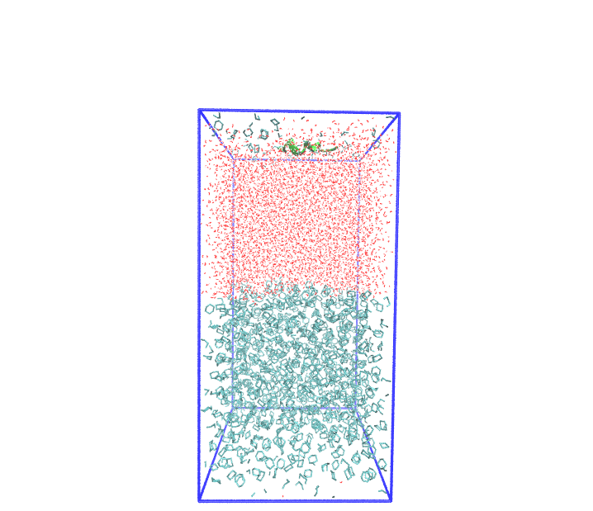
Peptide In Cyclohexane
Compare – after equilibration

Slide 23
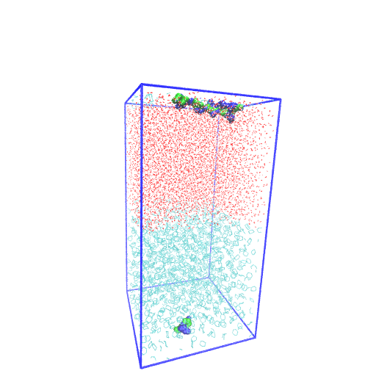
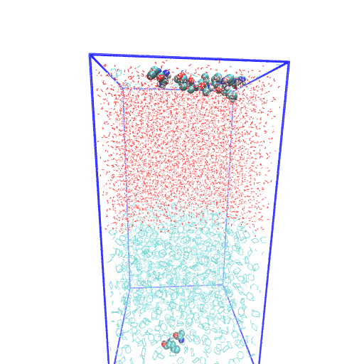
Peptide In Cyclohexane
Compare – MD run for 10 ns

