Slide 1
Intro to MD:
How to ensure the force field is with you
Fundamentals of Molecular Simulations
Week 4 – 2/1/19
by Josh Smith

Slide 2
Outline
Why molecular dynamics?
esp. how does it differ from MC
MD basics…
Newtonian mechanics
Integrators
Choosing our ensemble
Other considerations… (ergodicity, PBC)
Basic 2D simulations in Python

Slide 3
Why MD?
Offers a dynamic evolution of interesting molecular systems
MC
1
2
MD
𝛅t
𝛅t

Slide 4
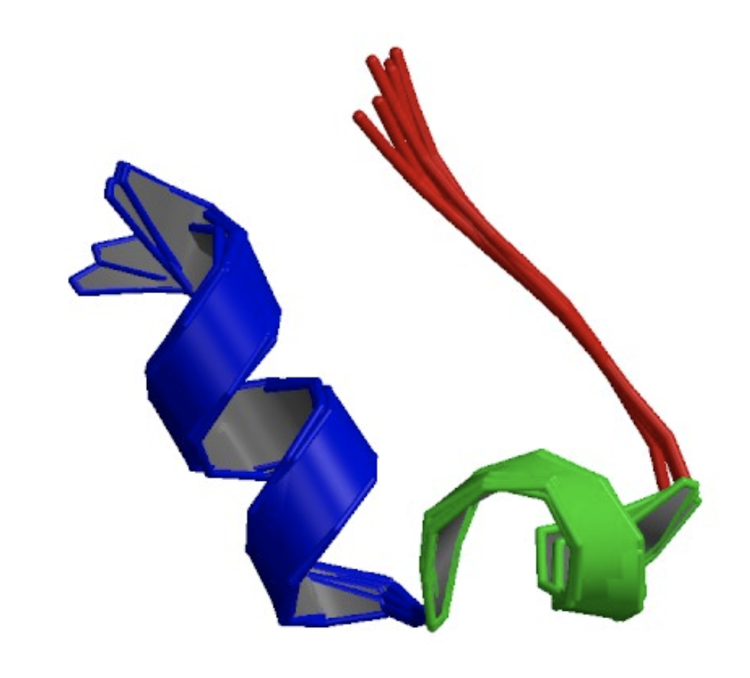
Why MD?
Some questions can’t be answered with MC (or experiment)
Protein-ligand binding/unbinding kinetics
Does dehydration precede ligand capture?
Protein folding/unfolding
Does secondary structure form before or after folding?
Characterizing reaction pathways (QM-MM)
Kinetics for formation and reaction of intermediate species
Trp-cage

Slide 5
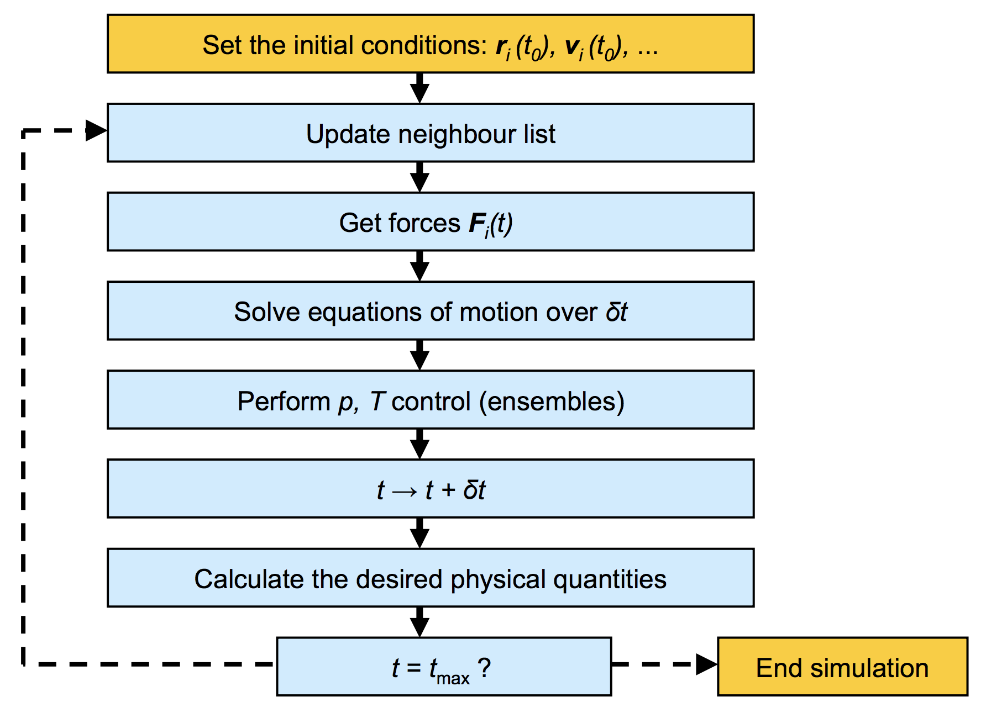
MD Basics
MD Algorithm
Notes:
Draw small system on the board…

Slide 6
MD Basics
MD Algorithm
Notes:
Draw small system on the board…

Slide 7
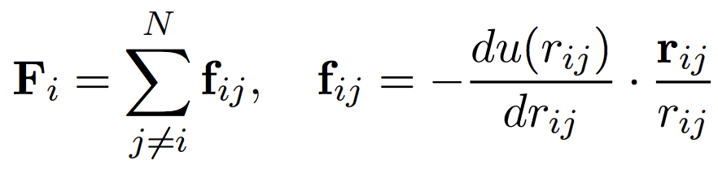
MD Basics
Force calculations: simple Newtonian mechanics!
Notes:
Illustrate this step on the board

Slide 8
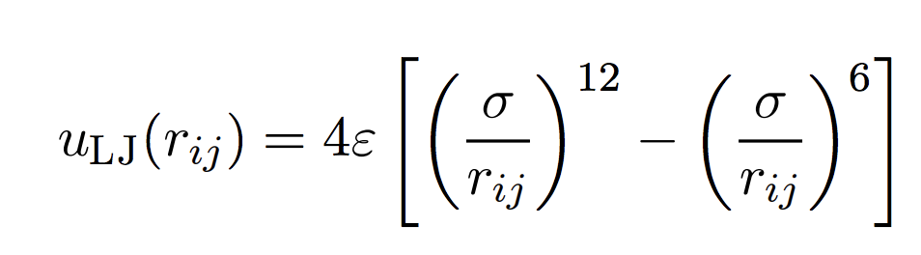
MD Basics
Force calculations: simple Newtonian mechanics!
eg. Lennard-Jones
potential

Slide 9
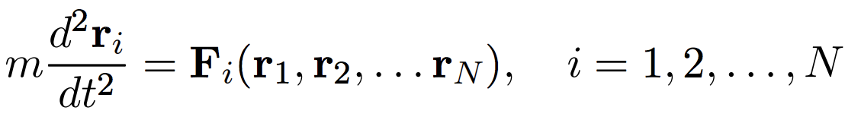
MD Basics
Force calculations: simple Newtonian mechanics!
eg. Lennard-Jones
potential

Slide 10
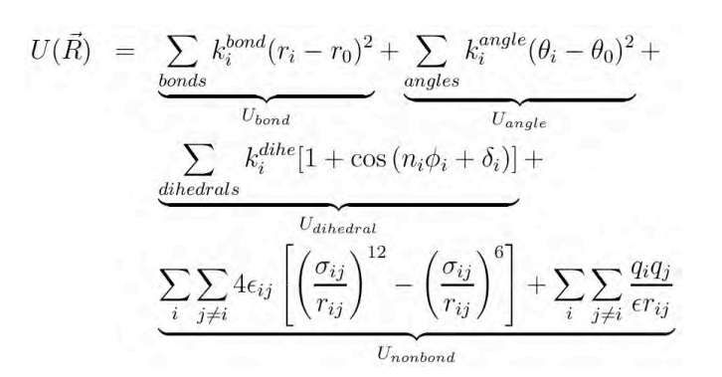
MD Basics
Potential function in a classical MD simulation....
bonded
non-bonded
Fun fact: our ES methods extend the potential function experienced by the atoms in our simulation.

Slide 11
MD Basics
MD Algorithm
Notes:
Draw small system on the board…

Slide 12
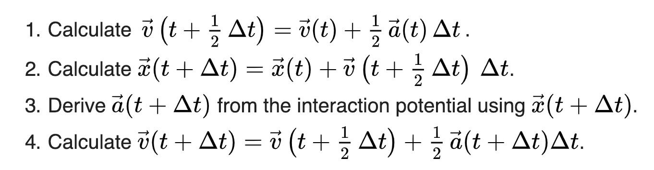






Solving equations of motion numerically
Velocity Verlet
this step
next step
𝛅t
𝛅t
Notes:
https://en.wikipedia.org/wiki/Verlet_integration#Velocity_Verlet
Only calculating acceleration ONCE!

Slide 13
Choosing Our Ensemble
MD Algorithm
Notes:
Draw small system on the board…

Slide 14
Choosing Our Ensemble
Thermostats and barostats
Isolated system (NVE)

Slide 15
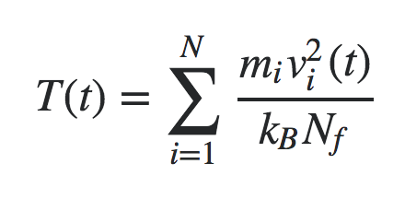
Choosing Our Ensemble
298 K
Thermostats and barostats
Isolated system (NVE)
Add thermostat → NVT

Slide 16
Choosing Our Ensemble
298 K
Thermostats and barostats
Isolated system (NVE)
Add thermostat → NVT
𝛅t
300 K

Slide 17
Choosing Our Ensemble
298 K
Thermostats and barostats
Isolated system (NVE)
Add thermostat → NVT
𝛅t
rescale
300 K

Slide 18
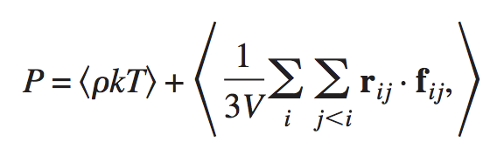
Choosing Our Ensemble
1.0 bar
Thermostats and barostats
Isolated system (NVE)
Add thermostat → NVT
Add barostat → NPT
𝛅t
rescale
1.1 bar

Slide 19
Other Considerations
MD Algorithm
Notes:
Draw small system on the board…

Slide 20
Other Considerations
THE ERGODIC HYPOTHESIS
In the limit of infinite time, time avg. = ensemble avg.

Slide 21
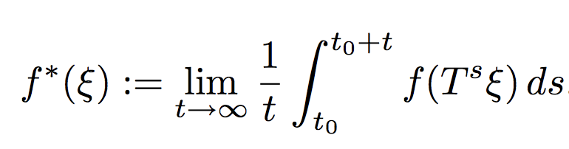
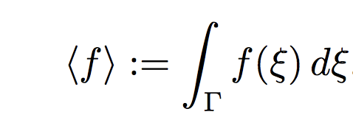
Other Considerations
THE ERGODIC HYPOTHESIS
In the limit of infinite time, time avg. = ensemble avg.
We want:
We have:

Slide 22

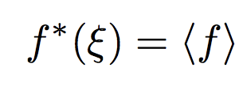
Other Considerations
THE ERGODIC HYPOTHESIS
In the limit of infinite time, time avg. = ensemble avg.
We want:
We have:
Thankfully:

Slide 23
Other Considerations
Periodic Boundary Conditions (PBC)
~5 nm
How does this tiny box tell us anything
about the macroscopic world??

Slide 24
Other Considerations
Periodic Boundary Conditions (PBC)
To infinity…
and beyond?
(eg. water NPT)

Slide 25
Now for the fun part!
How do we actually do it?
Initialize starting structure (positions, momenta)
Choose force field parameters (QM? Experiment? Both?)
Evolve system according to Newtonian mechanics
Add forces as we see fit.
Together, let’s...
Check out some simple Python code for MD
Simulate a system of our very own!

