Slide 1
Sarah takes VMD by storm!
A picture book written by Sarah Alamdari

Slide 2
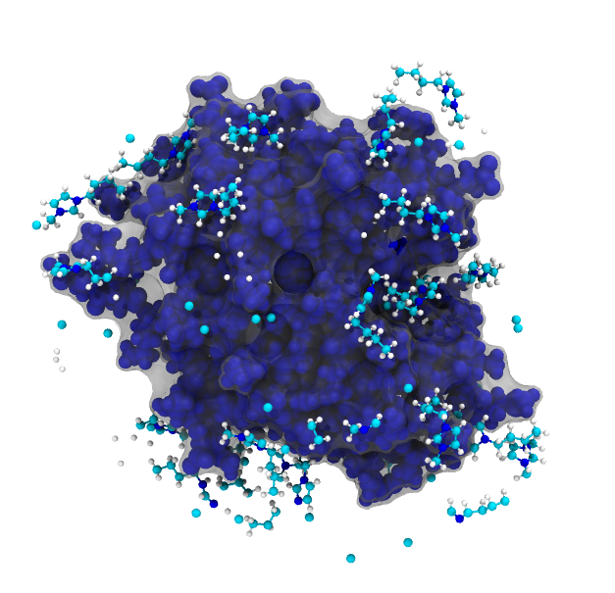
Image #1
Personal favorite because it’s cute
Used:
Charge, surf, protein (transparent)
Conformation, VDW, protein
Name, CPK, all solvent not water
Closing remarks: how do you get rid of the rogue molecules?

Slide 3
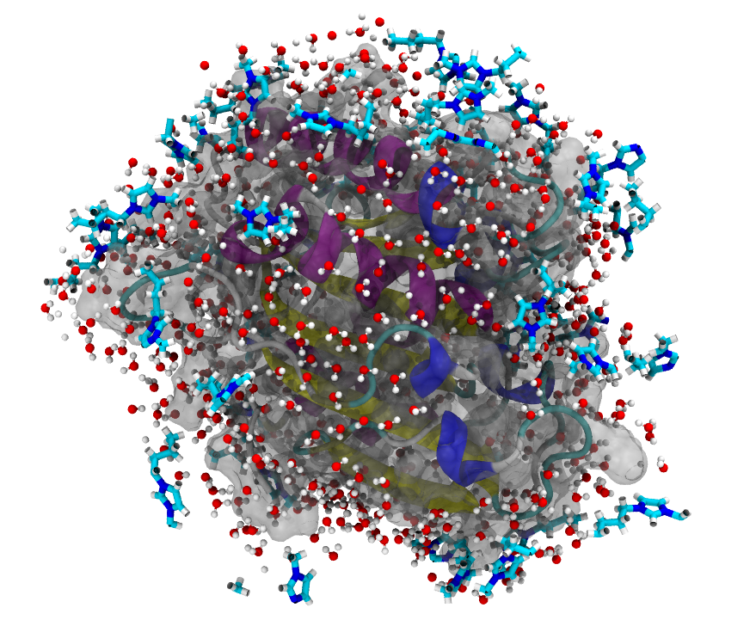
Image #2
Used:
Charge, surf, protein (transparent)
Secondary structure, New cartoon, protein
Name, dynamic bonds, all solvent
Conclusion: I don’t like water molecules

Slide 4
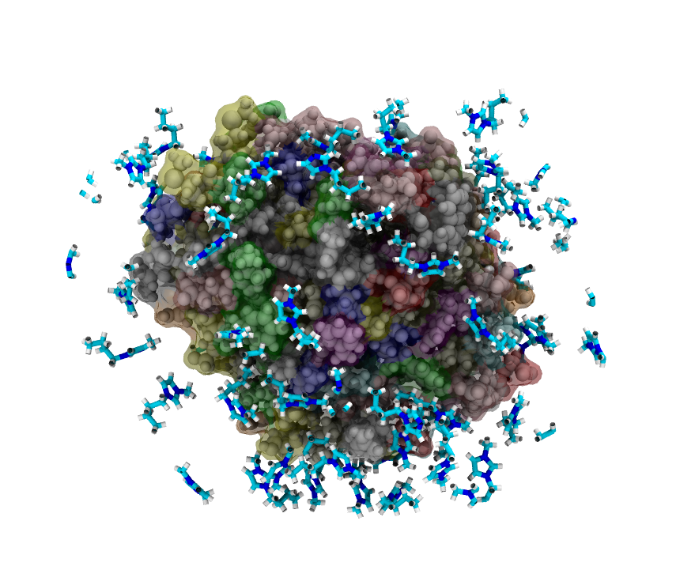
Image #3
Used:
Resname, surf, protein (transparent)
Charge, VDW, protein
Name, dynamic bonds, all solvent not water
Conclusion: VMD is fun

